Slide 1
SCP 100
Sarah Thibodeau
srthibodeau64@marianuniversity.edu
920-923-8096

Slide 2
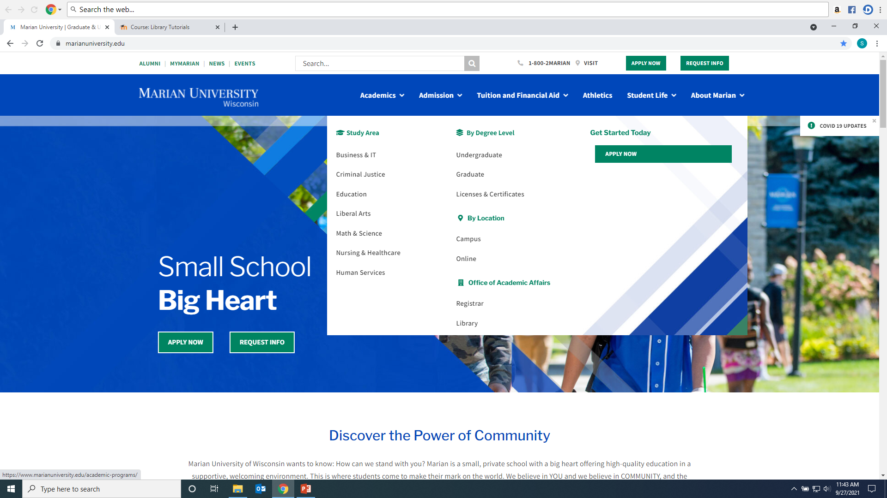
Click on Library from Marian website:

Slide 3
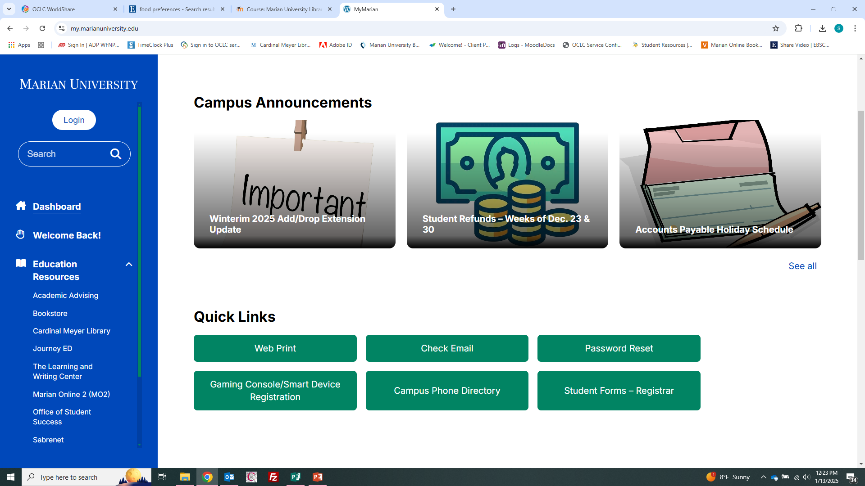
From MyMarian, click on Cardinal Meyer Library under Education Resources:

Slide 4
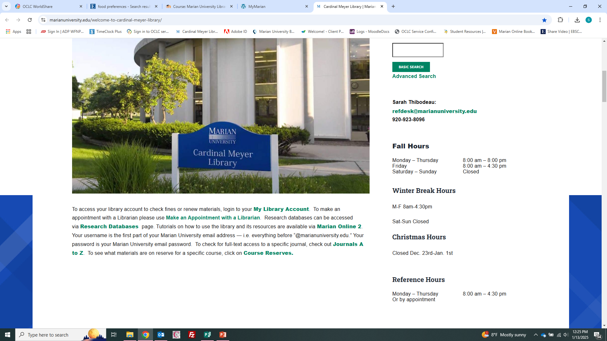
Hours are on MyMarian and Library webpage:

Slide 5
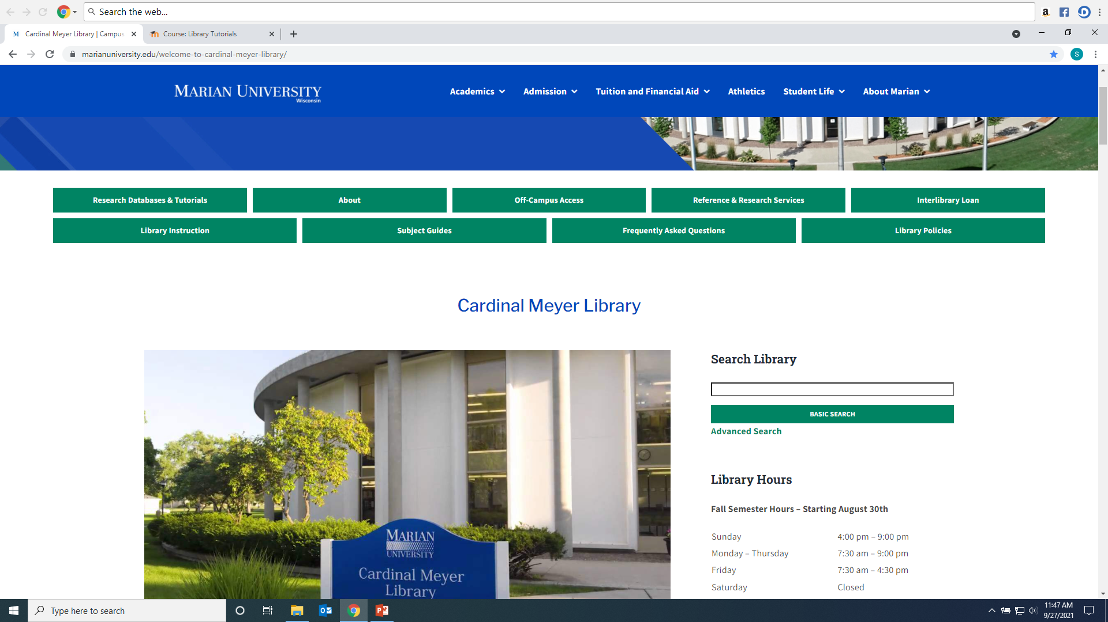
From the Search Library Box, you can search for books, DVDs, articles, videos and other library materials:

Slide 6
Or click on Advanced Search to be more specific:

Slide 7
Some faculty place virtual or physical library materials on reserve. Reserve items are kept at the front circulation desk.

Slide 8
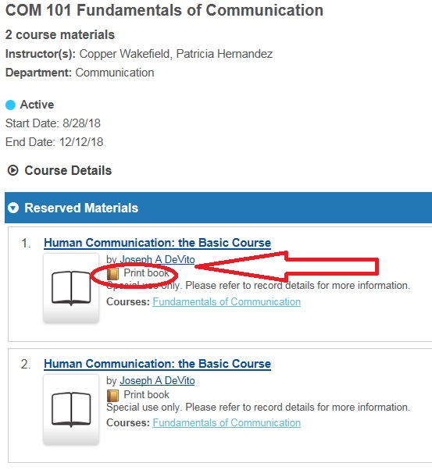
Reserve books (often only for 2 hours, library use only)

Slide 9
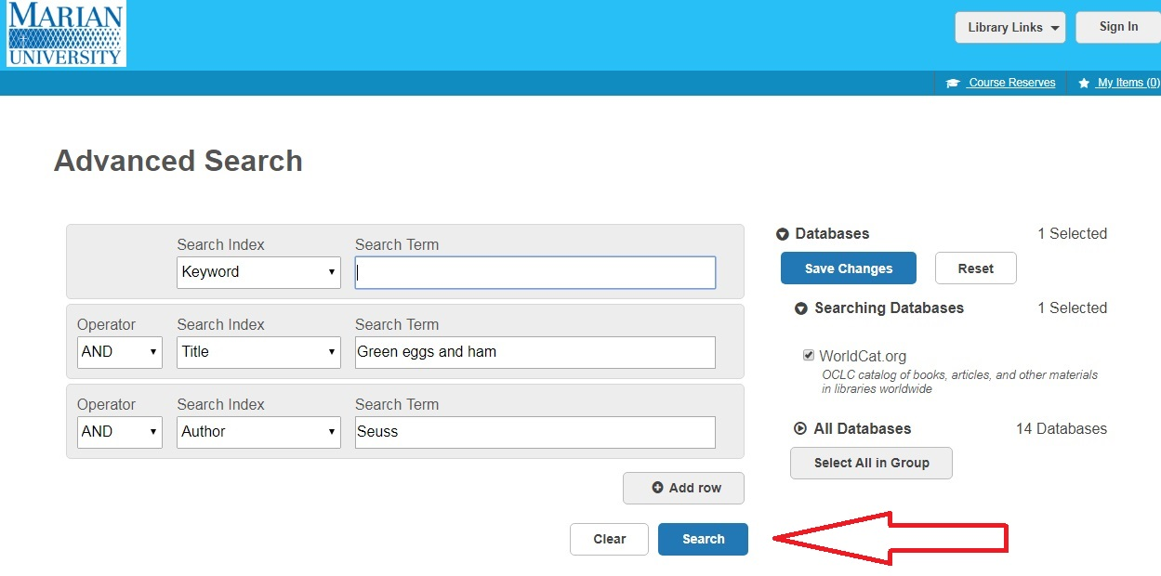
To find a book: type in title words, author words, or keywords. Click “Search”

Slide 10
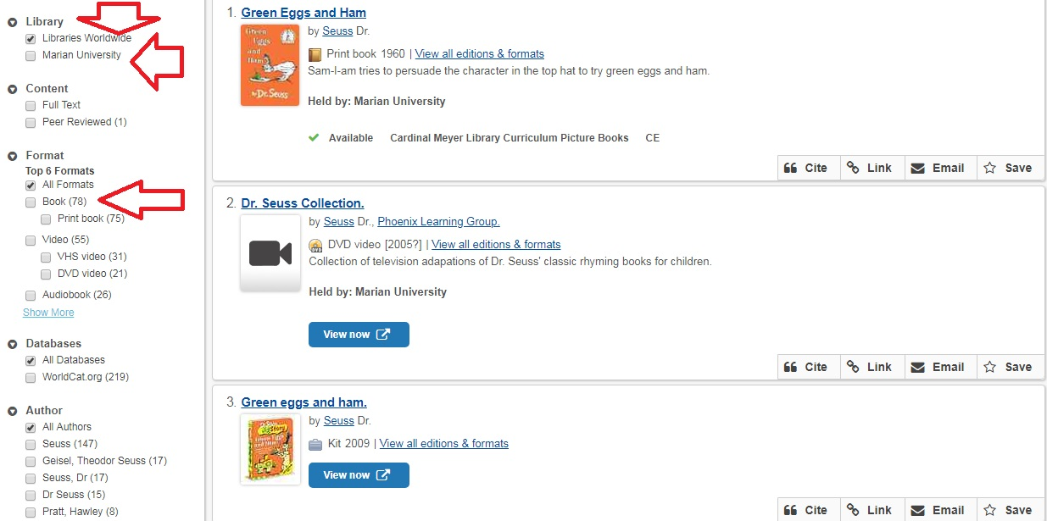
Results include all libraries and all formats (books, DVDs, games…)

Slide 11
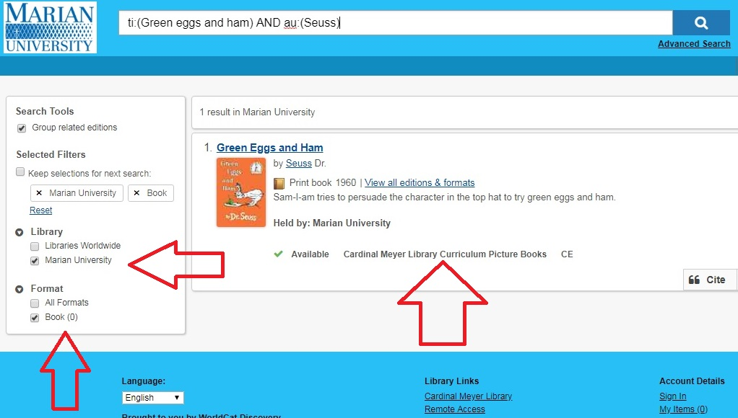
Limit to just Marian University and Format (such as Books) as needed. Marian owns the book!

Slide 12
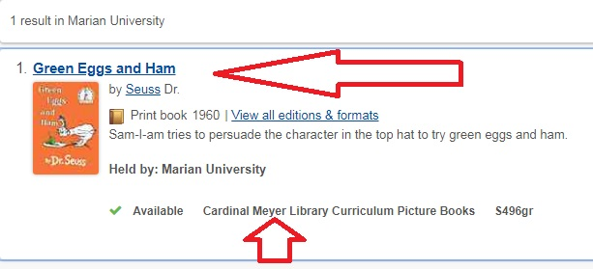
Green Eggs and Ham is shelved in the Curriculum Picture Books shelves under S496gr. To get more details, click on its title:

Slide 13
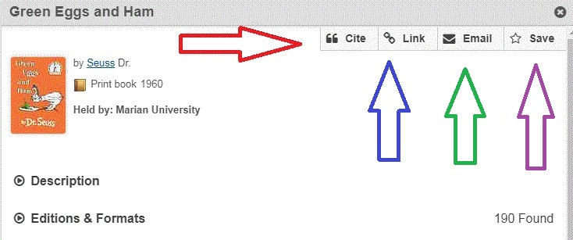
You can email the info, save it, format it for a bibliography and get an Internet link to find it later:

Slide 14
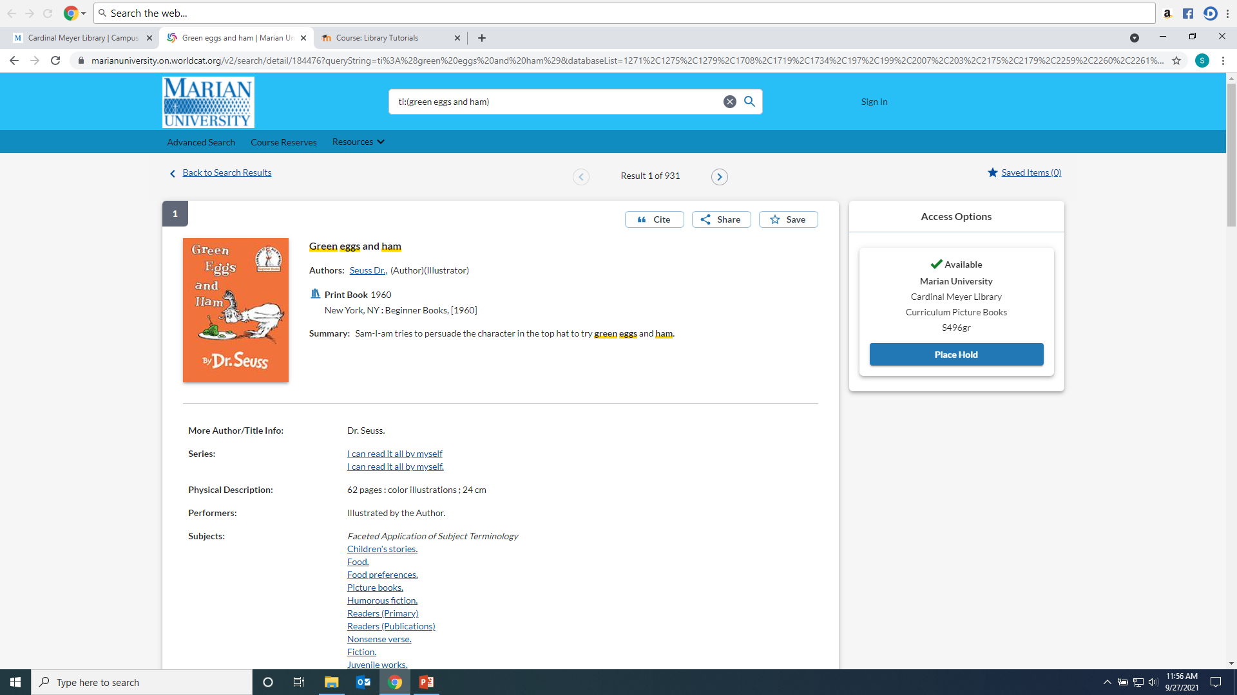
Marian’s copy is Available, but if it was checked out, click on Place Hold to get it next:

Slide 15
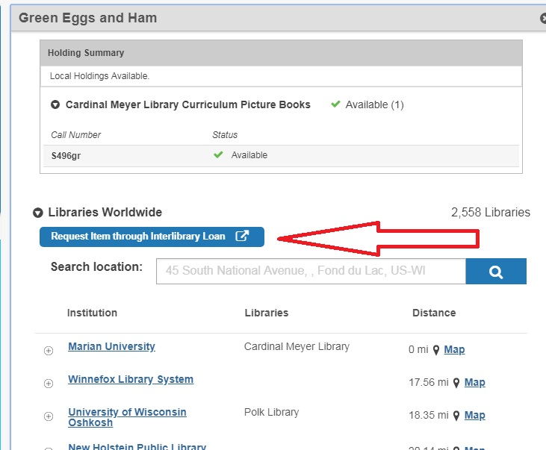
You can request it from another library through Interlibrary Loan or scroll down to discover if your local library has a copy and check it out there:

Slide 16
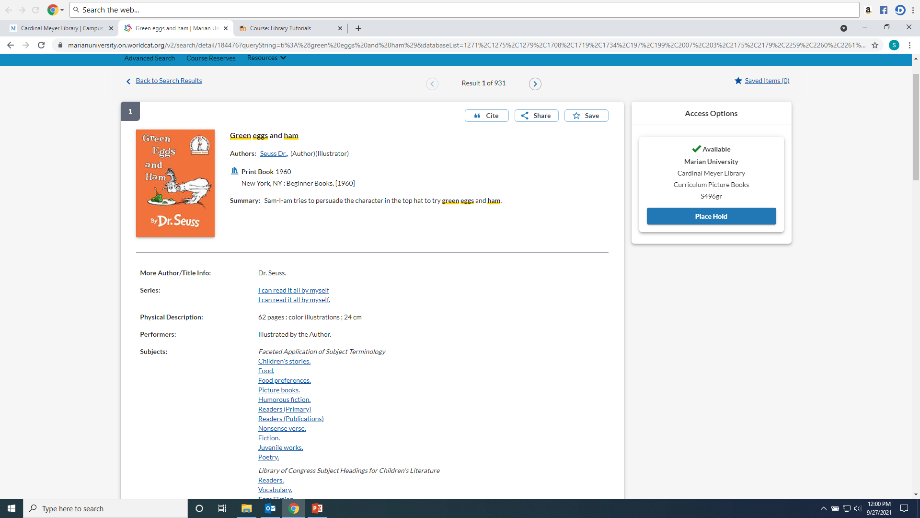
To find subject headings and other details,click on the item Title and look for the “Summary” and “Subjects” headings:

Slide 17
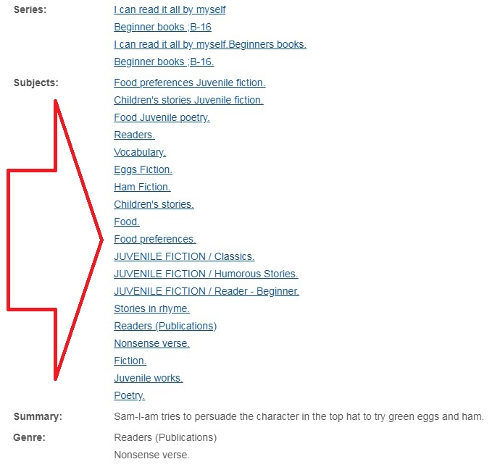
Subject Headings link to other items with those topics, for instance: Food preferences or Eggs--Fiction

Slide 18
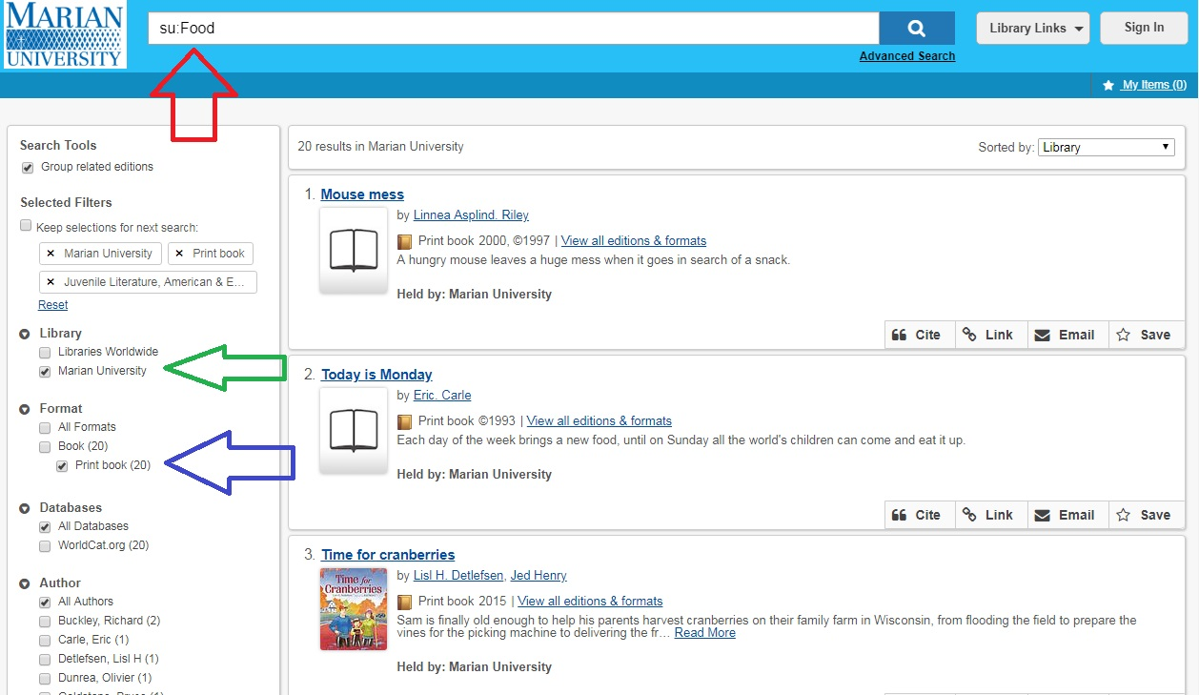
Results for Food. I also choose Marian, Print Book…

Slide 19
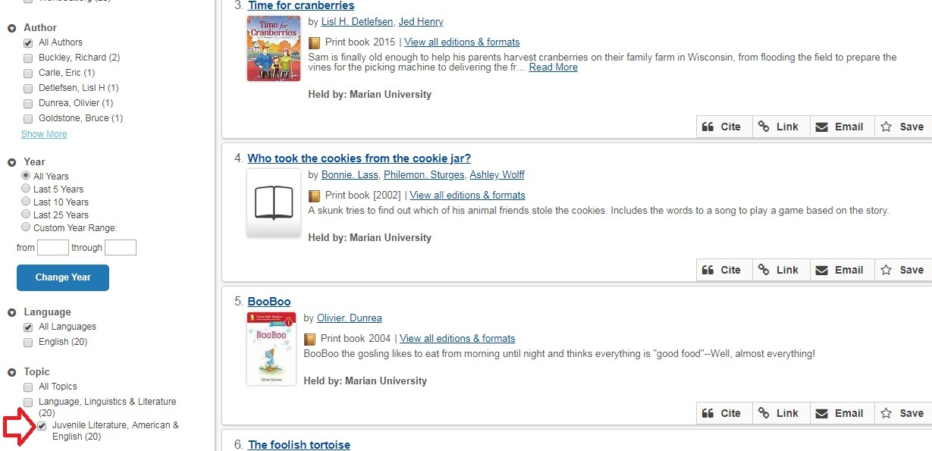
Scroll down to see more facets including “Juvenile literature:”

Slide 20
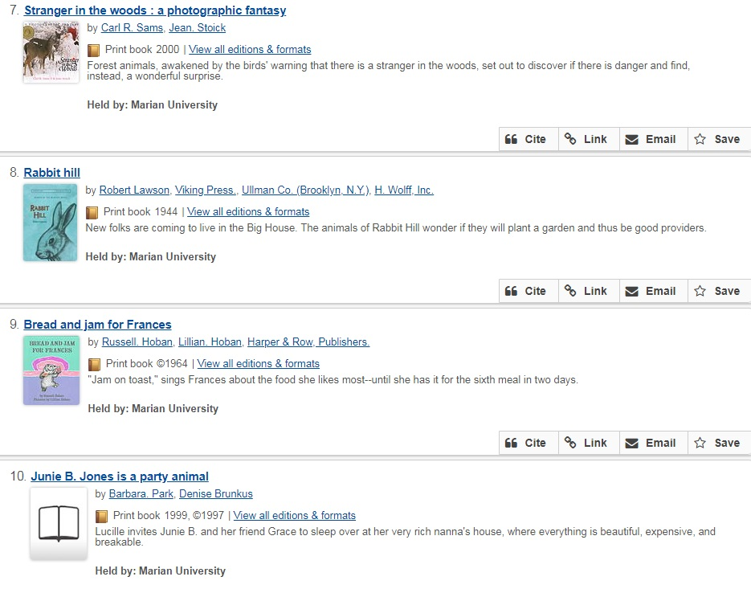
Find more books! Check the subject headings for other subjects or series to explore.

Slide 21
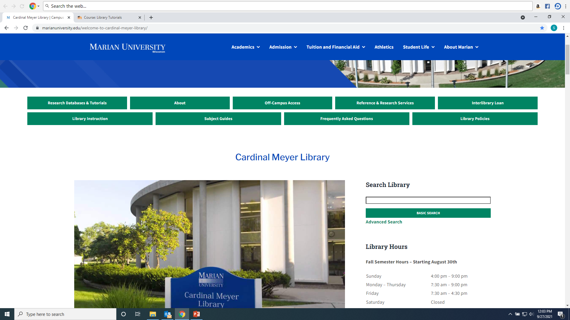
You can also start the search in the Basic Search box:

Slide 22
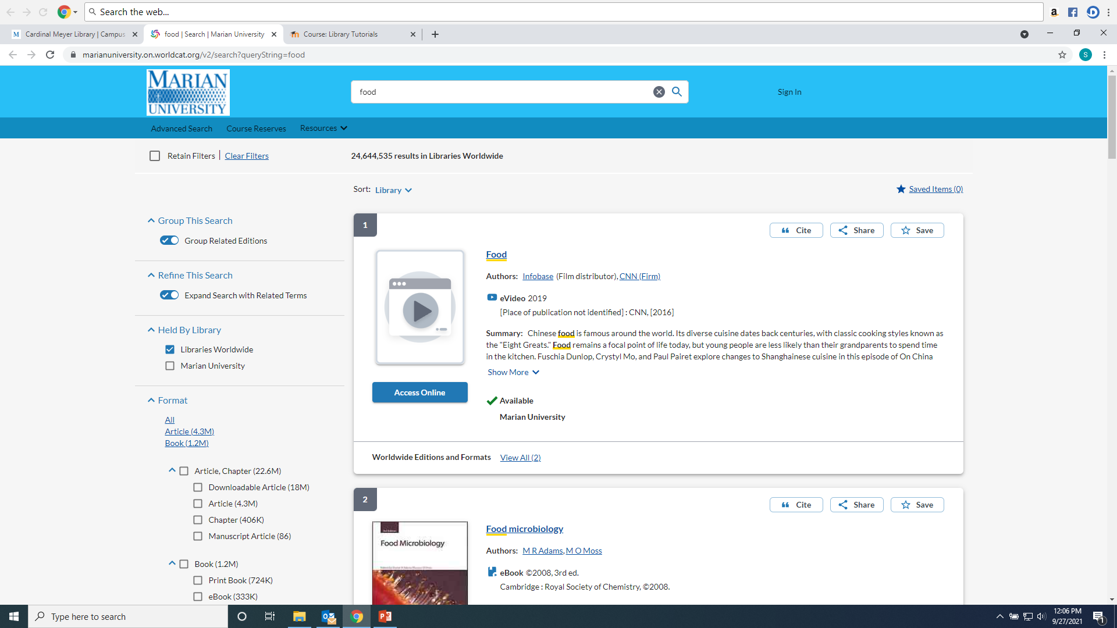
As desired, narrow the results. Examples: Marian, Books

Slide 23
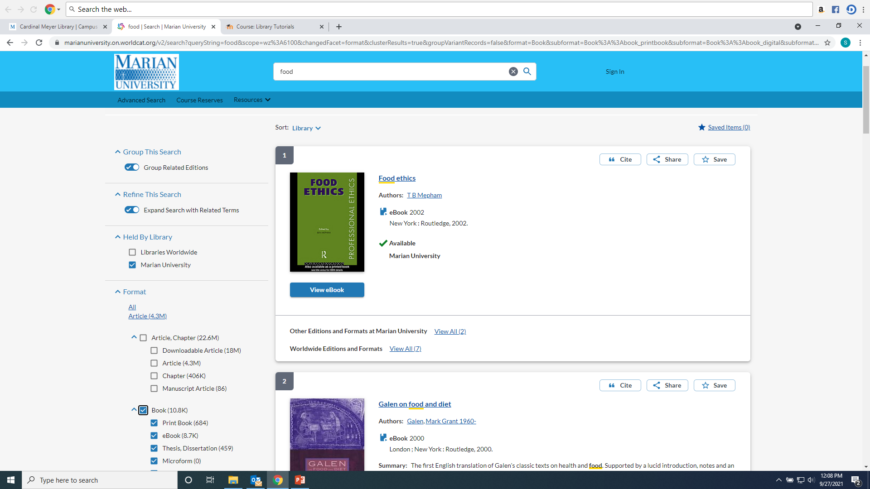
Results for books at Marian University. Includes ebooks and print books.

Slide 24
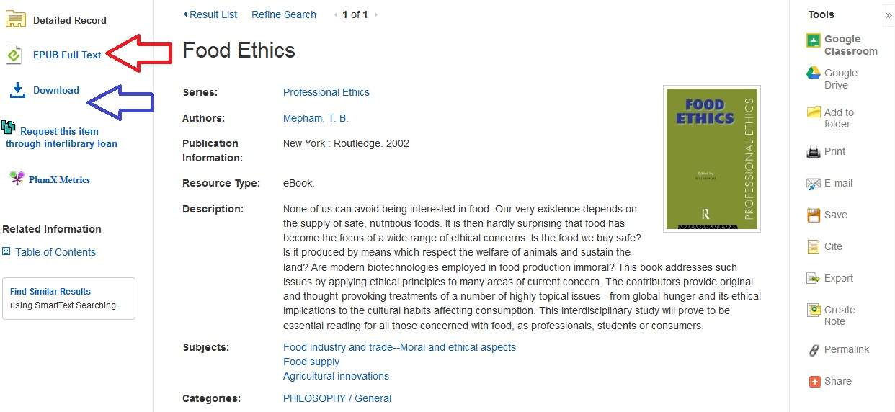
Ebooks can be read online or individual chapters saved or printed:

Slide 25
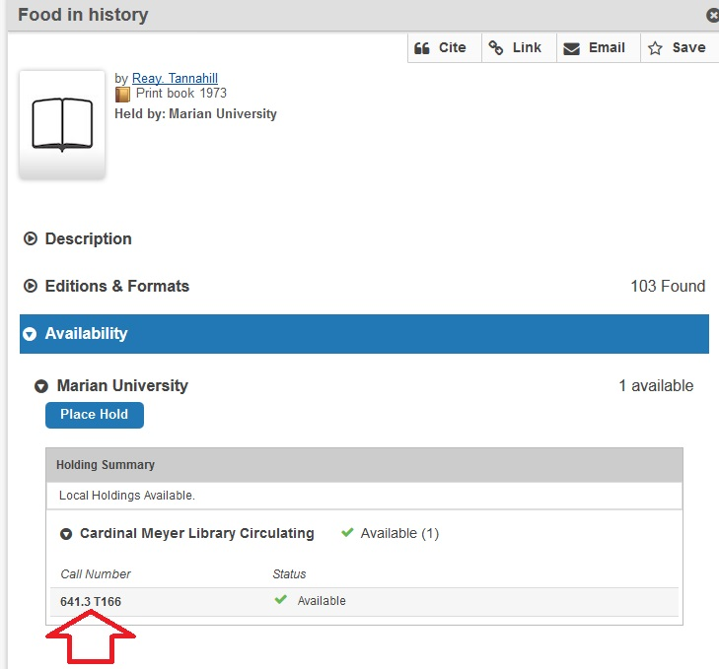
Library items are shelved by Dewey call numbers (except picture books):

Slide 26
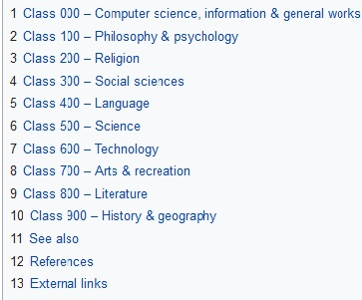
Dewey call numbers assign numbers to different topics. Library materials are then arranged by those call numbers so it is easier to find items by subject:

Slide 27
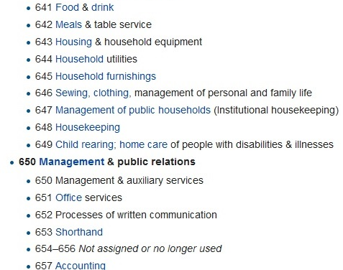
Dewey 600s:
The Dewey Decimal System then assigns ever longer decimal numbers to sub-topics.

Slide 28
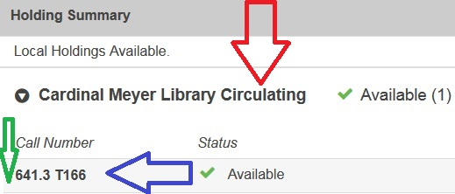
Circulating is the book section in the middle of the library, 641.3 is the Dewey number, .T166 indicates the author begins with the letter “T:”

Slide 29
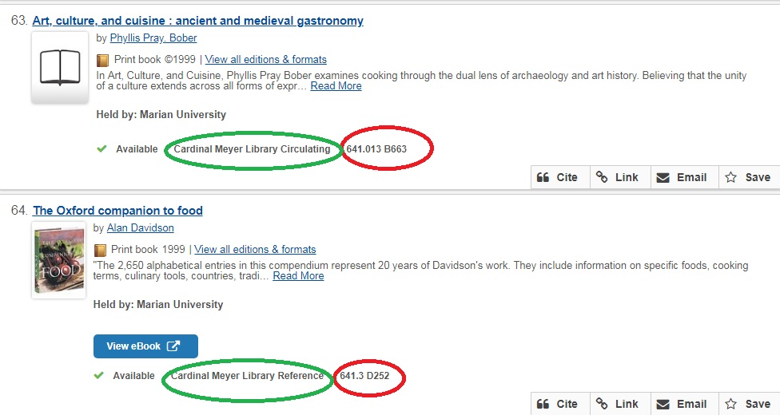
Throughout the Library, call number 641 is for food!

Slide 30
Marian Library areas include:
Picture Books (outside wall near front door)
Curriculum books (outside wall further west)
Curriculum High School (west side of library near computers on wall)
Circulating (shelves in center of library)
Reference (east and south outside wall)
DVDs and CDs (shelves near circulation desk)
Oversize (large books on east side near study tables)
Games and Magazines/Journals (near north side comfy chairs)

Slide 31
Search Library Box also can find articles:

Slide 32
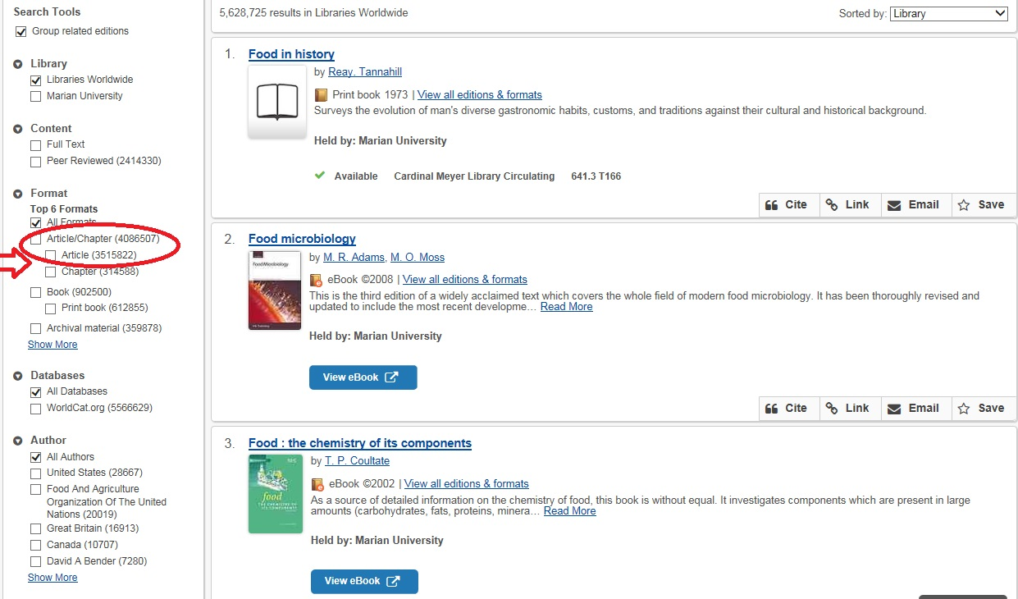
Click on the Article box to narrow from 5,628,725 total items to 3,526,157 articles only:

Slide 33
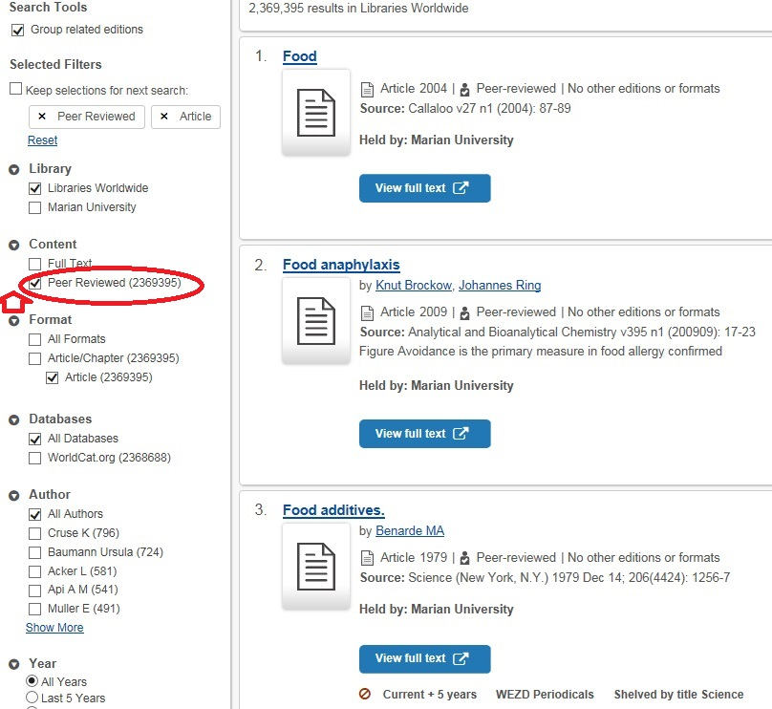
Click on “Peer reviewed” to narrow from 3,527,167 articles 2,369,395:

Slide 34
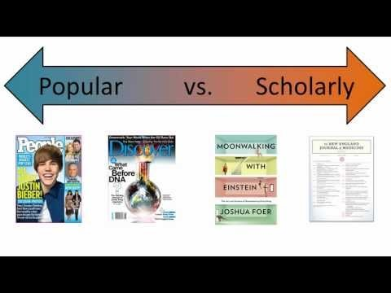
What is a scholarly or peer reviewed article?

Slide 35
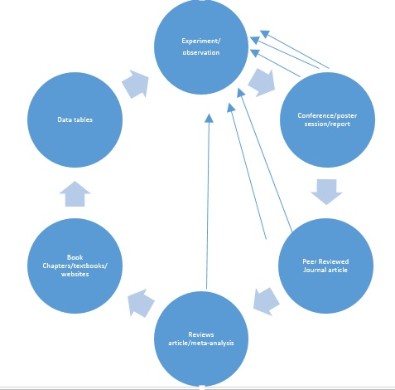
Knowledge cycle:

Slide 36
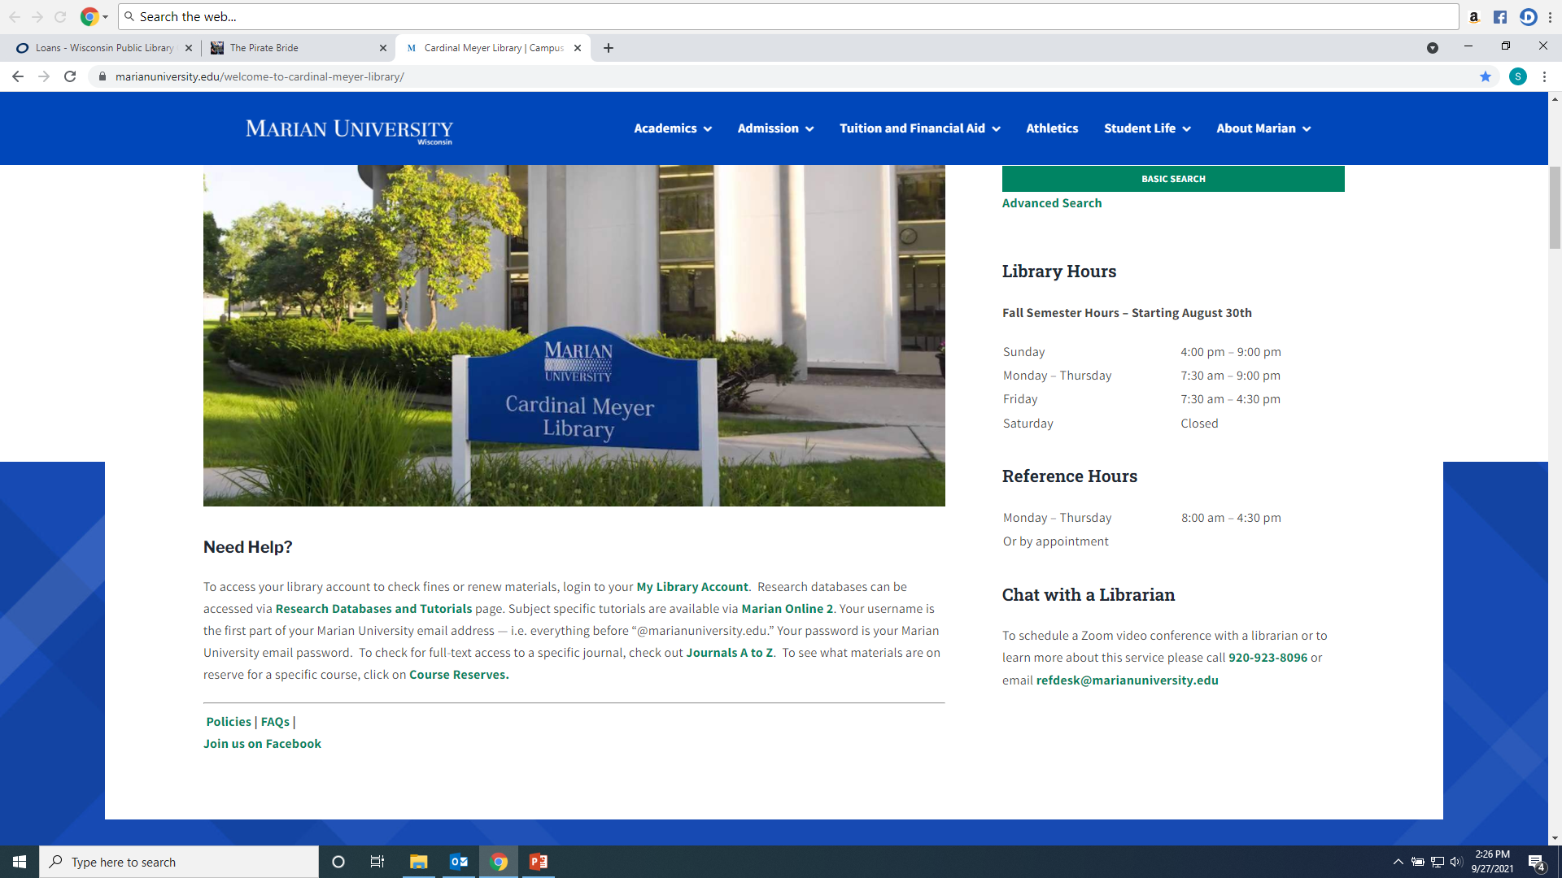
To search individual databases:

Slide 37
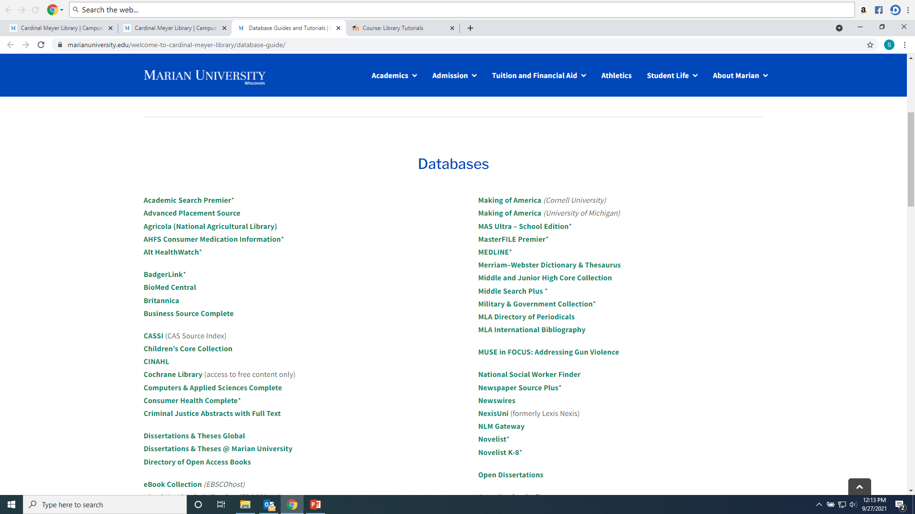
Choose a database according to the subject—ask a librarian for more help!

Slide 38
Academic Search Premier provides articles useful for most subjects:

Slide 39
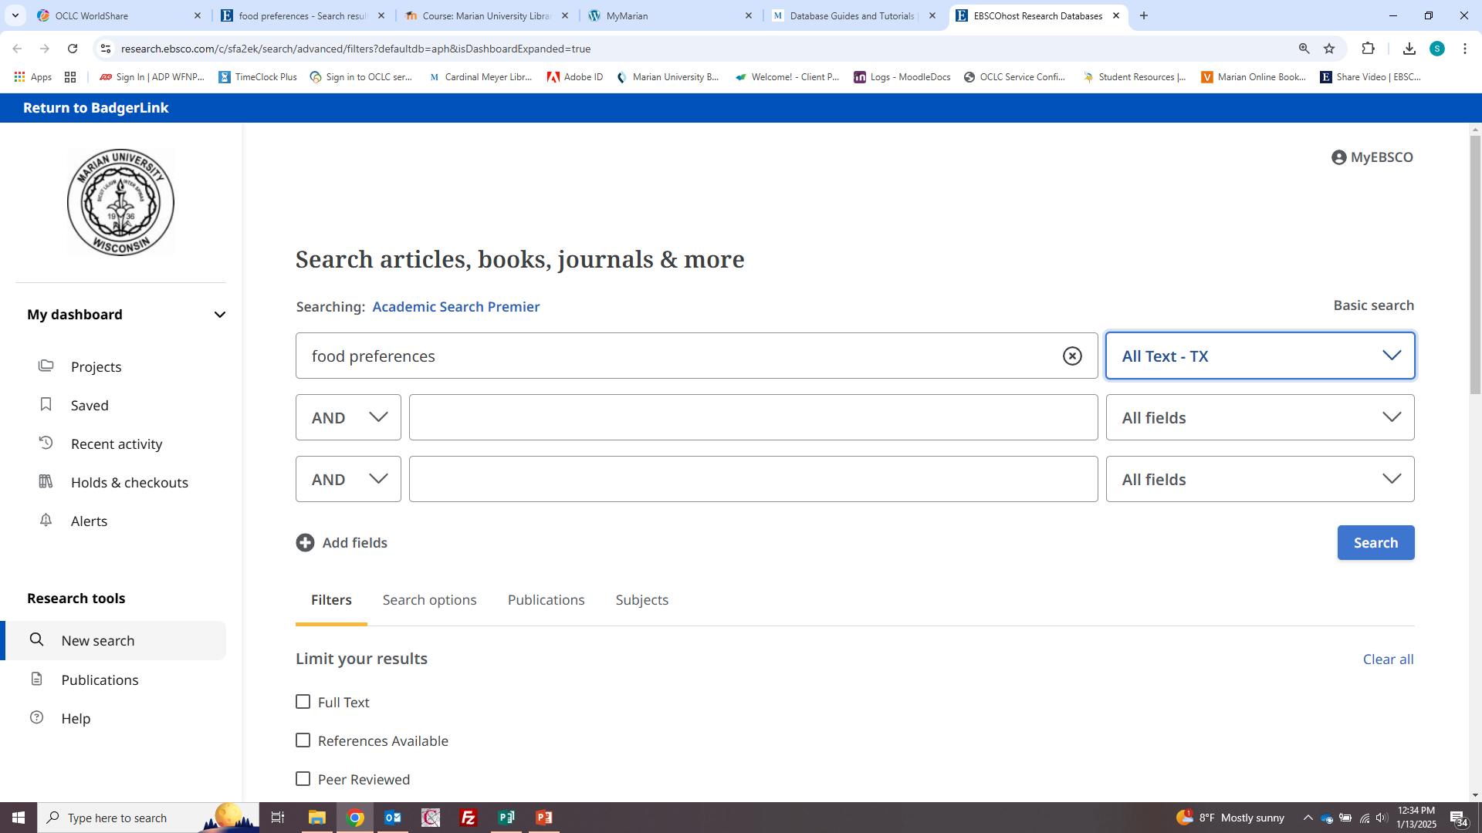
Enter keywords into search boxes and choose “All Text” from the drop down menu

Slide 40
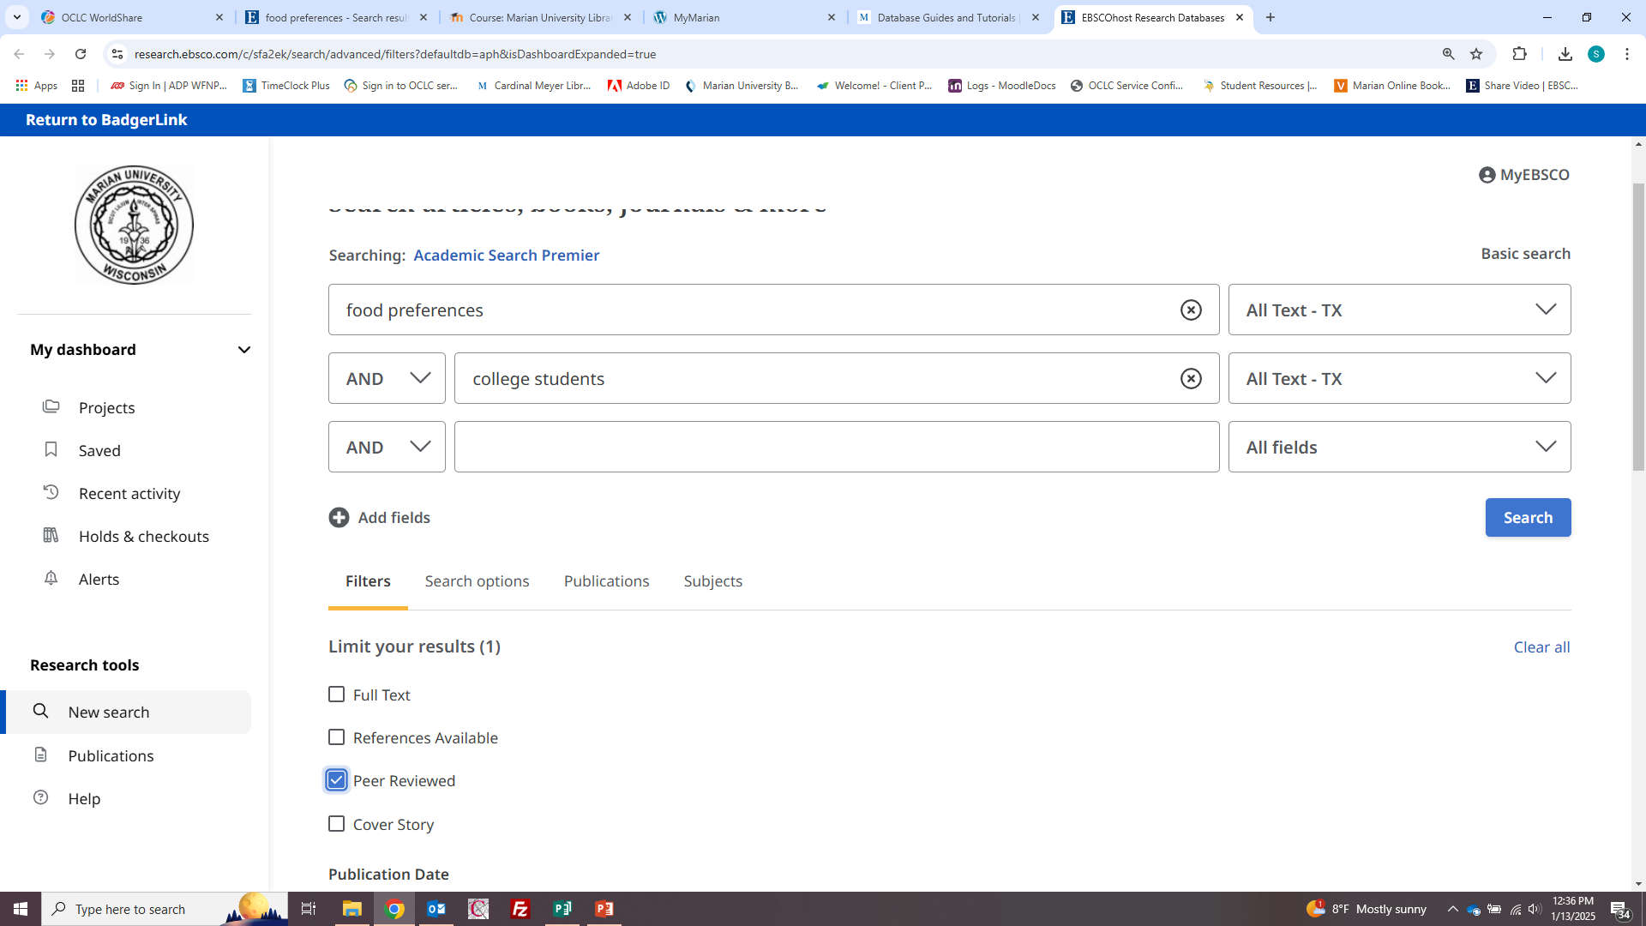
Narrow results more by adding more terms, limited to peer reviewed only…

Slide 41
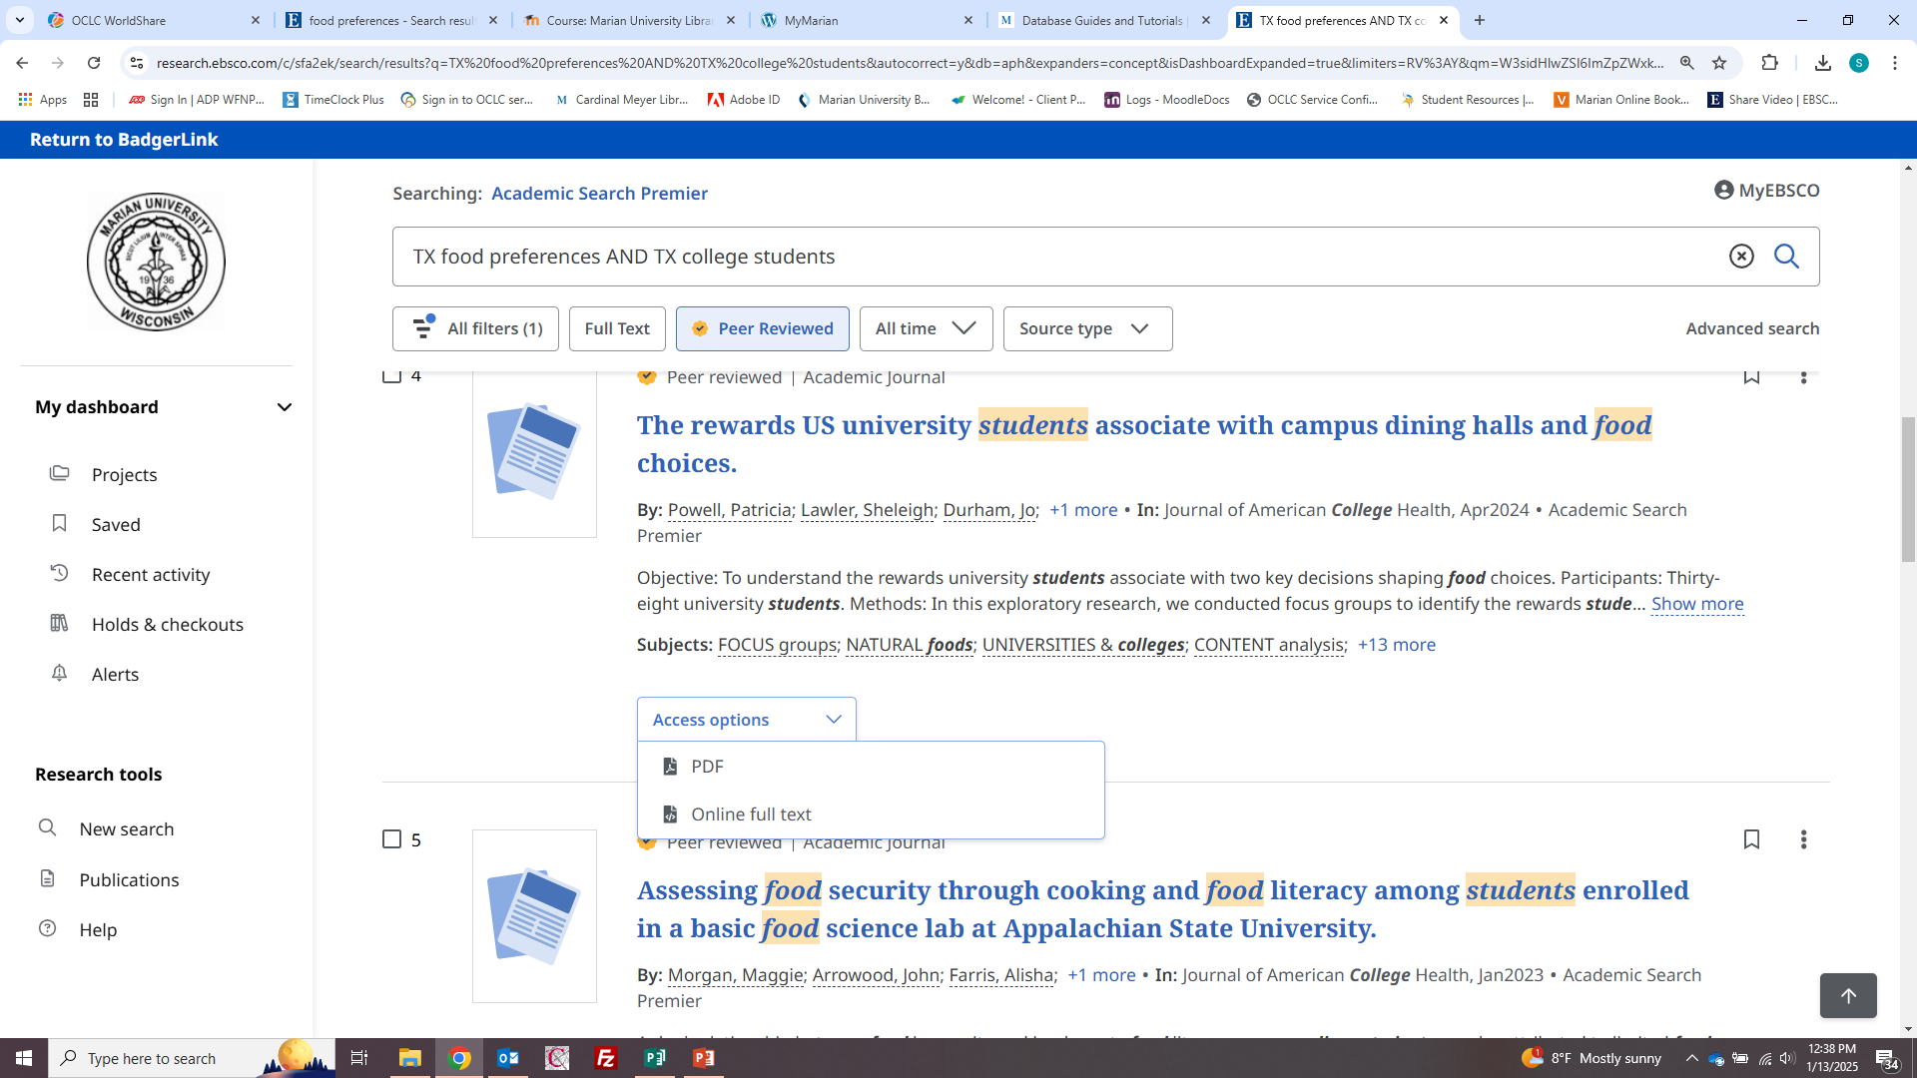
Articles will have a PDF, Online Full Text or Interlibrary loan

Slide 42
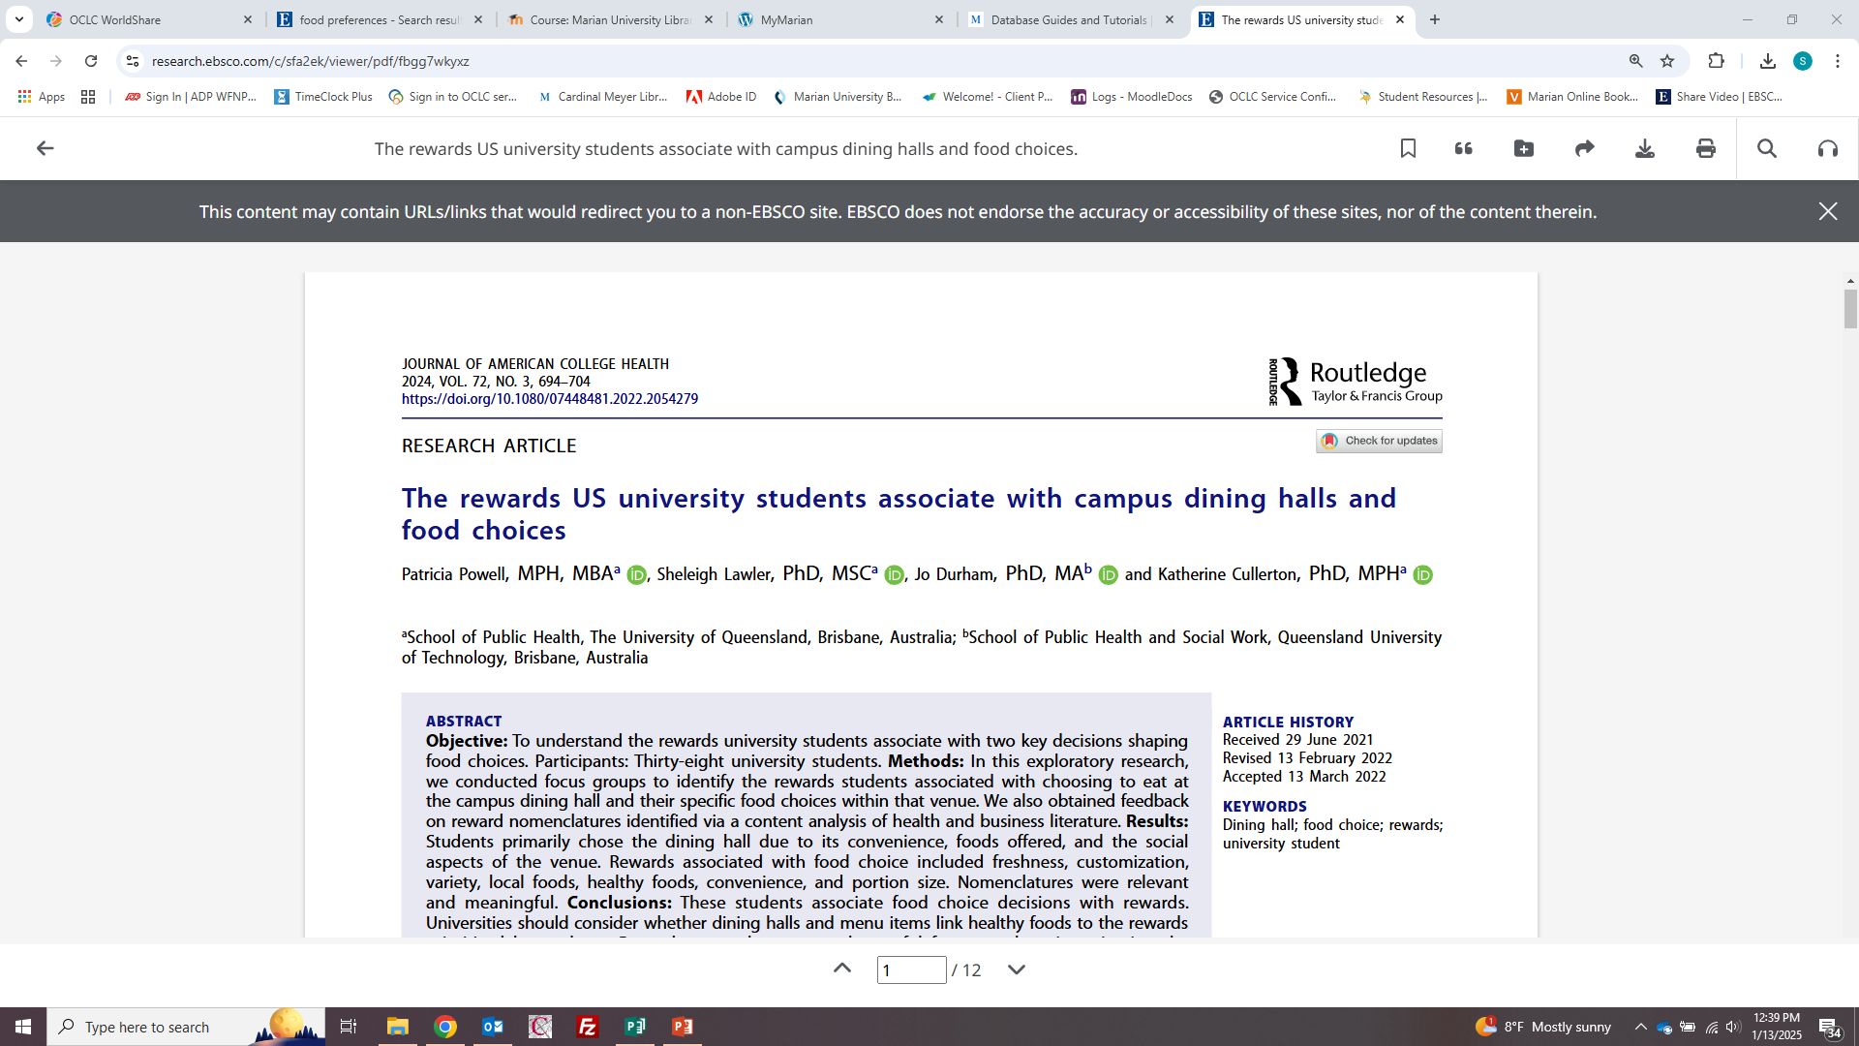
Articles can be shared, downloaded, and printed using the icons on the top right. You can also search within the article for keywords or have the article read to you.

Slide 43
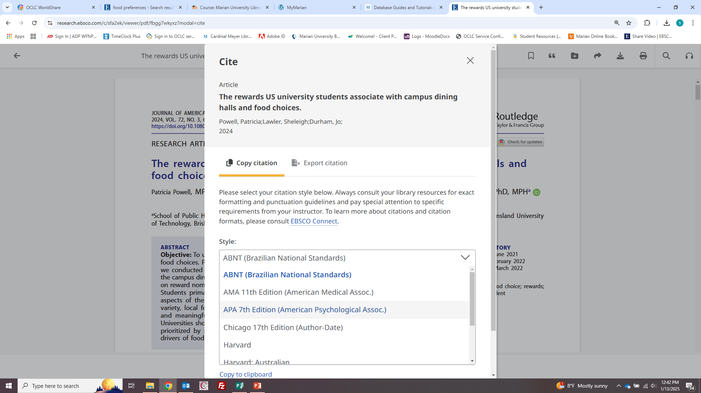
Use “Cite” icon to change to APA format, the icon is the quote mark on top right:

Slide 44
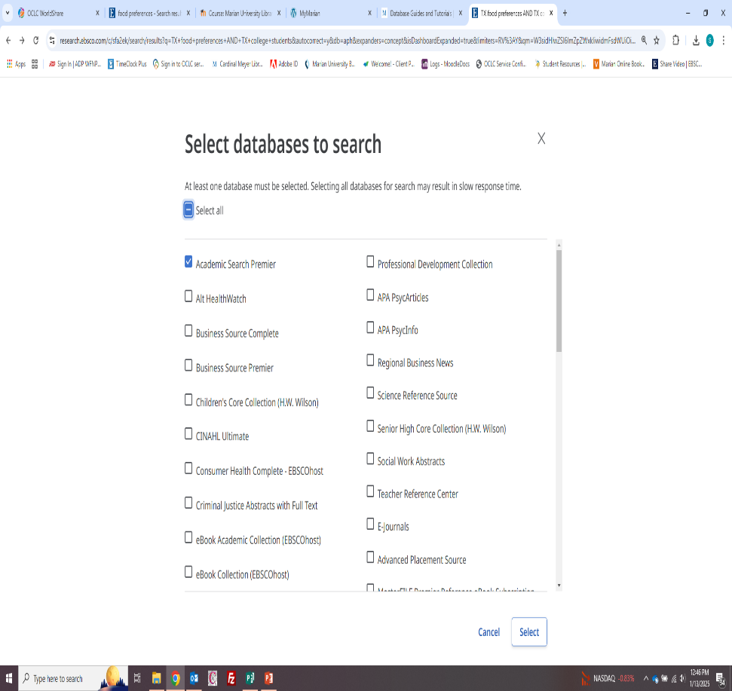
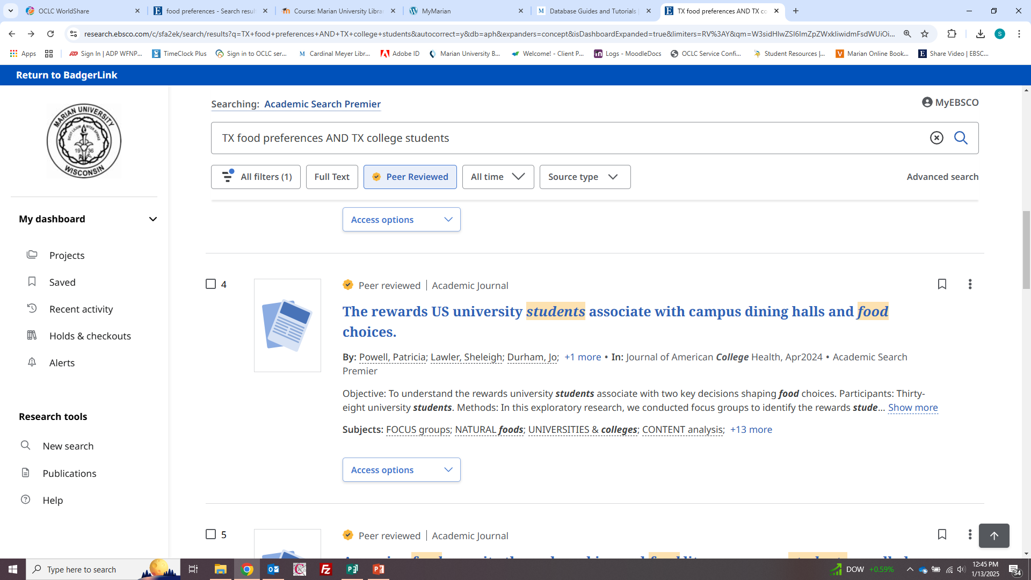
If more articles are needed, re-do the search by combining Ebsco databases into one search

Slide 45
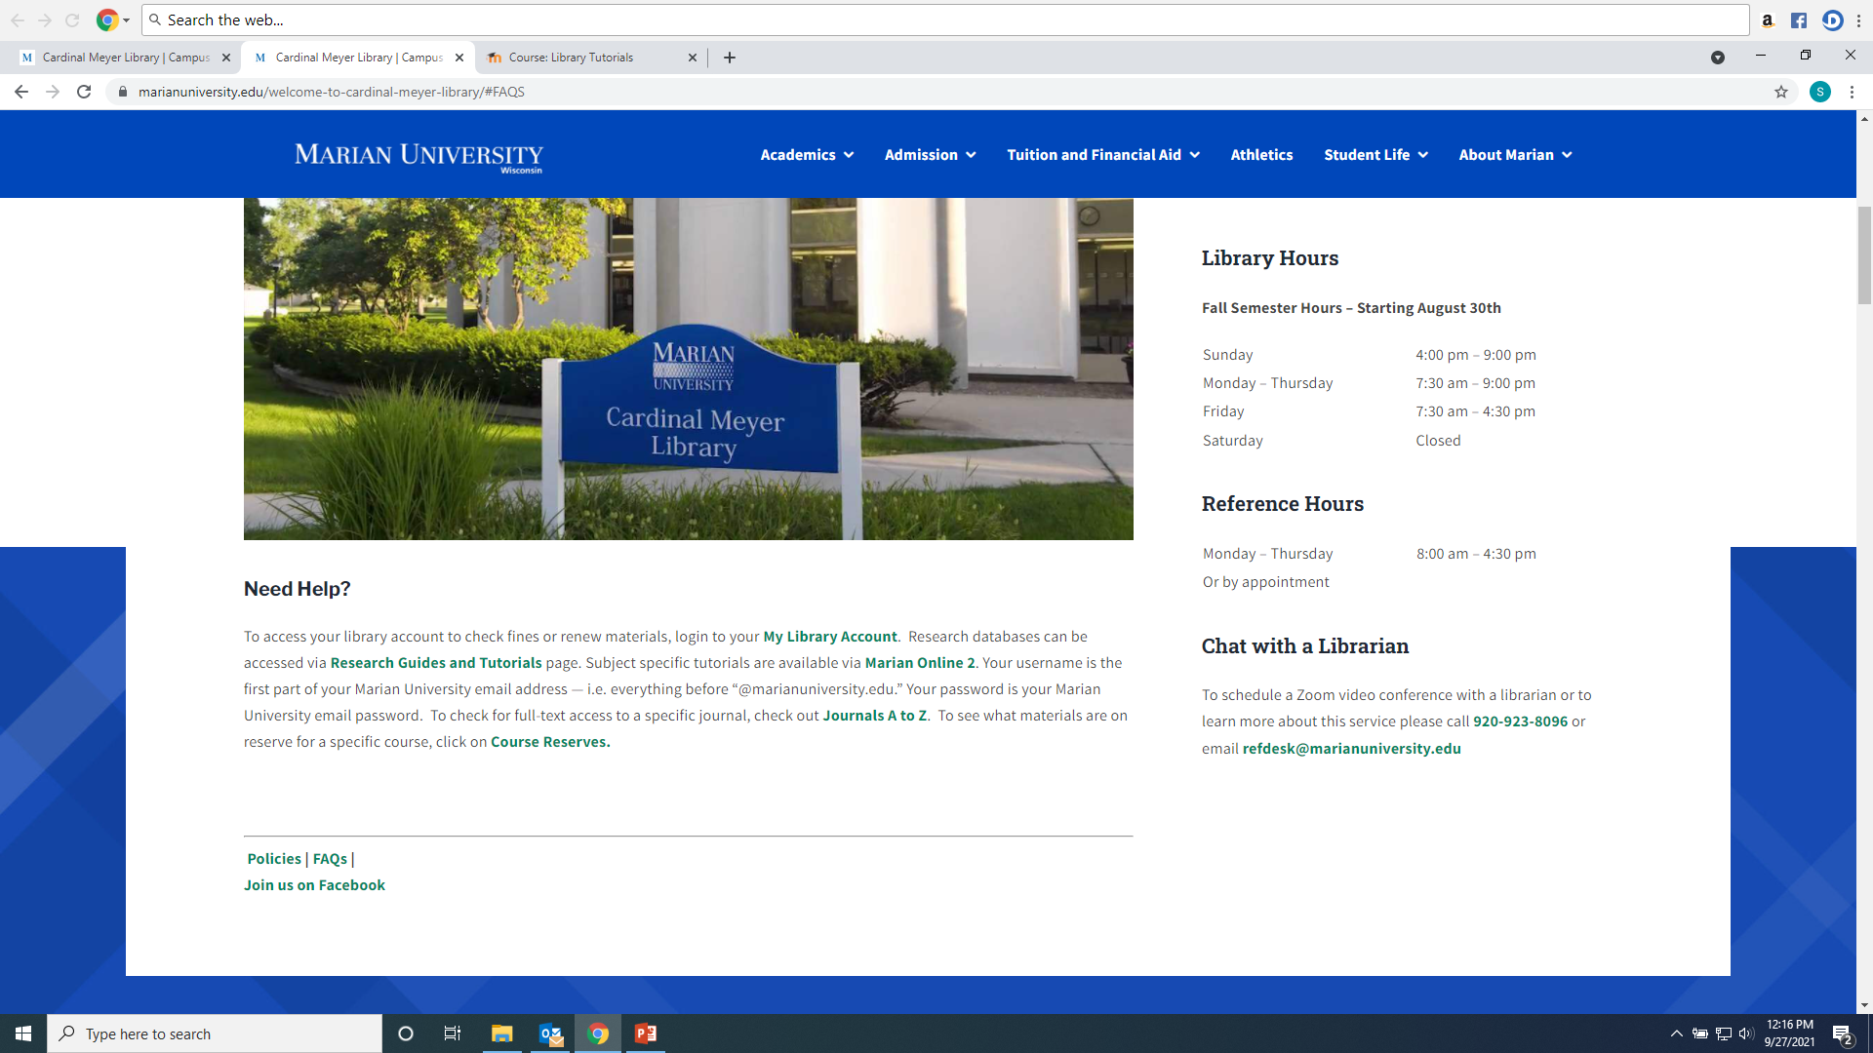
Any Questions?
Ask a library staff member!

