Slide 1
SCP 100
Sarah Thibodeau
srthibodeau64@marianuniversity.edu
920-923-8096

Slide 2
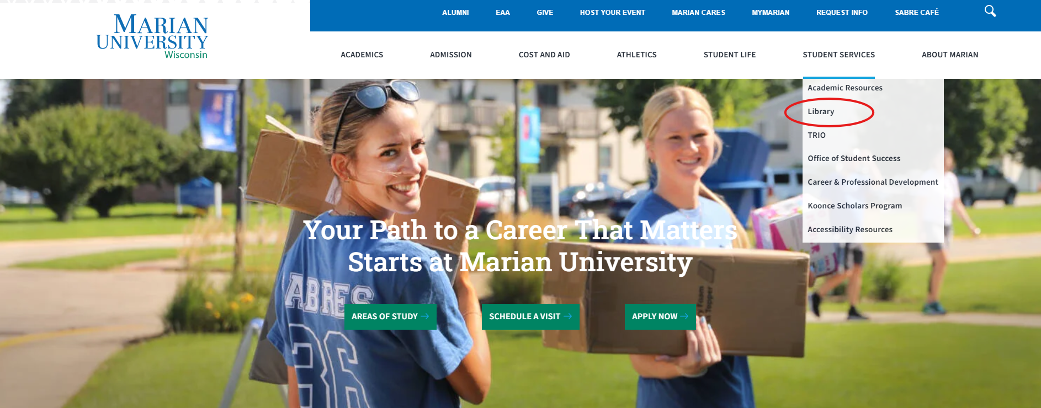
Click on Library from Marian website:

Slide 3
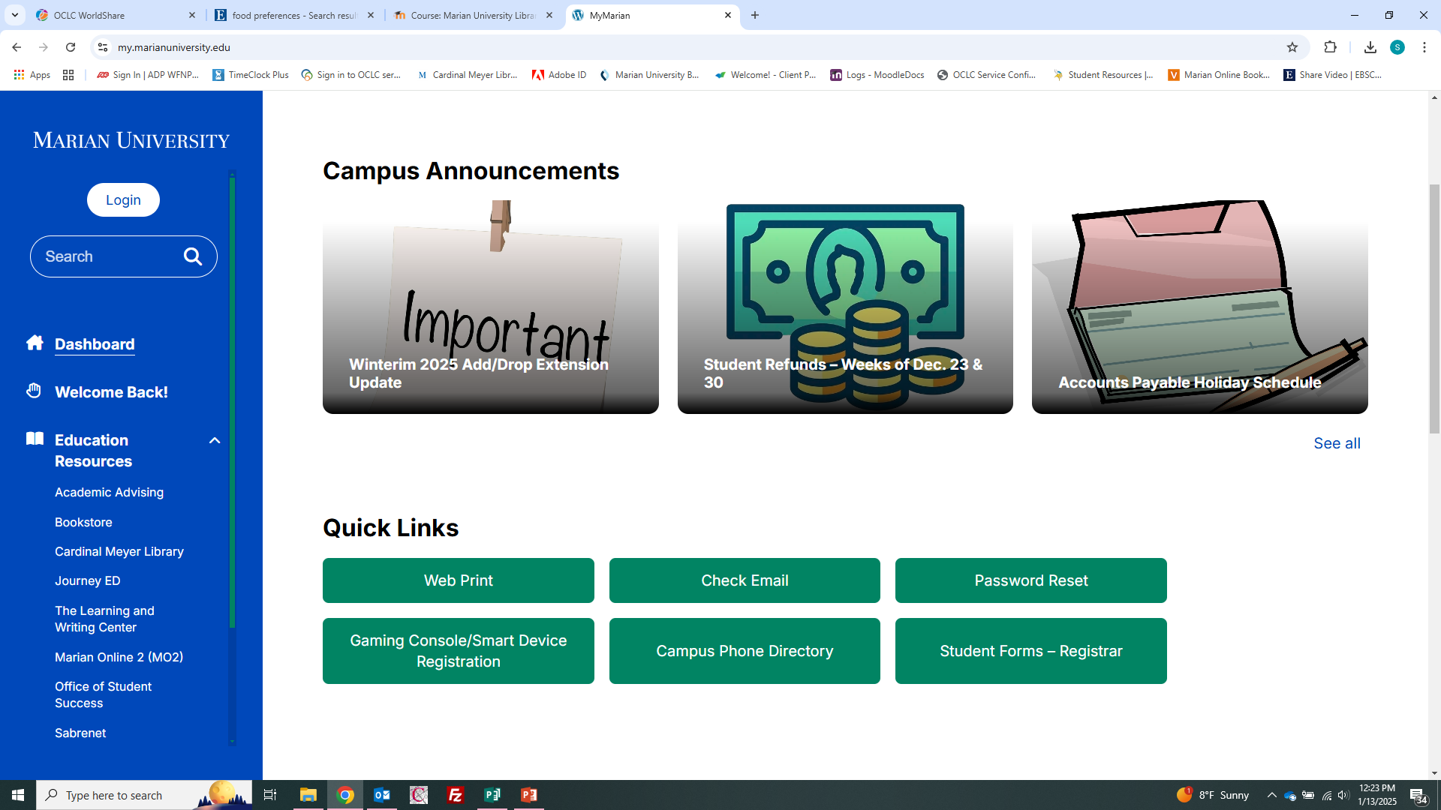
From MyMarian, click on Cardinal Meyer Library under Education Resources:

Slide 4
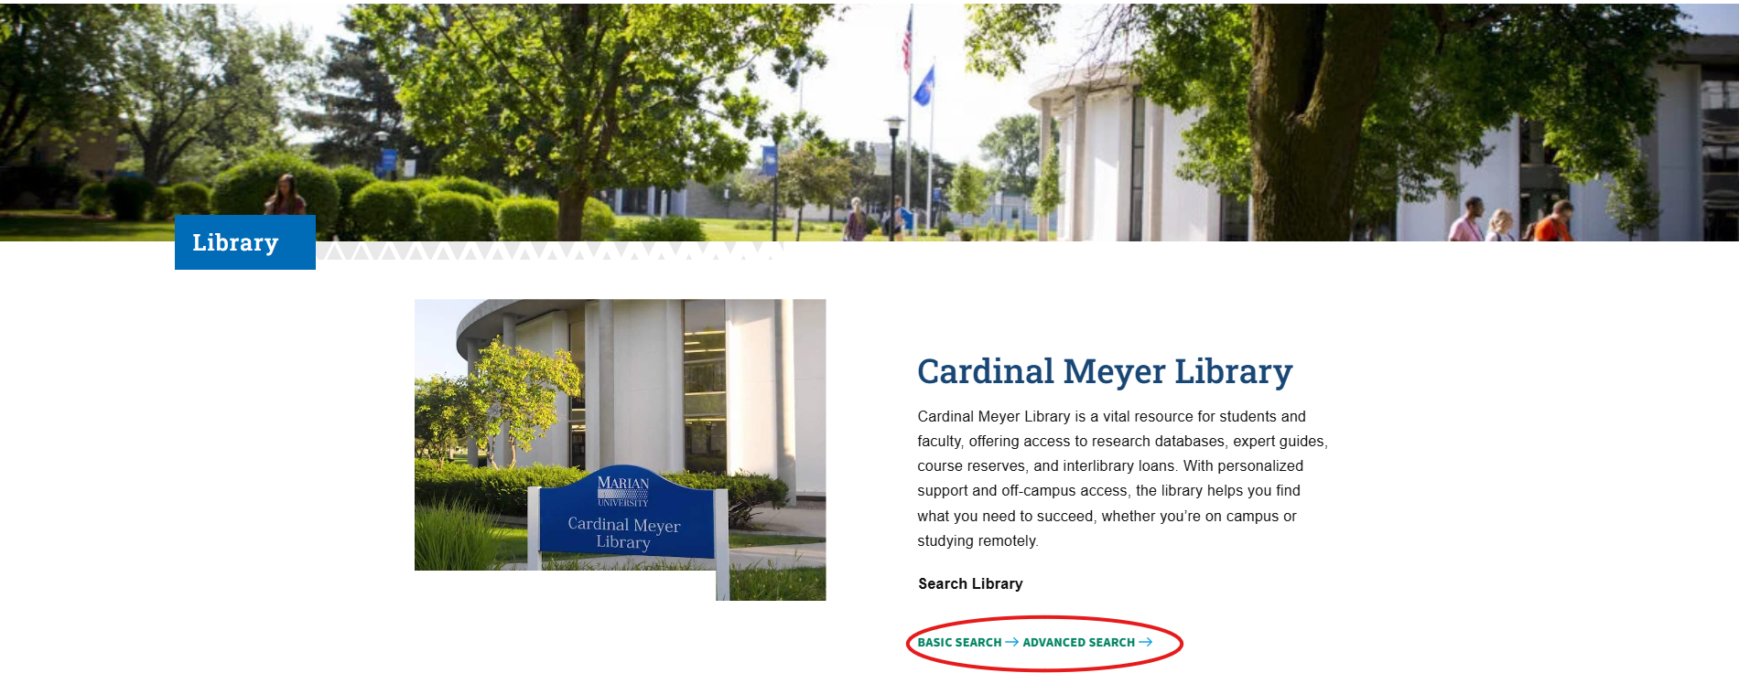
Search the library catalog for books,ebooks, articles, and other library materials:

Slide 5
Some faculty place virtual or physical library materials on reserve. Reserve items are kept at the front circulation desk.

Slide 6
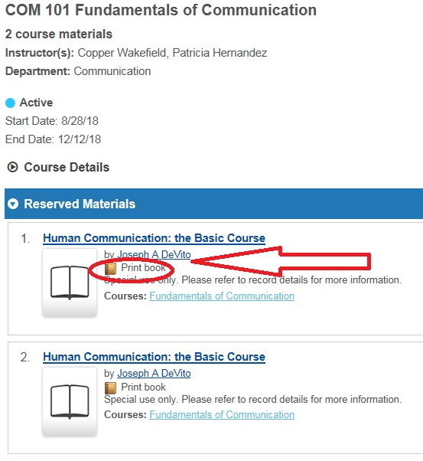
Reserve books (often only for 2 hours, library use only)

Slide 7
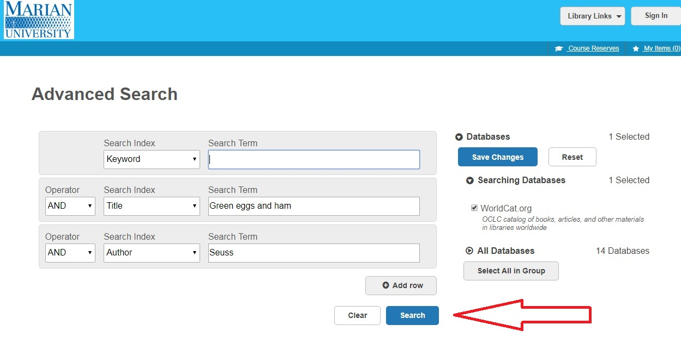
To find a book: type in title words, author words, or keywords. Click “Search”

Slide 8
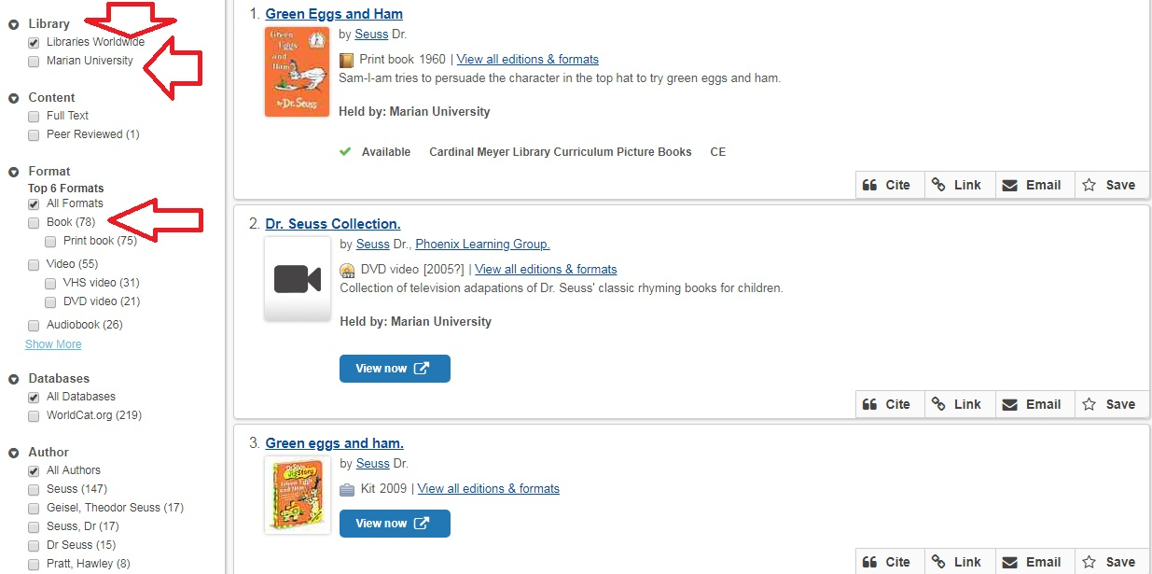
Results include all libraries and all formats (books, DVDs, games…)

Slide 9
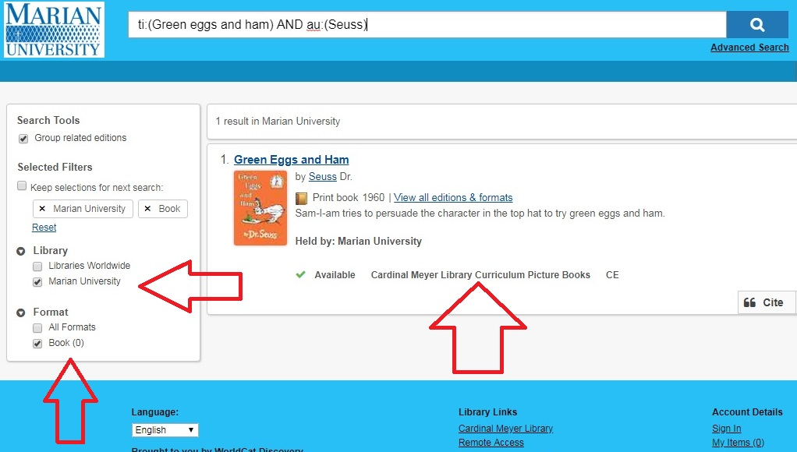
Limit to just Marian University and Format (such as Books) as needed. Marian owns the book!

Slide 10
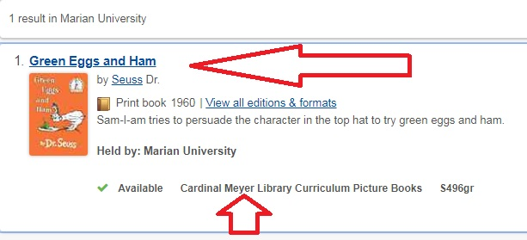
Green Eggs and Ham is shelved in the Curriculum Picture Books shelves under S496gr. To get more details, click on its title:

Slide 11
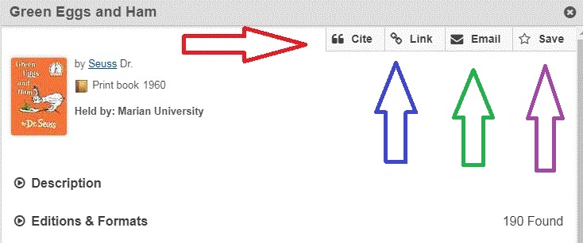
You can email the info, save it, format it for a bibliography and get an Internet link to find it later:

Slide 12
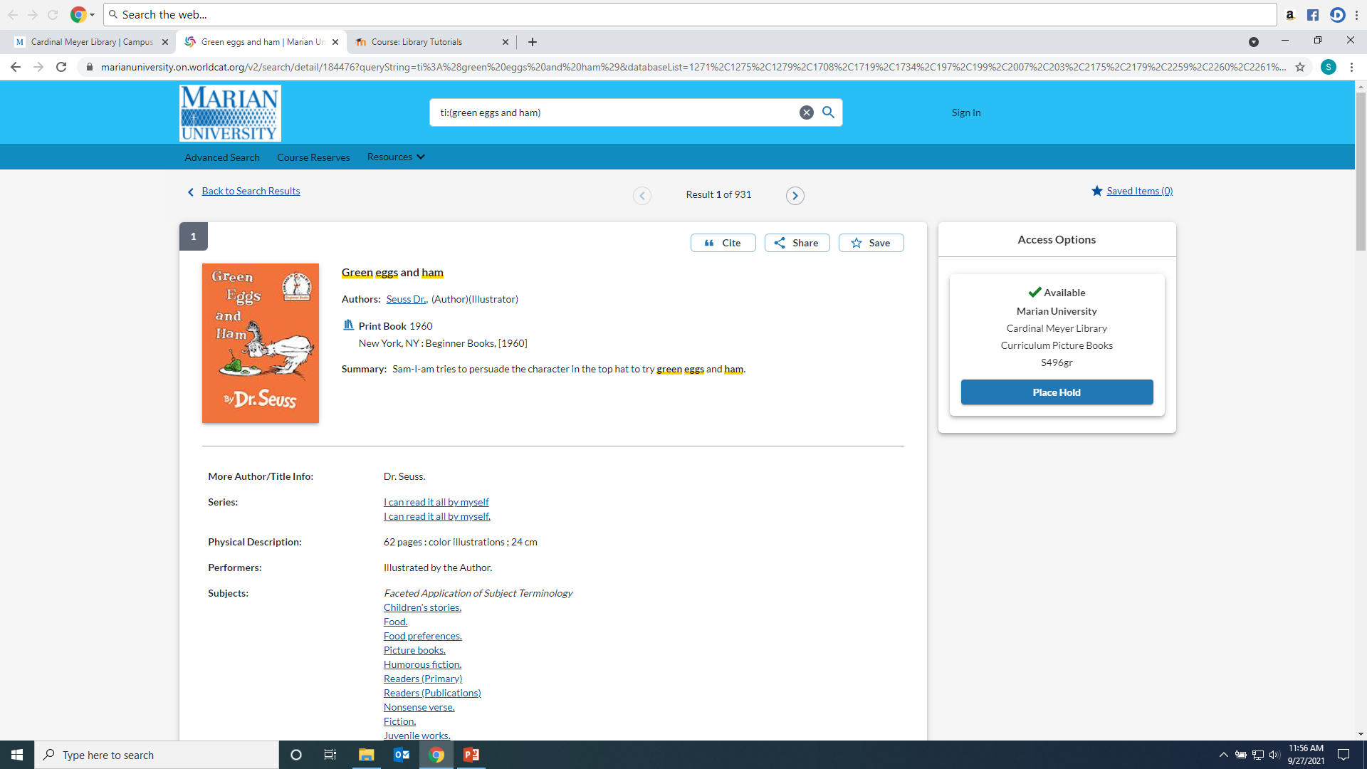
Marian’s copy is Available, but if it was checked out, click on Place Hold to get it next:

Slide 13
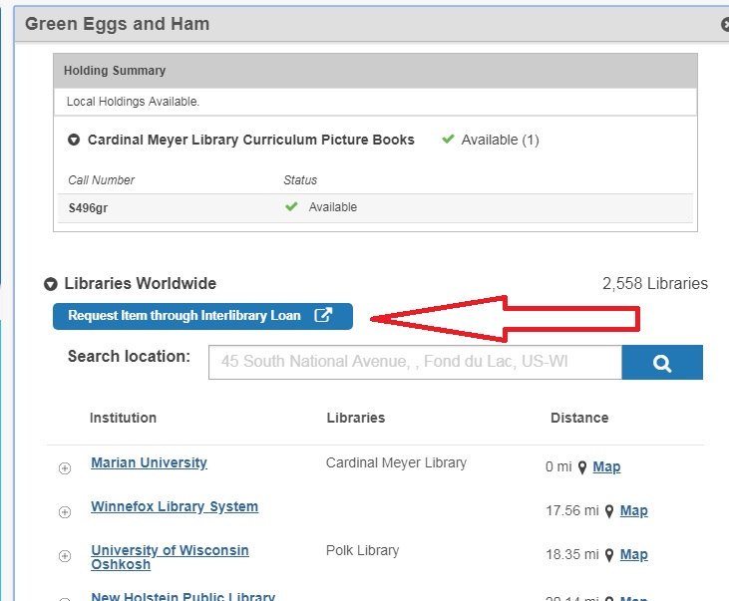
You can request it from another library through Interlibrary Loan or scroll down to discover if your local library has a copy and check it out there:

Slide 14
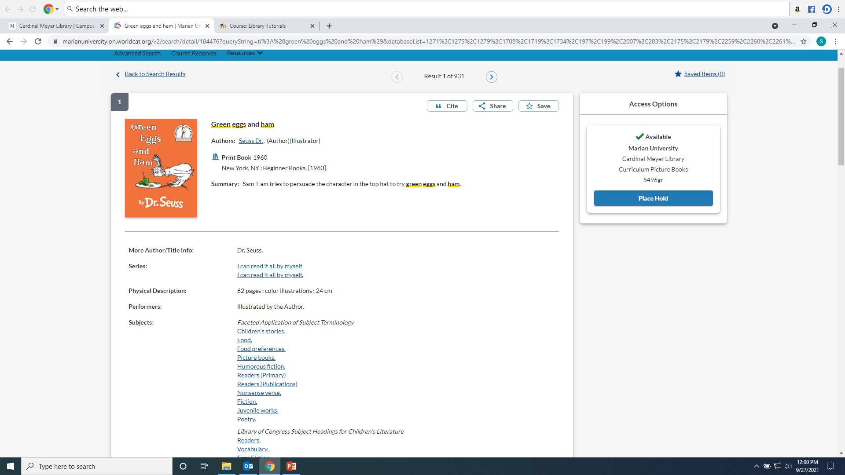
To find subject headings and other details,click on the item Title and look for the “Summary” and “Subjects” headings:

Slide 15
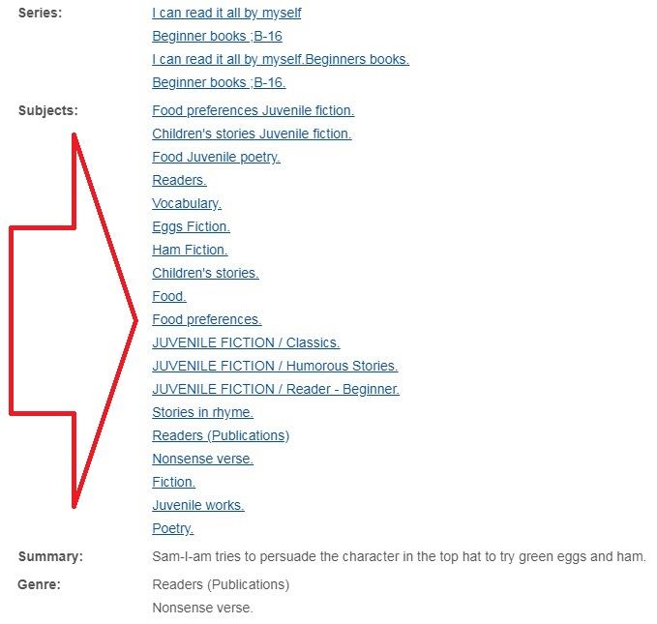
Subject Headings link to other items with those topics, for instance: Food preferences or Eggs--Fiction

Slide 16
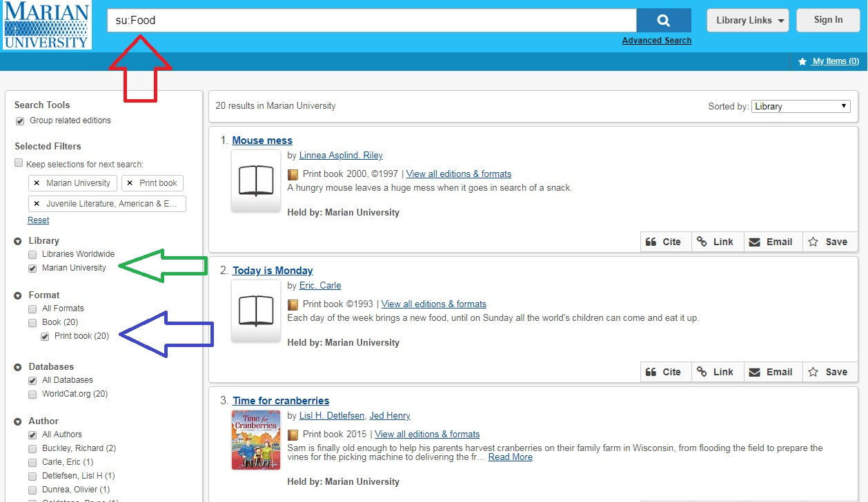
Results for Food. I also choose Marian, Print Book…

Slide 17
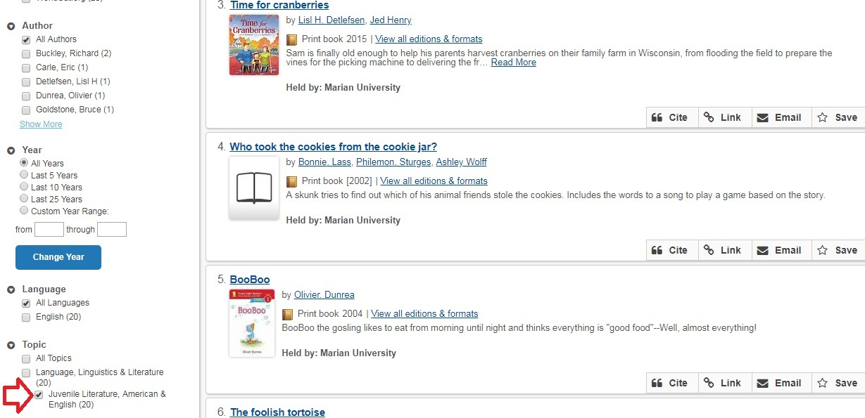
Scroll down to see more facets including “Juvenile literature:”

Slide 18
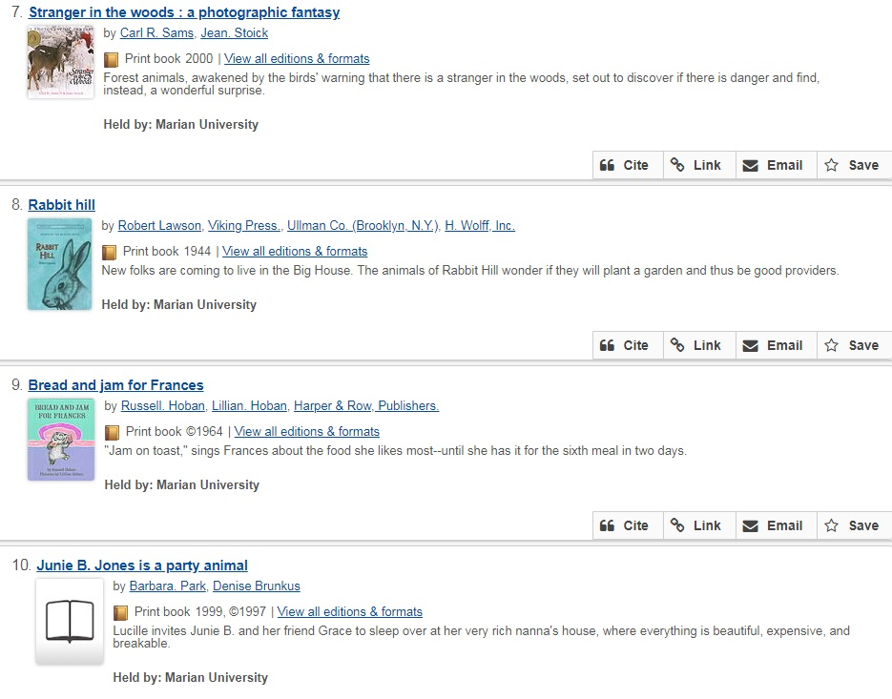
Find more books! Check the subject headings for other subjects or series to explore.

Slide 19
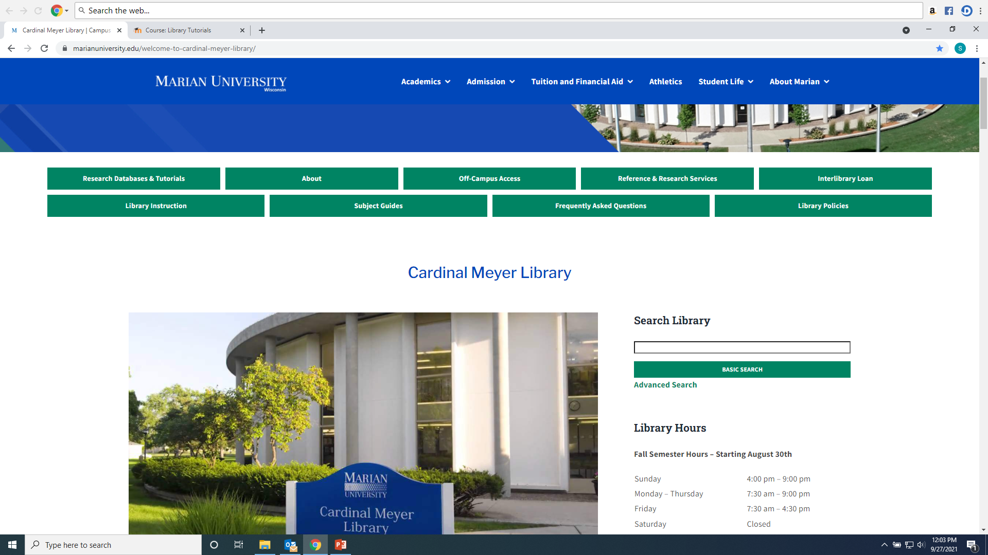
You can also start the search in the Basic Search box:

Slide 20
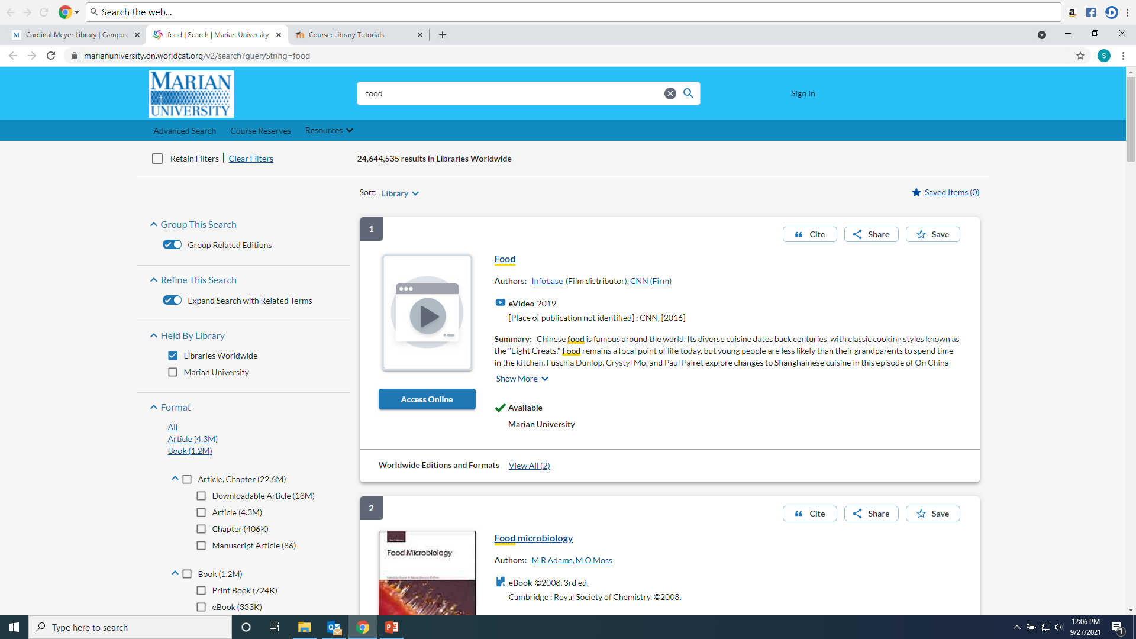
As desired, narrow the results. Examples: Marian, Books

Slide 21
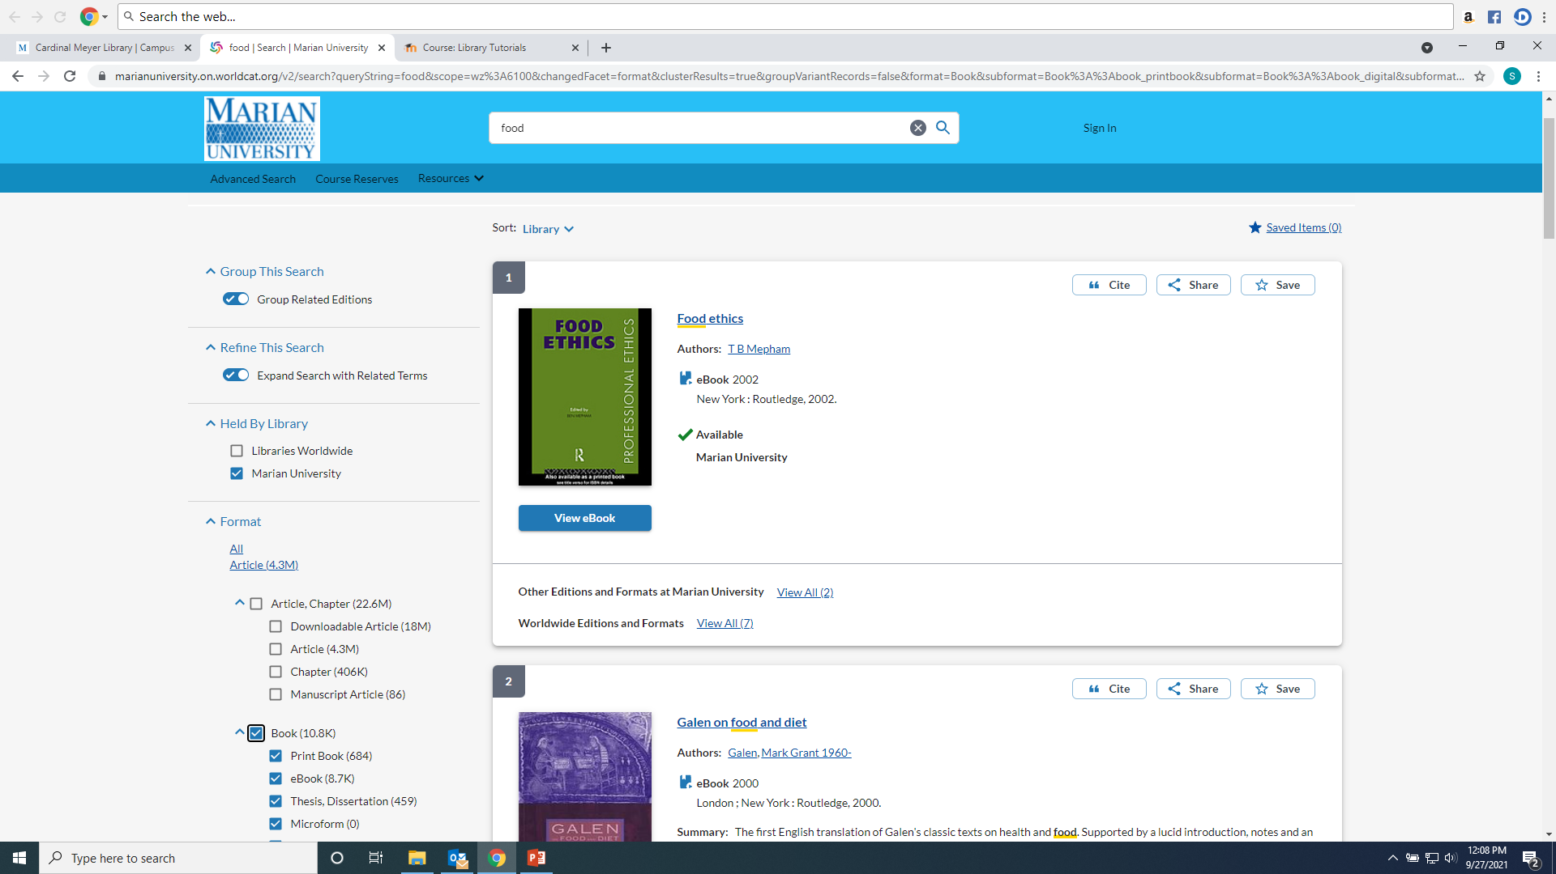
Results for books at Marian University. Includes ebooks and print books.

Slide 22
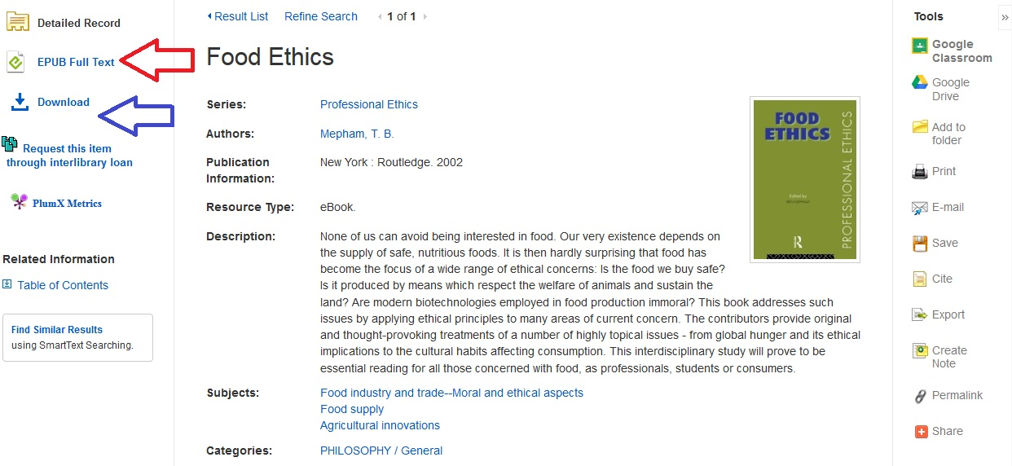
Ebooks can be read online or individual chapters saved or printed:

Slide 23
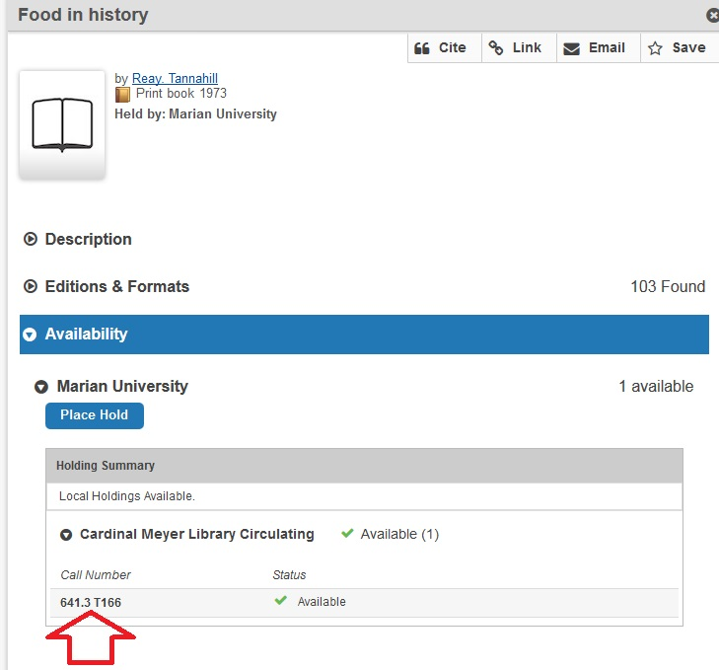
Library items are shelved by Dewey call numbers (except picture books):

Slide 24
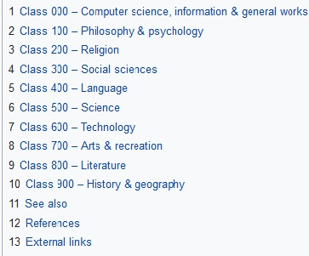
Dewey call numbers assign numbers to different topics. Library materials are then arranged by those call numbers so it is easier to find items by subject:

Slide 25
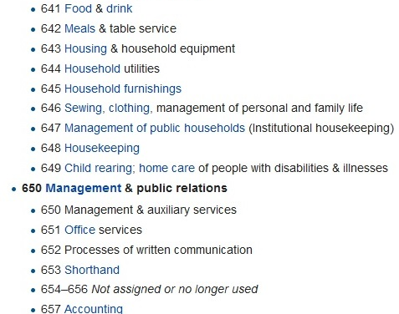
Dewey 600s:
The Dewey Decimal System then assigns ever longer decimal numbers to sub-topics.

Slide 26
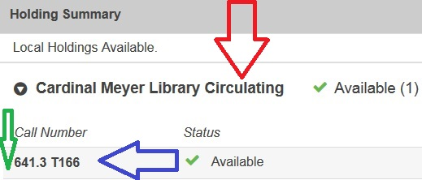
Circulating is the book section in the middle of the library, 641.3 is the Dewey number, .T166 indicates the author begins with the letter “T:”

Slide 27
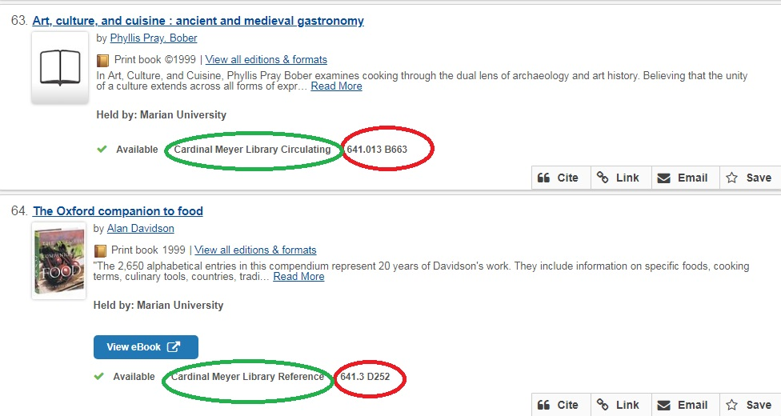
Throughout the Library, call number 641 is for food!

Slide 28
Marian Library areas include:
Picture Books (outside wall near front door)
Curriculum books (outside wall further west)
Curriculum High School (west side of library near computers on wall)
Circulating (shelves in center of library)
Reference (east and south outside wall)
DVDs and CDs (shelves near circulation desk)
Oversize (large books on east side near study tables)
Games and Magazines/Journals (near north side comfy chairs)

Slide 29
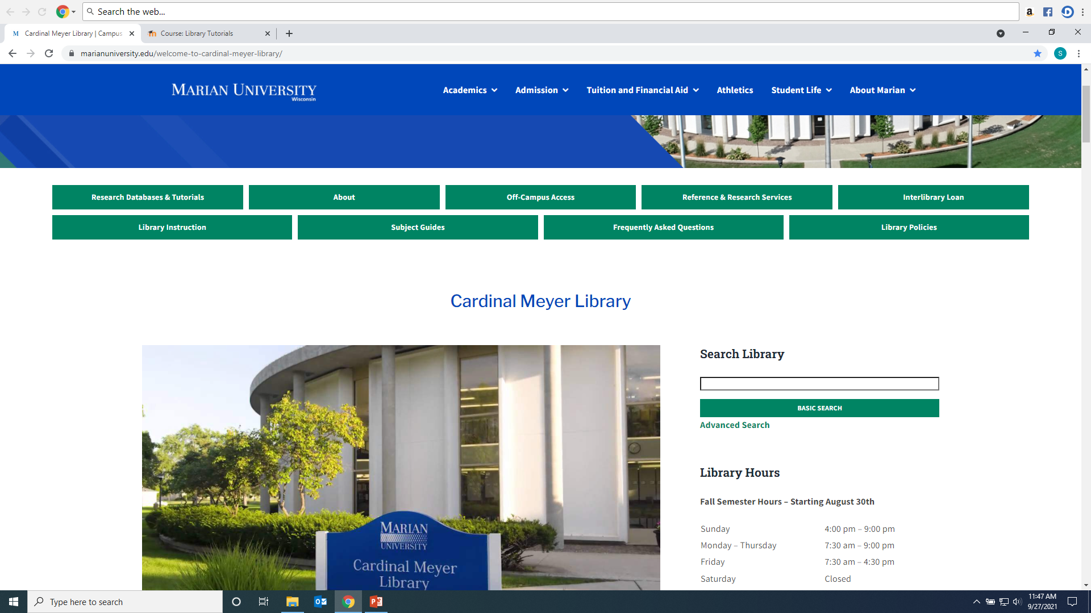
Search Library Box also can find articles:

Slide 30
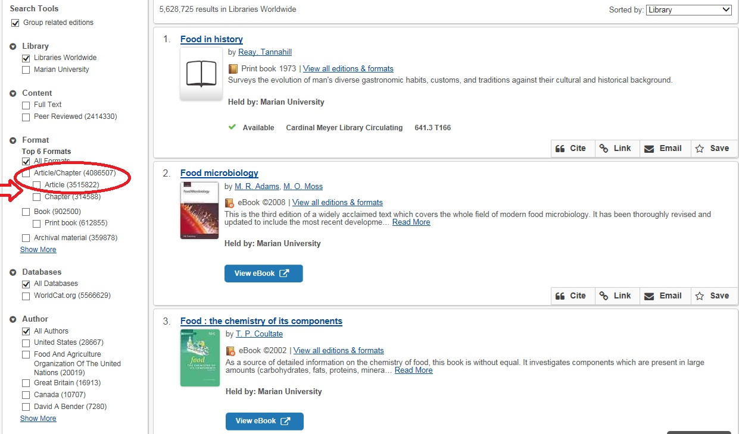
Click on the Article box to narrow from 5,628,725 total items to 3,526,157 articles only:

Slide 31
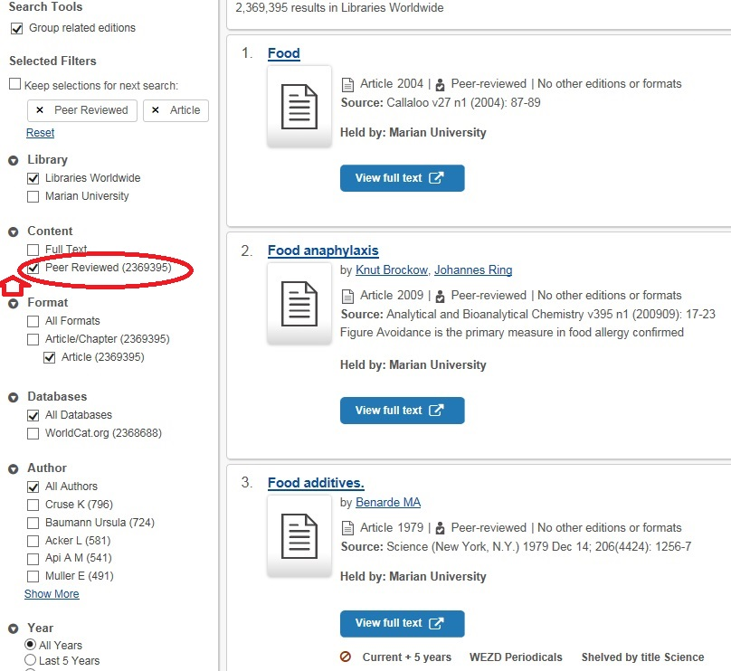
Click on “Peer reviewed” to narrow from 3,527,167 articles 2,369,395:

Slide 32
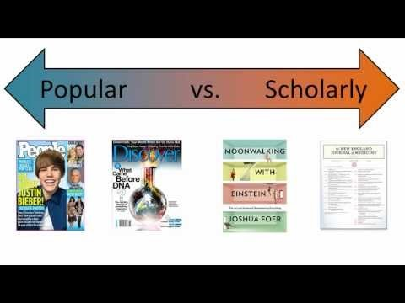
What is a scholarly or peer reviewed article?

Slide 33
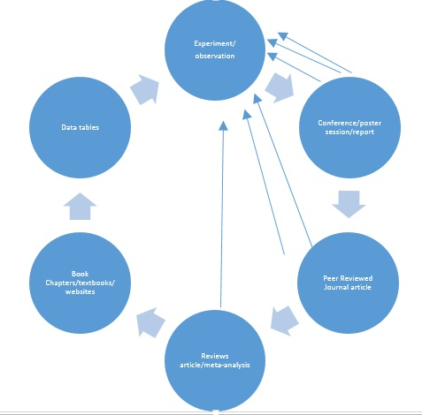
Knowledge cycle:

Slide 34
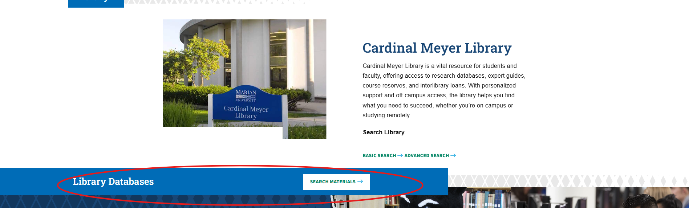
To search individual databases:

Slide 35
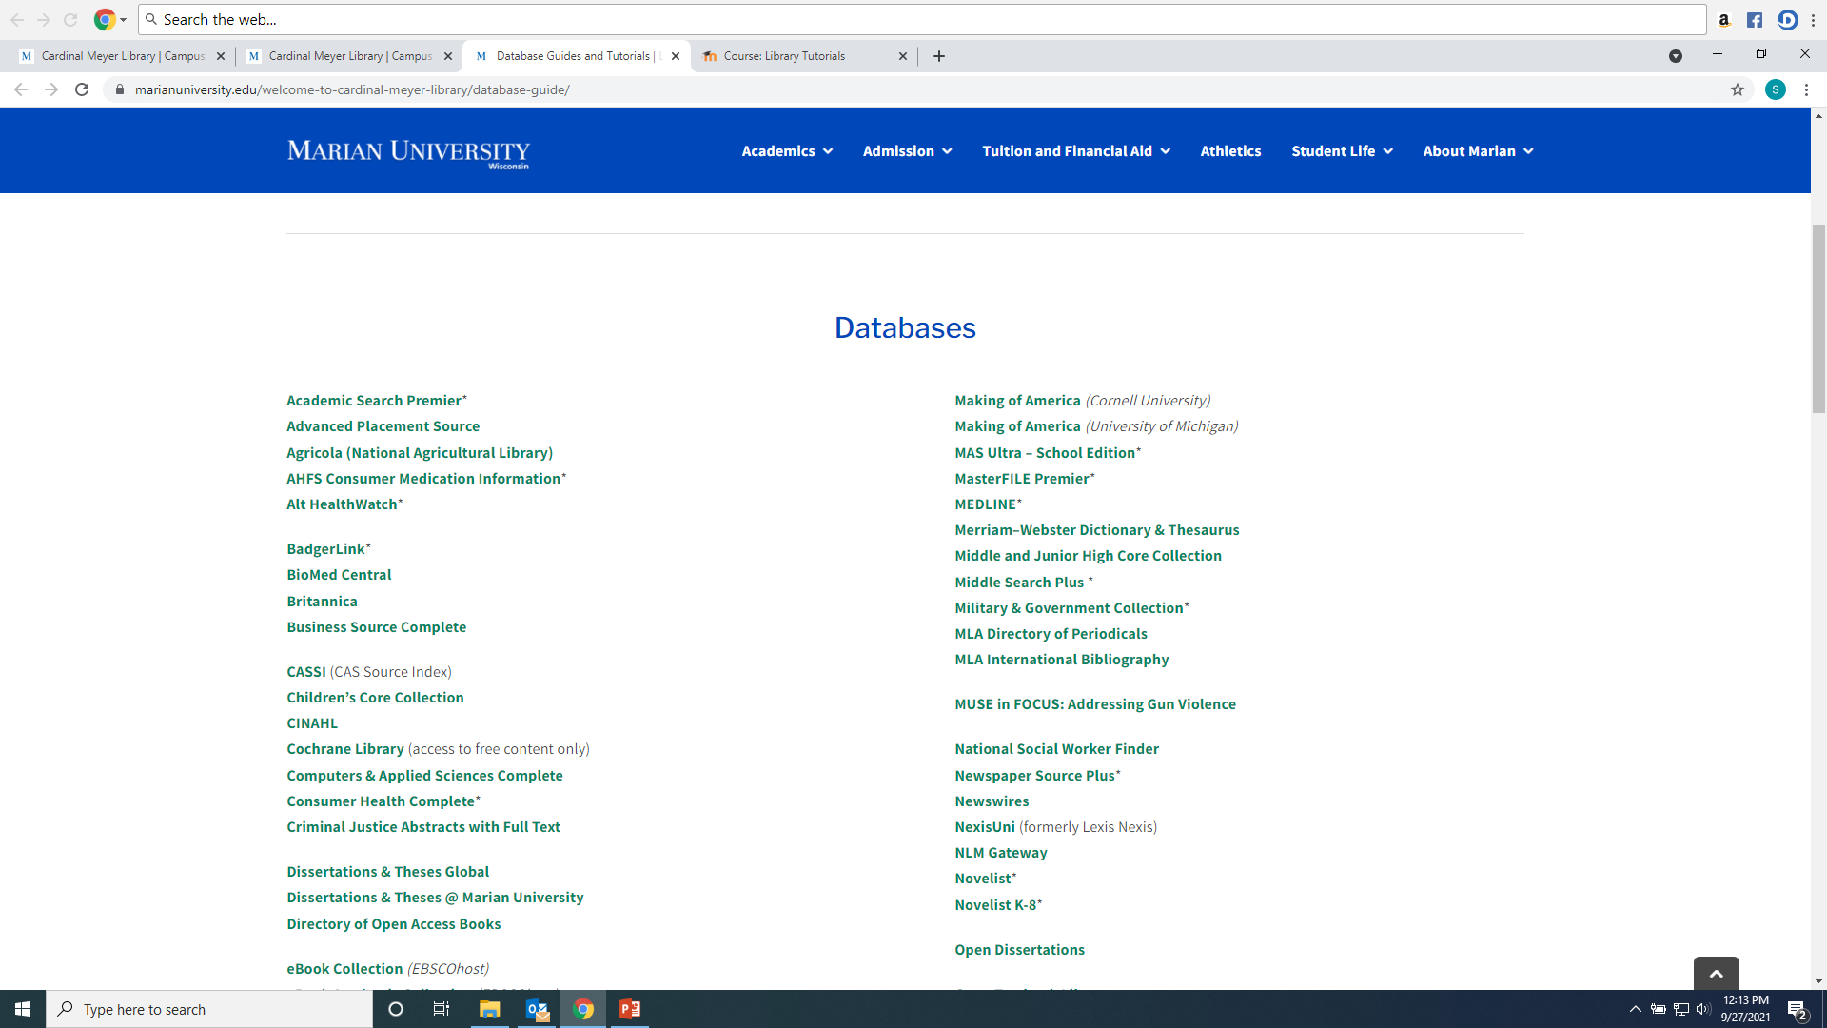
Choose a database according to the subject—ask a librarian for more help!

Slide 36
Academic Search Premier provides articles useful for most subjects:

Slide 37
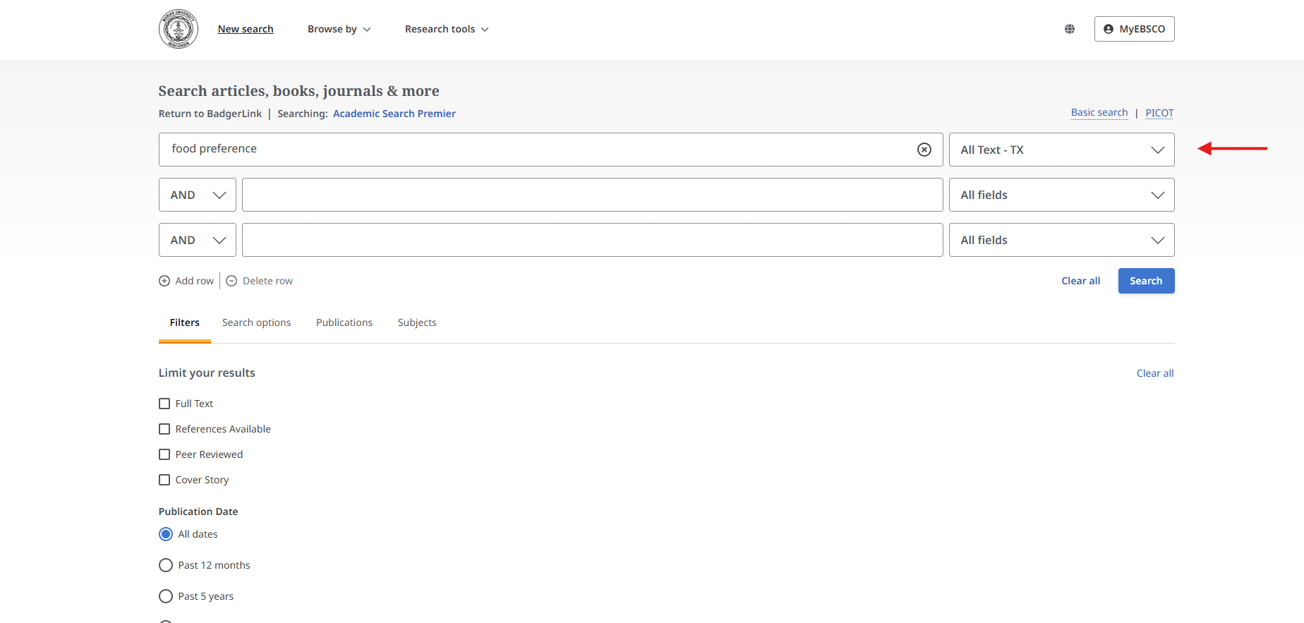
Enter keywords into search boxes and choose “All Text” from the drop down menu

Slide 38
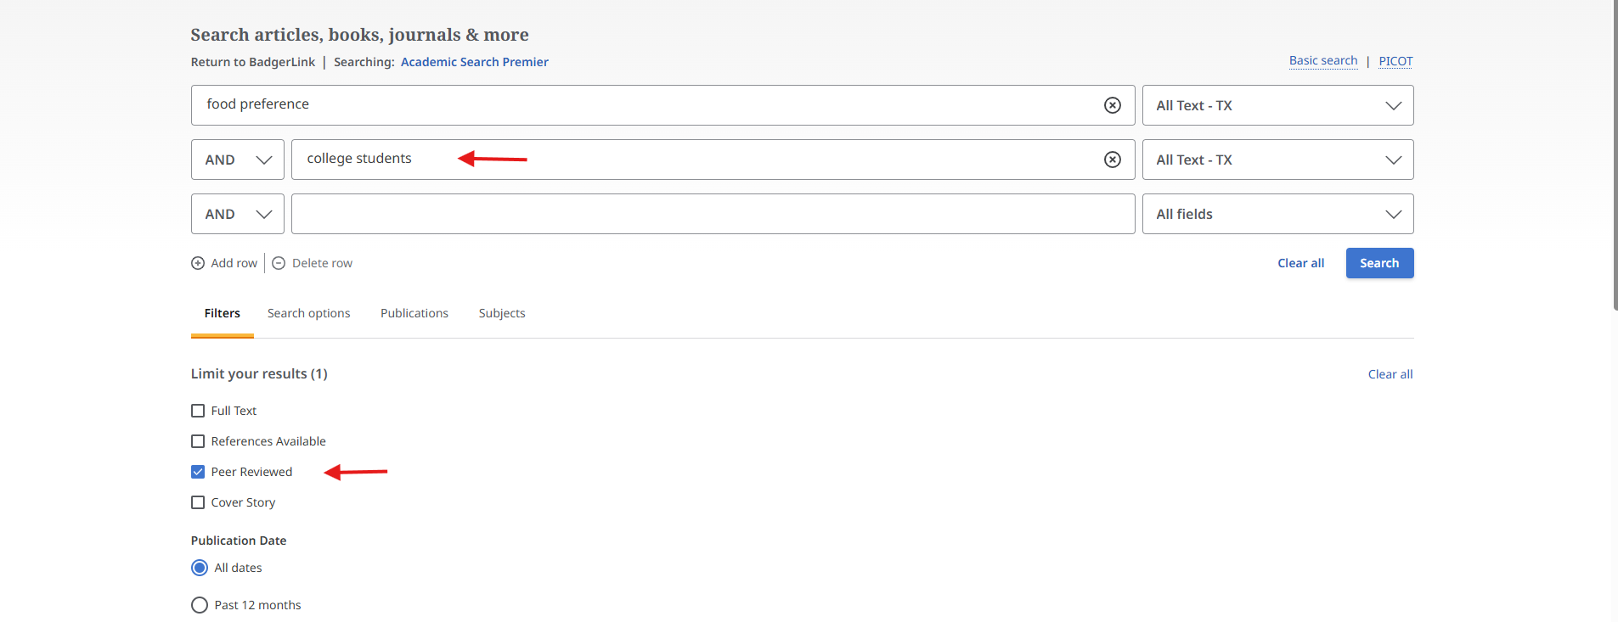
Narrow results more by adding more terms, limited to peer reviewed only…

Slide 39
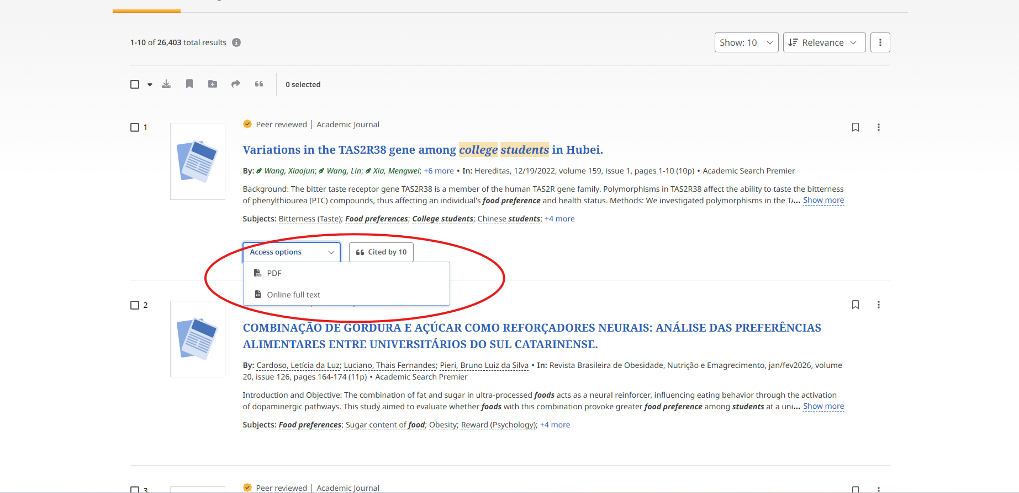
Articles will have a PDF, Online Full Text or Interlibrary loan

Slide 40
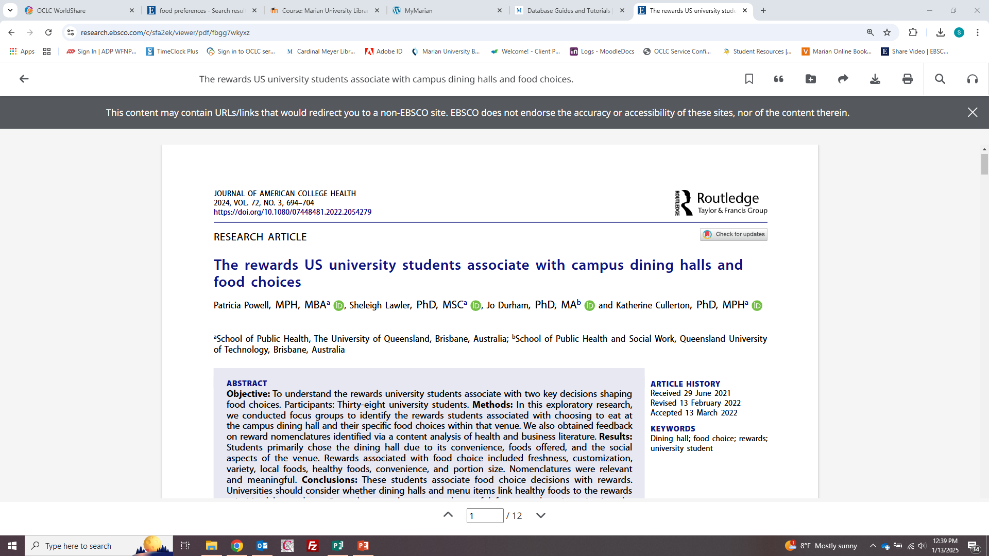
Articles can be shared, downloaded, and printed using the icons on the top right. You can also search within the article for keywords or have the article read to you.

Slide 41
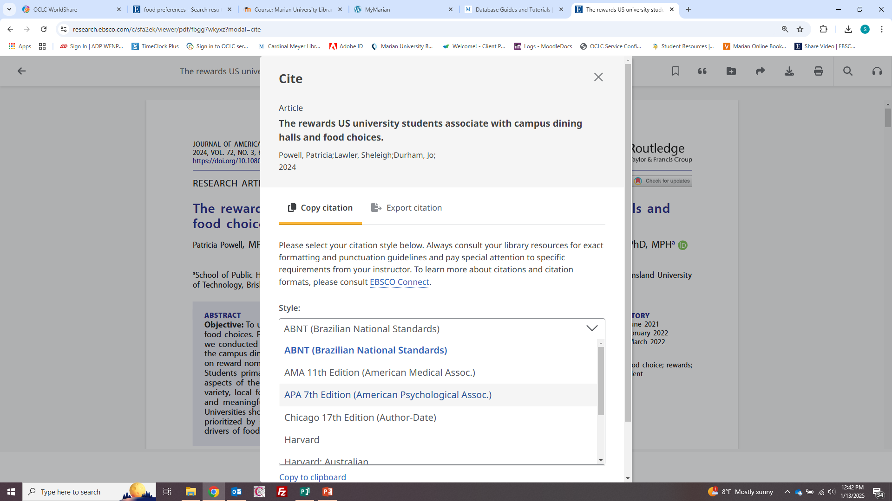
Use “Cite” icon to change to APA format, the icon is the quote mark on top right:

Slide 42
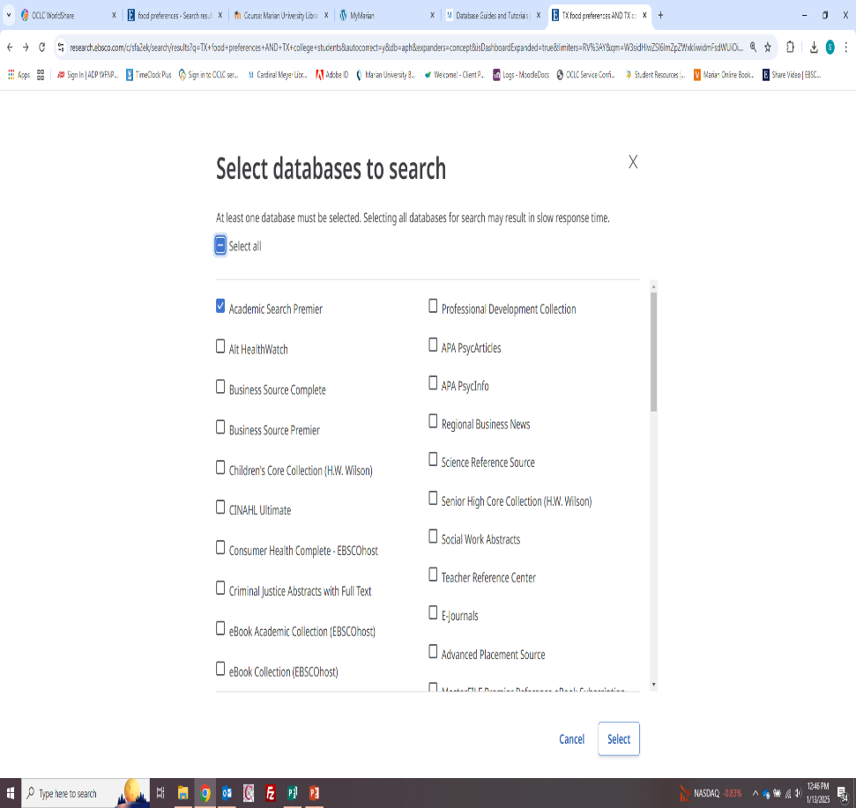
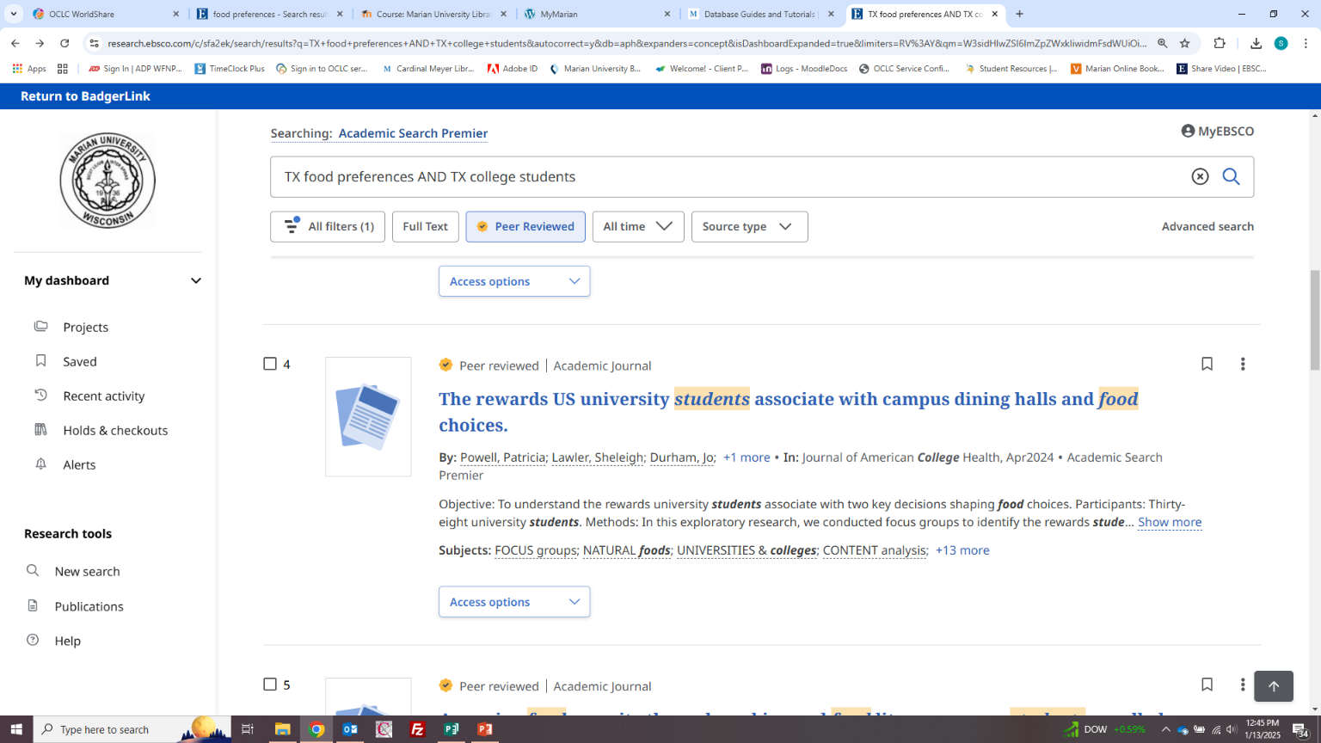
If more articles are needed, re-do the search by combining Ebsco databases into one search

Slide 43
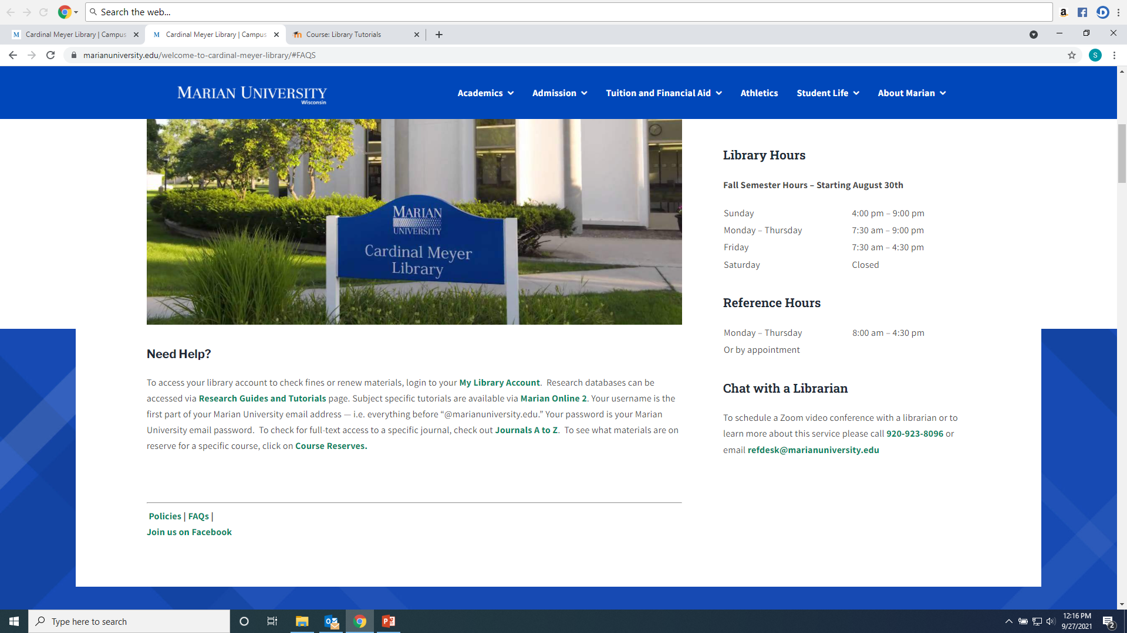
Any Questions?
Ask a library staff member!

