Slide 1
Information Literacy (Evaluating Resources)
Marian University Cardinal meyer library

Slide 2
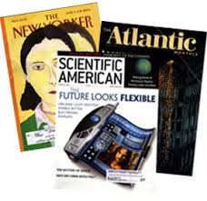
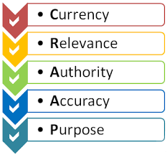
What we will cover:
Key characteristics of scholarly and popular sources
What is “peer review”
Other types of research materials
CRAAP Test

Slide 3
Scholarly Sources
Purpose: to share research or scholarship with the academic community
Author: scholars/researchers; credentials/affiliations provided
Audience: scholars, researchers, students
Review: editorial board made up of other scholars and researchers; some are peer-reviewed
Frequency: quarterly or semi-annually
Ads: minimal, usually only for scholarly products like books
Examples: American Journal of Sociology, Journal of the American Medical Association, Journal of Clinical Psychology

Slide 4
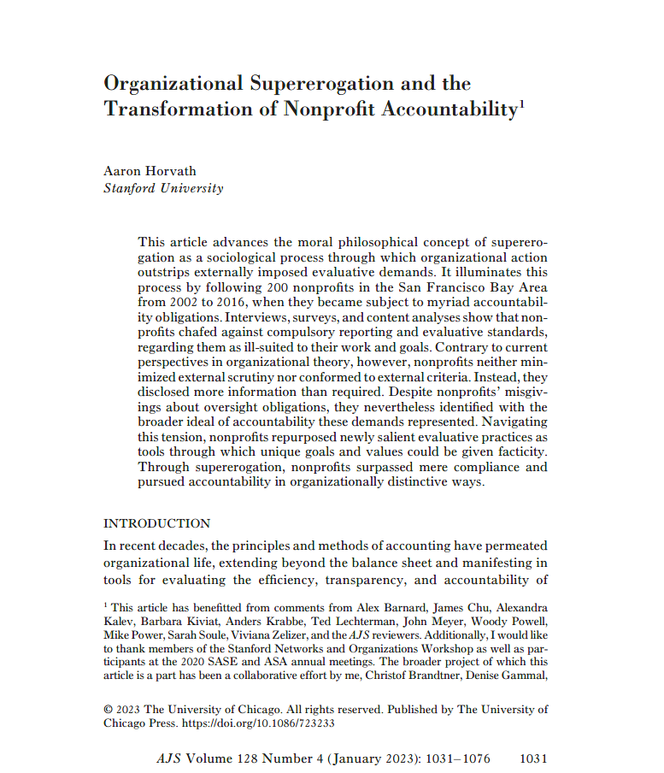
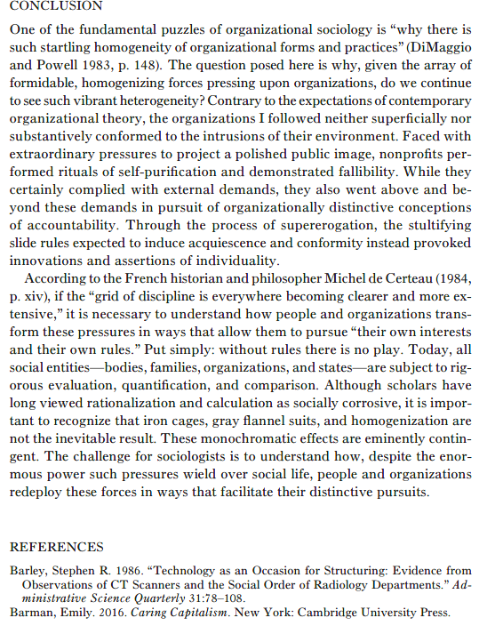
What to look for in scholarly articles
Conclusion
Author w/professional affiliation
Abstract
Introduction
References
Publication

Slide 5
Popular Sources (newspapers and magazines)
Writers: staff writers, journalists, freelancers; usually not experts on the subject
Purpose: to inform, entertain, or elicit an emotional response
Audience: general readers
Editorial process: articles evaluated for form and content by staff editors
Examples: Time; The Atlantic, Wall Street Journal, Ebony

Slide 6
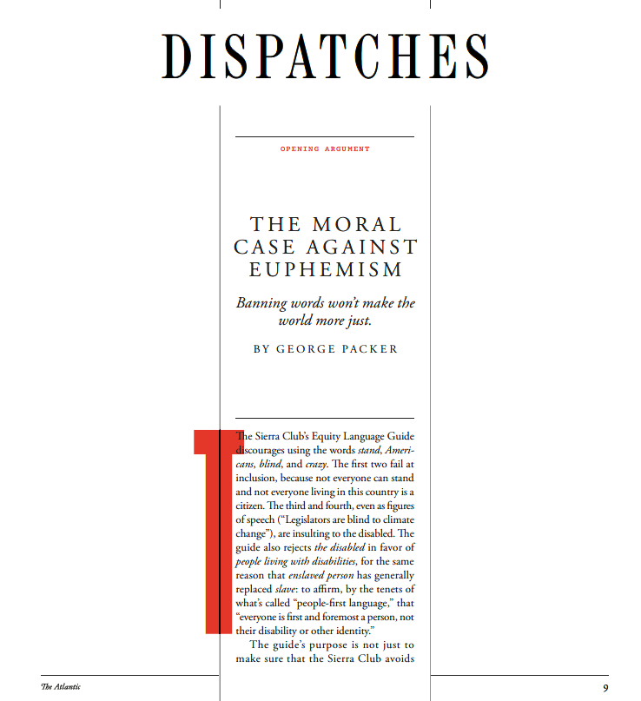
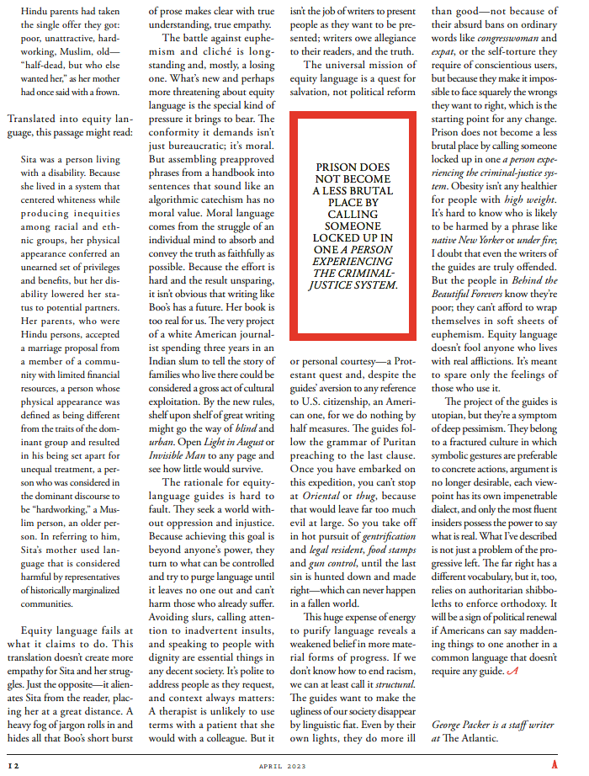
What to look for in popular articles
No Abstract
No Conclusion
No author credentials/affiliations
No Introduction
No References

Slide 7
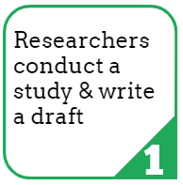
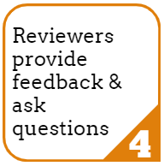
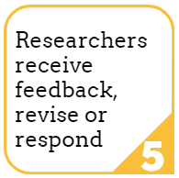
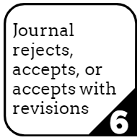
What is “peer review”
Peer review is a process for evaluating research studies before they are published by an academic journal. These studies typically communicate original research or analysis for other researchers.

Slide 8
Other types of research materials
Professional/Trade Sources: Trade publications are generally for practitioners. They are focused on a specific field but are not intended to be "scholarly". Rather, they communicate the news and trends in that field.
Books/Book Chapters: Many academic books will be edited by an expert or group of experts. Often, books are a good source for a thorough investigation of a topic. Unlike a scholarly article, which will usually focus on the results of one research project, a book is likely to include an overview of research or issues related to its topic.
Theses and Dissertations: Theses and dissertations are the result of an individual student's research while in a graduate program. They are written under the guidance and review of an academic committee but are not considered "peer-reviewed" or "refereed" publications.
Conference Proceedings: Conference proceedings are compilations of papers, research, and information presented at conferences. Proceedings are sometimes peer-reviewed and are often the first publication of research that later appears in a scholarly publication

Slide 9
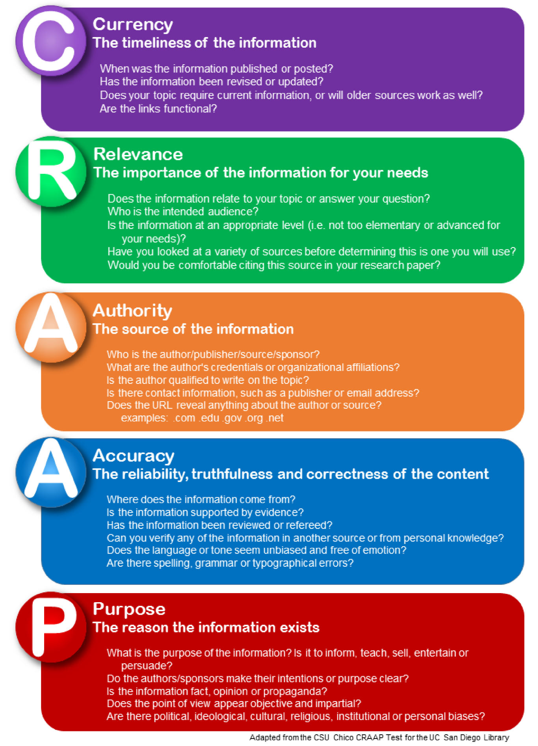
CRAAP Test

Slide 10
Ask a Librarian
Reference Desk:
920-923-8096
refdesk@marianuniversity.edu

