Slide 1
Business Databases: Research Articles
Sarah Thibodeau
srthibodeau64@marianuniversity.edu
920-923-8096

Slide 2
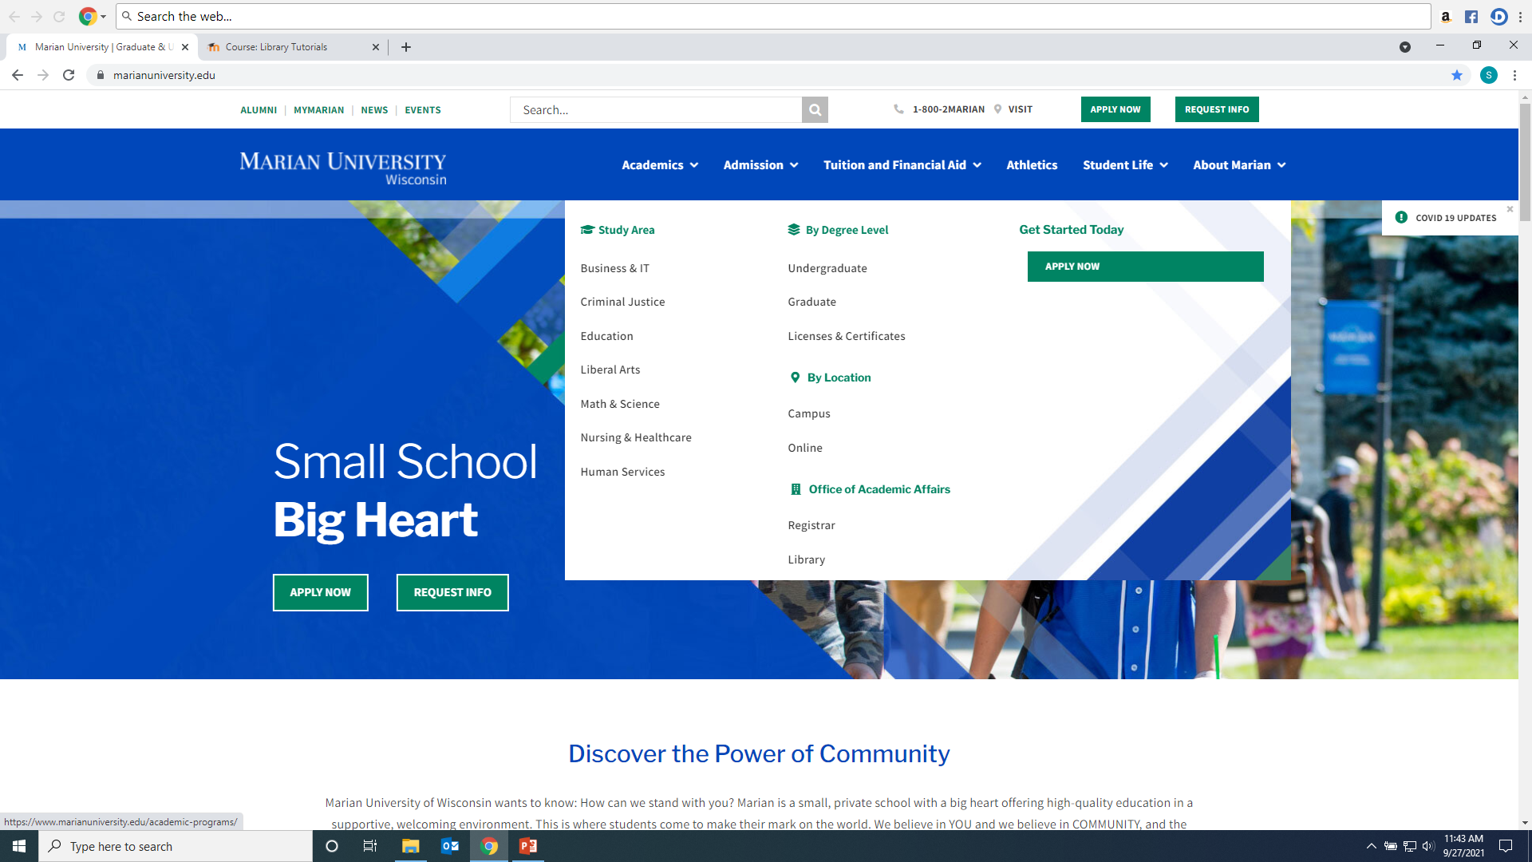
Click on Library from Marian website: https://www.marianuniversity.edu/

Slide 3
Scholarly/Peer-Reviewed Article vs. Popular Sources

Slide 4
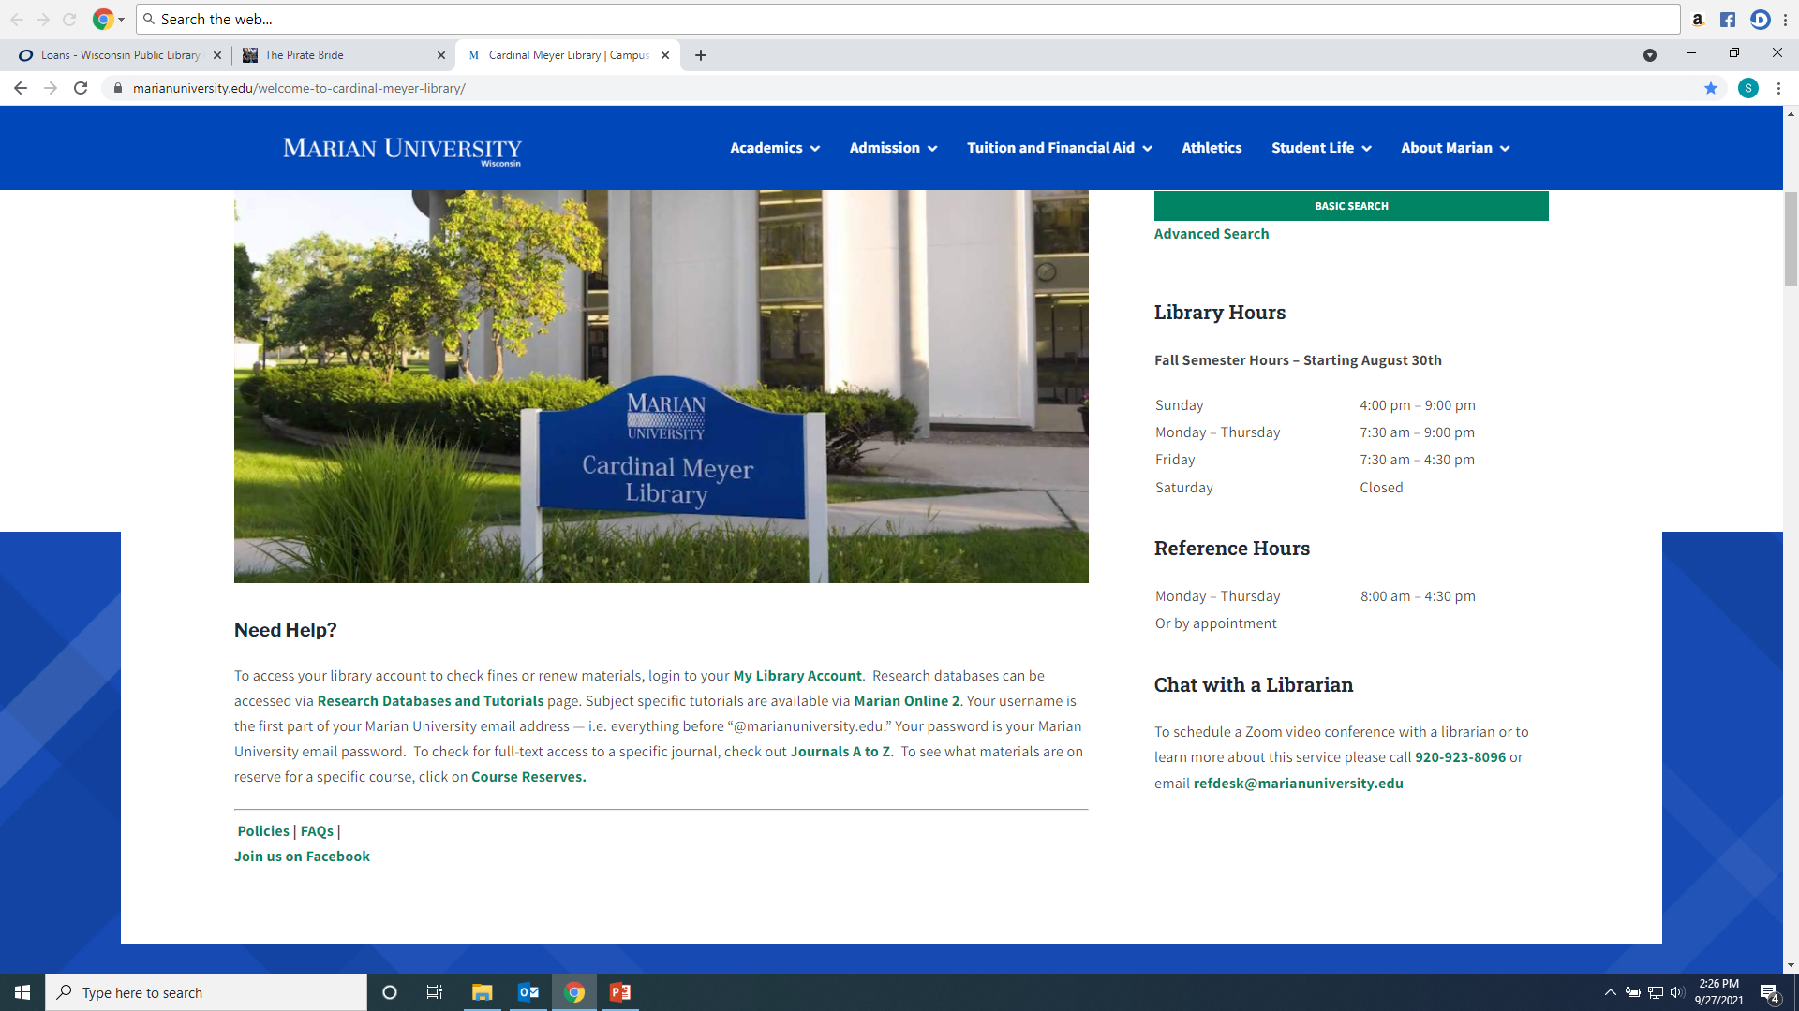
From the Library Home Page click on the “Research Databases and Tutorials” link.

Slide 5
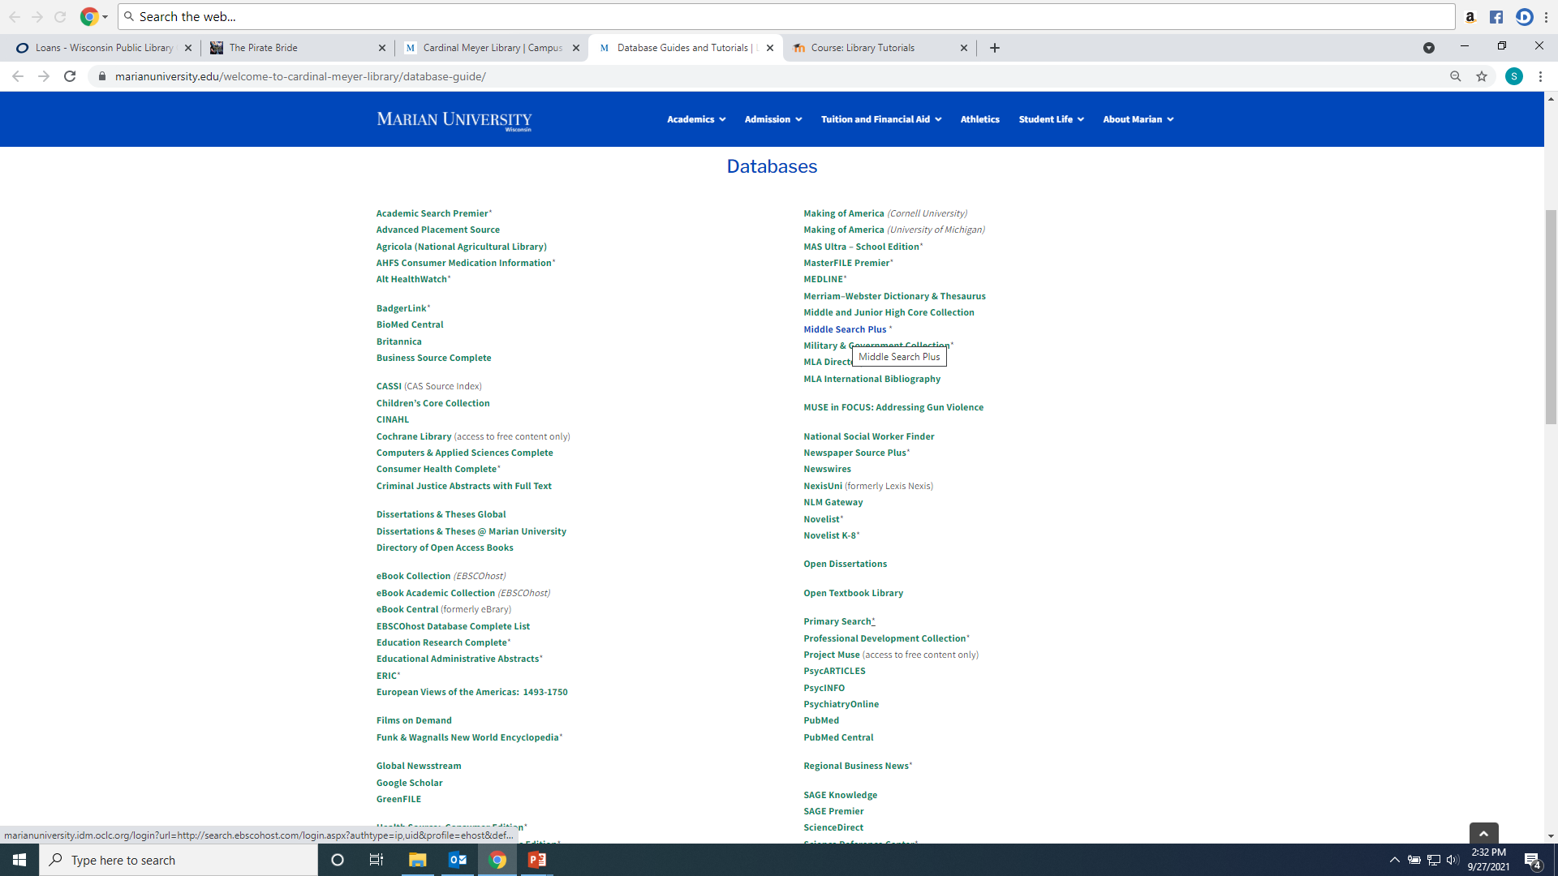
Recommended databases to search for Business research articles are: Business Source Complete, NexisUni, SAGE Premier, US Newstream, Global Newstream, and Academic Search Premier.

Slide 6
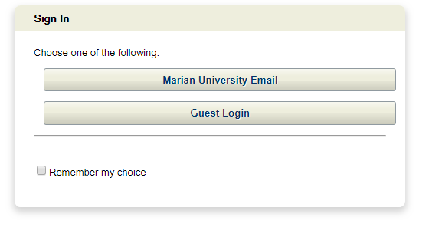
If you are accessing the databases from off-campus, you will be asked to login by clicking on the “Marian University Email” button. You must enter your full Marian Email and password”

Slide 7
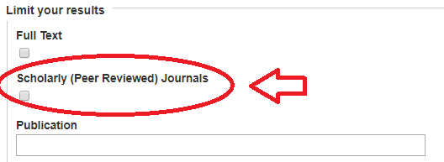
Searching Business Source Complete and Academic Search Premier Type keywords into boxes, make sure “Tx All Text” is used for keyword searching. For scholarly articles make sure the “Scholarly (Peer Reviewed) Journals” is checked

Slide 8
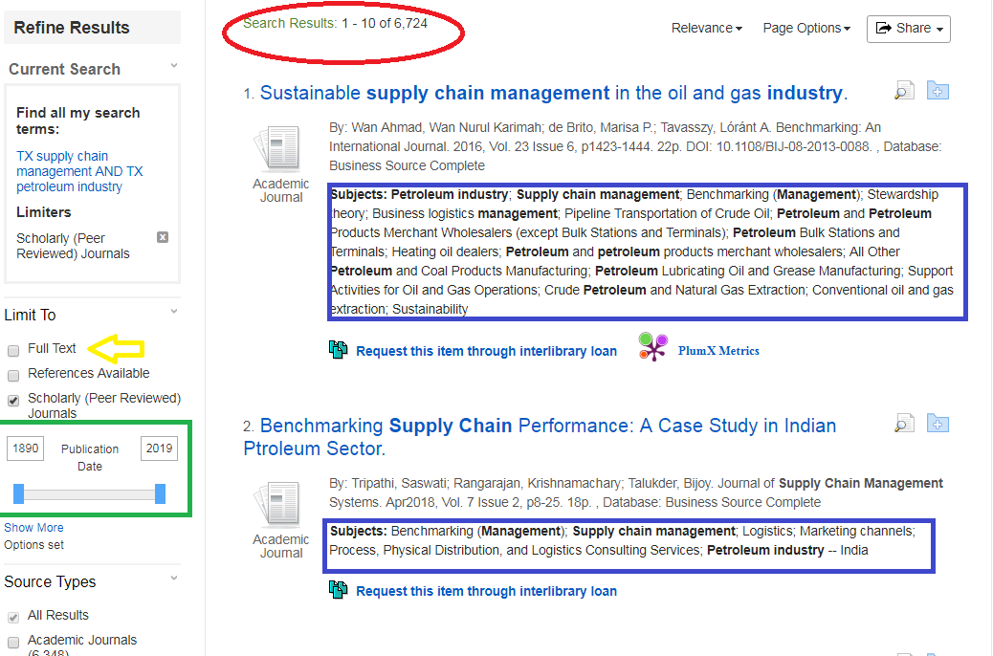
6,724 results. Check subject headings to discover more or better search words. Narrow down by clicking the Date Range or Full text:

Slide 9
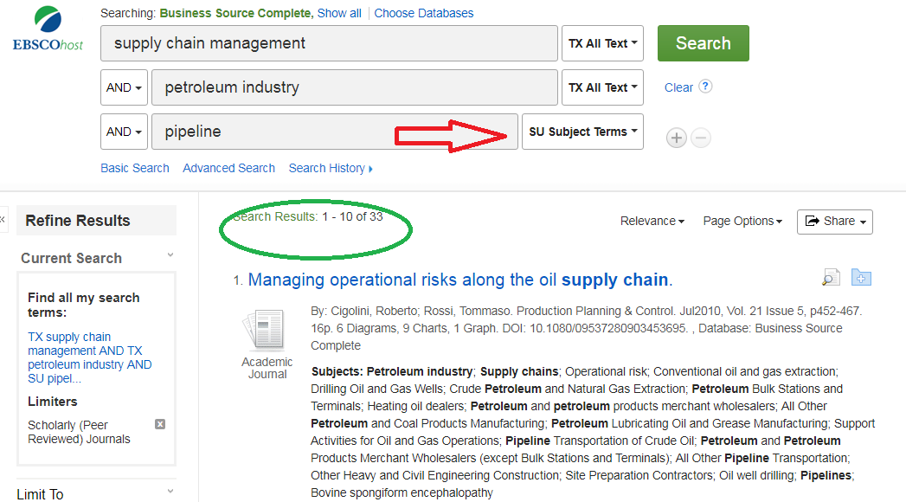
Narrow results more by adding more terms, requiring that they are Subjects…

Slide 10
AND narrows down and brings fewer results. OR adds synonyms or concepts and finds more results. Can be typed or as drop down arrow: example: supply chain management OR scm.

Slide 11
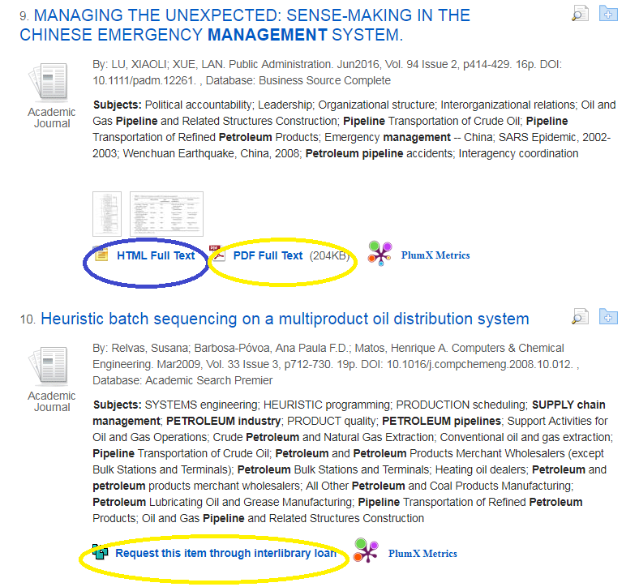
Look for PDF Full Text or HTML Full Text or Linked Full Text to open the article. If the citation does not have one of these three options, click Request through Interlibrary Loan (which will open a form that will request the library get the article from another library)

Slide 12
To Email, Save, Print or Cite (will give citation in format of your choosing) an article:

Slide 13
Nexis Uni includes:
Corporate information such as corporate officers and executives, financial data, SEC filings, and analyst reports
Legal cases
Scholarly and trade business articles, and business news
Legal reviews
Administrative regulations
Legislation

Slide 14
To find info on a specific company:

Slide 15
You can search by location, company name, industry, ticker symbol:

Slide 16
“Mercury Marine” exists as both a publically traded and privately held company:

Slide 17
Mercury Marine Private report. Private companies are not required to release as much information:

Slide 18
Mercury Marine Public report. Note the parent company has a link:

Slide 19
Find data, industry reviews, competitors, analysis…

Slide 20
Nexis Uni Help and Tips. Advanced search also may be easier:

Slide 21
Advanced Search. Click Add to create search. Use ! or * to find words beginning with those letters. Scroll down to click “Search” button.

Slide 22
The original search can be narrowed by adding additional terms, by document type, subject, topic, time period…

Slide 23
Save individual results, print, email, download…

Slide 24
Law review article example. Journal title:

Slide 25
Nexis Uni law cases:

Slide 26
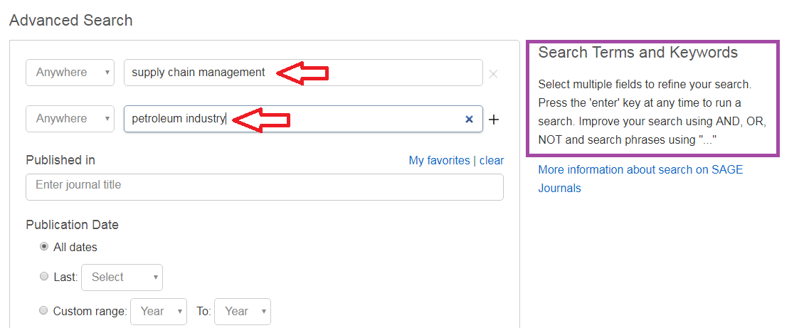
Searching SAGE Premier: Enter Keywords into search boxes; use Boolean Operators And, Or, Not to refine your search

Slide 27
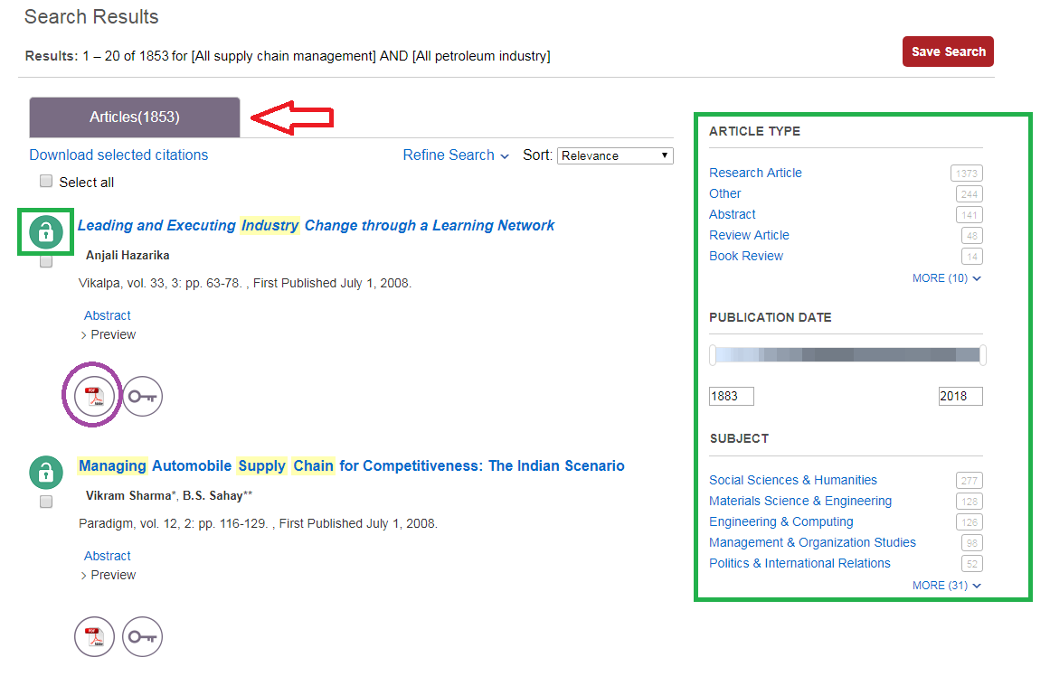
Results with be in at the top (1853). Use the Limiters on the left to narrow your search. The open lock means Marian has the article full text; the closed lock means the article is not full text and may need to be Interlibrary Loaned. Click on either the HTML or PDF full text option to open the article.

Slide 28
To find citation information for an article in the appropriate format click the “Cite” icon

Slide 29
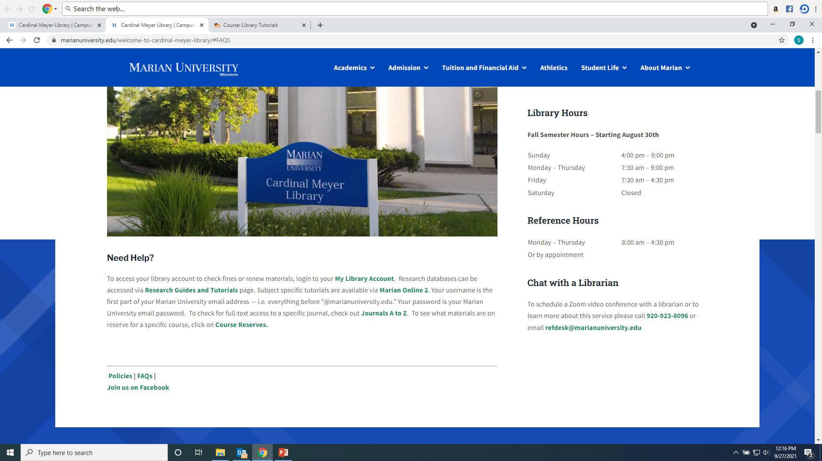
Any Questions? Ask a library staff member!

