Slide 1
Business Databases: Research Articles
Sarah Thibodeau
srthibodeau64@marianuniversity.edu
920-923-8096

Slide 2
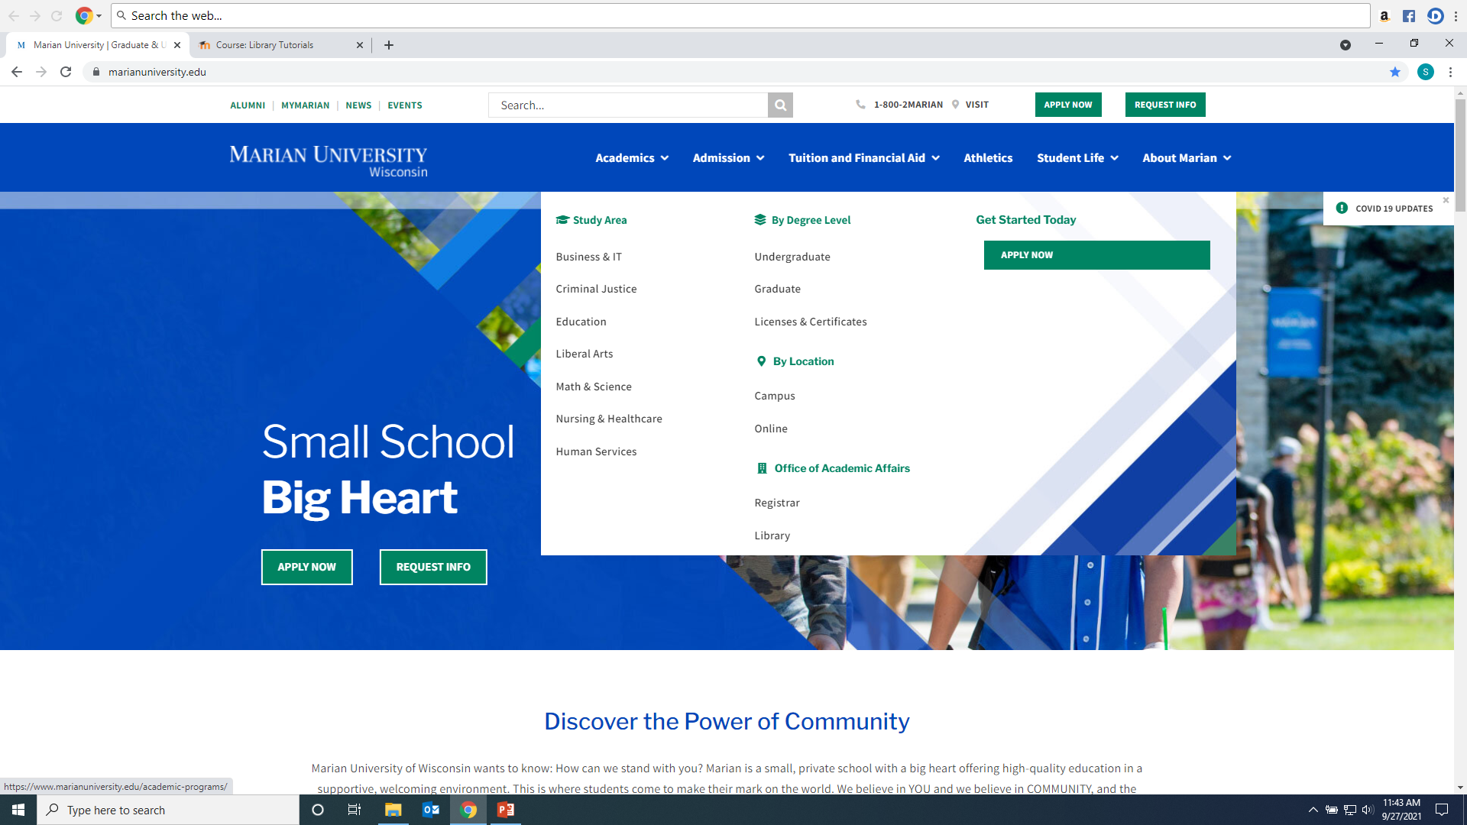
Click on Library from Marian website: https://www.marianuniversity.edu/

Slide 3
Scholarly/Peer-Reviewed Article vs. Popular Sources

Slide 4
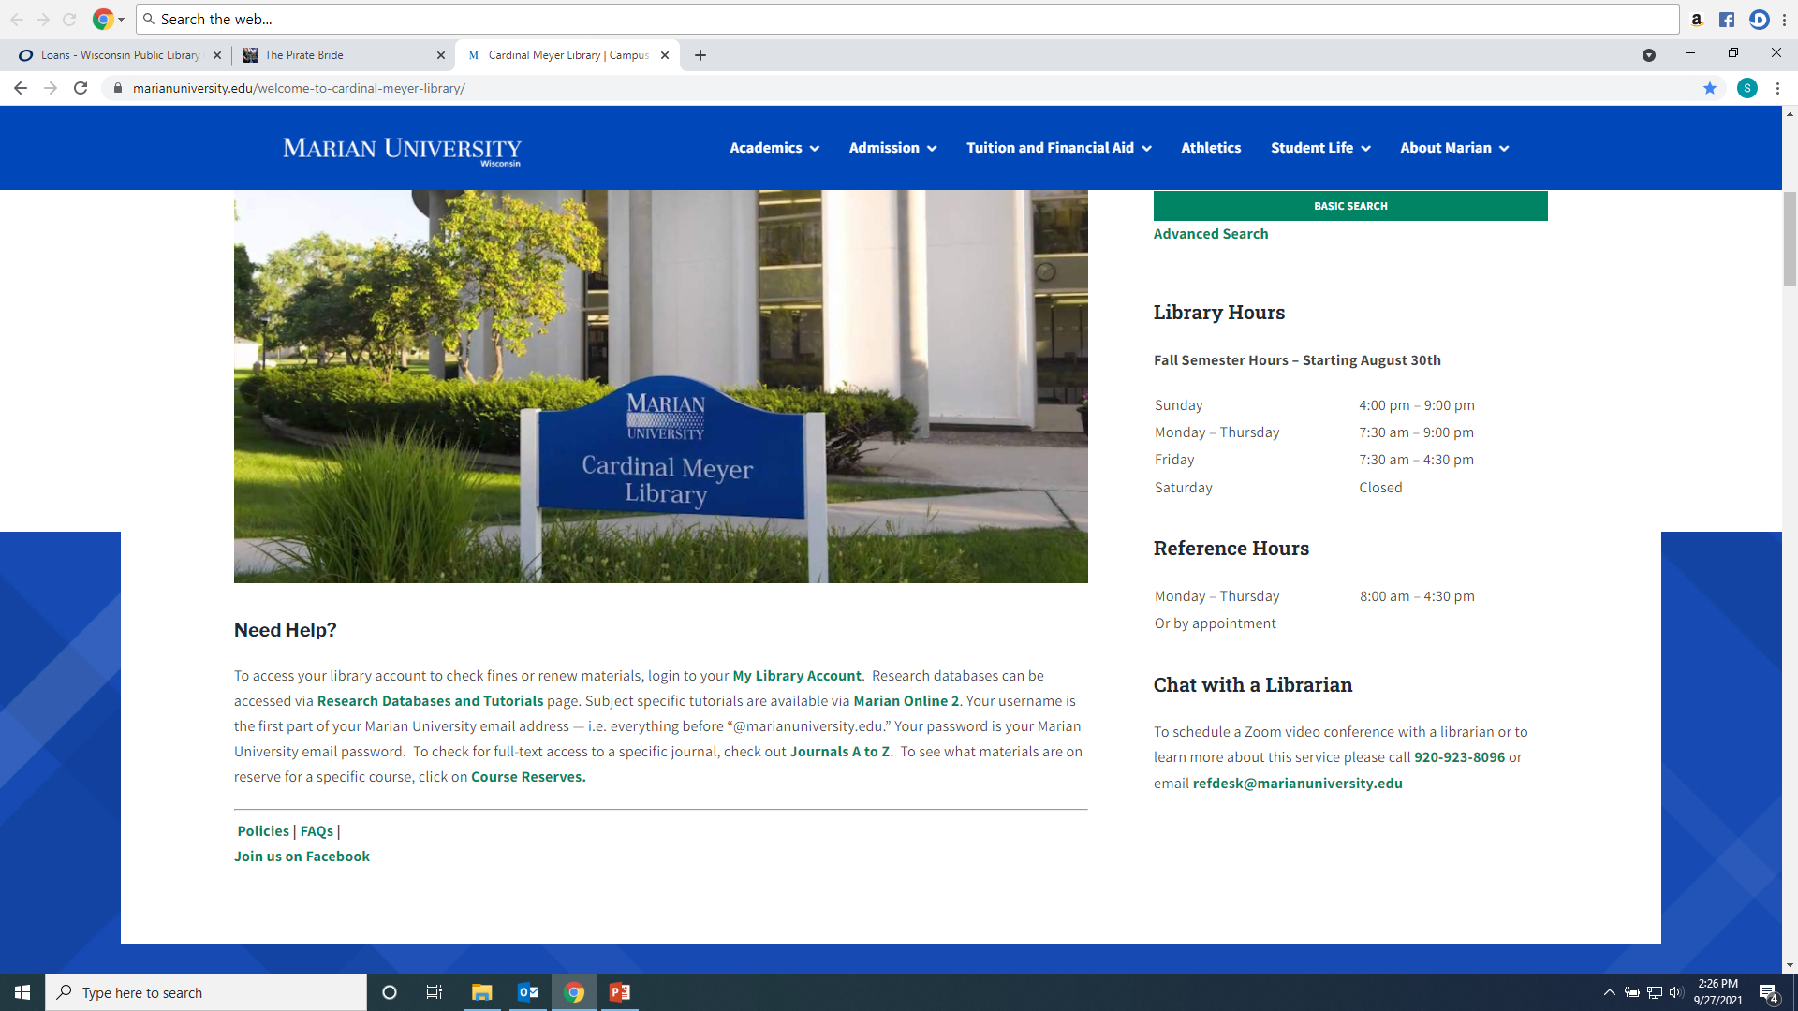
From the Library Home Page click on the “Research Databases and Tutorials” link.

Slide 5
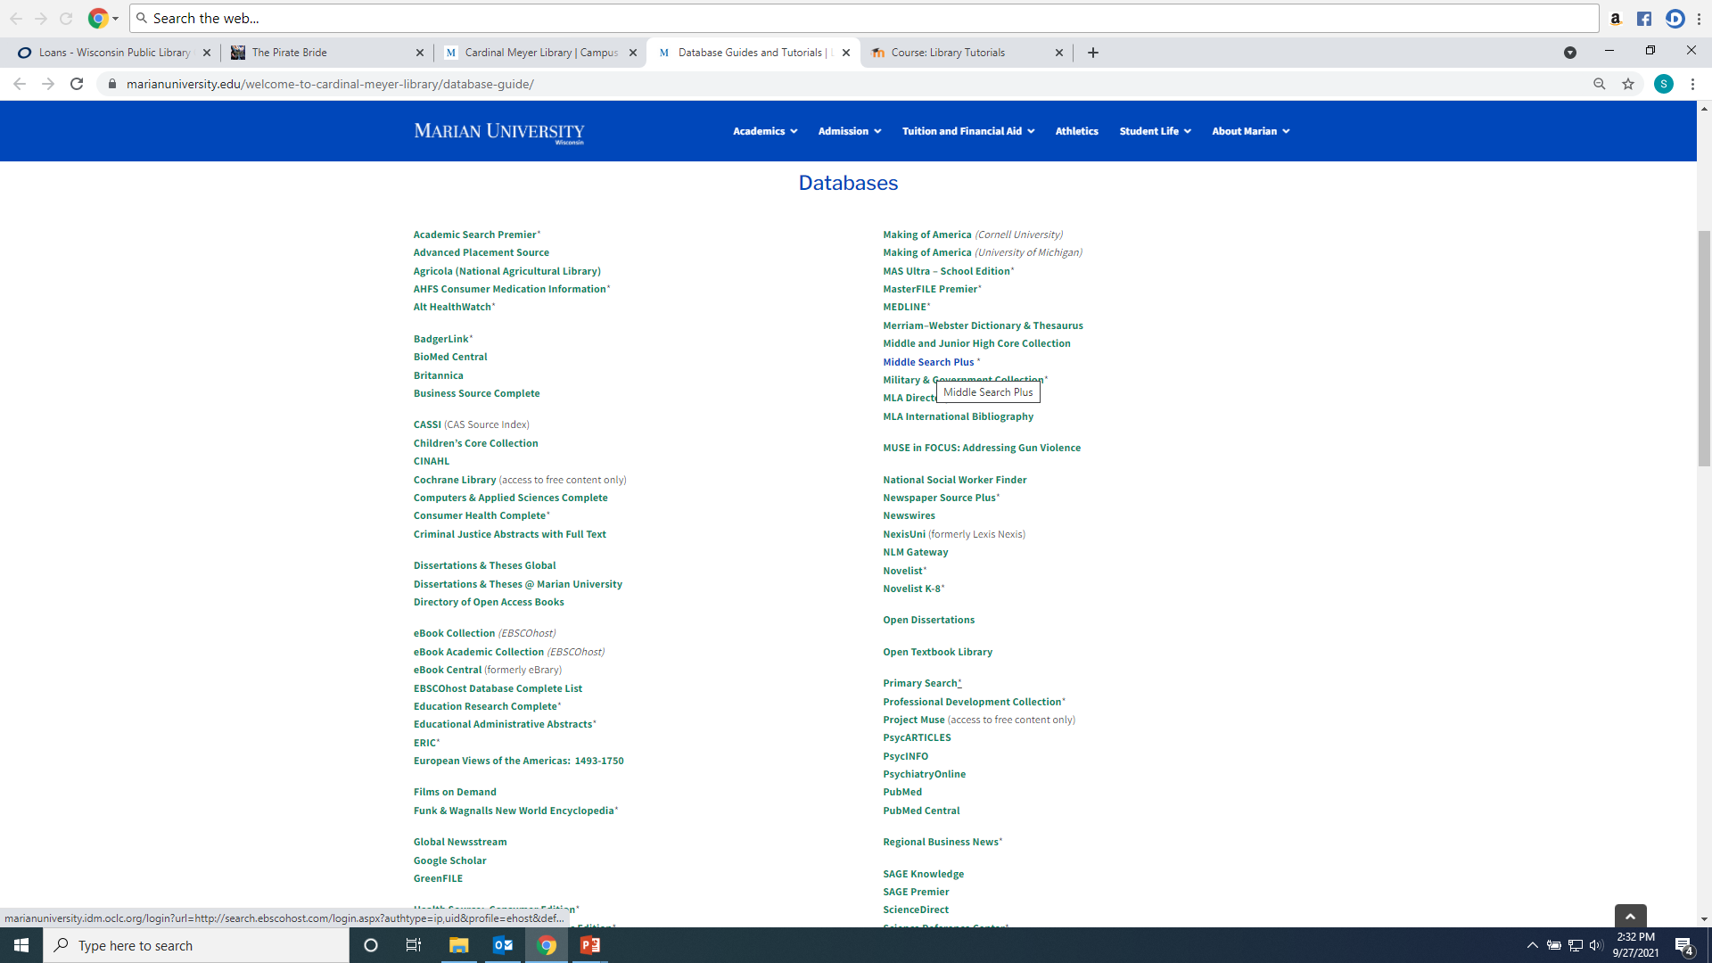
Recommended databases to search for Business research articles are: Business Source Complete, NexisUni, SAGE Premier, US Newstream, Global Newstream, and Academic Search Premier.

Slide 6
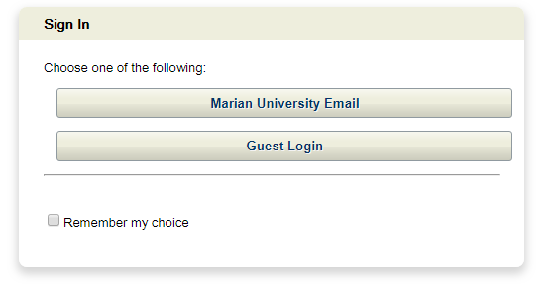
If you are accessing the databases from off-campus, you will be asked to login by clicking on the “Marian University Email” button. You must enter your full Marian Email and password”

Slide 7
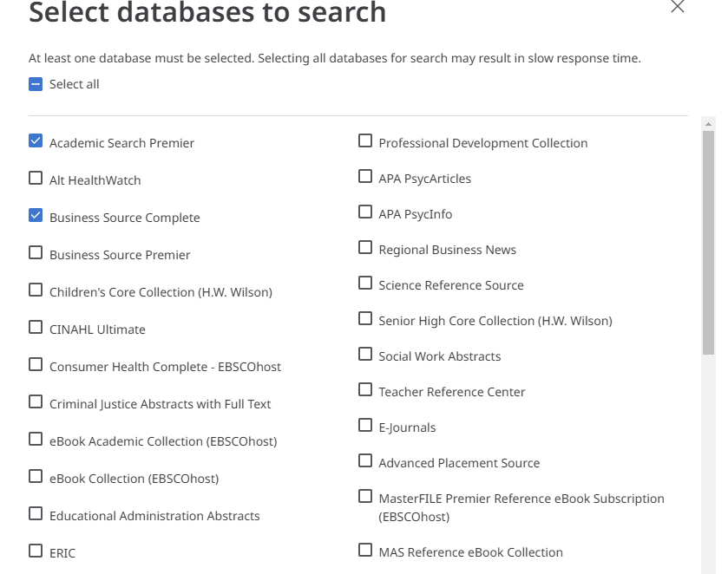
Searching Business Source Complete and Academic Search Premier at the same time by clicking on name of database, then choose as many resources to search in Ebscohost.

Slide 8
Enter keywords into the search boxes and select “All Text” for each box terms are entered into

Slide 9
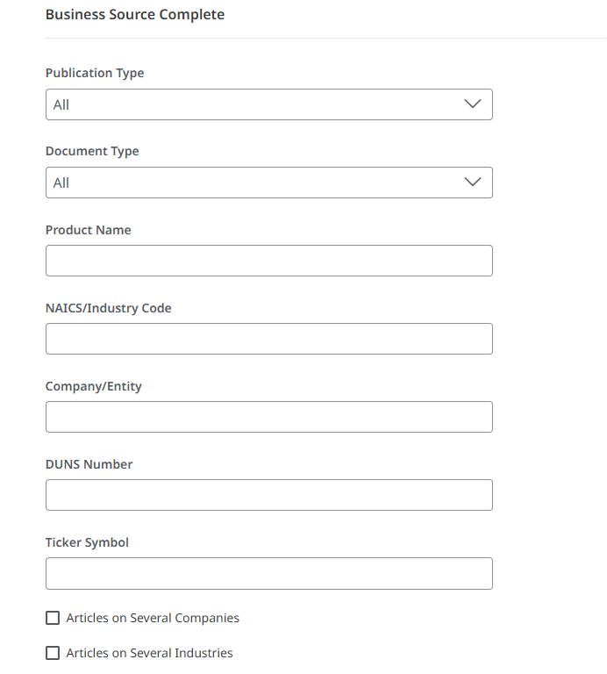
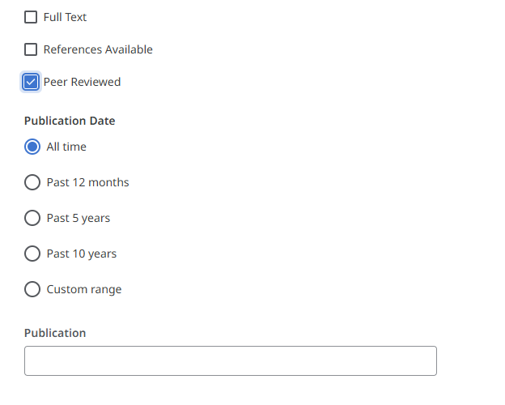
Add Filters to your search: For example “Peer Reviewed” will limit to only academic research journals. Add company/product names, document types, etc. These will vary by database.

Slide 10
When reviewing your result lists, you should read an article's abstract (summary) to determine its use. You can also generate keywords for your article searches using the subject headings or keywords listed in the citation.

Slide 11
You will have three types of article access options in Ebscohost resources. Click the “Access Options” drop-down menu to see what is available for each article. They are PDF, Online Full Text, or a link to an outside open-access source. If you see “Request this item through Interlibrary Loan” the library can request the article from another institution at no cost to the student.

Slide 12
Articles can be printed, downloaded, and shared. On the top right of a full text article you will see a tool bar for these features.

Slide 13
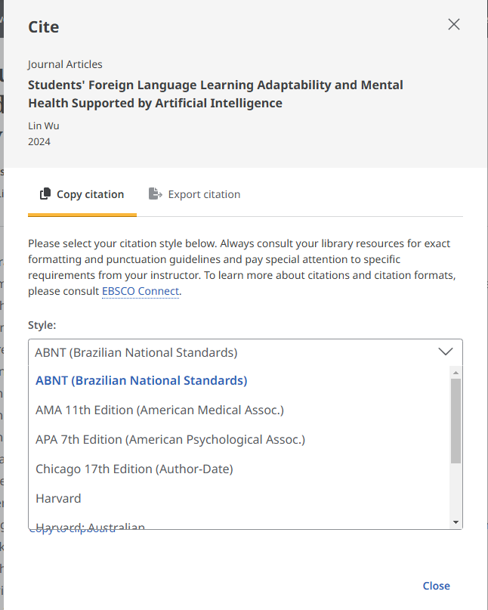
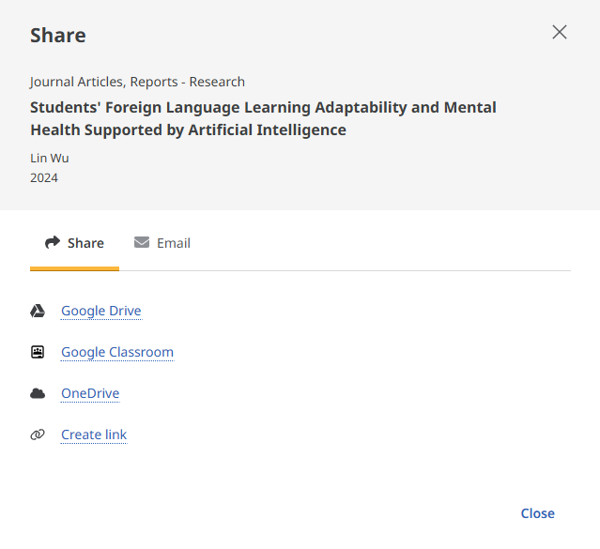
Articles can be shared via a permanent link or email. If a professor requests a link to an article posted on MO2 use the “Create Link” option. Citations is various formats can be created for each article by using the “quote” marks on top right menu bar.

Slide 14
Nexis Uni includes:
Corporate information such as corporate officers and executives, financial data, SEC filings, and analyst reports
Legal cases
Scholarly and trade business articles, and business news
Legal reviews
Administrative regulations
Legislation

Slide 15
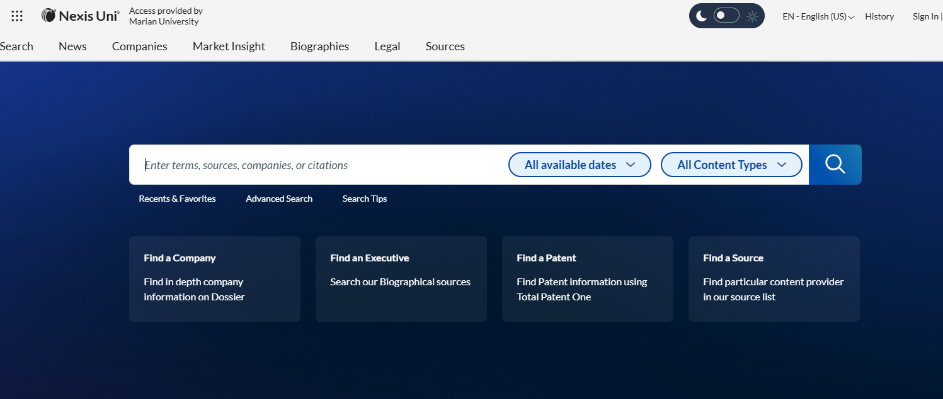
To find info on a specific company:

Slide 16
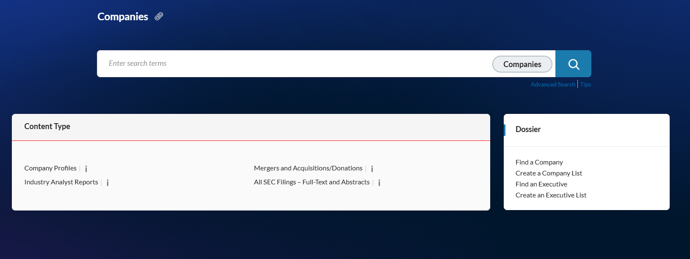
You can search by location, company name, industry, ticker symbol, executive name to find articles, news and legal information about company. You can also use Find a Company under Dossier to find company information, sec filings, mergers and acquisitions, legal, intellectual property, etc.

Slide 17
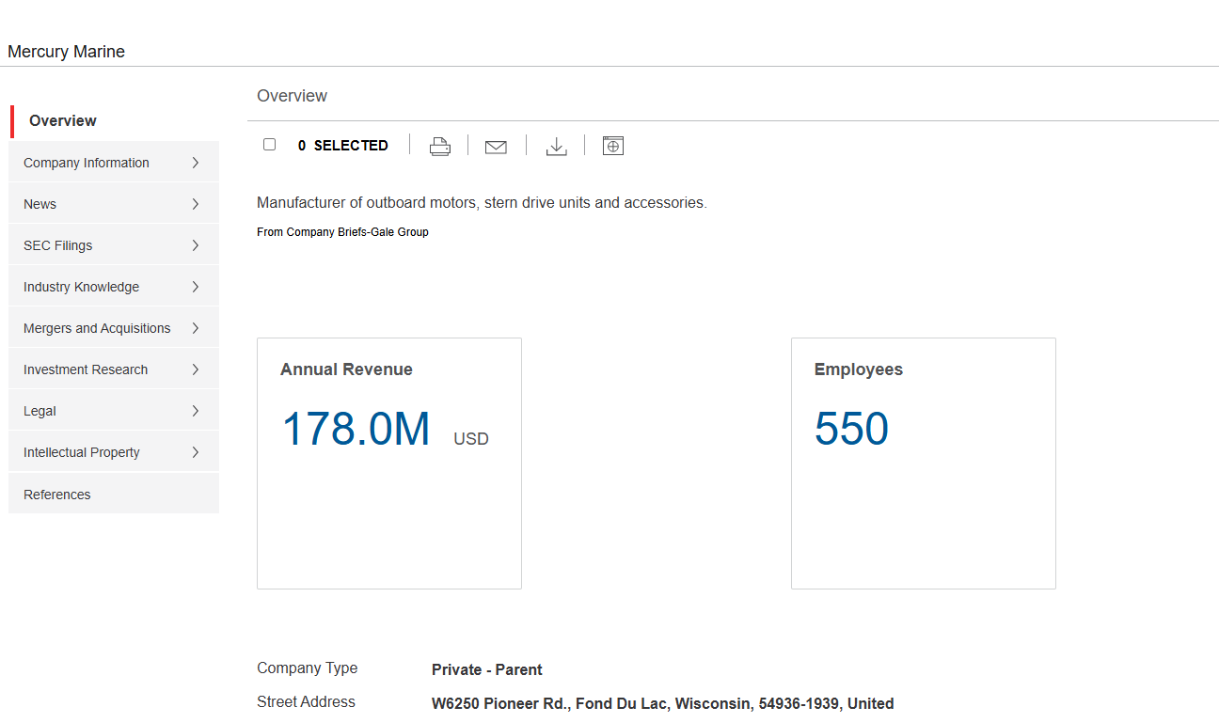
“Mercury Marine” example Dossier:

Slide 18
Nexis Uni Help and Tips. Advanced search also may be easier:

Slide 19
Advanced Search. Click Add to create search. Use ! or * to find words beginning with those letters. Scroll down to click “Search” button.

Slide 20
The original search can be narrowed by adding additional terms, by document type, subject, topic, time period…

Slide 21
Save individual results, print, email, download…

Slide 22
Law review article example. Journal title:

Slide 23
Nexis Uni law cases:

Slide 24
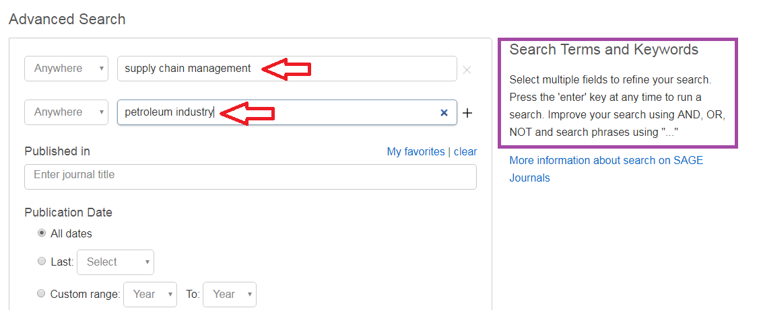
Searching SAGE Premier: Enter Keywords into search boxes; use Boolean Operators And, Or, Not to refine your search

Slide 25
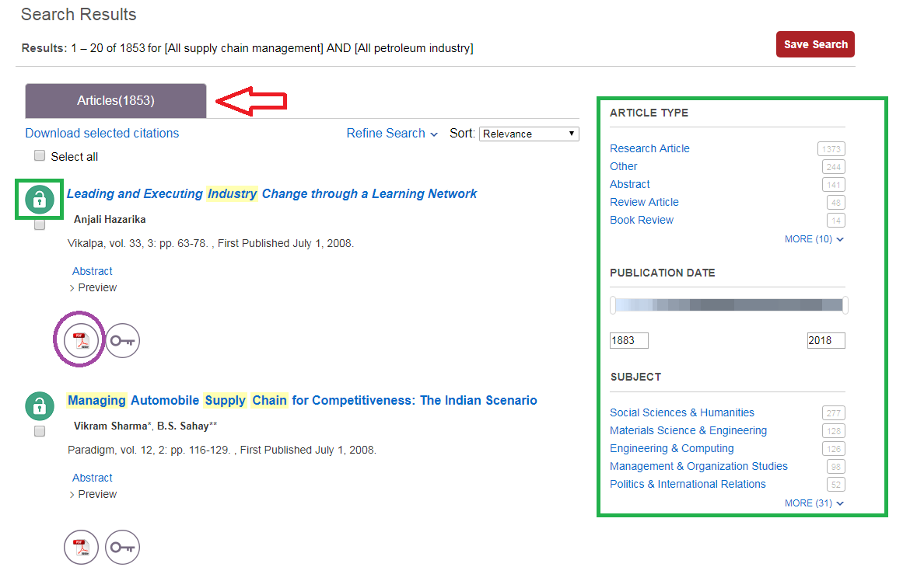
Results with be in at the top (1853). Use the Limiters on the left to narrow your search. The open lock means Marian has the article full text; the closed lock means the article is not full text and may need to be Interlibrary Loaned. Click on either the HTML or PDF full text option to open the article.

Slide 26
To find citation information for an article in the appropriate format click the “Cite” icon

Slide 27
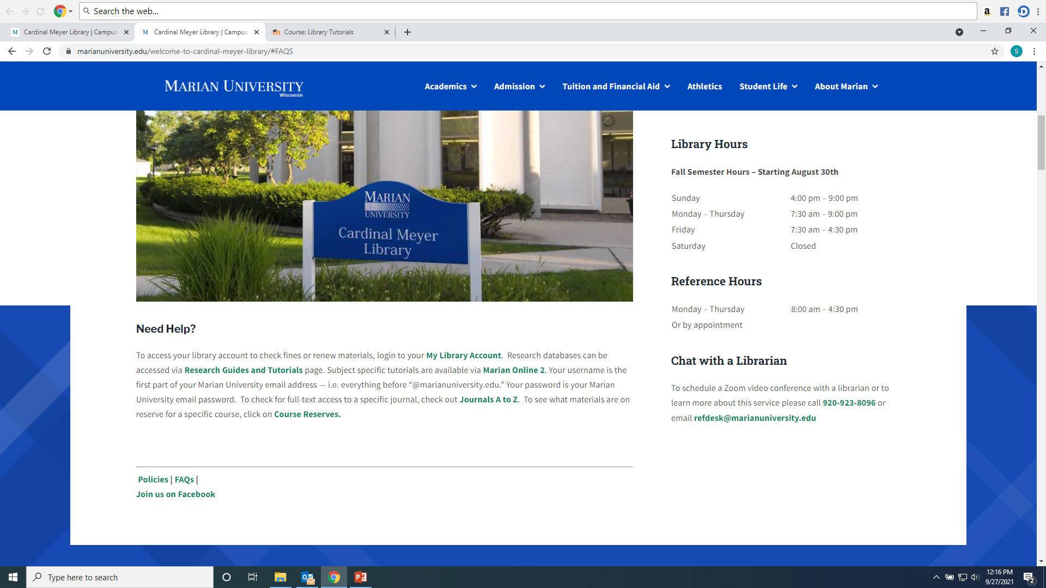
Any Questions? Ask a library staff member!

