Slide 1
Psychology Databases: Research Articles
Sarah Thibodeau
srthibodeau64@marianuniversity.edu
920-923-8096

Slide 2
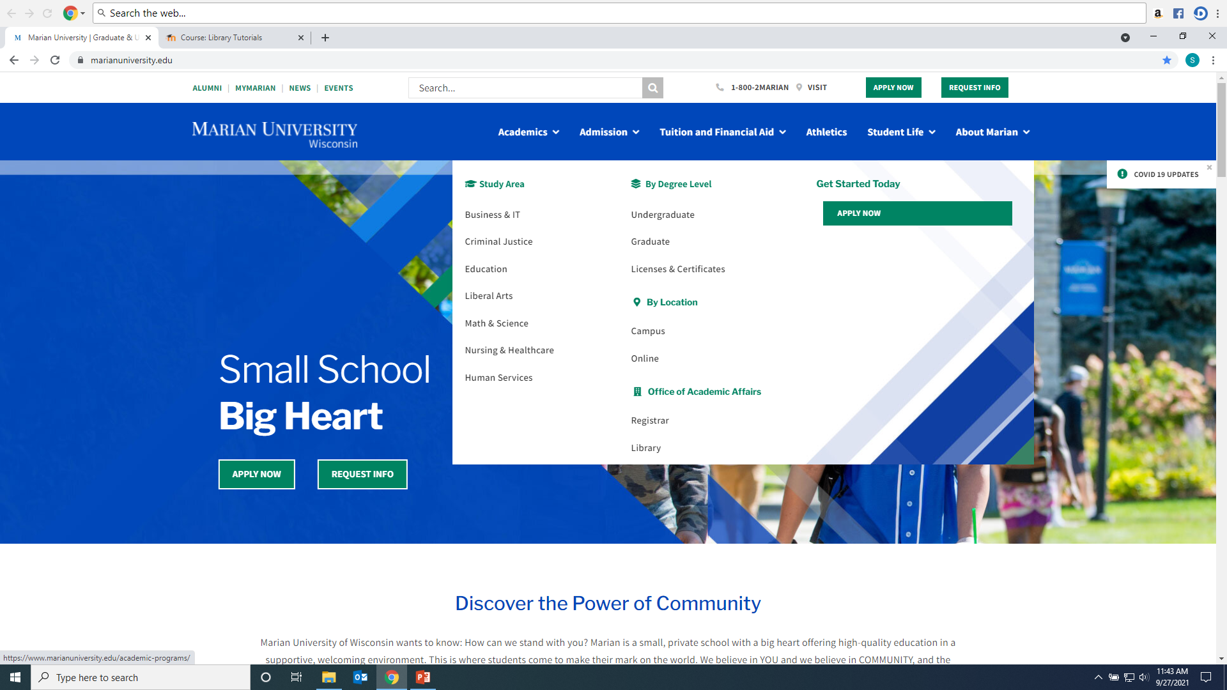
Click on Library from Marian website: https://www.marianuniversity.edu/

Slide 3
From MyMarian, click on Library: https://my.marianuniversity.edu/SitePages/Home.aspx

Slide 4
Scholarly/Peer-Reviewed Article vs. Popular Sources

Slide 5
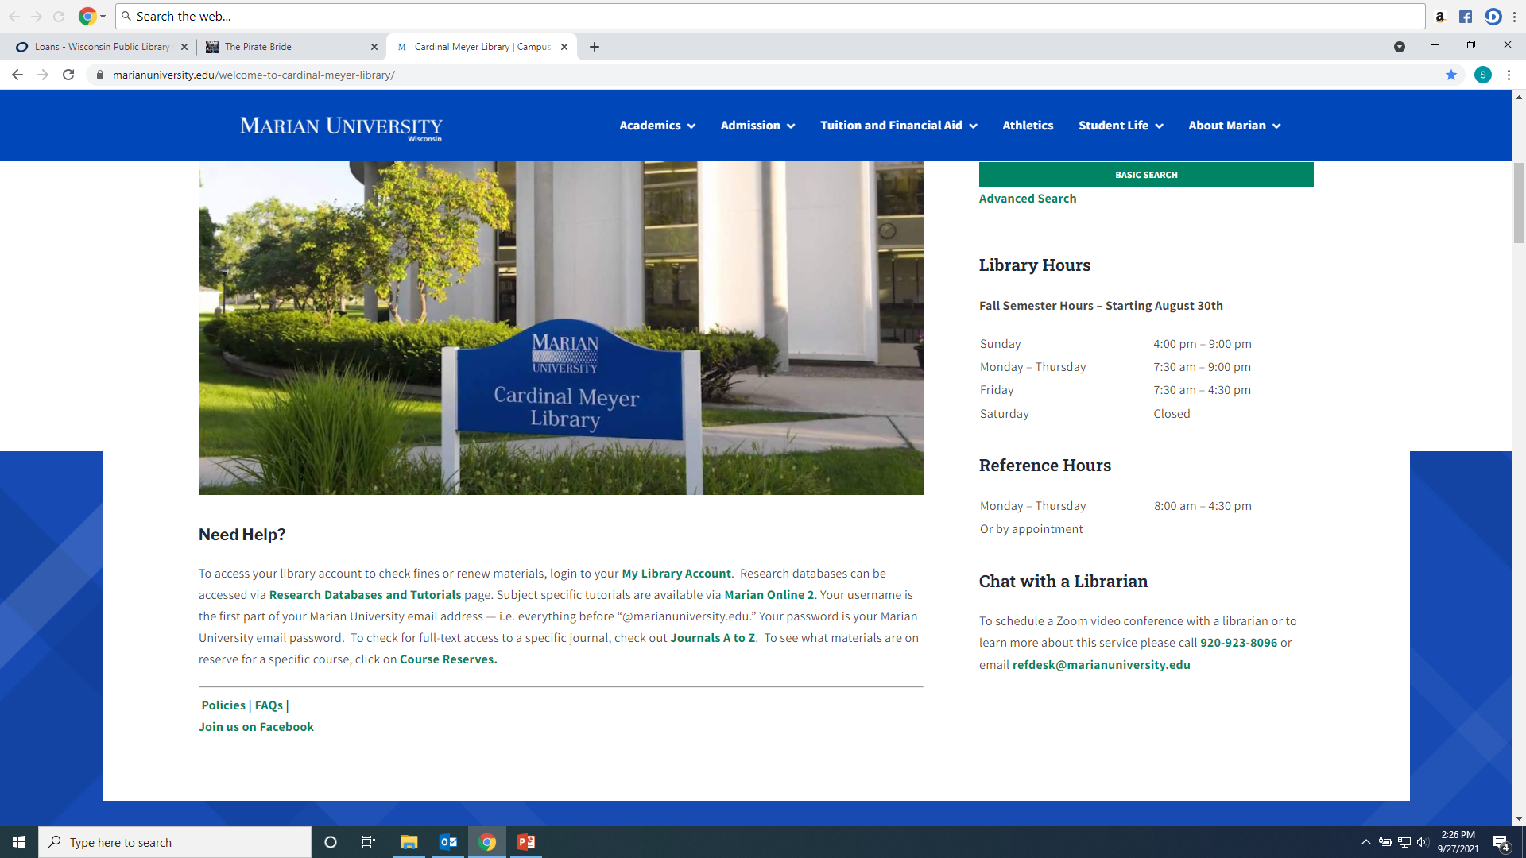
From the Library Home Page click on the “Databases” link on the left hand menu

Slide 6
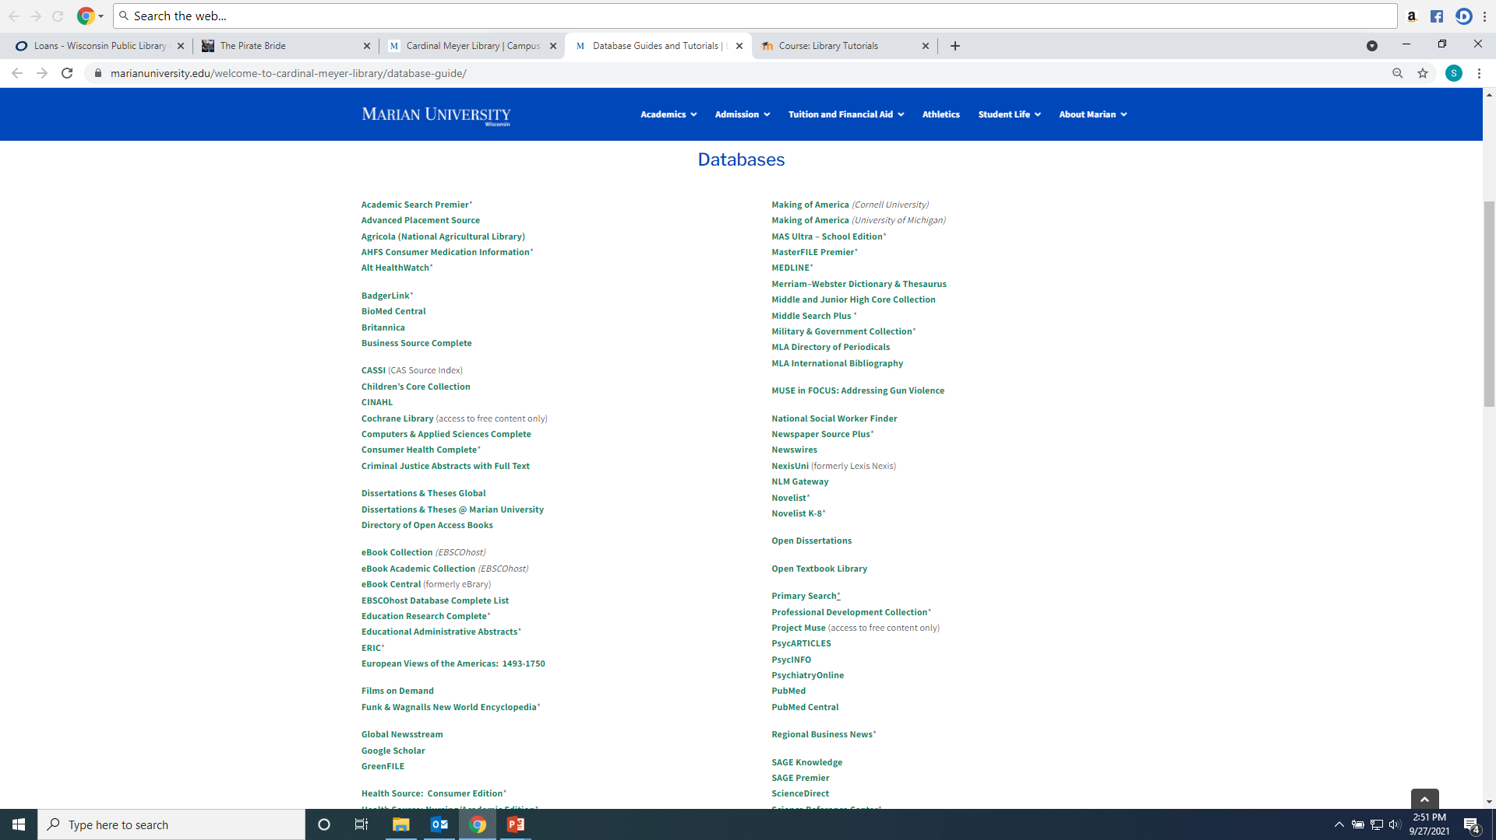
Recommended databases to search for Psychology research articles are: PsycINFO, PsycARTICLES, SAGE Premier, and Academic Search Premier, and Psychiartry Online (which has the DSM ebook).

Slide 7
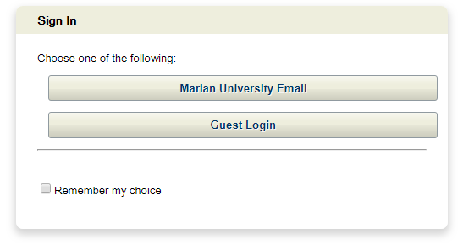
If you are accessing the databases from off-campus, you will be asked to login by clicking on the “Marian University Email” button. You must enter your full Marian Email and password”

Slide 8
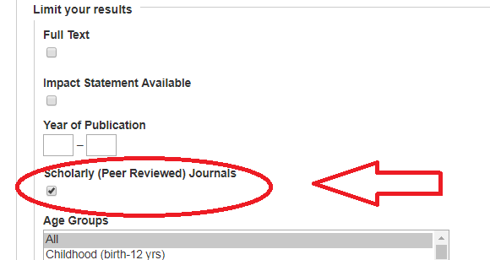
Searching PsycINFO, PsycARTICLES, and Academic Search Premier Type keywords into boxes, make sure “Tx All Text” is used for keyword searching. For scholarly articles make sure the “Scholarly (Peer Reviewed) Journals” is checked

Slide 9
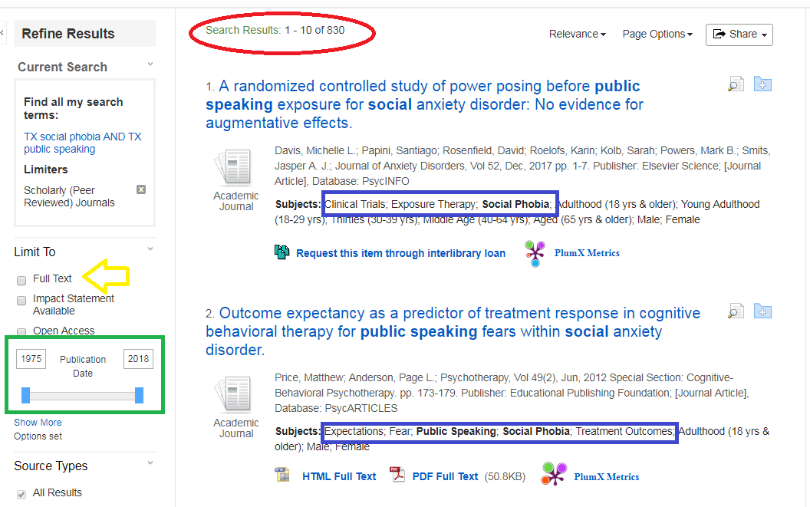
830 results. Check subject headings to discover more or better search words. Narrow down by clicking the Date Range or Full text:

Slide 10
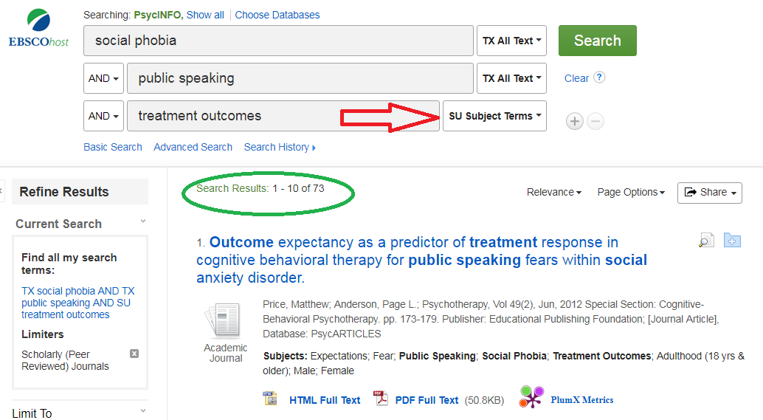
Narrow results more by adding more terms, requiring that they are Subjects…

Slide 11
AND narrows down and brings fewer results. OR adds synonyms or concepts and finds more results. Can be typed or as drop down arrow: example: social phobia OR social anxiety.

Slide 12
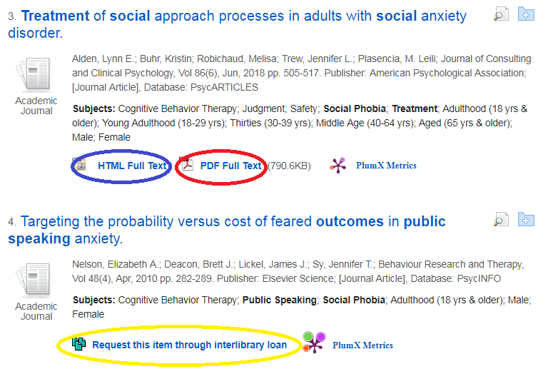
Look for PDF Full Text or HTML Full Text or Linked Full Text to open the article. If the citation does not have one of these three options, click Request through Interlibrary Loan (which will open a form that will request the library get the article from another library)

Slide 13
To Email, Save, Print or Cite (will give citation in format of your choosing) an article:

Slide 14
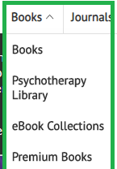
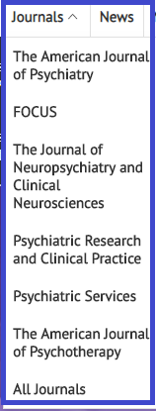
Searching Psychiartry Online You have three options of browsing the collection: the DSM Library, Books, and Journals

Slide 15
Advanced Keyword Search: enter terms into boxes; you can use Boolean Operators to narrow your search.

Slide 16
Number of Results will display at the top of the result page; if an article has an open lock it is full text, if it has a closed lock it is not full text and may need to be Interlibrary Loaned; you can narrow your results by using the Limiters: author, keyword, publication, and topics.

Slide 17
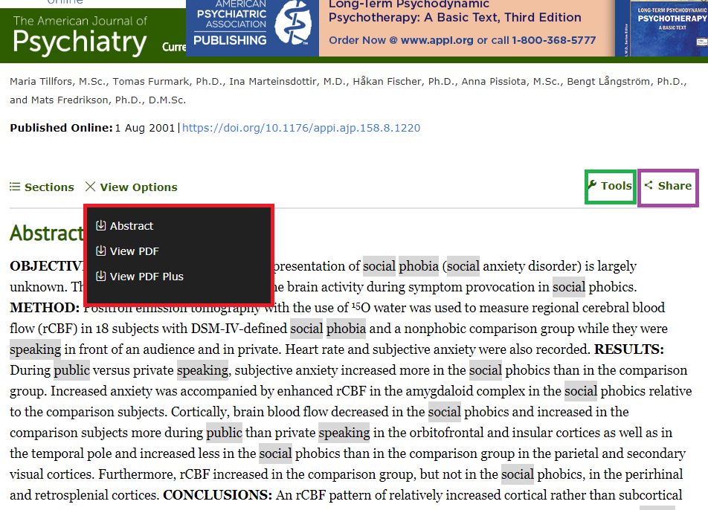
To download a PDF Full Text of an article or book chapter, click on “View Options”; to email the article click “Share”; to cite the article click “Tools”

Slide 18
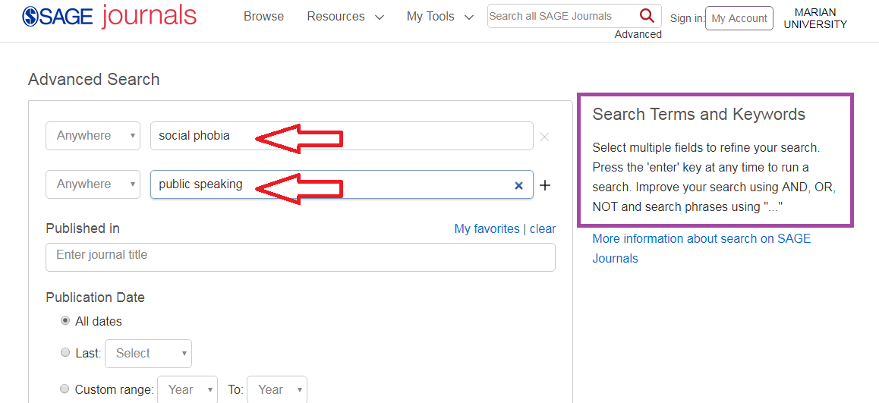
Searching SAGE Premier: Enter Keywords into search boxes; use Boolean Operators And, Or, Not to refine your search

Slide 19
Results with be in at the top (2927). Use the Limiters on the left to narrow your search. The open lock means Marian has the article full text; the closed lock means the article is not full text and may need to be Interlibrary Loaned. Click on either the HTML or PDF full text option to open the article.

Slide 20
To find citation information for an article in the appropriate format click the “Cite” icon

Slide 21
Any Questions? Ask a library staff member!

Slide 22
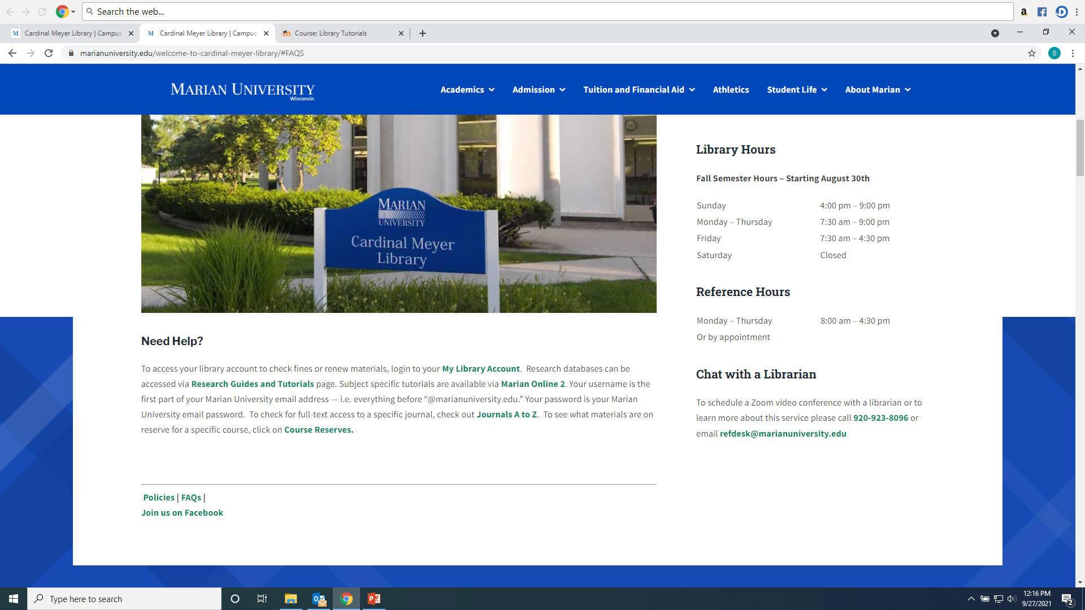
Any Questions? Ask a library staff member!

