Slide 1
How to research in Social Work
Cardinal Meyer Library
Marian University

Slide 2
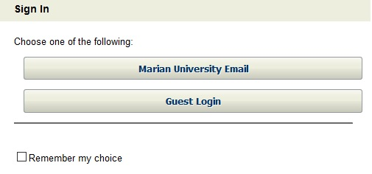
Off Campus Access
To access databases from home, users must click on Marian University Email and then enter their email and Marian password:

Slide 3
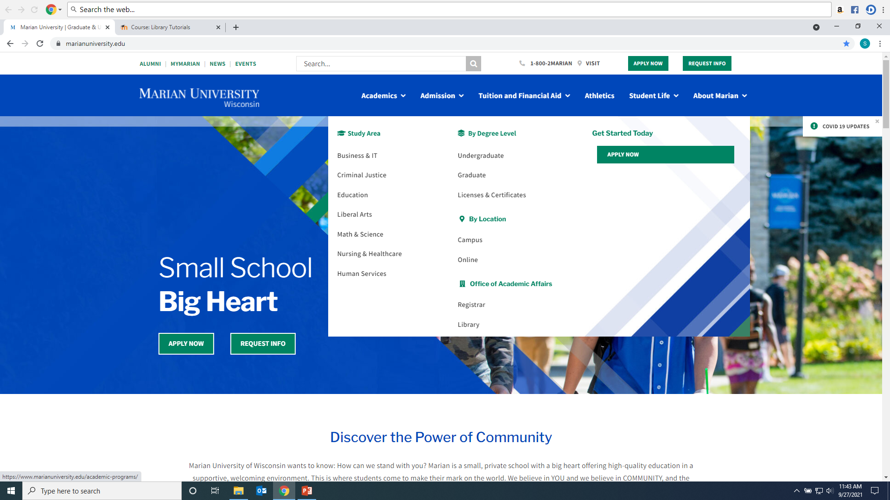
Click on Library from Marian website:

Slide 4
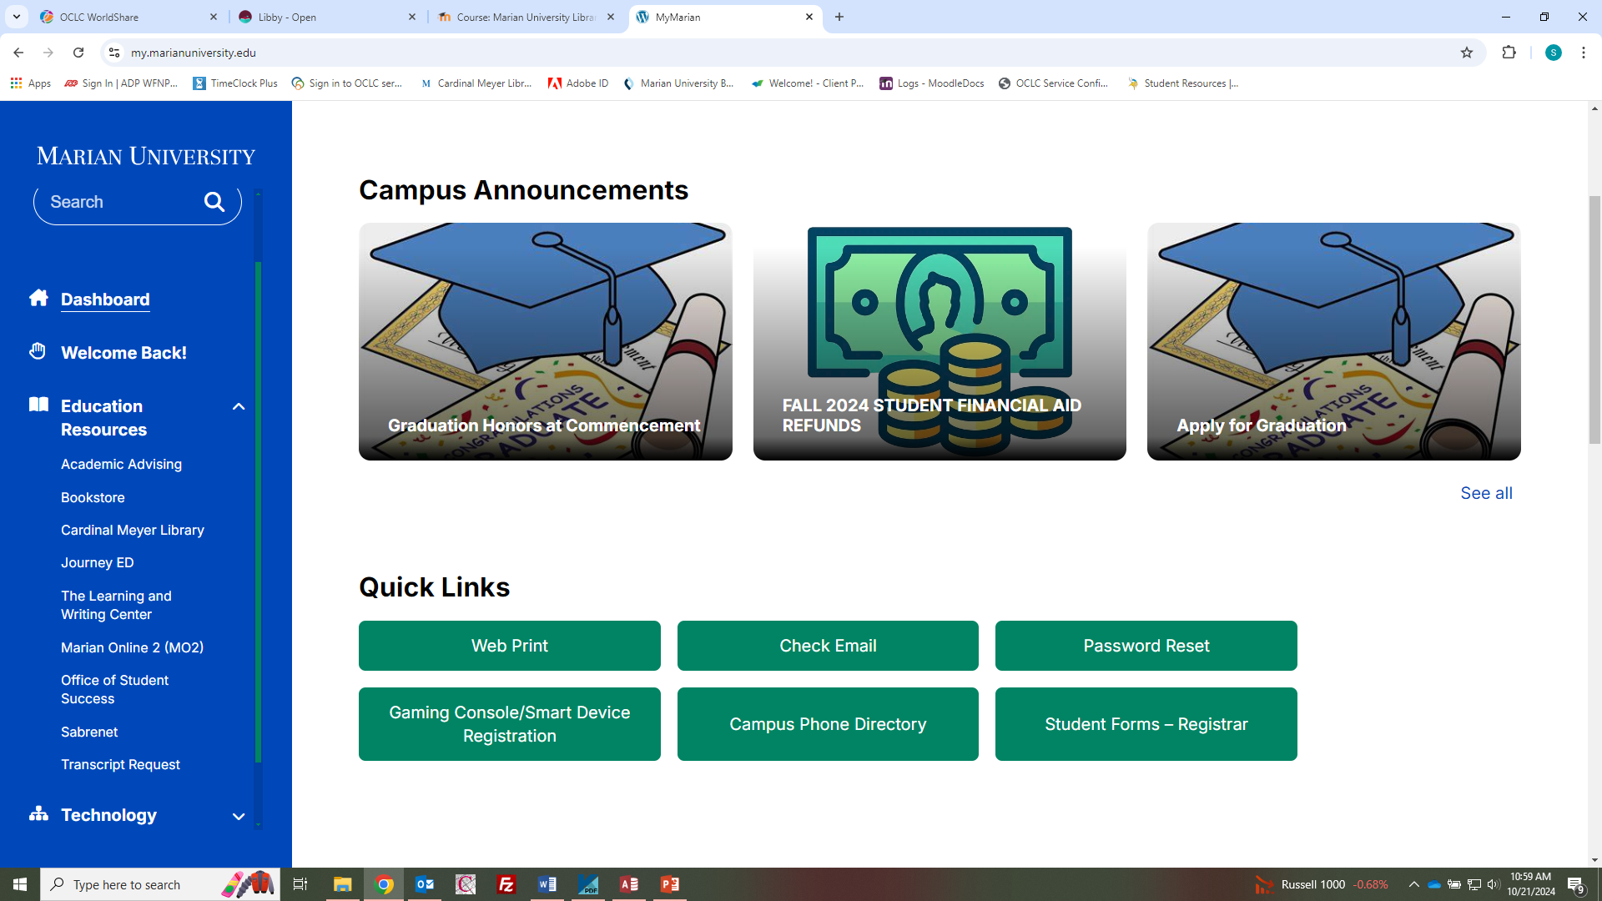
From MyMarian, click on Library:

Slide 5
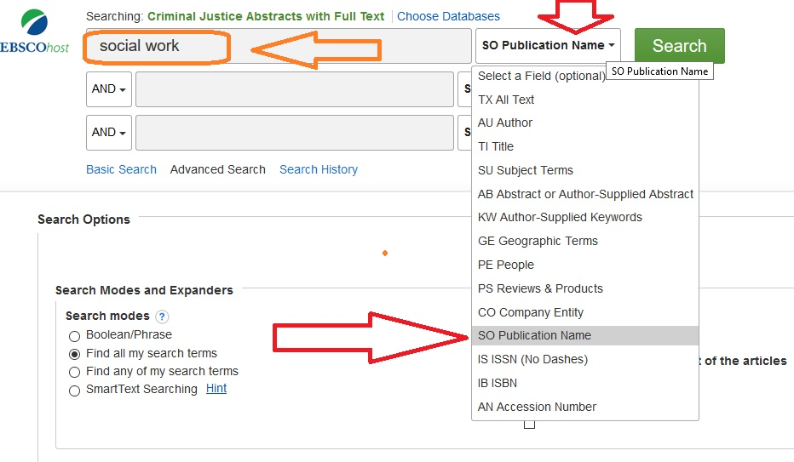
Finding Full Text Issues
Type journal name (“Social Work”) in the search box
Use the drop down to choose SOURCE

Slide 6
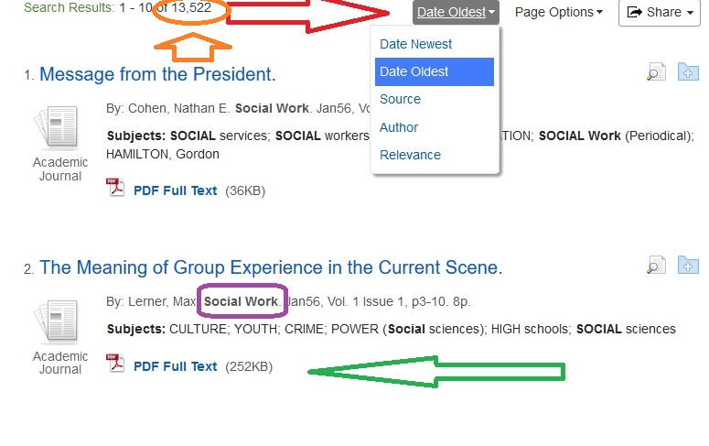
“Social Work” articles
13522 articles found
Use drop down to sort by date, source, relevance…
Click on PDF or HTML to read article

Slide 7
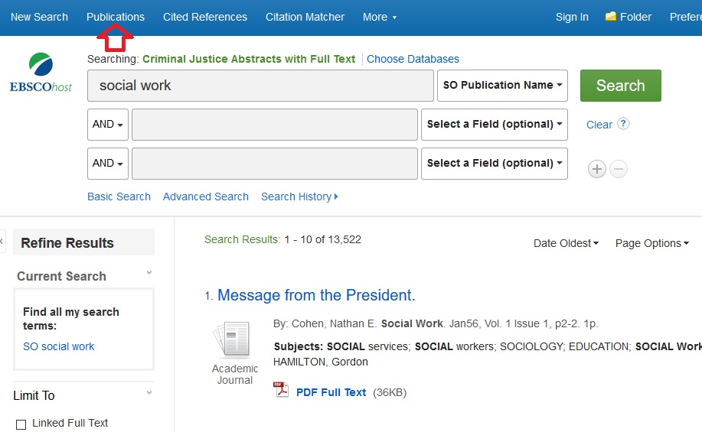
To view journal directly
Click on Publications on the top bar

Slide 8
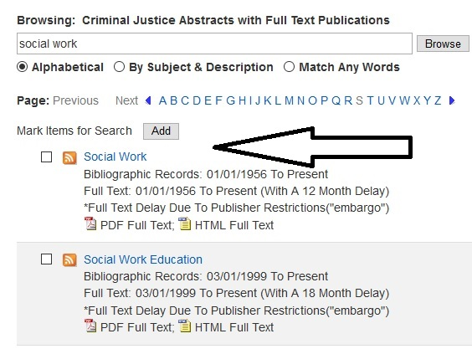
To see all full text issues
Type in journal name or on the first letter of the name to browse
Click on the desired title

Slide 9
Social Work full text
Click on the desired issues to view the table of contents of each issue and read the full text
The most recent issues are not available

Slide 10
find articles through databases
To locate articles for research, use the library databases OR for this assignment, find a professional journal in your field such as Social Work
Accessing a Database
Connect to the library
homepage
Click on Research Databases and Tutorials
Then select a database to
search from the alphabetical
list of databases
Or select Subject Guides and select the appropriate subject or discipline page to find databases related to social work

Slide 11
Social Work Abstracts
Social Work Abstracts offers extensive coverage of more than 450 social work and human services journals dating back to 1965. Produced by the National Association of Social Workers (NASW), the database provides citations and abstracts dealing with all aspects of the social work field, including theory and practice, areas of service and social issues and problems
Click on the link for Social Work Abstracts to proceed to the search screen.

Slide 12
Social Work Abstracts
Example Search: Enter keywords in the boxes at the top of the search screen.
In the drop down menu next to the search box, select an option of where the database will look for the keywords. The ‘All Text’ option will search everywhere for the keywords.

Slide 13
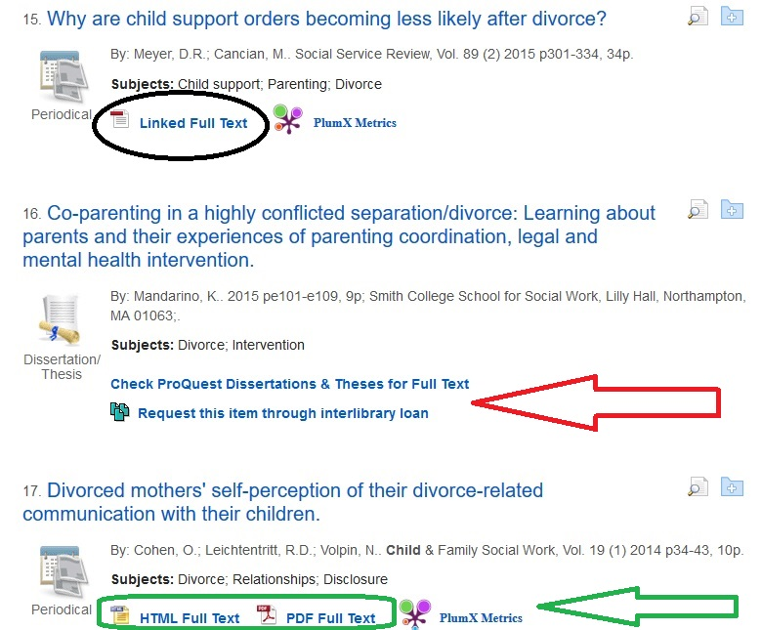
Social Work Abstracts

Slide 14
Social Work Abstracts
To read the article, click on the PDF or HTML links:
If the article is not available in full text, click the Request Item through Interlibrary loan link to order the item from a different library.
Note: Items requested via Interlibrary Loan may take 7-10 days to arrive in the library but emailed articles are often quicker
A link may be provided to another database that does have the full text, in the proceeding example, it is a dissertation in the ProQuest Dissertations and Theses database

Slide 15
Sage Premier
SAGE Premier access the full text of all SAGE Journals back to 1999 including journals in Criminology, Education, Health Sciences, Management & Organization Studies, Political Science, Psychology, Social Work, Sociology and Urban Studies.

Slide 16
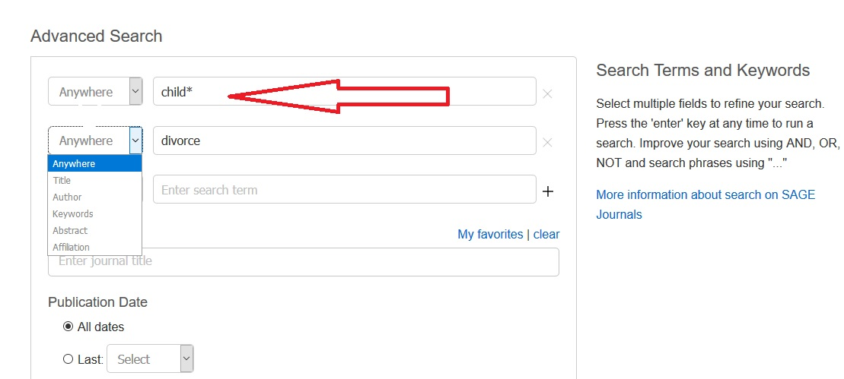
Sage Premier
Enter keywords into the search box
Use dropdown to specific title words, author, etc.

Slide 17
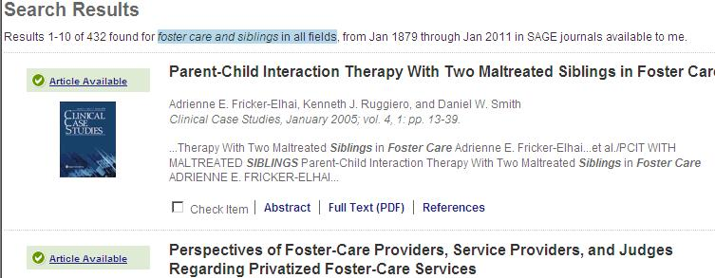
Sage Premier
A list of articles that pertain to the terms searched will be displayed. The number of articles will be displayed above the result list.
To display an article, click on the “Full Text PDF” link below the citation.

Slide 18
Recommended Databases
PsycARTICLES & PsycINFO are provided by the American Psychological Association. Contains more than 2 million citations and summaries of scholarly journal articles, book chapters, books, and dissertations, all in psychology and related disciplines. Includes peer-reviewed articles.
CINAHL (Cumulative Index to Nursing and Allied Health) contains articles from the nursing literature including scholarly journals including some in the related field of social work
Academic Search Complete covers the all academic subject areas and includes news articles, articles from professional journals, and scholar, peer reviewed research articles.
Criminal Justice Abstracts covers many social work journals if they relate to criminal justice.
PsychiatryOnline incudes the DSM and articles and books in psychiatry

Slide 19
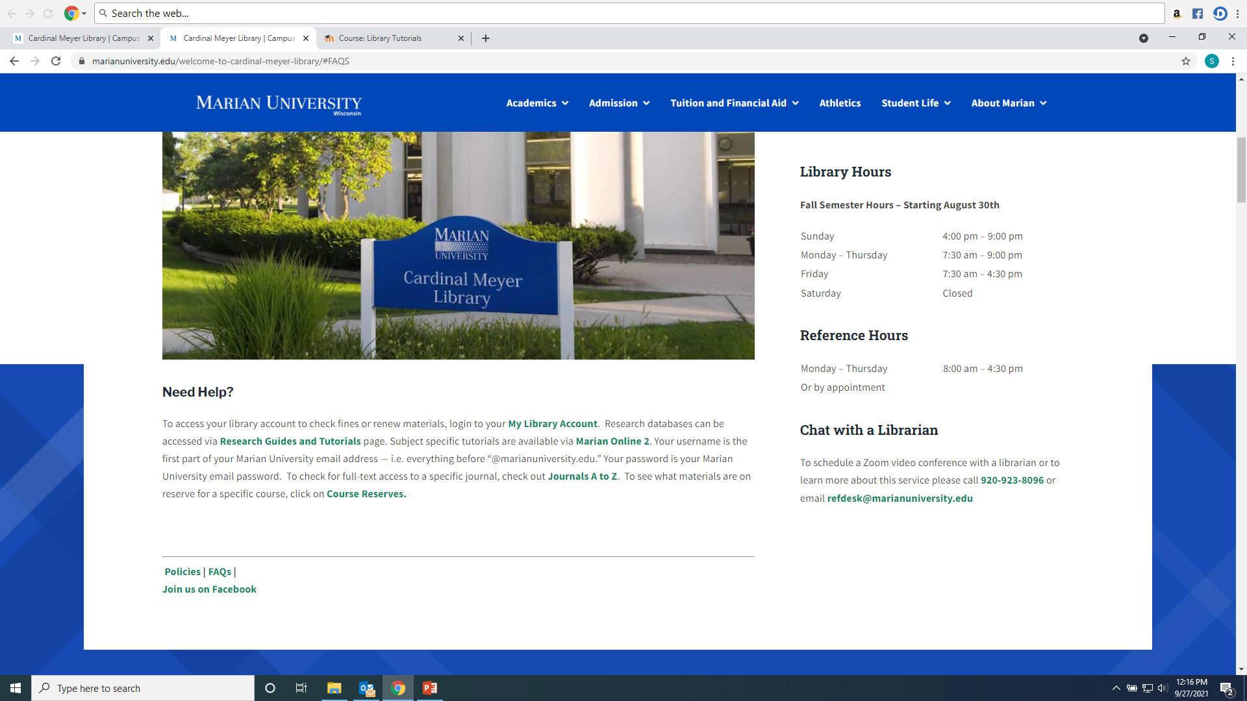
Questions

