Slide 1
Education Databases: Research Articles
Sarah Thibodeau
srthibodeau64@marianuniversity.edu
920-923-8096

Slide 2
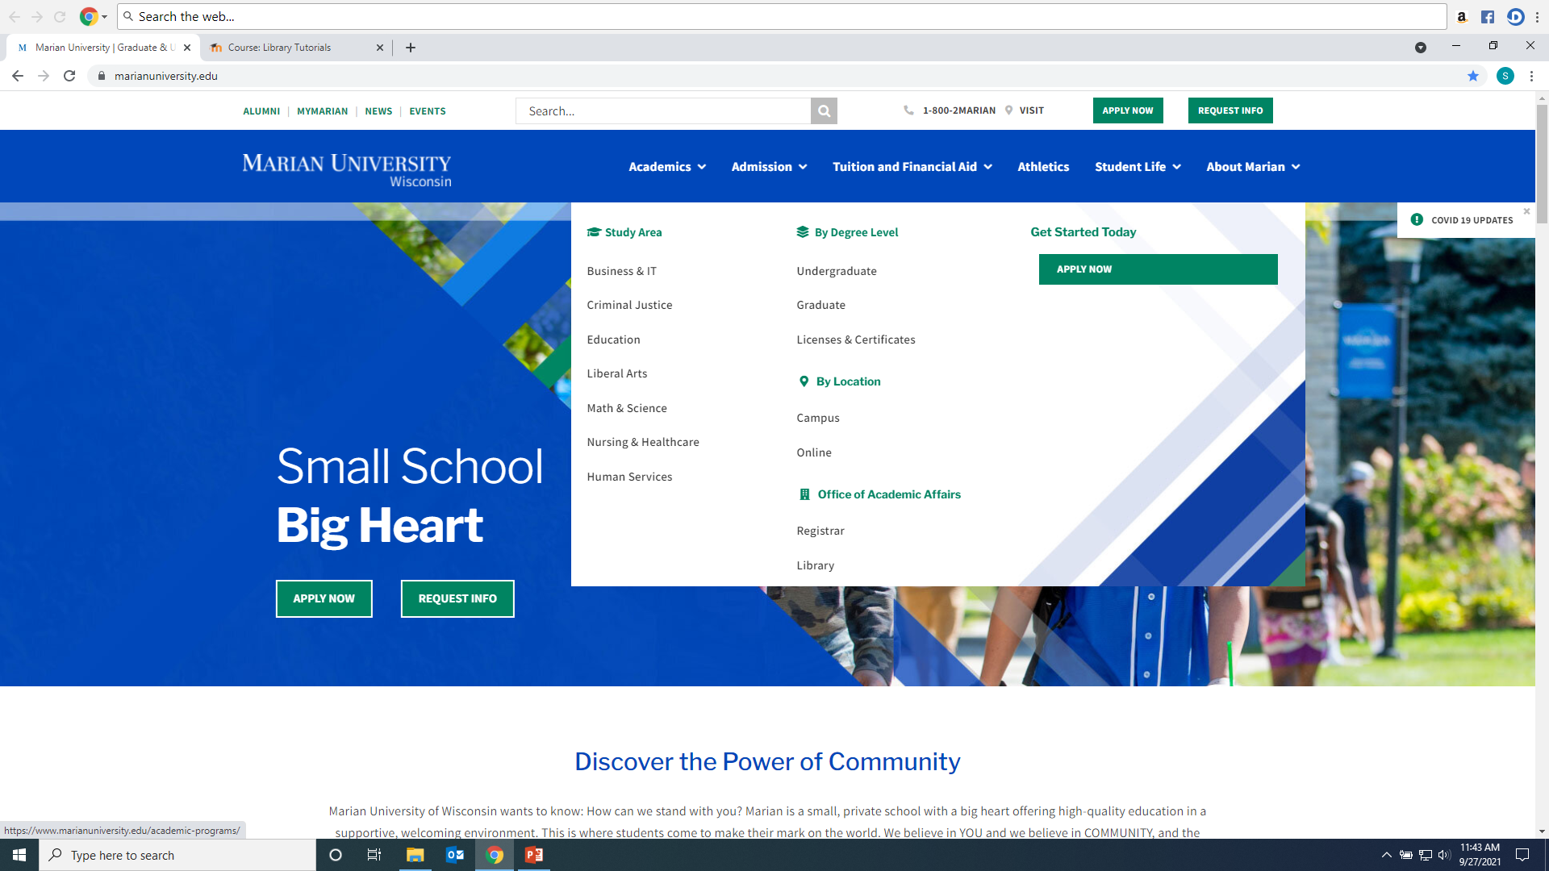
Click on Library from Marian website: https://www.marianuniversity.edu/

Slide 3
Scholarly/Peer-Reviewed Article vs. Popular Sources

Slide 4
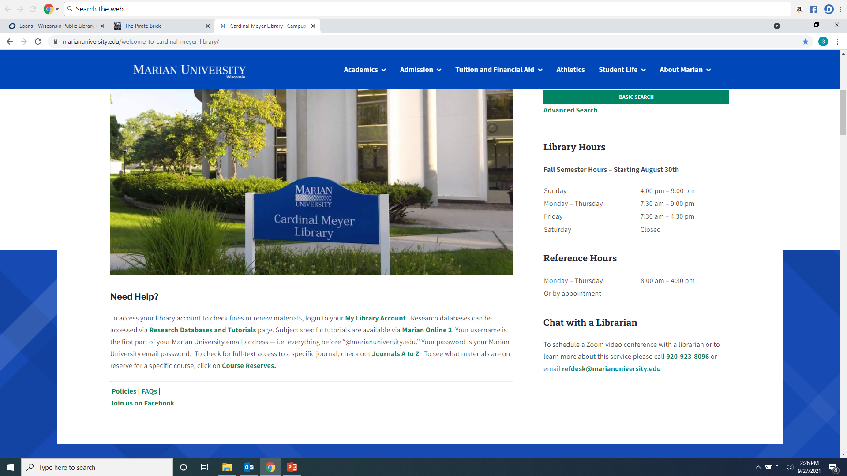
From the Library Home Page click on the “Research Databases and Tutorials” link.

Slide 5
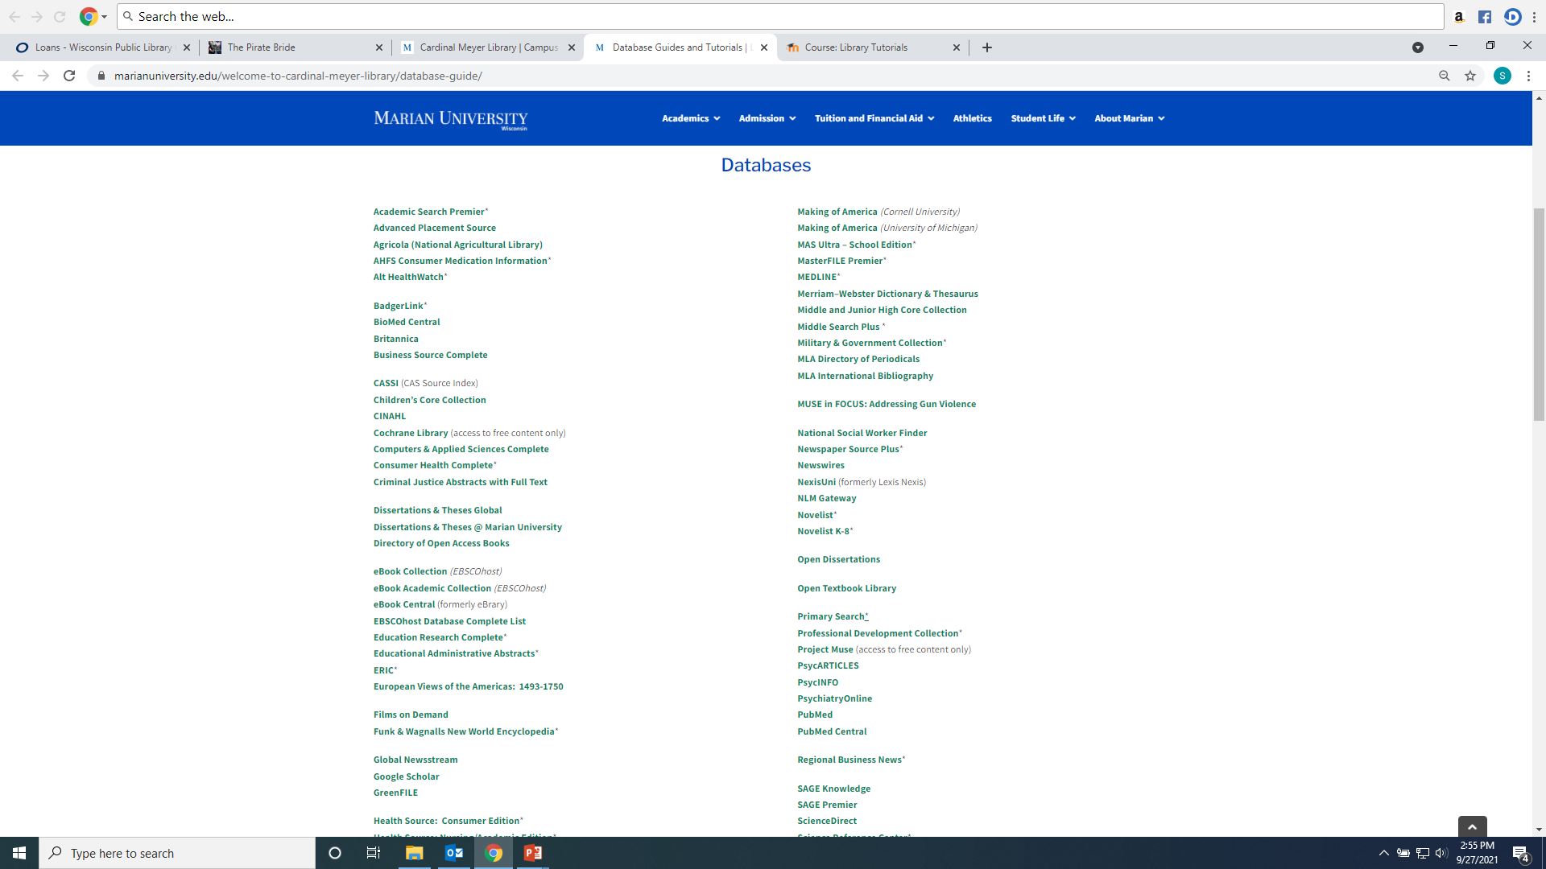
Recommended databases to search for Education research articles are: ERIC, SAGE Premier, Education Research Complete, Educational Administration Abstracts, Teacher Reference Center, and Academic Search Premier.

Slide 6
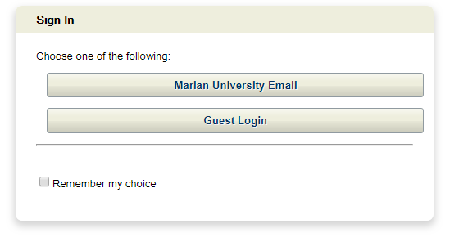
If you are accessing the databases from off-campus, you will be asked to login by clicking on the “Marian University Email” button. You must enter your full Marian Email and password”

Slide 7
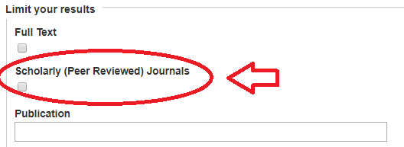
Searching ERIC, Education Research Complete, Teacher Reference Center, Academic Search Premier and Educational Administrative Abstracts Type keywords into boxes, make sure “Tx All Text” is used for keyword searching. For scholarly articles make sure the “Scholarly (Peer Reviewed) Journals” is checked

Slide 8
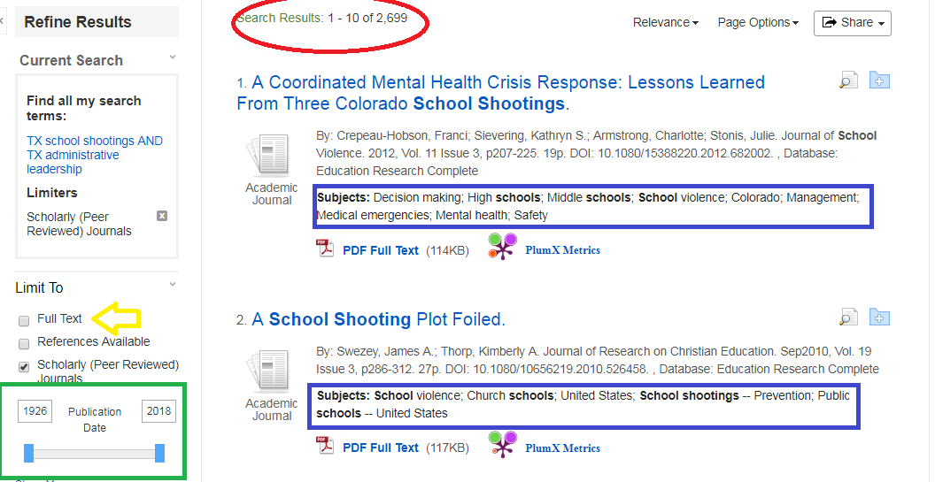
2,699 results. Check subject headings to discover more or better search words. Narrow down by clicking the Date Range or Full text:

Slide 9
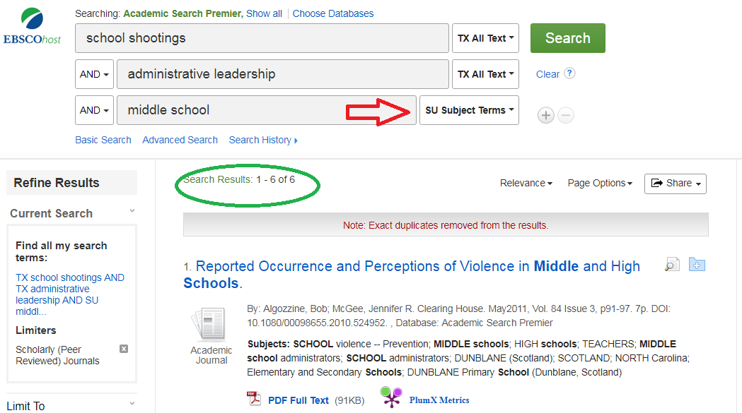
Narrow results more by adding more terms, requiring that they are Subjects…

Slide 10
AND narrows down and brings fewer results. OR adds synonyms or concepts and finds more results. Can be typed or as drop down arrow: example: school shootings OR school violence.

Slide 11
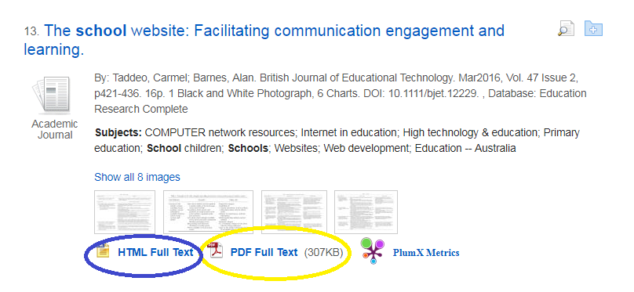
Look for PDF Full Text or HTML Full Text or Linked Full Text to open the article. If the citation does not have one of these three options, click Request through Interlibrary Loan (which will open a form that will request the library get the article from another library)

Slide 12
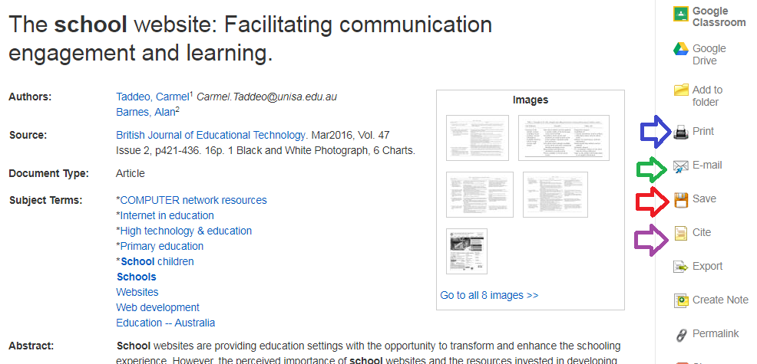
To Email, Save, Print or Cite (will give citation in format of your choosing) an article:

Slide 13
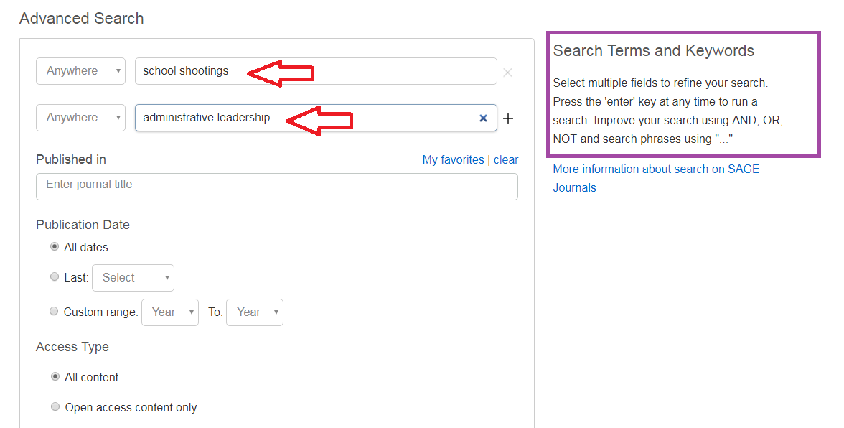
Searching SAGE Premier: Enter Keywords into search boxes; use Boolean Operators And, Or, Not to refine your search

Slide 14
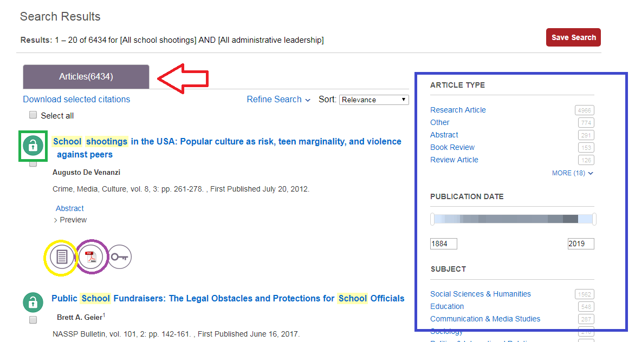
Results with be in at the top (6434). Use the Limiters on the left to narrow your search. The open lock means Marian has the article full text; the closed lock means the article is not full text and may need to be Interlibrary Loaned. Click on either the HTML or PDF full text option to open the article.

Slide 15
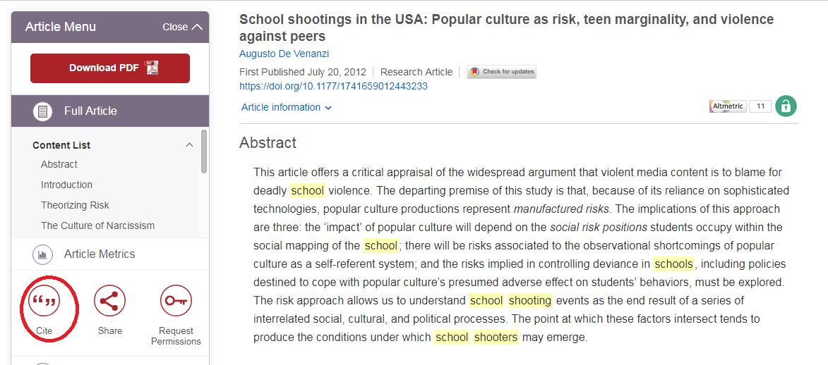
To find citation information for an article in the appropriate format click the “Cite” icon

Slide 16
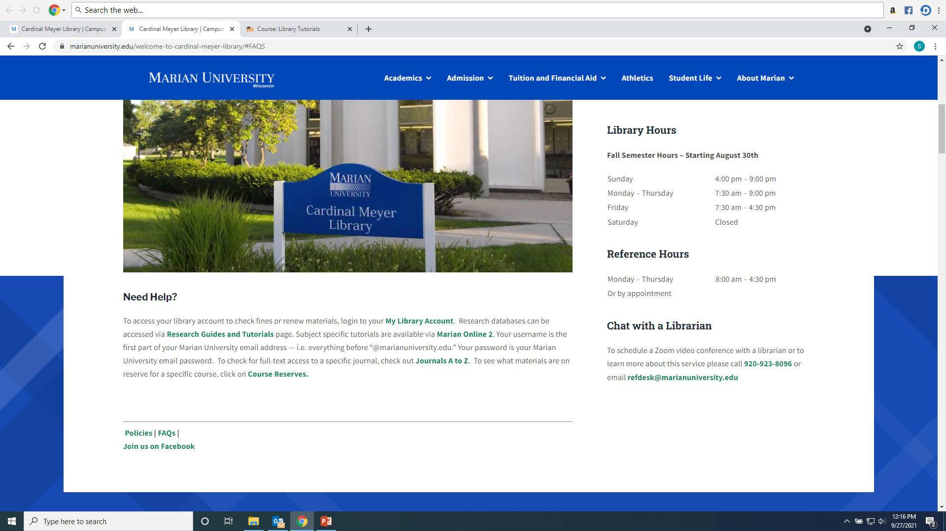
Any Questions? Ask a library staff member!

