Slide 1
Education Databases: Research Articles
Sarah Thibodeau
srthibodeau64@marianuniversity.edu
920-923-8096

Slide 2
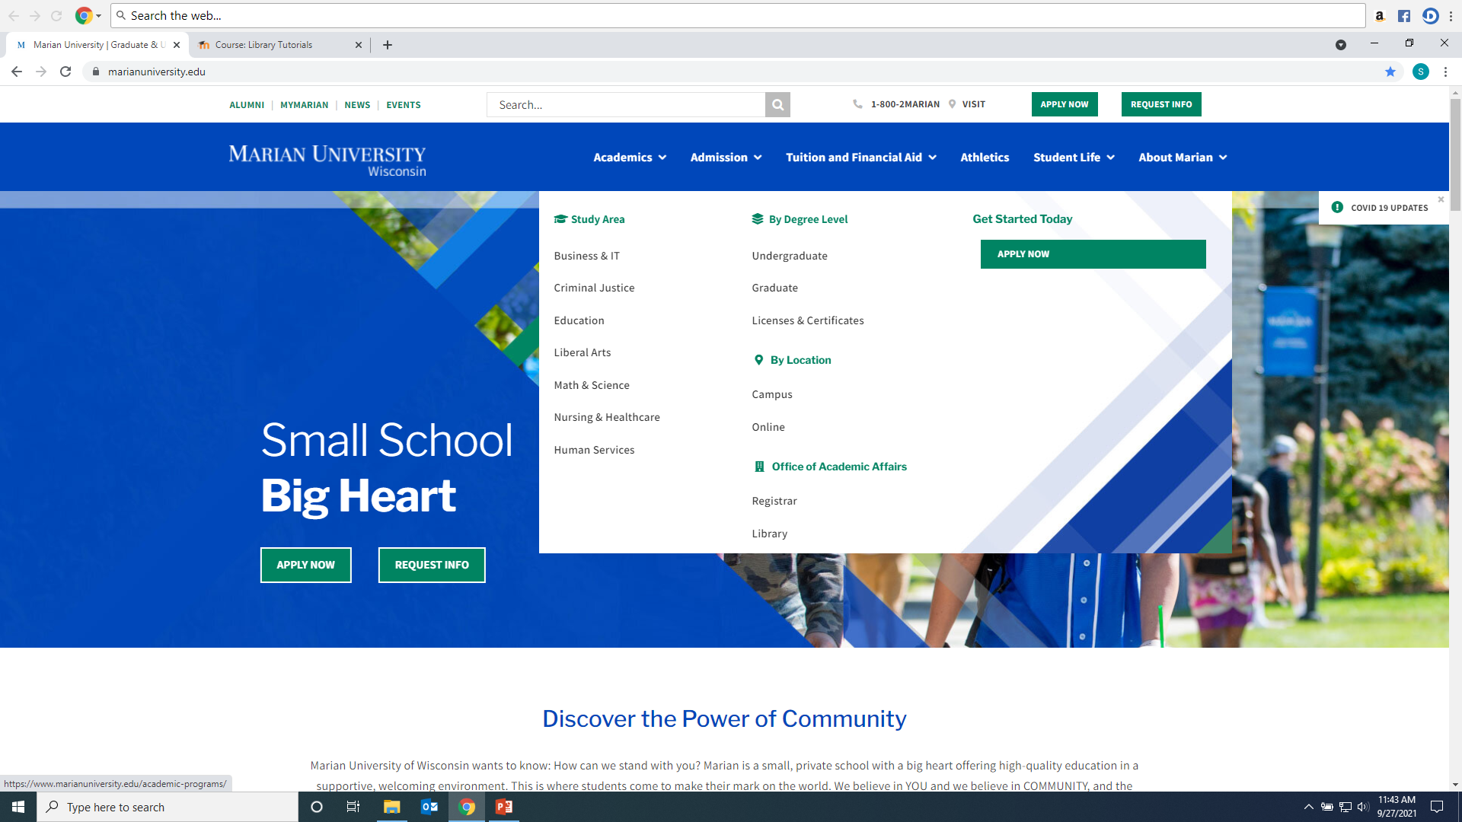
Click on Library from Marian website: https://www.marianuniversity.edu/

Slide 3
Scholarly/Peer-Reviewed Article vs. Popular Sources

Slide 4
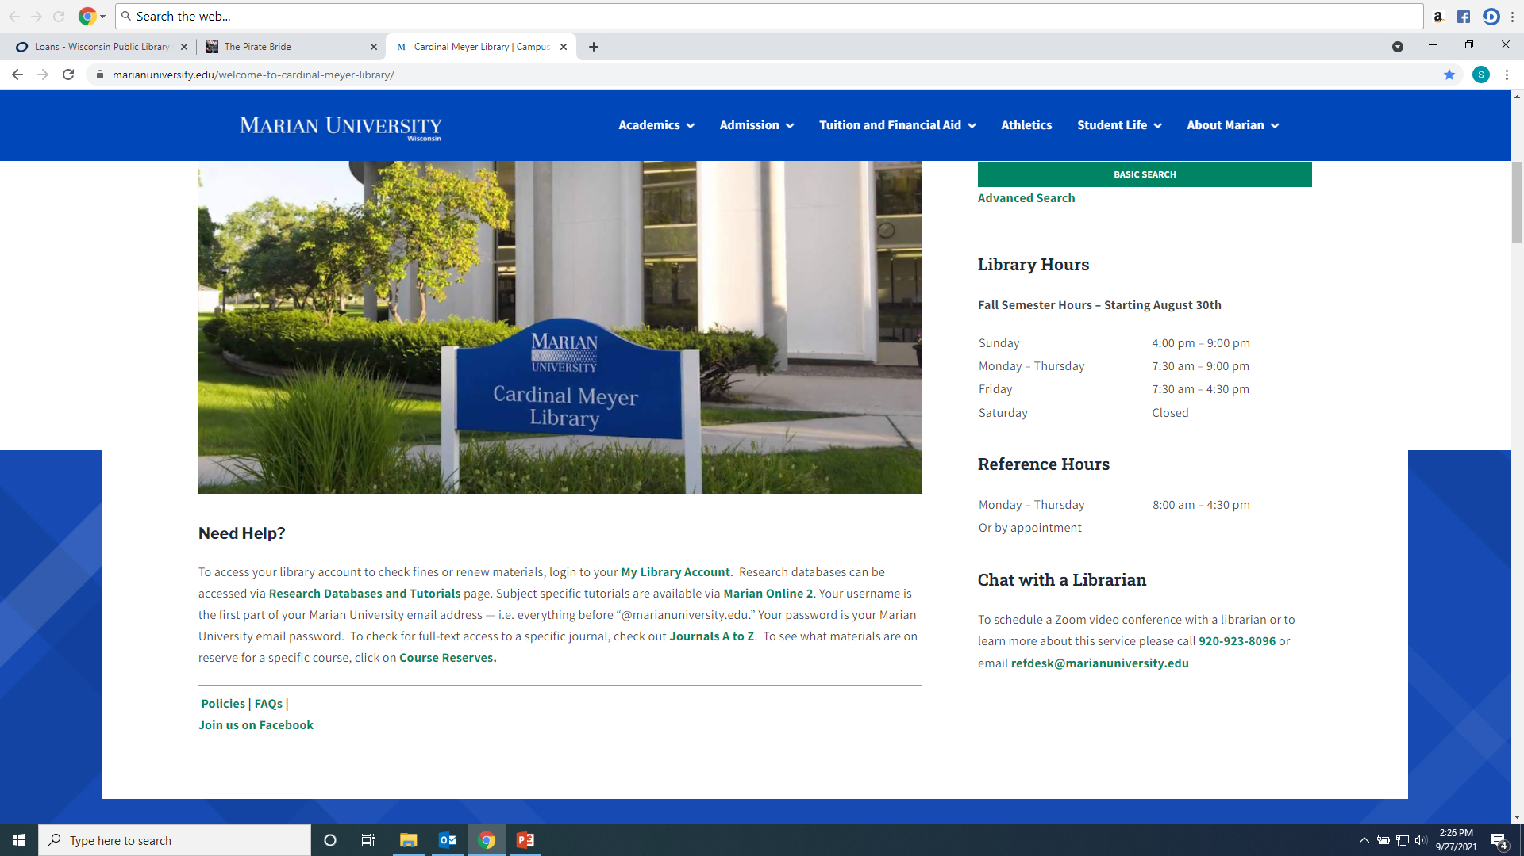
From the Library Home Page click on the “Research Databases and Tutorials” link.

Slide 5
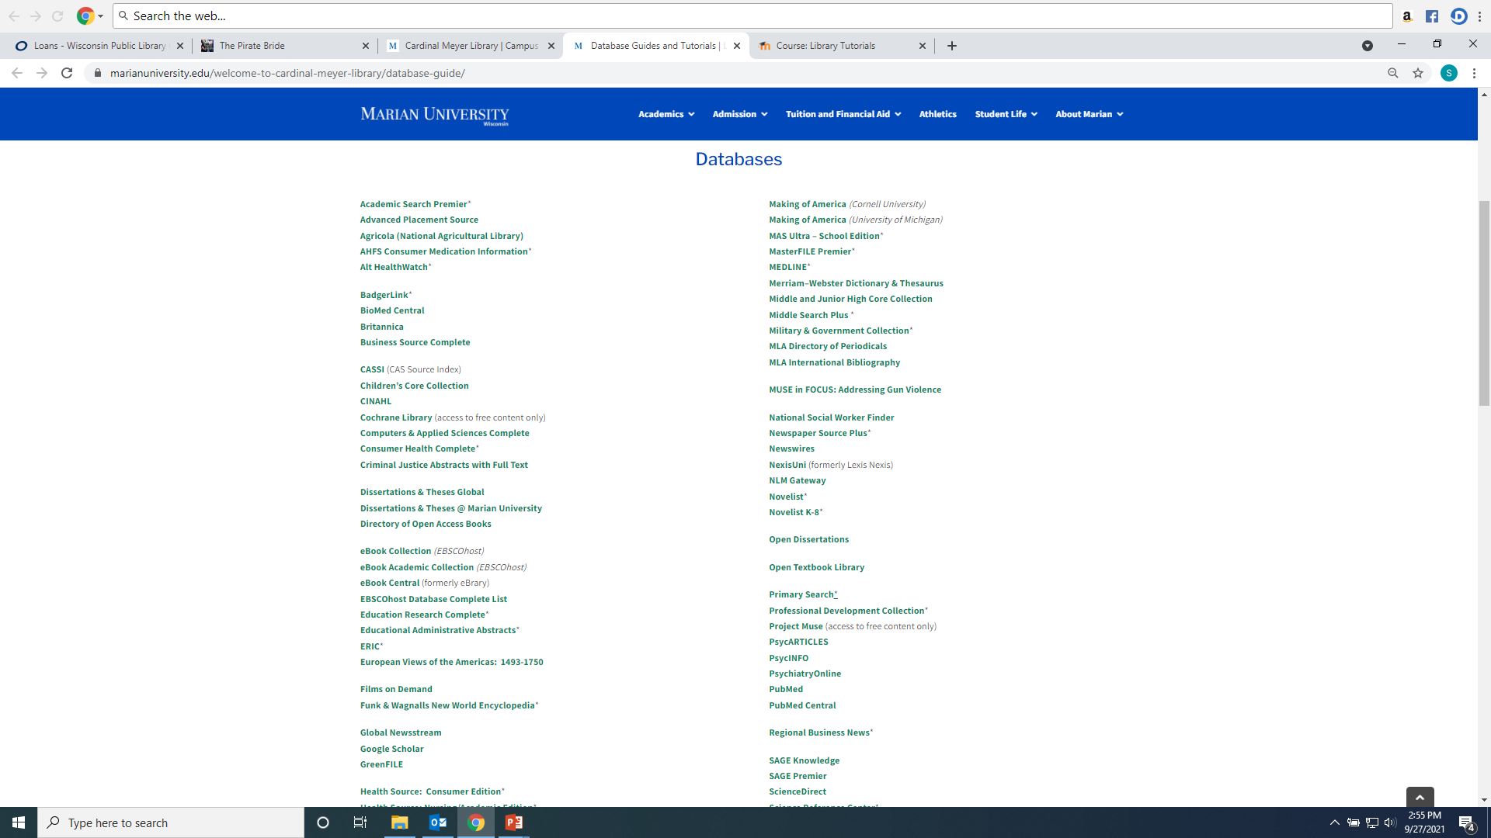
Recommended databases to search for Education research articles are: ERIC, SAGE Premier, Education Research Complete, Educational Administration Abstracts, Teacher Reference Center, and Academic Search Premier.

Slide 6
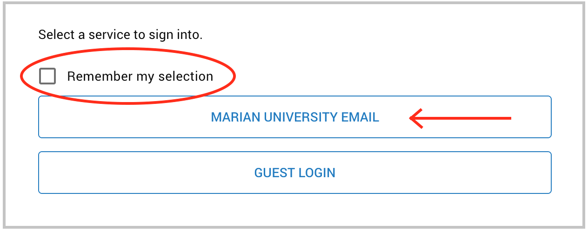
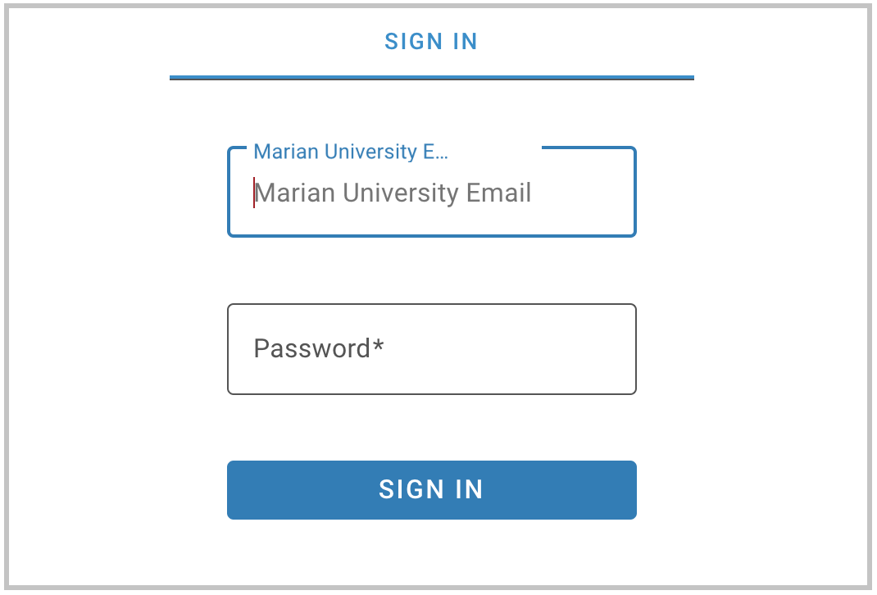
If you are accessing the databases from off-campus, you will be asked to login by clicking on the “Marian University Email” button. You must enter your full Marian Email and password”

Slide 7
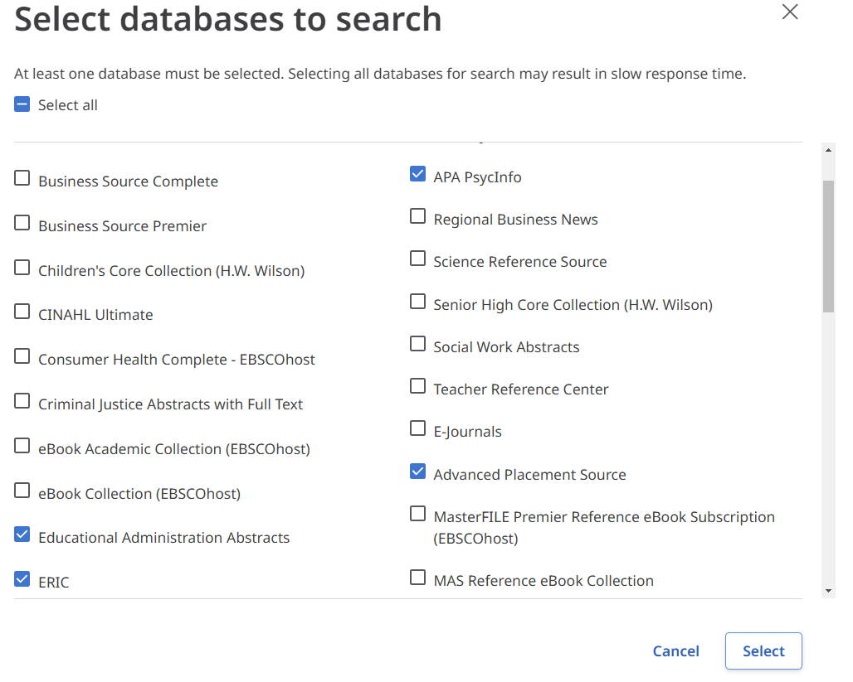
Searching ERIC, Education Research Complete, Teacher Reference Center, Academic Search Premier and Educational Administrative Abstracts These resources are part of the Library’s Ebscohost package. This means they can be search in combination with each other. To do this under “Searching” click on name listed to bring up a list of Ebsco databases, choose the one(s) you want to search and then click “Select”

Slide 8
Enter keywords into the search boxes and select “All Text” for each box terms are entered into

Slide 9
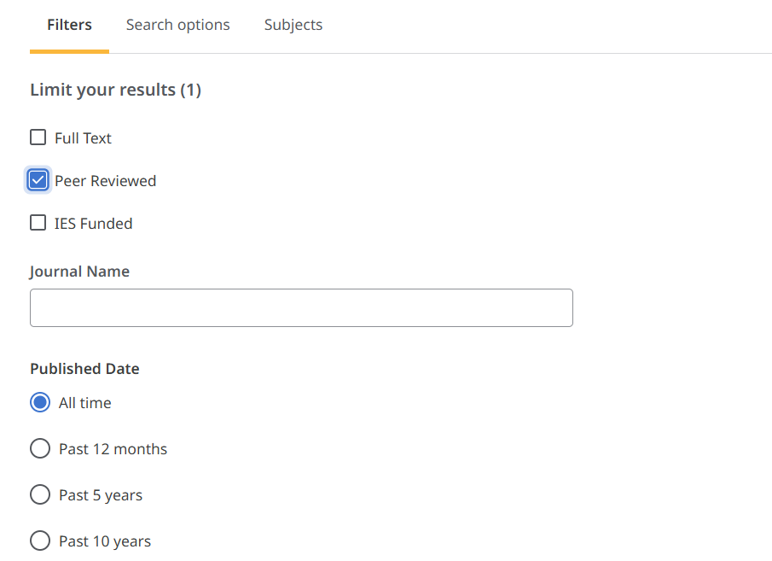
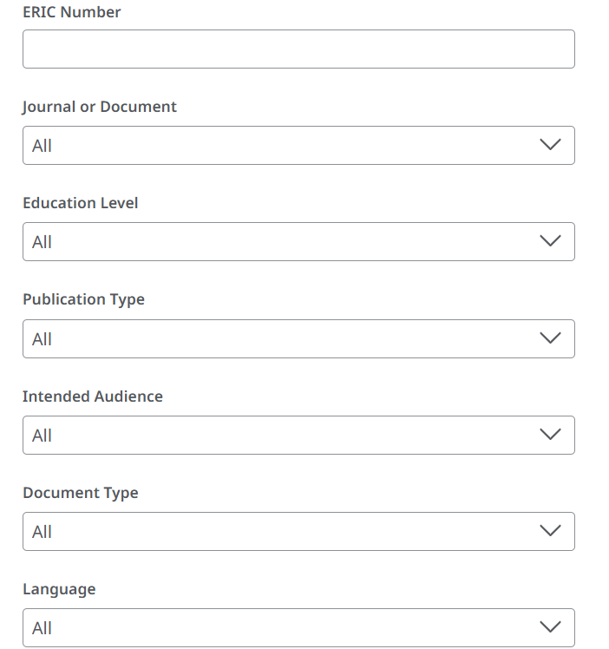
Add Filters to your search: For example “Peer Reviewed” will limit to only academic research journals. Add age groups, population types, document types and more to focus your search results.

Slide 10
When reviewing your result lists, you should read an article's abstract (summary) to determine its use. You can also generate keywords for your article searches using the subject headings or keywords listed in the citation.

Slide 11
You will have three types of article access options in Ebscohost resources. Click the “Access Options” drop-down menu to see what is available for each article. They are PDF, Online Full Text, or a link to an outside open access source. If you see “Request this item through Interlibrary Loan” the library can request the article from another institution at no cost to student.

Slide 12
Articles can be printed, downloaded, and shared. On the top right of a full text article you will see a tool bar for these features.
You can have the article read to you by using the “headphone” icon.

Slide 13
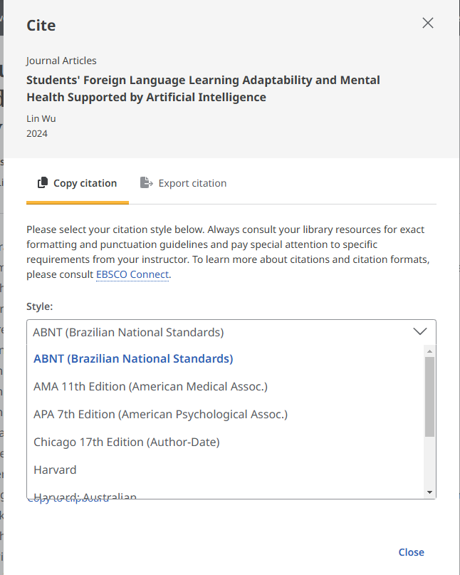
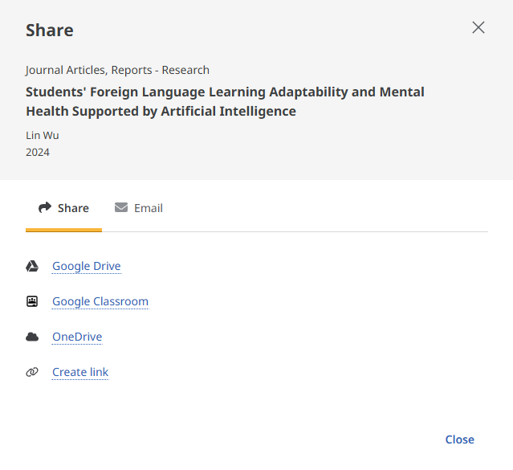
Articles can be shared via a permanent link or email. If a professor requests a link to an article posted on MO2 use the “Create Link” option. Citations is various formats can be created for each article by using the “quote” marks on top right menu bar.

Slide 14
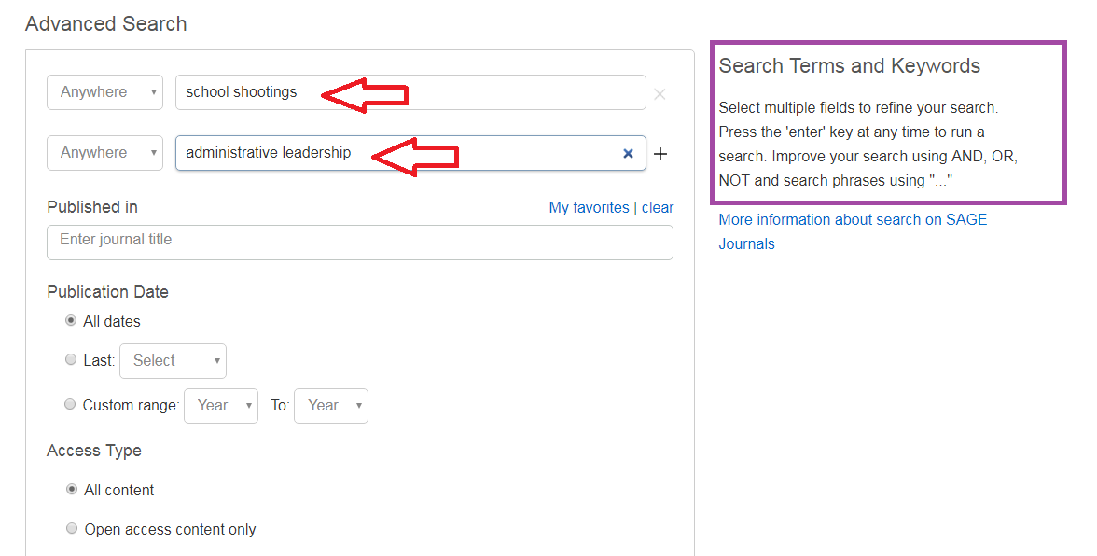
Searching SAGE Premier: Enter Keywords into search boxes; use Boolean Operators And, Or, Not to refine your search

Slide 15
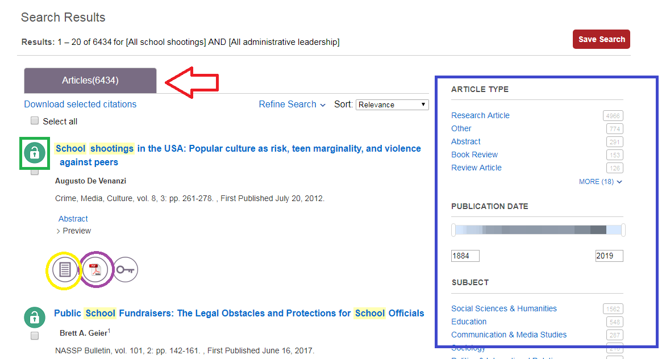
Results with be in at the top (6434). Use the Limiters on the left to narrow your search. The open lock means Marian has the article full text; the closed lock means the article is not full text and may need to be Interlibrary Loaned. Click on either the HTML or PDF full text option to open the article.

Slide 16
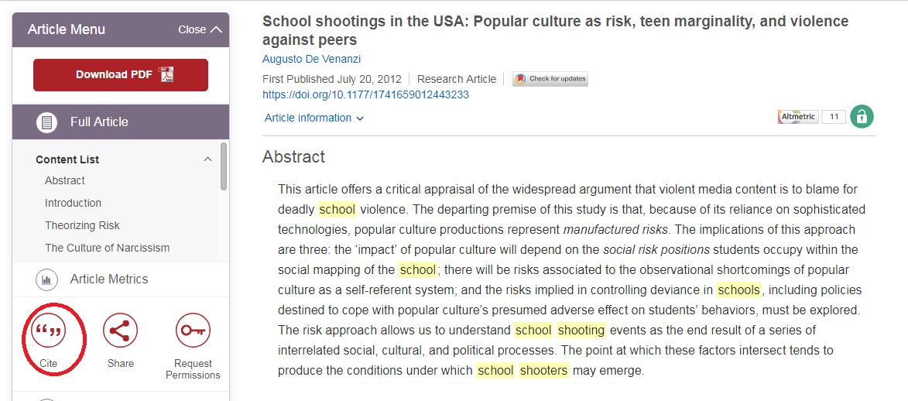
To find citation information for an article in the appropriate format click the “Cite” icon

Slide 17
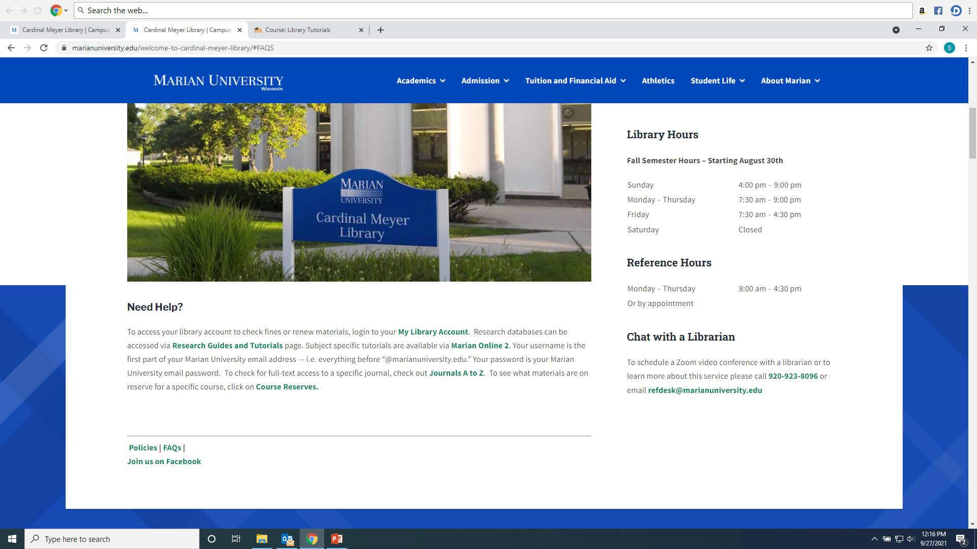
Any Questions? Ask a library staff member!

