Slide 1
Nursing Databases: Research Articles
Sarah Thibodeau
srthibodeau64@marianuniversity.edu
920-923-8096

Slide 2
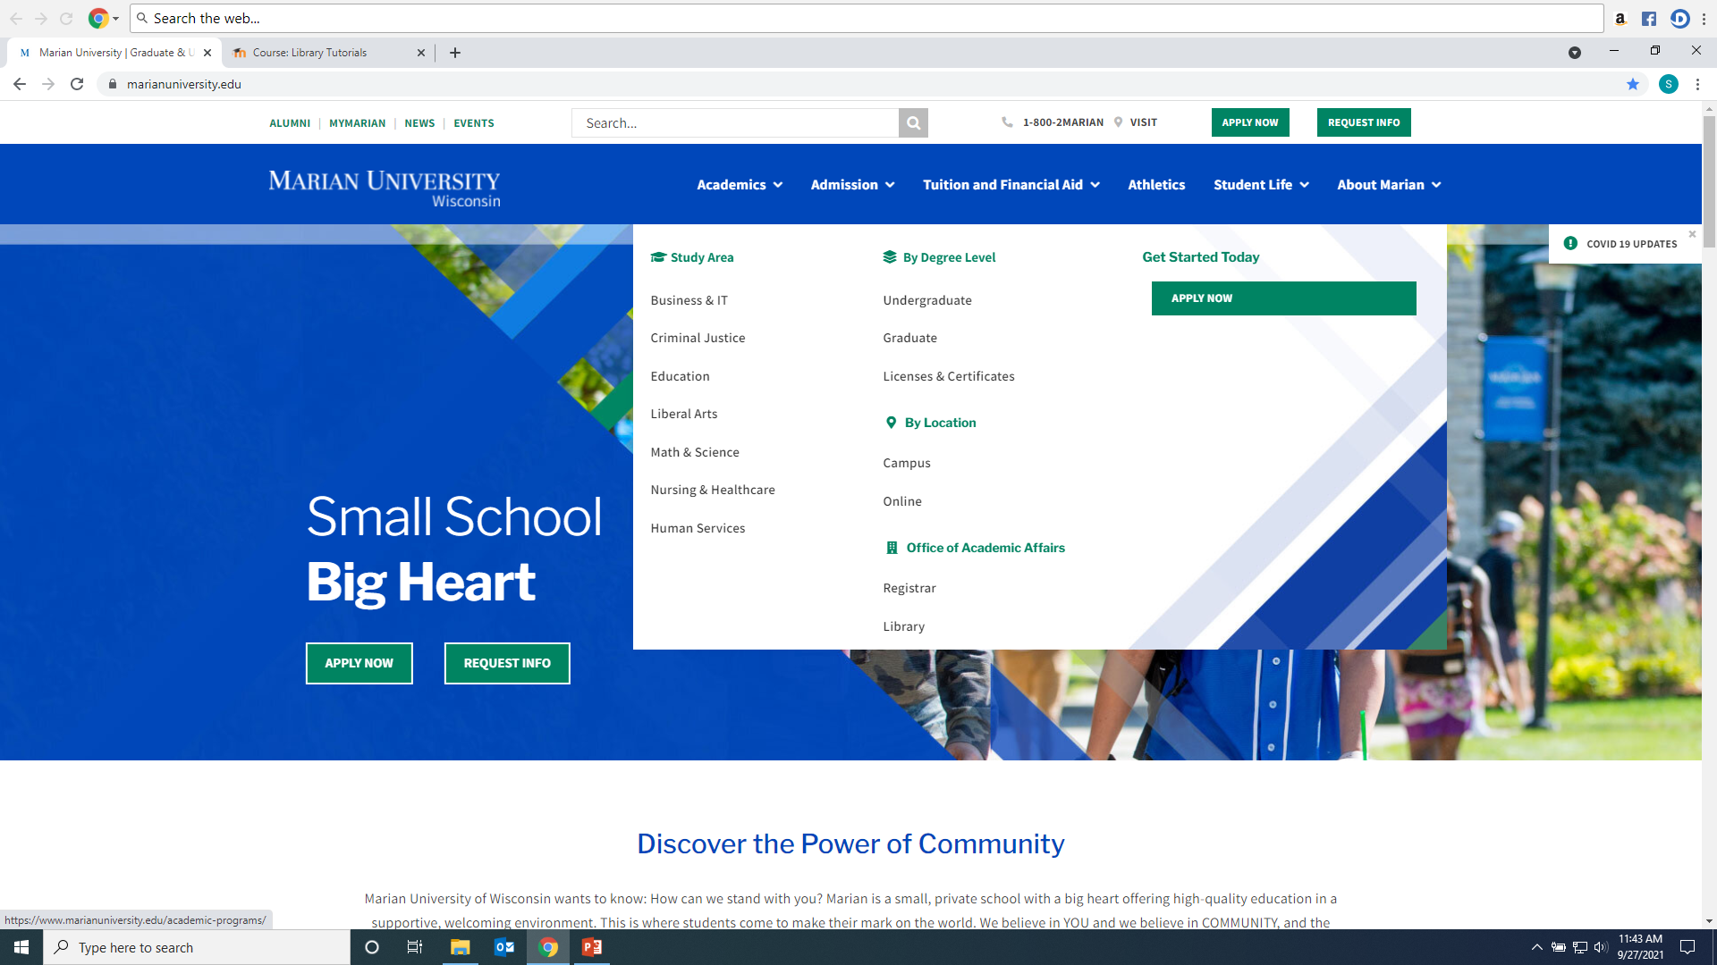
Click on Library from Marian website: https://www.marianuniversity.edu/

Slide 3
Scholarly/Peer-Reviewed Article vs. Popular Sources

Slide 4
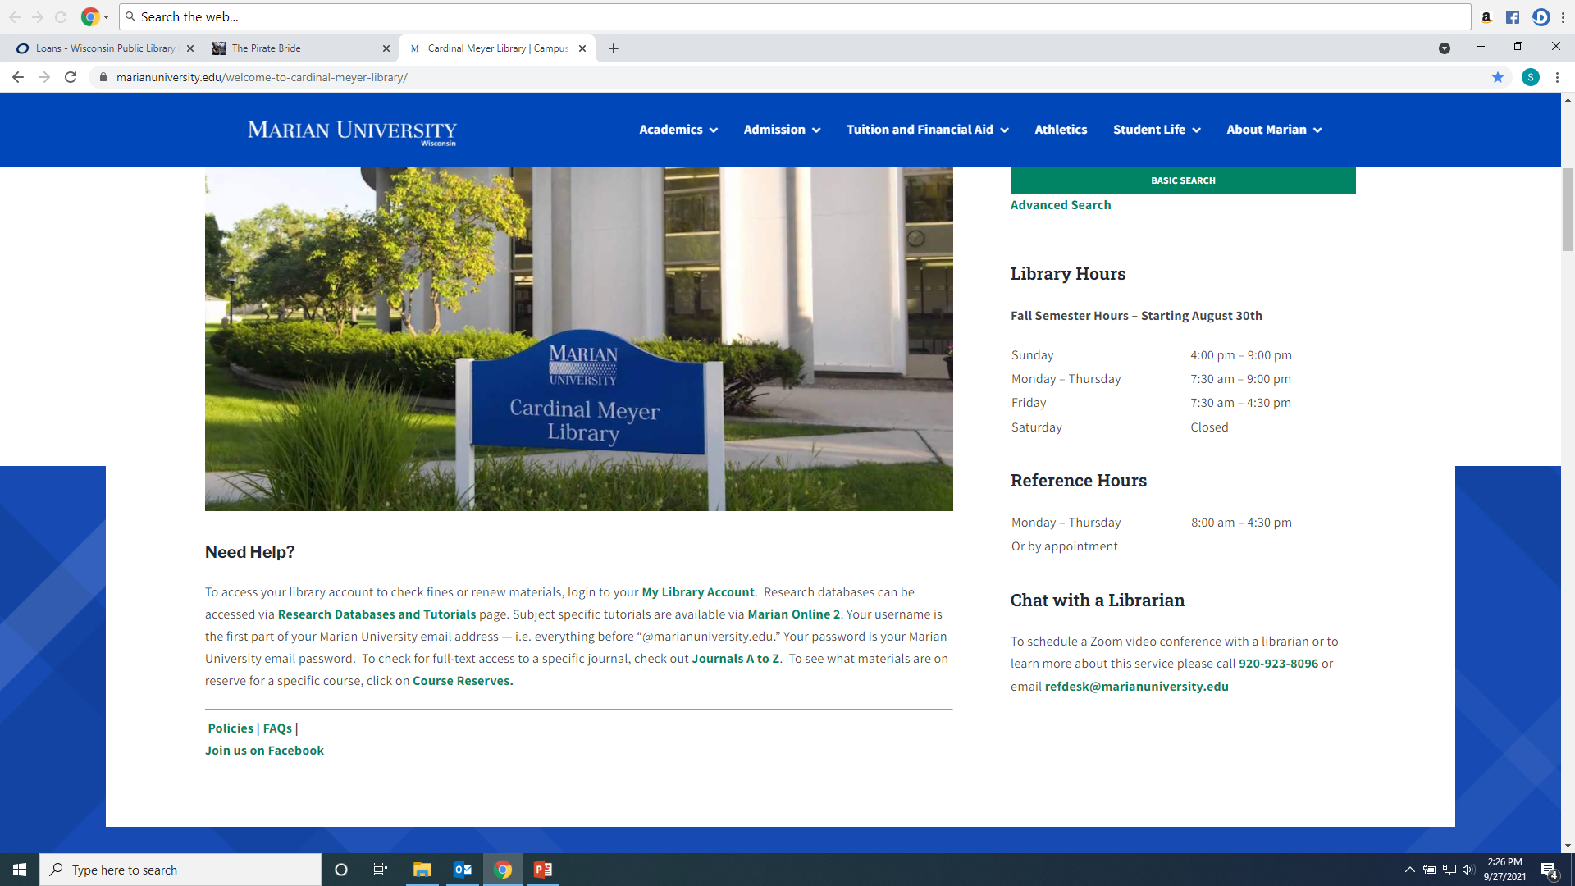
From the Library Home Page click on the “Databases” link on the left hand menu

Slide 5
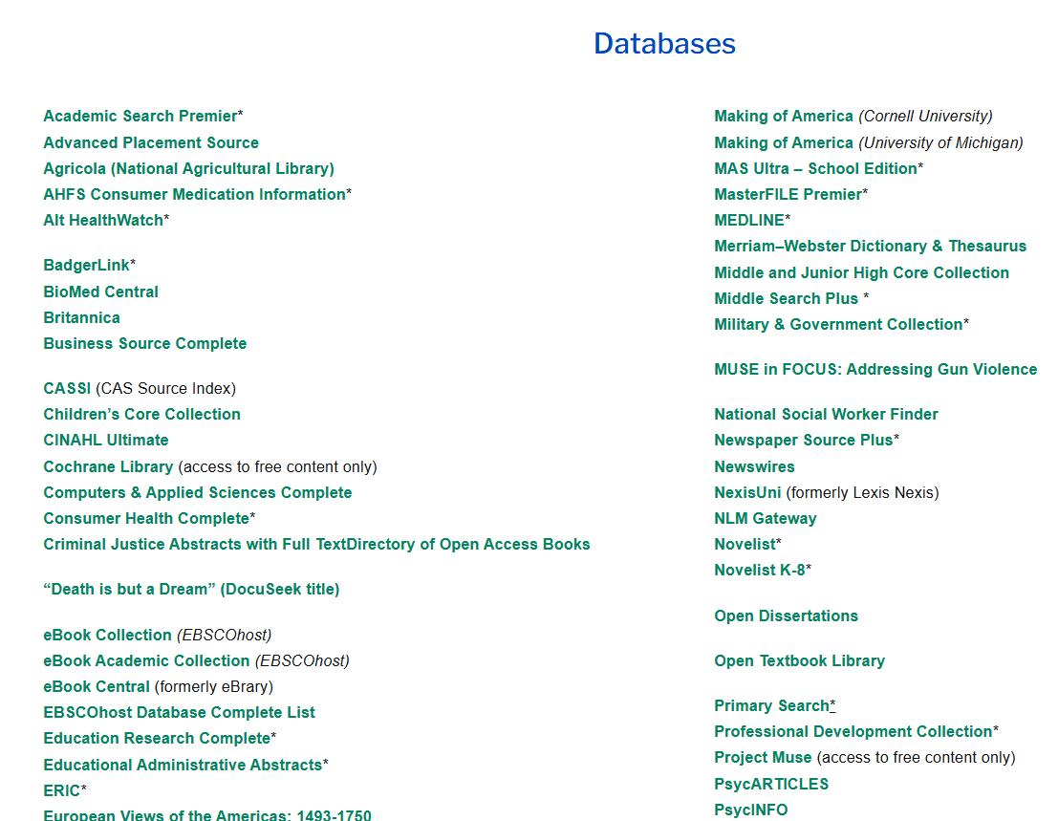
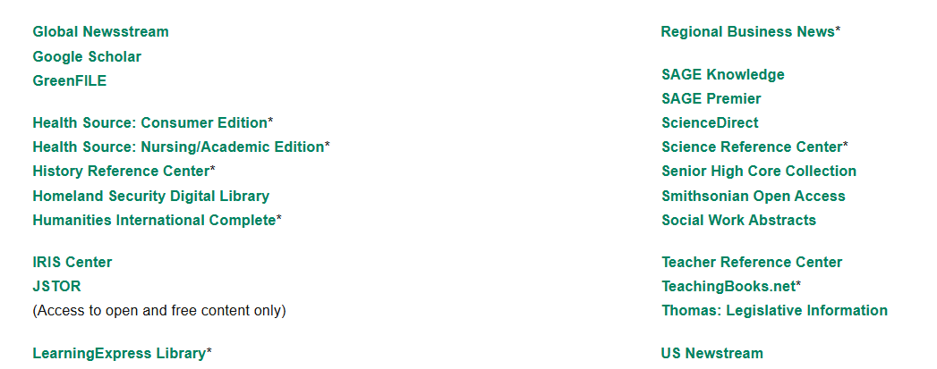
Recommended databases to search for Psychology research articles are: CINAHL Ultimate, PsycARTICLES, PsycInfo, SAGE Premier, and Academic Search Premier, and Psychiartry Online (which has the DSM ebook).

Slide 6
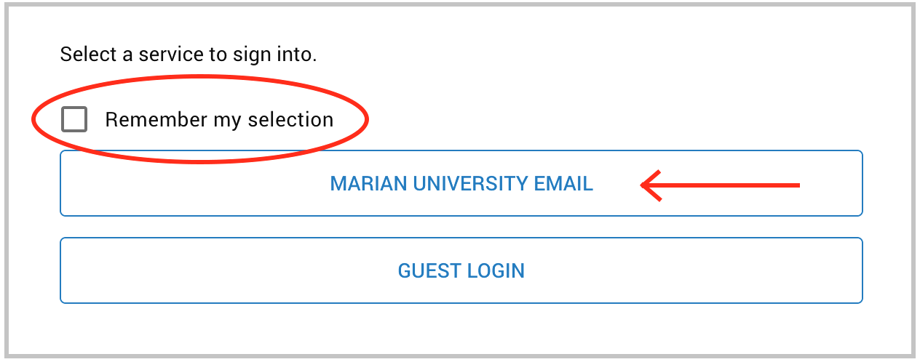
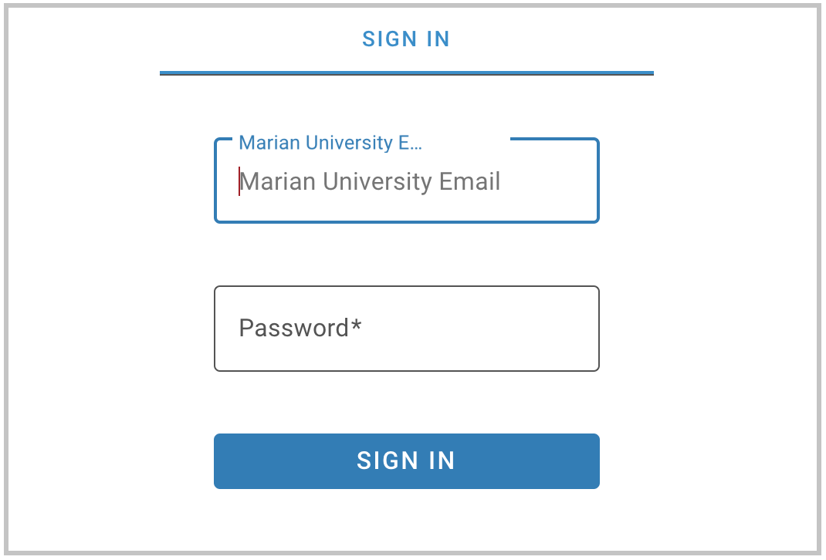
If you are accessing the databases from off-campus, you will be asked to login by clicking on the “Marian University Email” button. You must enter your full Marian Email and password”

Slide 7
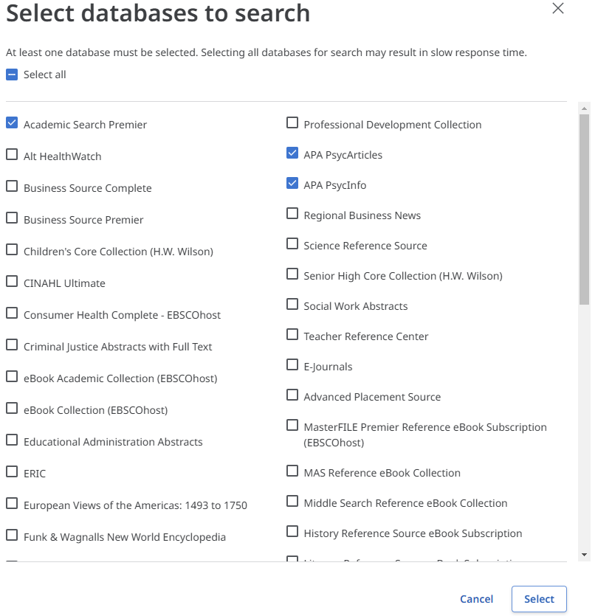
Searching CINAHL Ultimate, Health Source Nursing/Academic, PscyInfo, PsycArticles, and Academic Search Premier These resources are part of the Library’s Ebscohost platform. This means they can be searched in combination with each other. To do this under “Searching” click on the name listed to bring up a list of Ebsco databases, choose the one(s) you want to search, and then click “Select”

Slide 8
Enter keywords into the search boxes and select “All Text” for each box terms are entered into

Slide 9
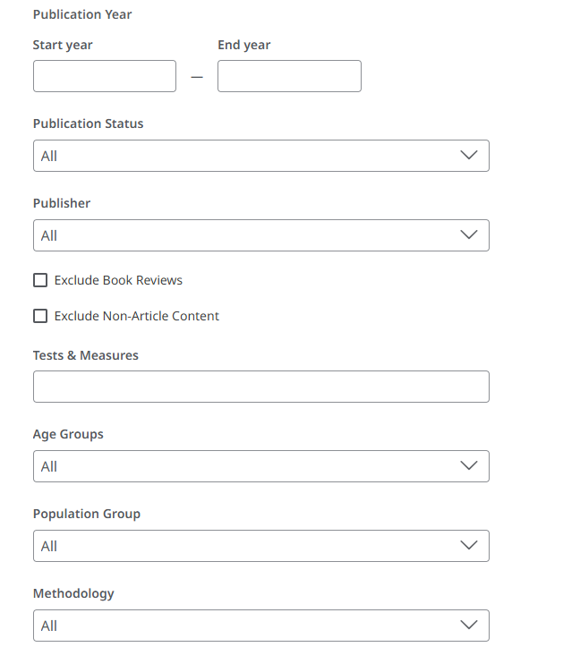
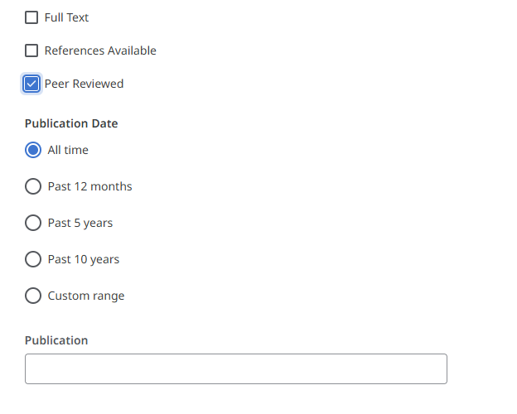
Add Filters to your search: For example “Peer Reviewed” will limit to only academic research journals. Add age groups, population types, document types and more to focus your search results. These will vary by database.

Slide 10
When reviewing your result lists, you should read an article's abstract (summary) to determine its use. You can also generate keywords for your article searches using the subject headings or keywords listed in the citation.

Slide 11
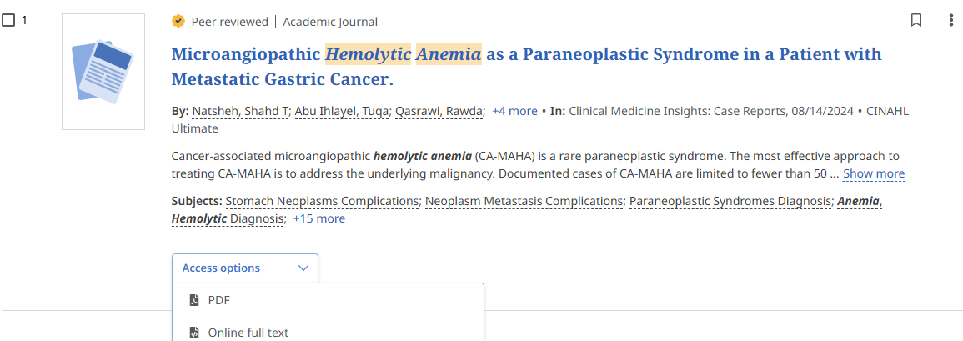
You will have three types of article access options in Ebscohost resources. Click the “Access Options” drop-down menu to see what is available for each article. They are PDF, Online Full Text, or a link to an outside open-access source. If you see “Request this item through Interlibrary Loan” the library can request the article from another institution at no cost to the student.

Slide 12
Articles can be printed, downloaded, and shared. On the top right of a full text article you will see a tool bar for these features.
You can have the article read to you by using the “headphone” icon.

Slide 13
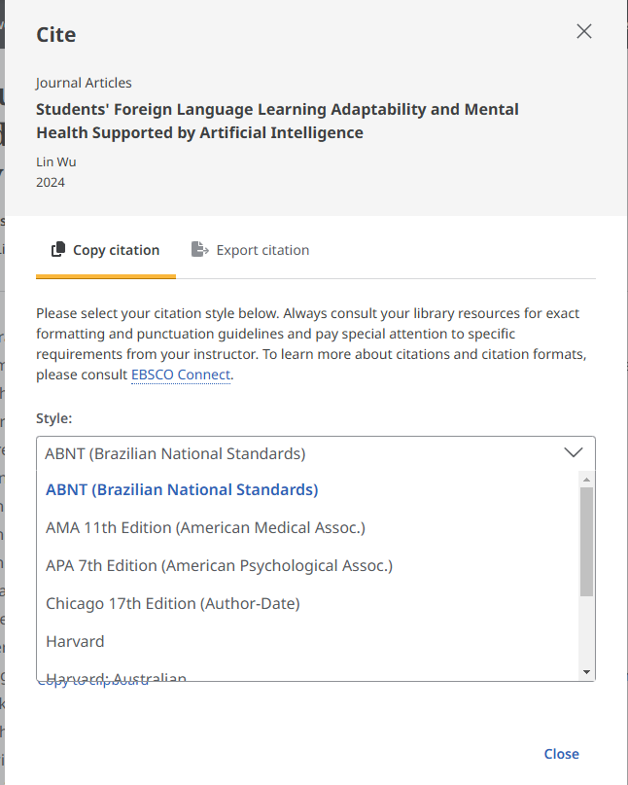
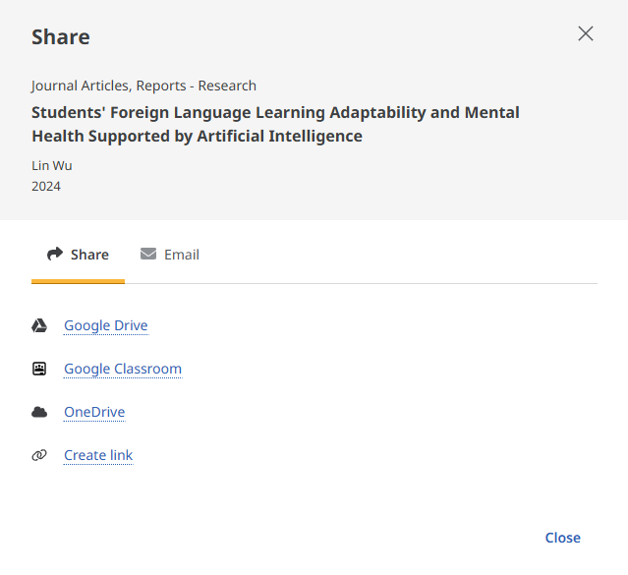
Articles can be shared via a permanent link or email. If a professor requests a link to an article posted on MO2 use the “Create Link” option. Citations is various formats can be created for each article by using the “quote” marks on top right menu bar.

Slide 14
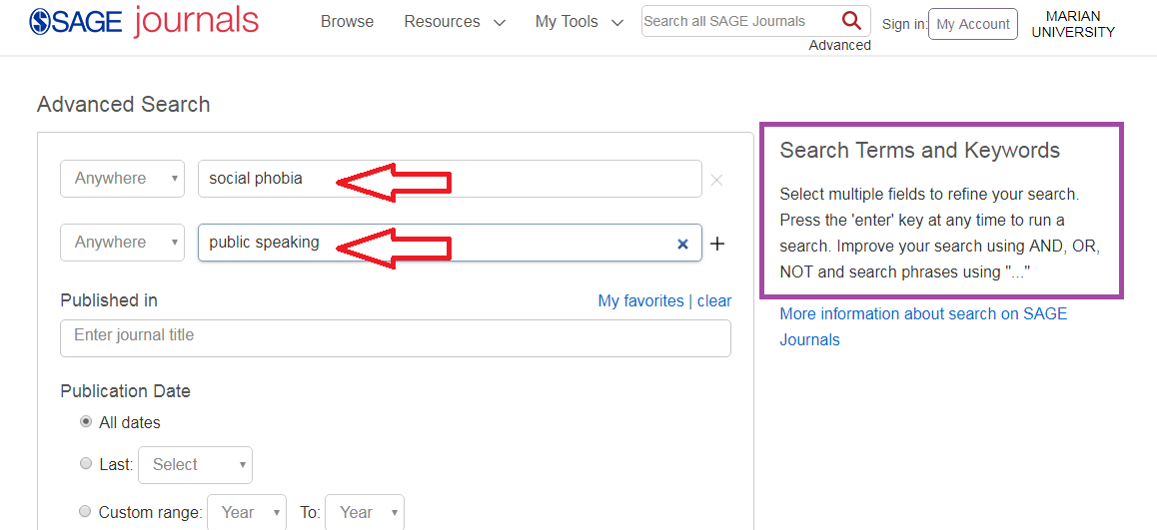
Searching SAGE Premier: Enter Keywords into search boxes; use Boolean Operators And, Or, Not to refine your search

Slide 15
Results with be in at the top (2927). Use the Limiters on the left to narrow your search. The open lock means Marian has the article full text; the closed lock means the article is not full text and may need to be Interlibrary Loaned. Click on either the HTML or PDF full text option to open the article.

Slide 16
To find citation information for an article in the appropriate format click the “Cite” icon

Slide 17
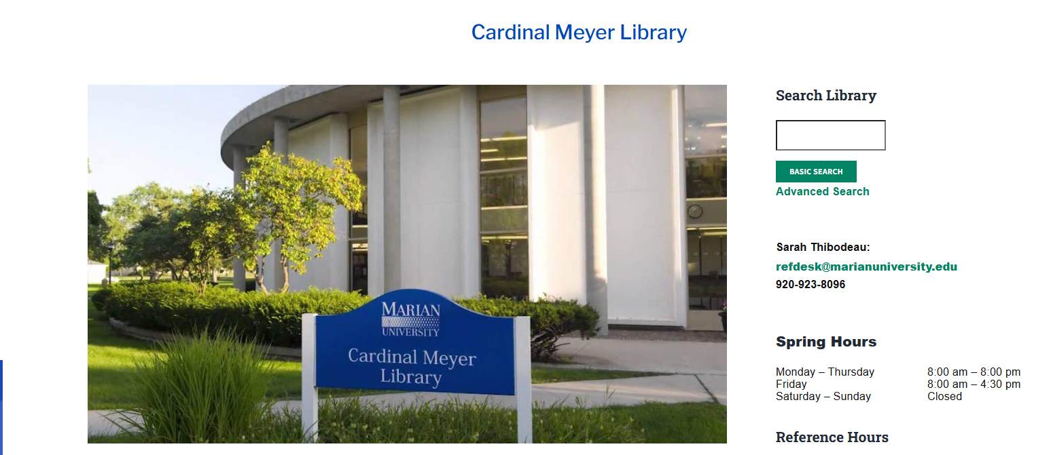
Any Questions? Ask a library staff member!

