Slide 1

Criminal Justice Databases:
Research Articles
Sarah Thibodeau
srthibodeau64@marianuniversity.edu
920-923-8096

Slide 2
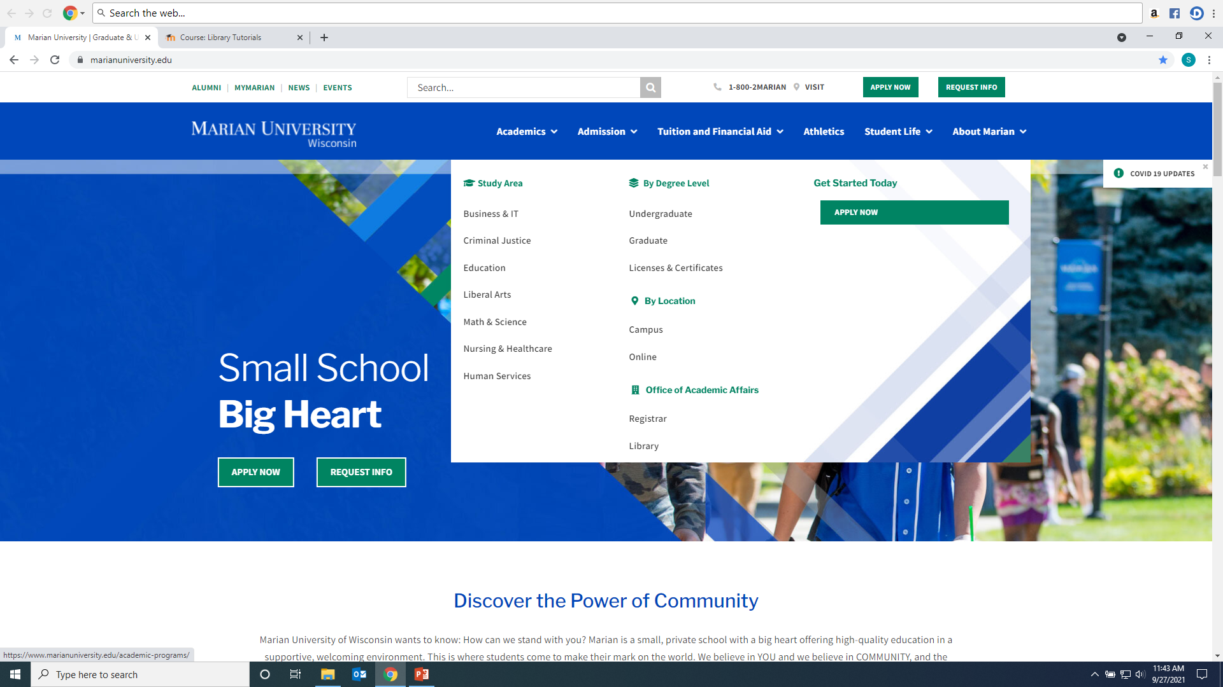
Click on Library from Marian website: https://www.marianuniversity.edu/

Slide 3
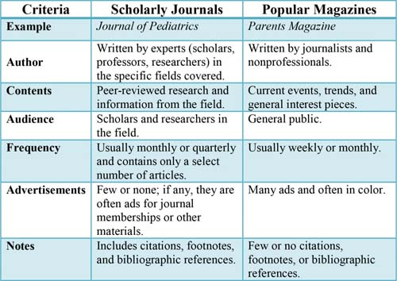
Scholarly/Peer-Reviewed Article vs. Popular Sources

Slide 4
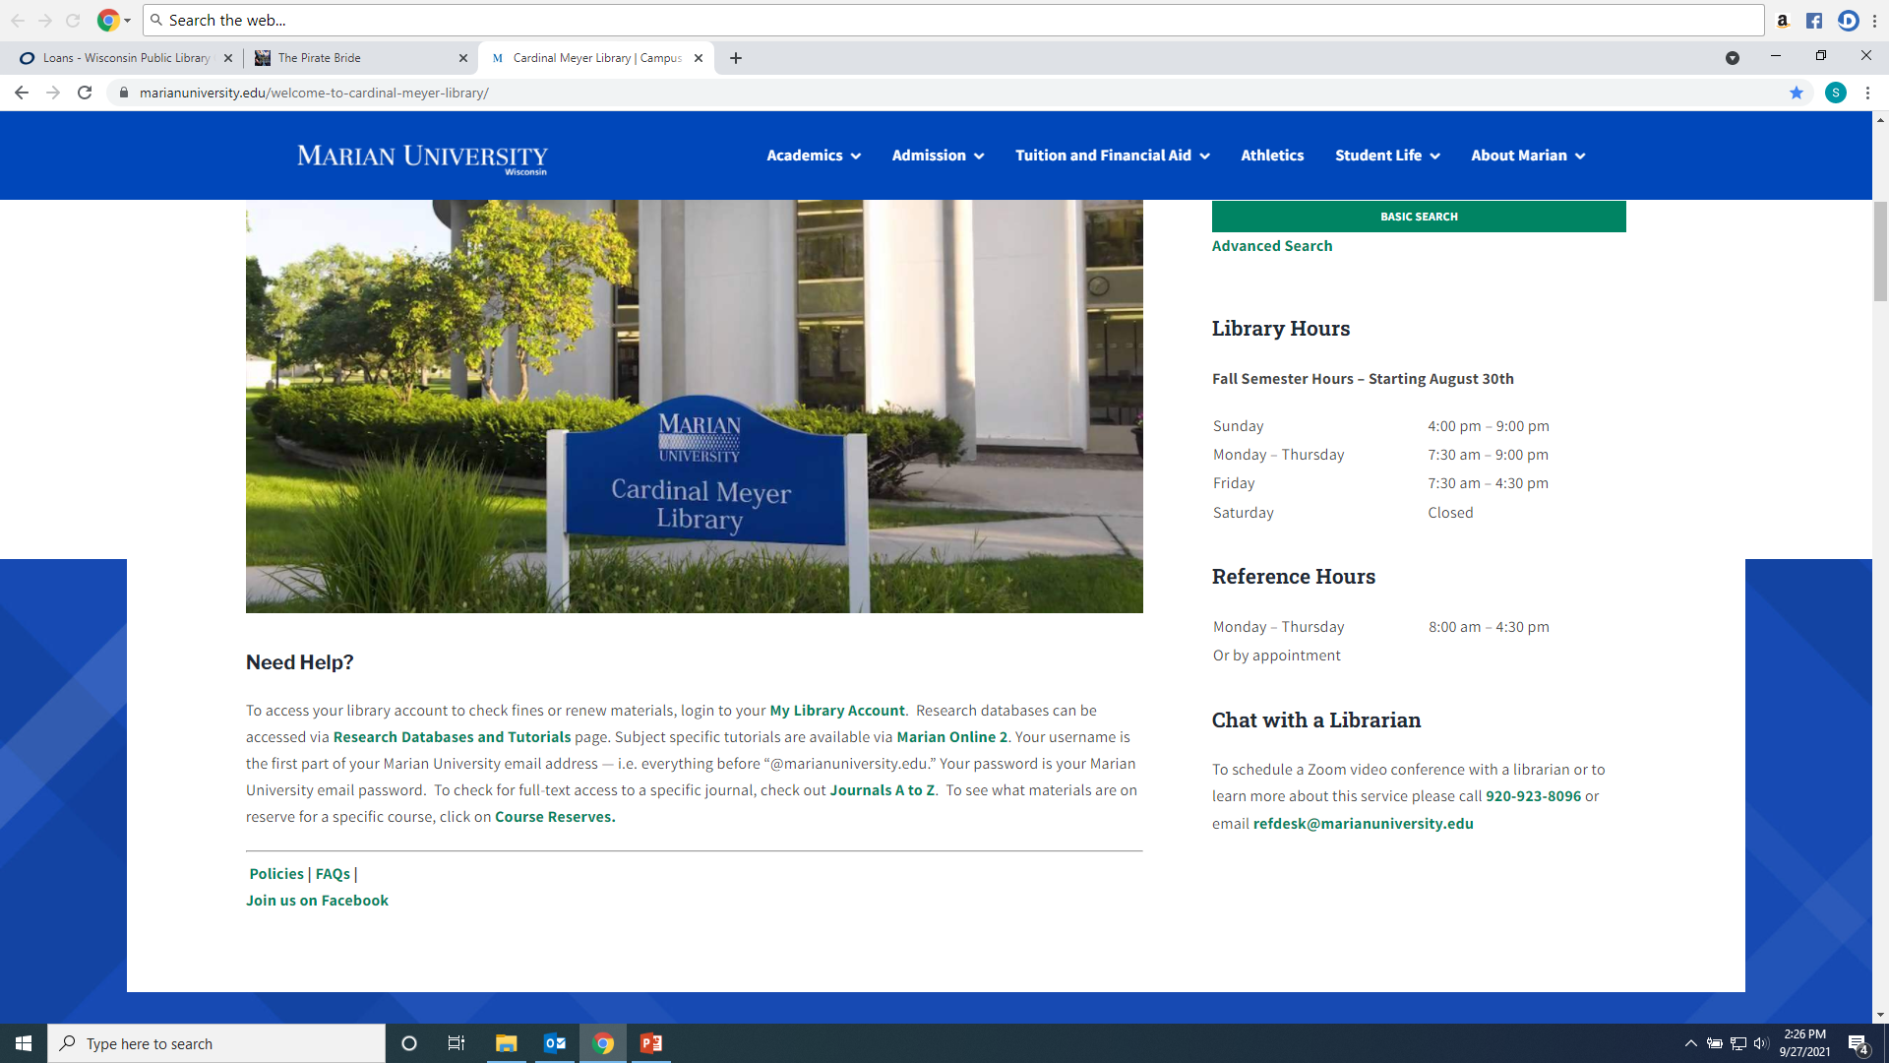
From the Library Home Page click on the “Databases” link on the left hand menu

Slide 5
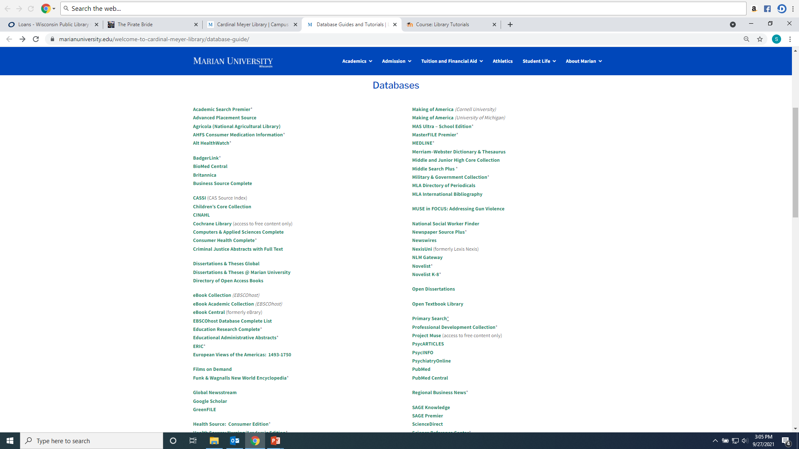
Recommended databases to search for Criminal Justice research articles are: Criminal Justice Abstracts with Full Text, SAGE Premier, NexisUni, Military & Government Collection, Homeland Security Digital Library and Academic Search Premier.

Slide 6
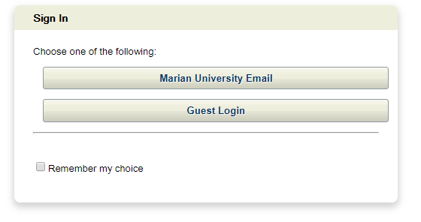
If you are accessing the databases from off-campus, you will be asked to login by clicking on the “Marian University Email” button. You must enter your full Marian Email and password”

Slide 7
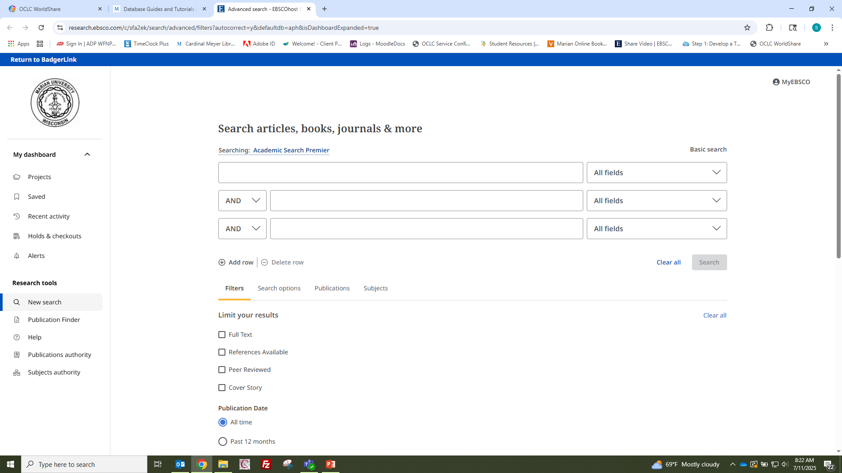
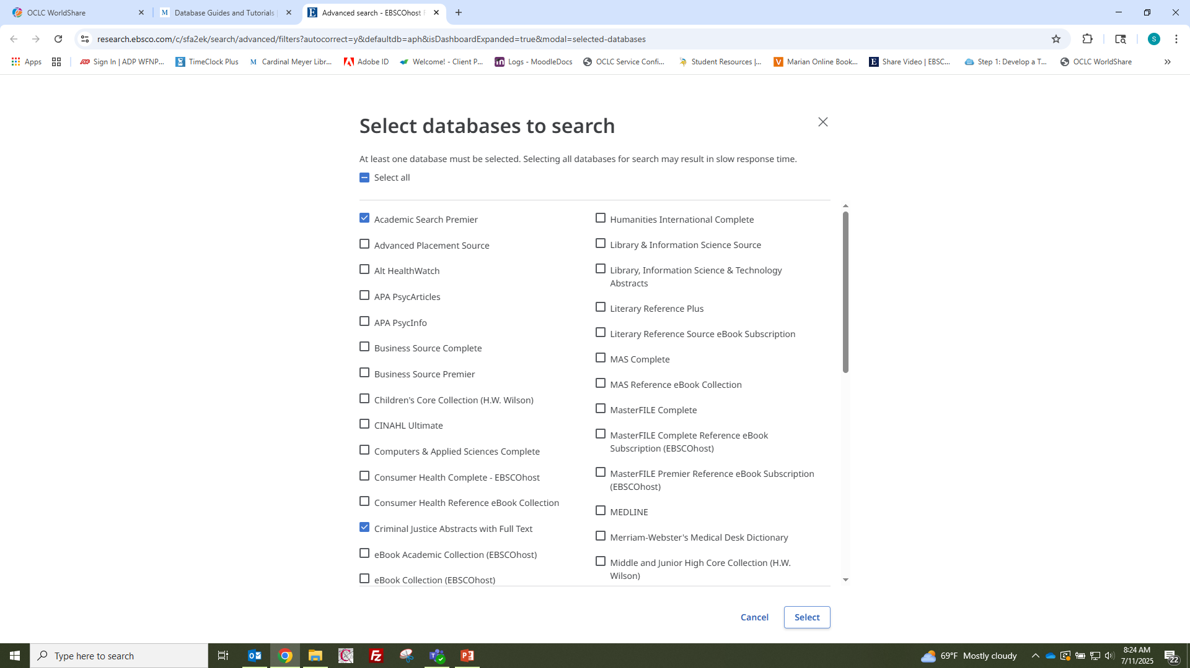
Searching Criminal Justice Abstracts w/Full Text, Military and Government Collection and Academic Search Premier
Click on the default name of database, when list opens select the checkbox next to each database you want to search.

Slide 8
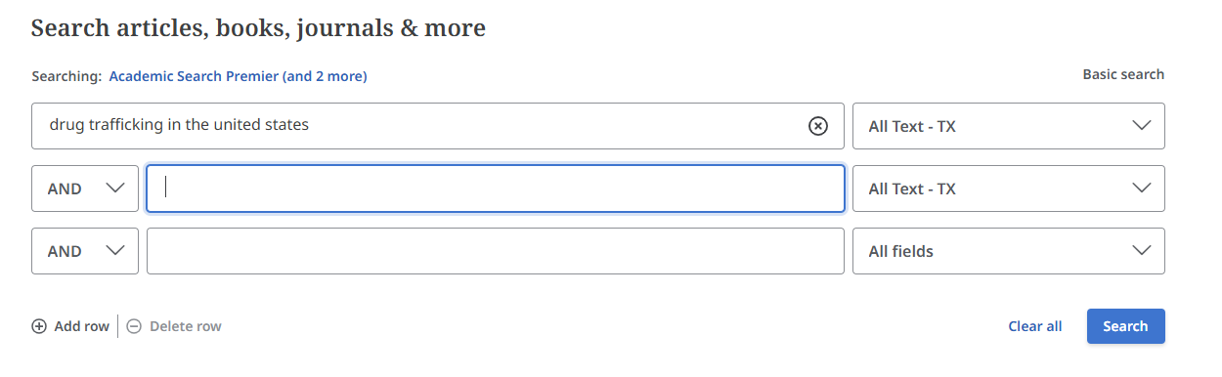
Enter keywords into the search boxes and select “All Text” for each box terms are entered into.

Slide 9
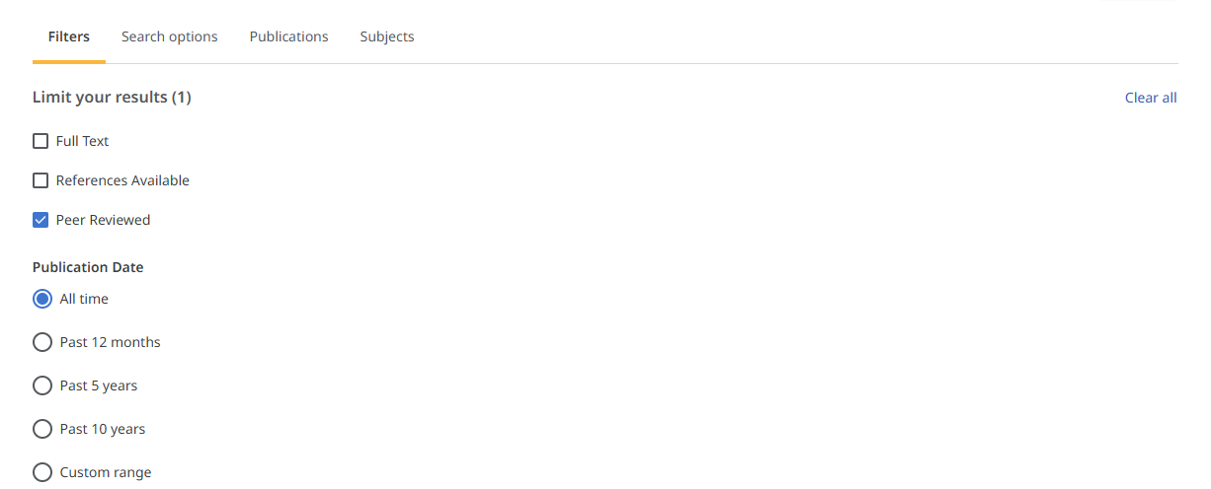
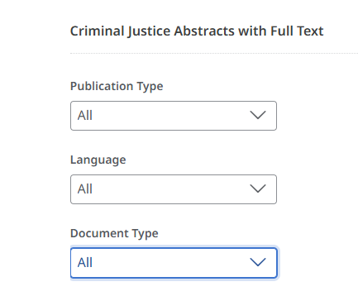
Add Filters to your search: For example, “Peer Reviewed” will limit to only academic research journals. Add age groups, population types, document types and more to focus your search results.

Slide 10
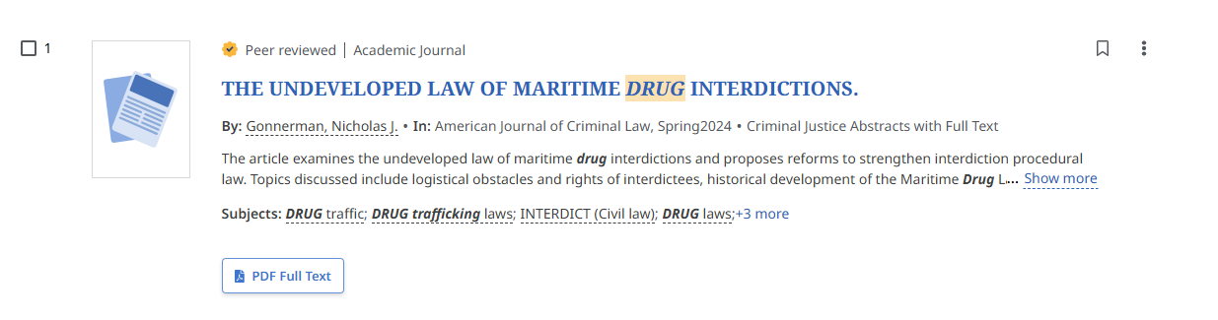
When reviewing your result lists, you should read an article's abstract (summary) to determine its use. You can also generate keywords for your article searches using the subject headings or keywords listed in the citation.

Slide 11
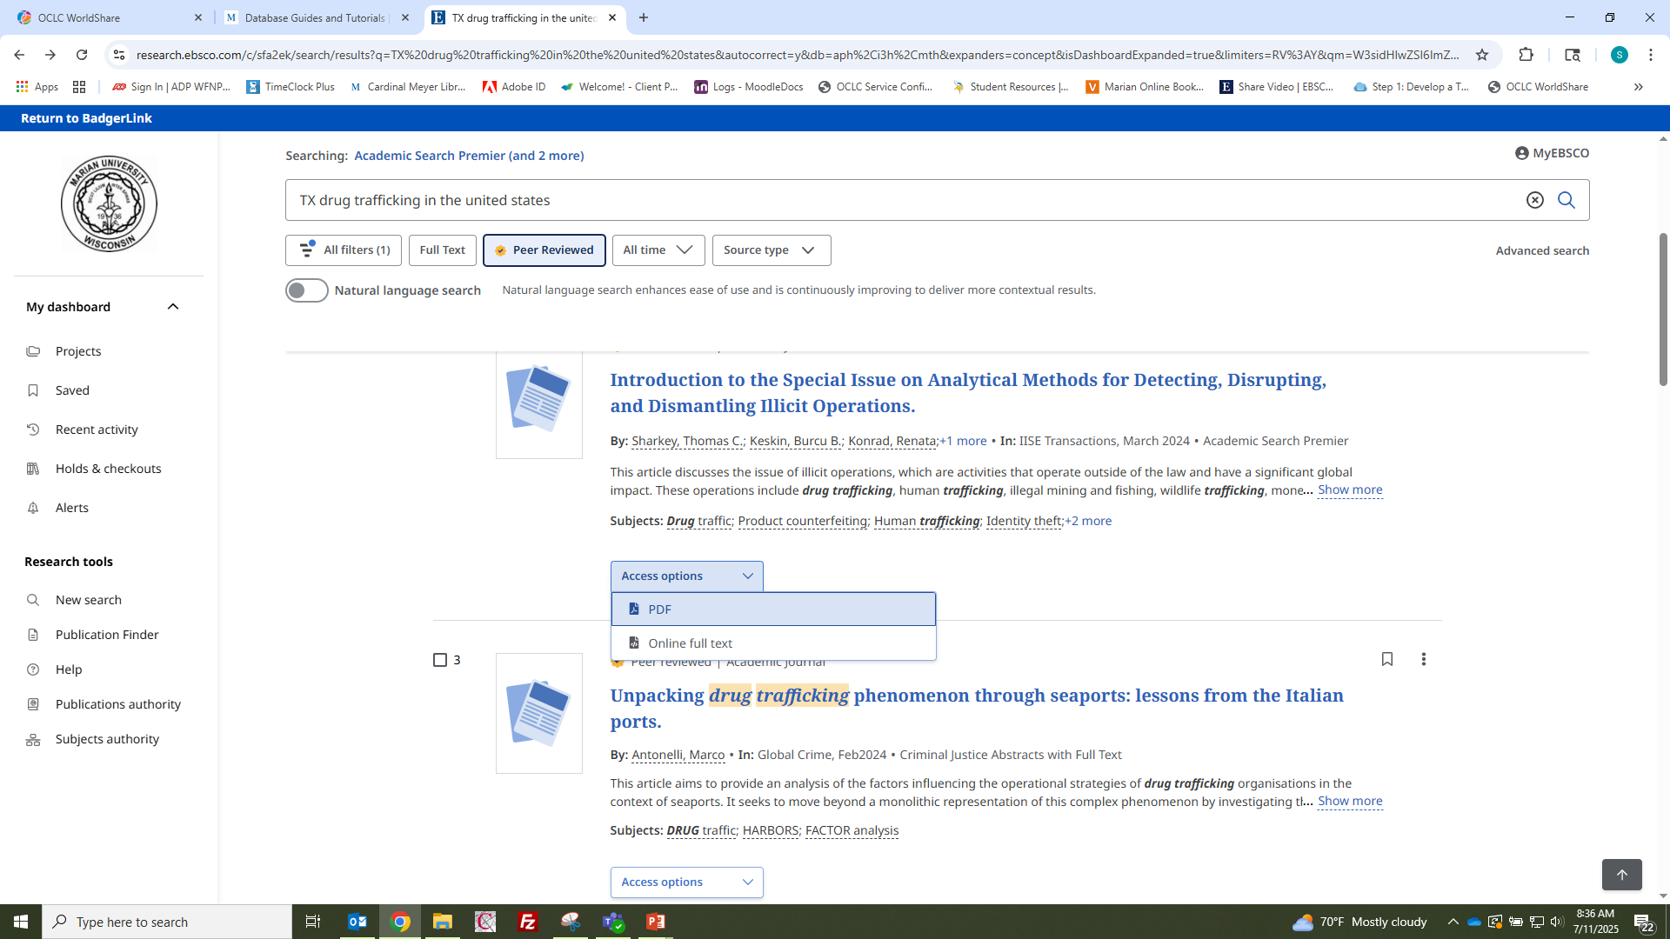
You will have three types of article access options in Ebscohost resources. Click the “Access Options” drop-down menu to see what is available for each article. They are PDF, Online Full Text, or a link to an outside open access source. If you see “Request this item through Interlibrary Loan” the library can request the article from another institution at no cost to student.

Slide 12
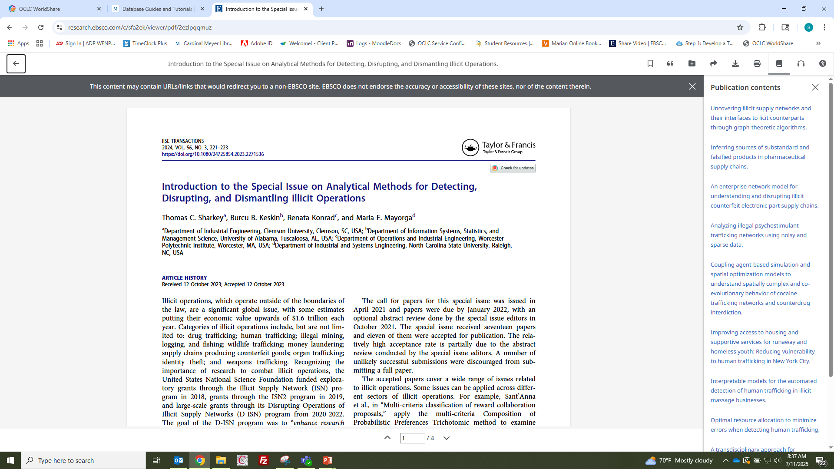
Articles can be printed, downloaded, and shared. On the top right of a full-text article, you will see a toolbar for these features. You can use the headphone icon to have the article read to you.

Slide 13
Nexis Uni includes:
Corporate information such as corporate officers and executives, financial data, SEC filings, and analyst reports
Legal cases
Scholarly and trade business articles, and business news
Legal reviews
Administrative regulations
Legislation

Slide 14
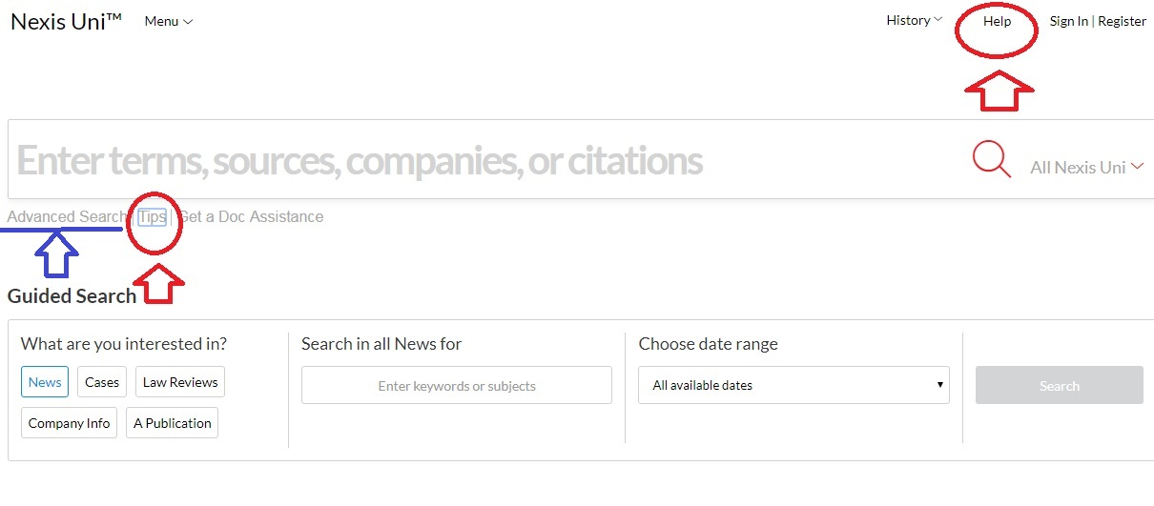
Nexis Uni Help and Tips. Advanced search also may be easier:

Slide 15
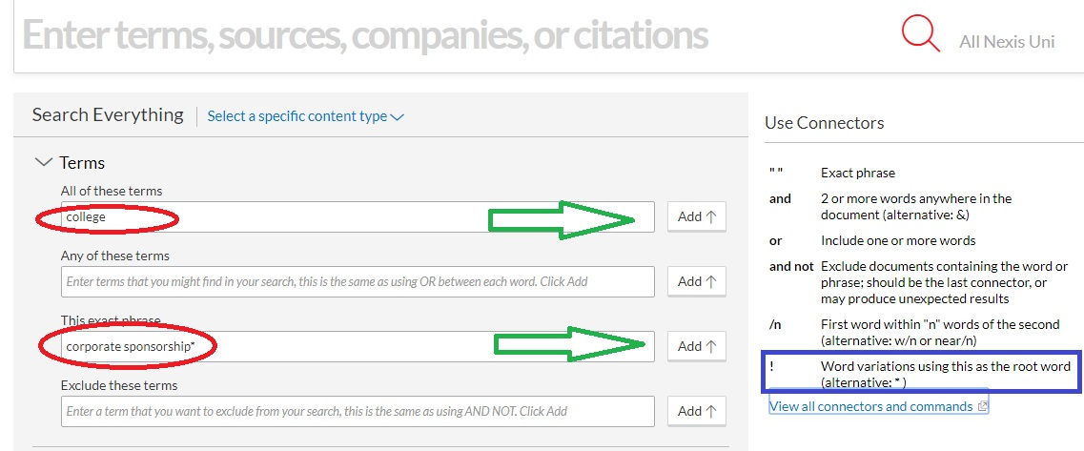
Advanced Search. Click Add to create search. Use ! or * to find words beginning with those letters. Scroll down to click “Search” button.

Slide 16
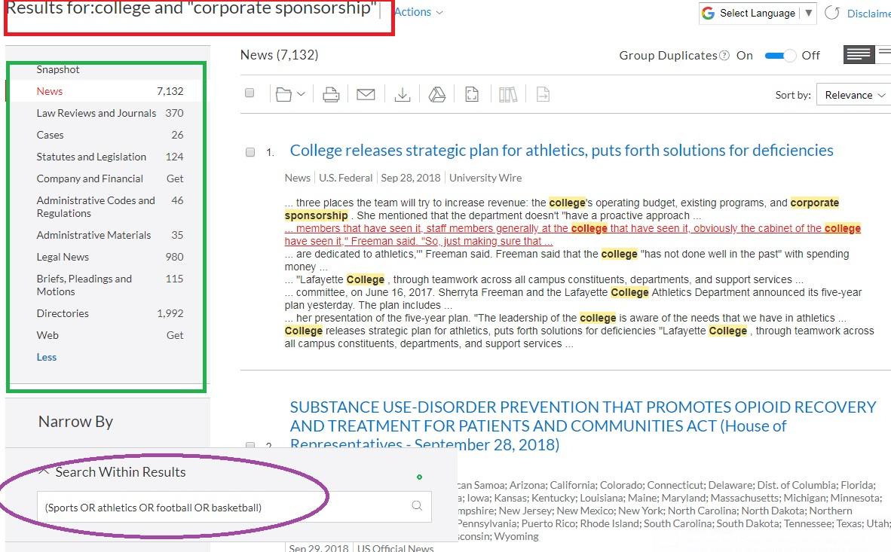
The original search can be narrowed by adding additional terms, by document type, subject, topic, time period…

Slide 17
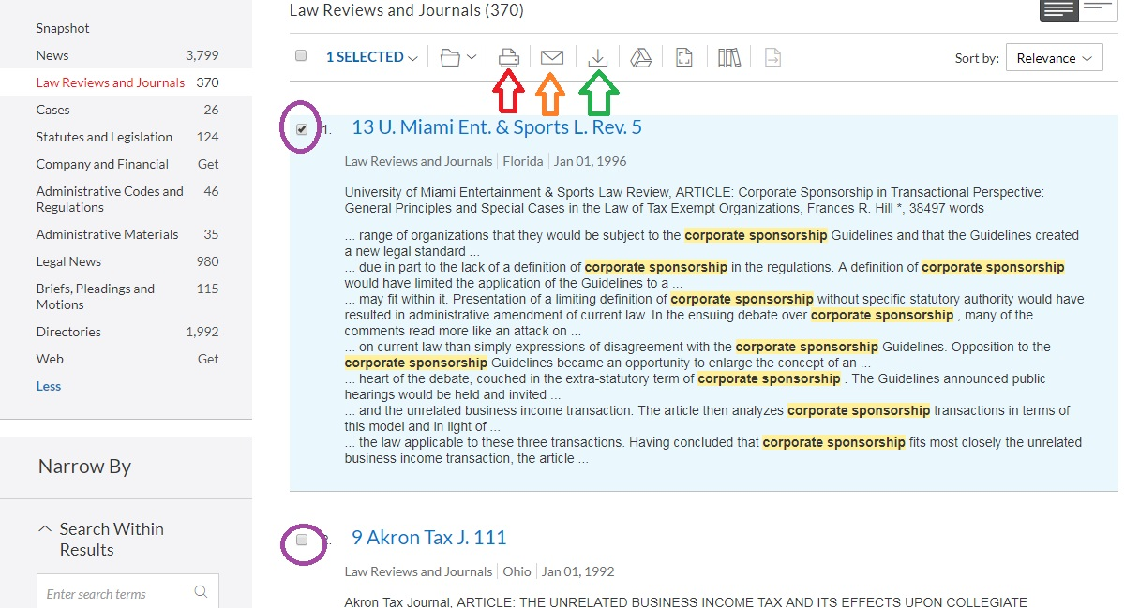
Save individual results, print, email, download…

Slide 18
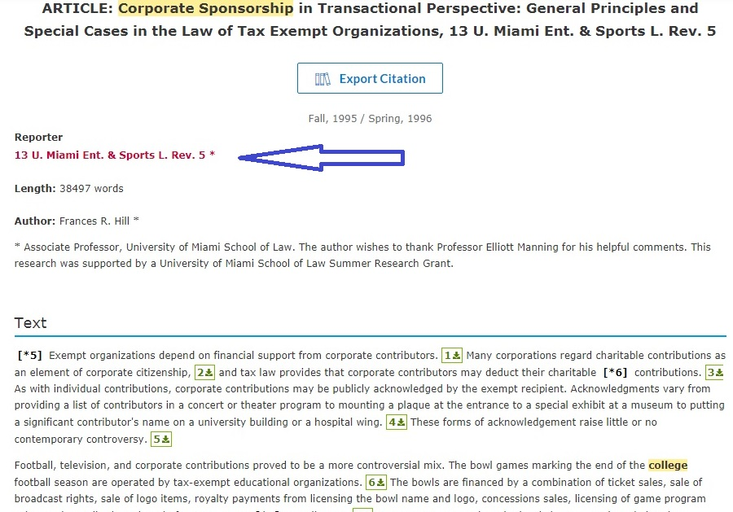
Law review article example. Journal title:

Slide 19
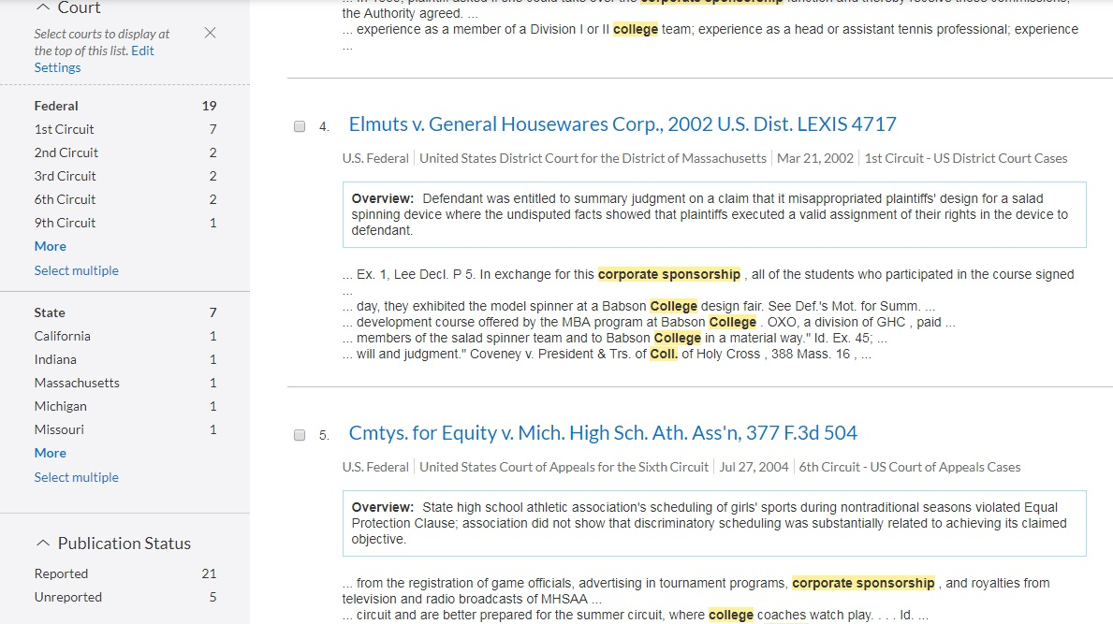
Nexis Uni law cases:

Slide 20
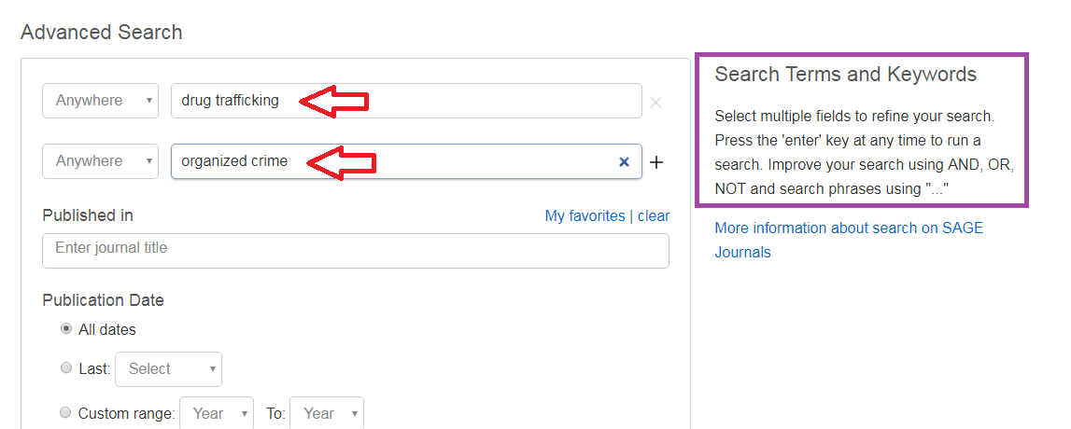
Searching SAGE Premier: Enter Keywords into search boxes; use Boolean Operators And, Or, Not to refine your search

Slide 21
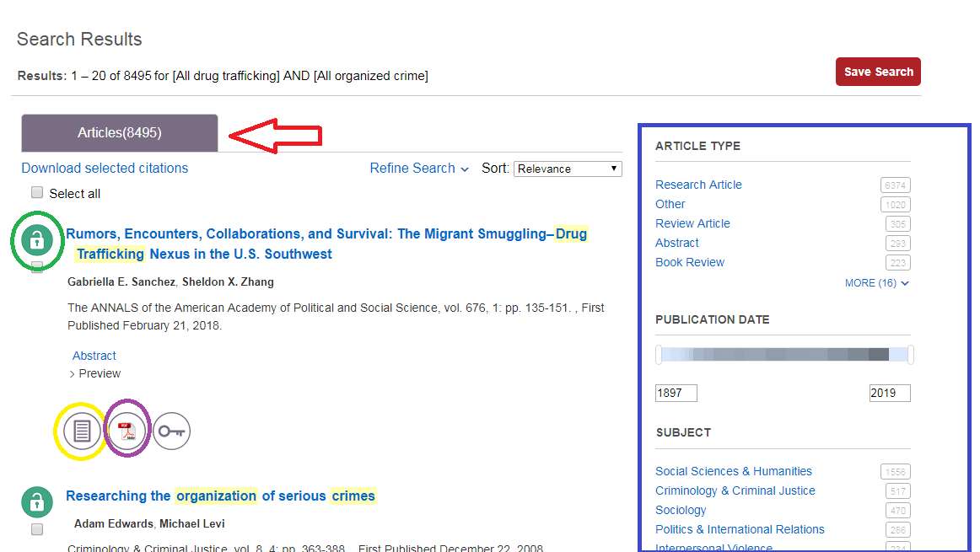
Results with be in at the top (8495). Use the Limiters on the left to narrow your search. The open lock means Marian has the article full text; the closed lock means the article is not full text and may need to be Interlibrary Loaned. Click on either the HTML or PDF full text option to open the article.

Slide 22
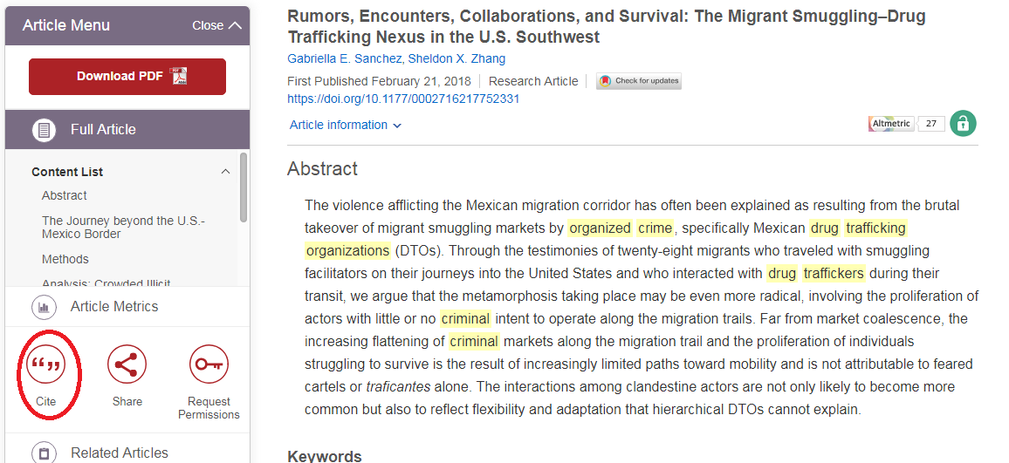
To find citation information for an article in the appropriate format click the “Cite” icon

Slide 23
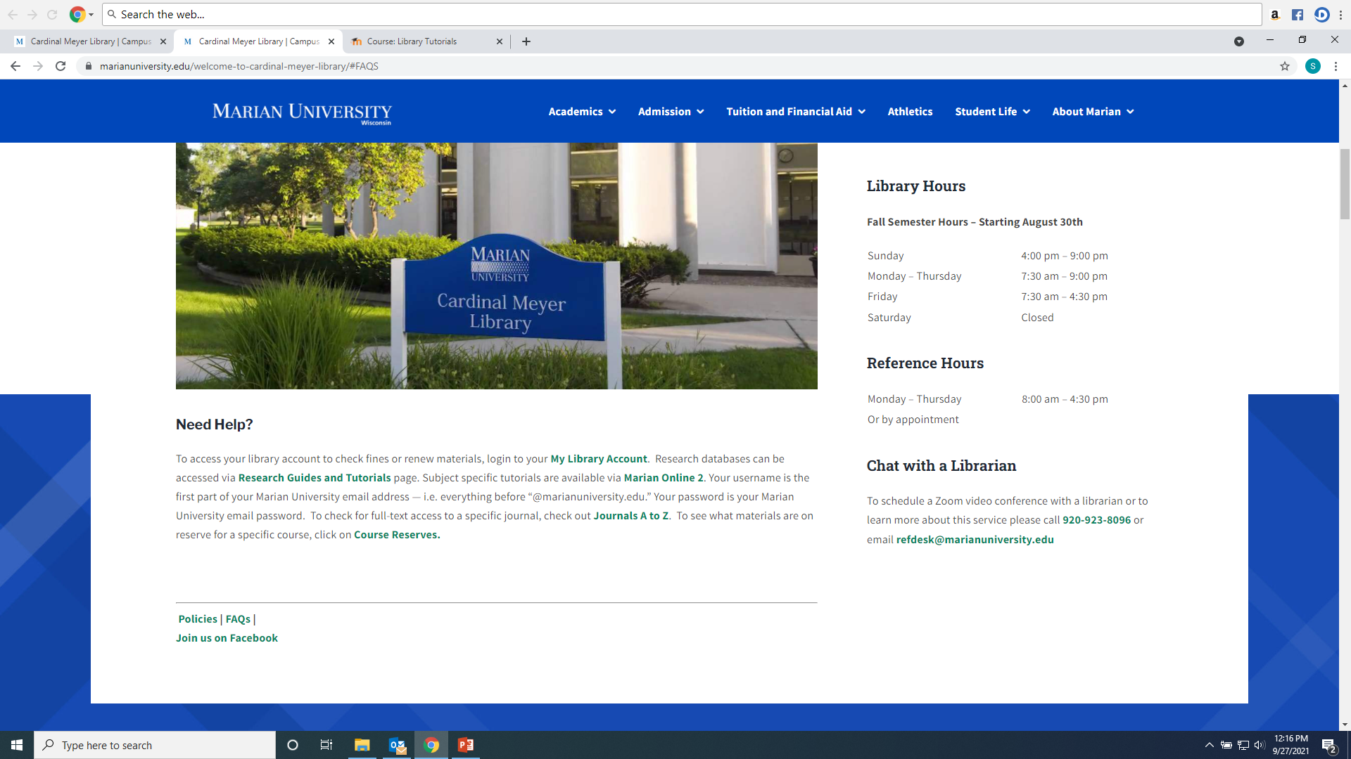
Any Questions?
Ask a library staff member!

