Slide 1
LIBRARY RESOURCES FOR CHEMISTRY
Cardinal Meyer Library
Marian University

Slide 2
Library resources
Connect to databases or websites through the Library’s webpage so that you can access online books or articles:
http://www.marianuniversity.edu/welcome-to-cardinal-meyer-library/

Slide 3
CHEMISTRY Reference Books
Dictionary of Organic Compounds, R547.003 D554
Physicians’ Desk Reference: R615.1 P578 [drug package inserts]
Merck Index: R615.103 M555m
*R at the front means reference area
540=Chemisty; 625=Pharmaceuticals
Entries usually give the original citation on a chemical’s discovery.

Slide 4
Scholarly process
Observation/
Experiment
Dissertation/
conference presentation
Peer reviewed journal article
Review article/Meta-analysis
Chemical "facts" or "laws"
Books/
textbooks/
websites
Notes:
Chemical “facts” include reactions such as H2+O=water or the properties such as boiling points or IR spectra.

Slide 5
Ebooks
Kaye & Laby Tables of Physical & Chemical Constants (16th Ed.)
The entire, unedited contents of the 16th edition (1995), containing tables of data, formulae, graphs and charts. Topics from fundamental constants to fiber optics, superconductivity to Raman spectroscopy, etc.

Slide 6
Chemistry Resources
ChemSpider (UK--free!): http://www.chemspider.com/
PubChem (USA--free!): (http://pubchem.ncbi.nlm.nih.gov/
PubChem Searcher (free)
ToxNet: (free) http://toxnet.nlm.nih.gov/
Notes:
SciFinder indexes chemistry articles as well as having a database of chemicals and reactions that can be searched by name, structure, registry number.
Reaxys also provides a database of information on chemicals and reactions
Web of Science allows you to search by keyword and author but most importantly by citation. It allows you to trace every source used by an article, as well as anyone since who has cited an article. This allows you to track the progress done on a scientific topic.
ChemSpider provides a free database on chemicals and their properties.

Slide 7
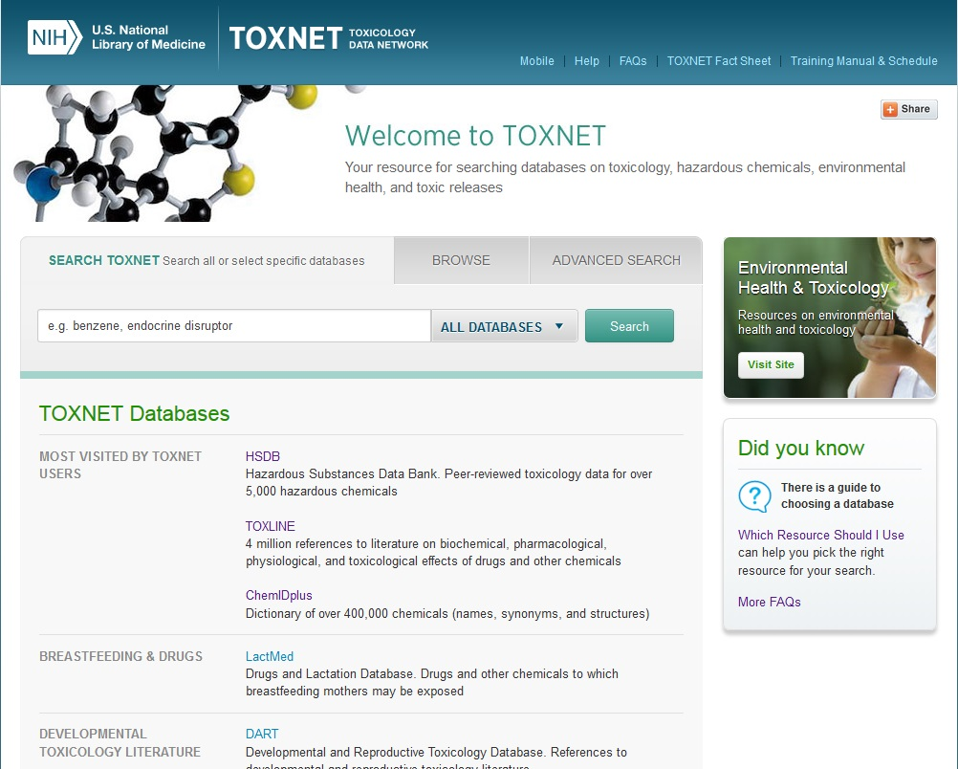
ToxNet

Slide 8
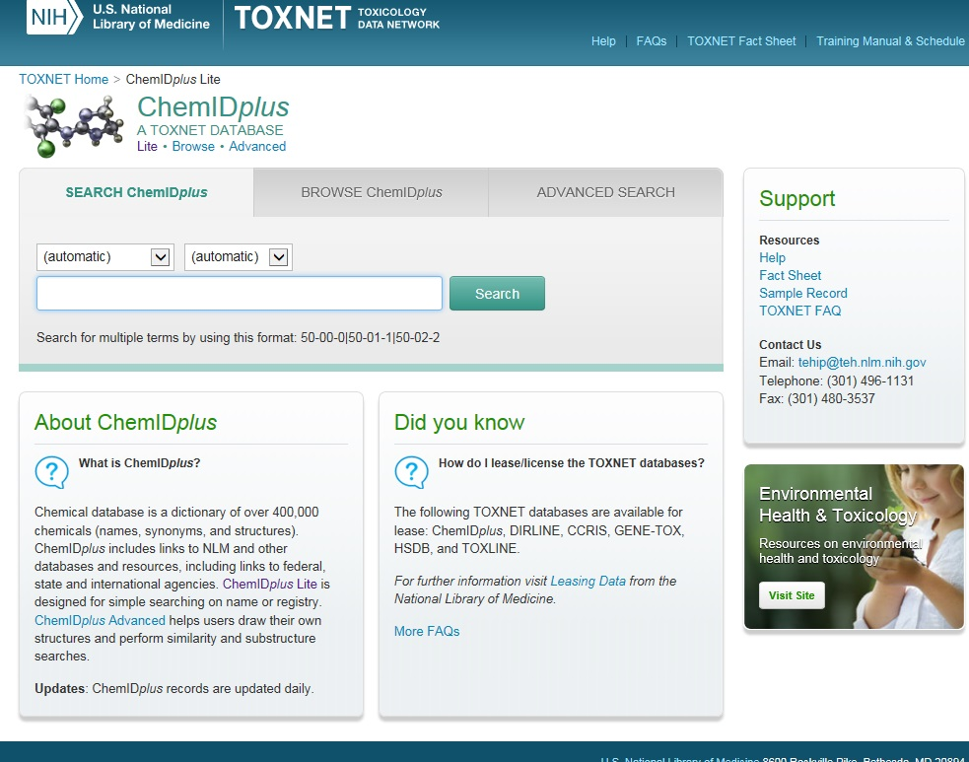
ChemIDPlus

Slide 9
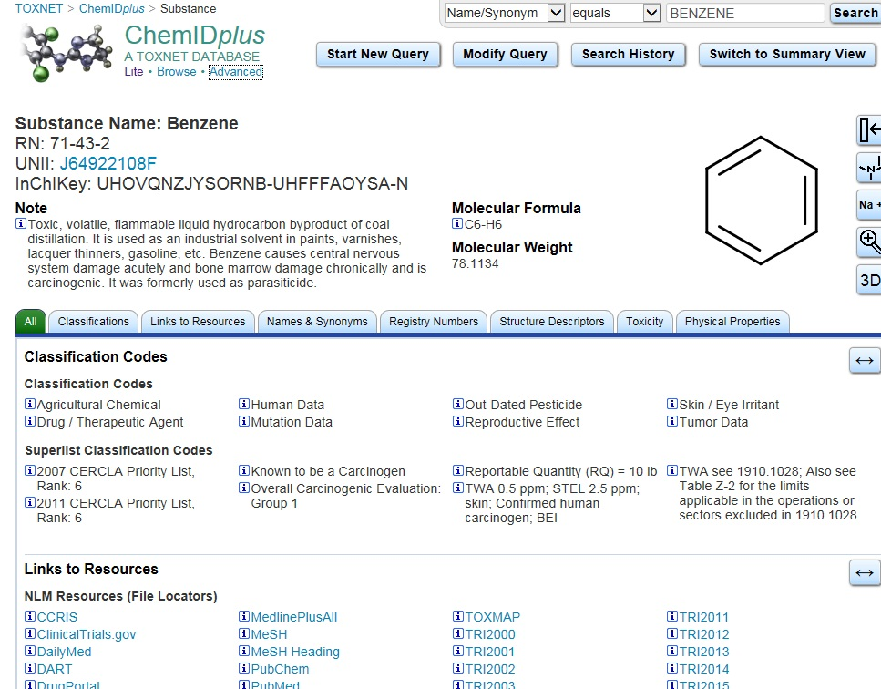
Benzene Results

Slide 10
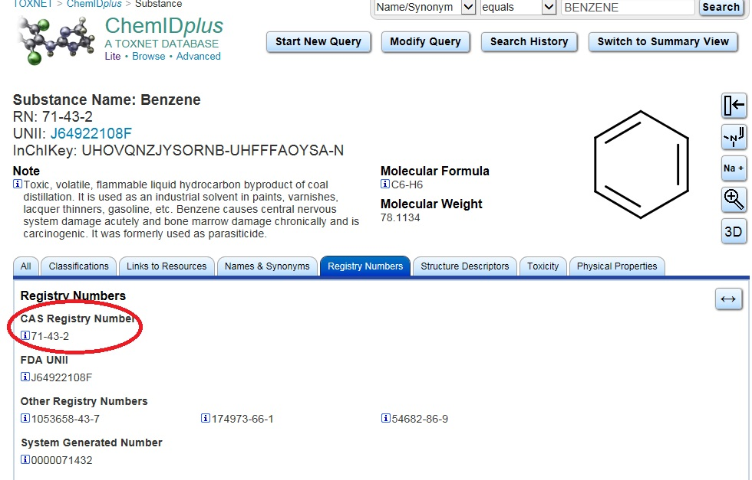
CAS Registry Number

Slide 11
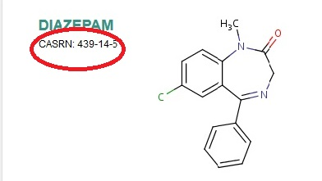
Chemical Abstracts Registry Number
Used to find a substance over many databases like an Social Security number for a person

Slide 12
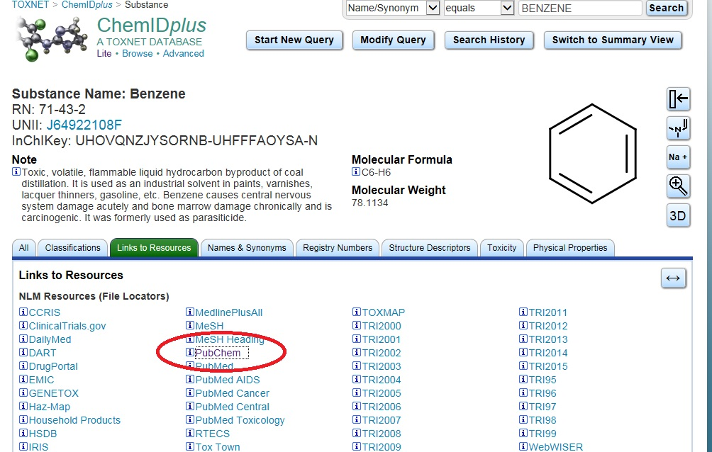
Links to Resources

Slide 13
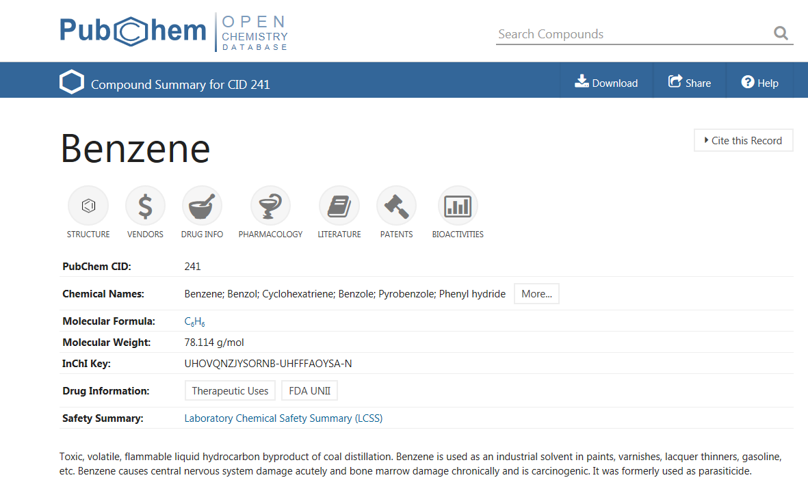
PubChem

Slide 14
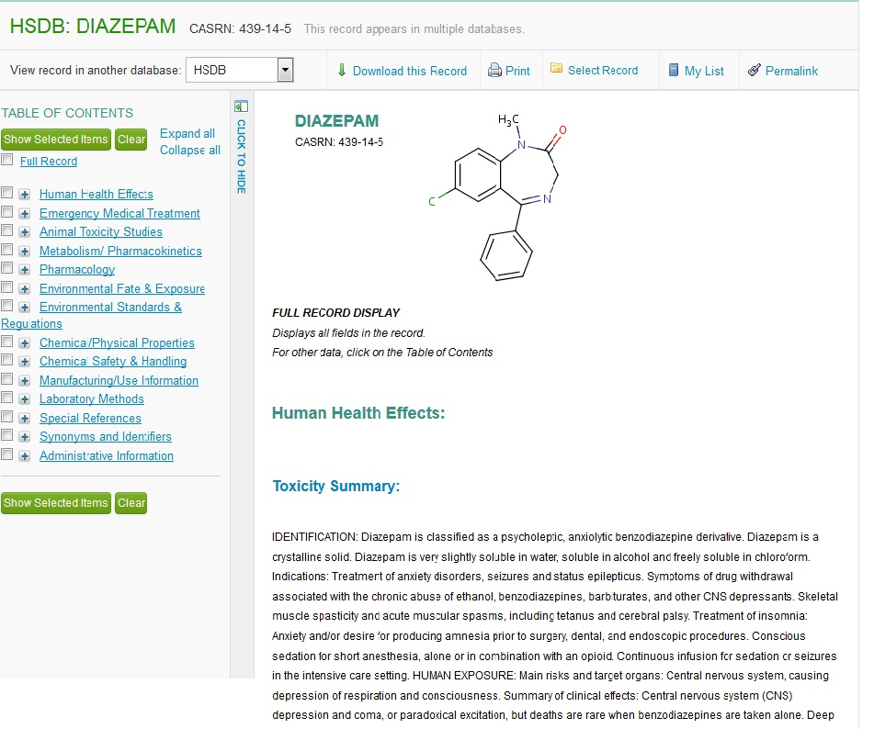
Hazardous Substances Data Base

Slide 15
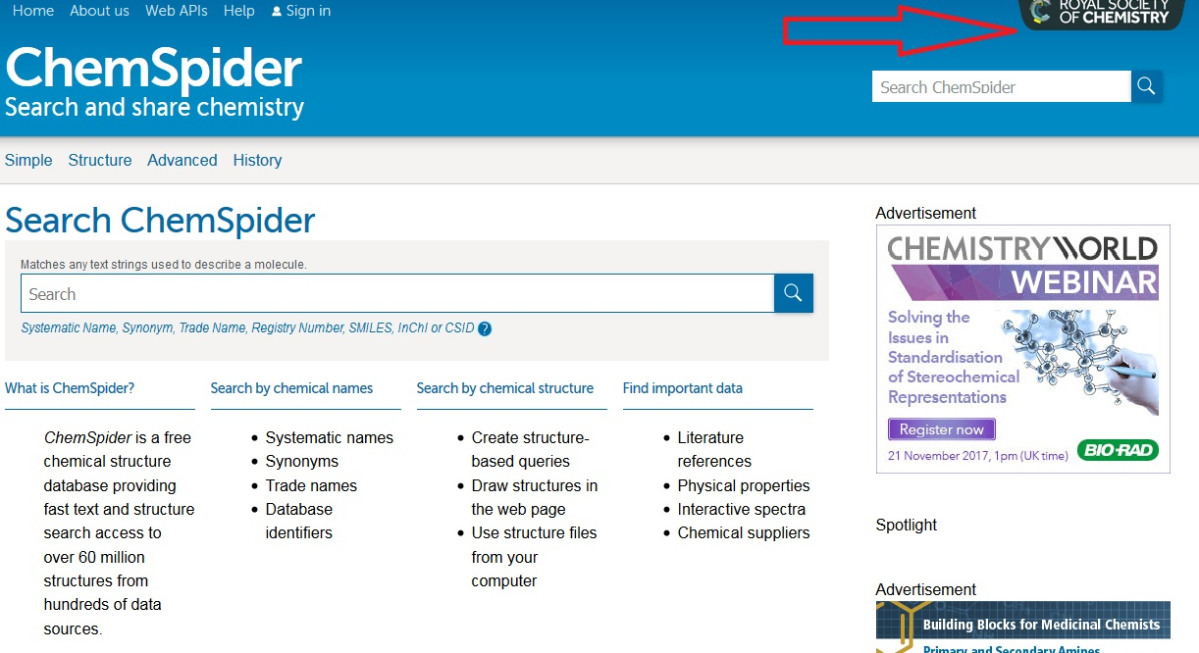
ChemSpider

Slide 16
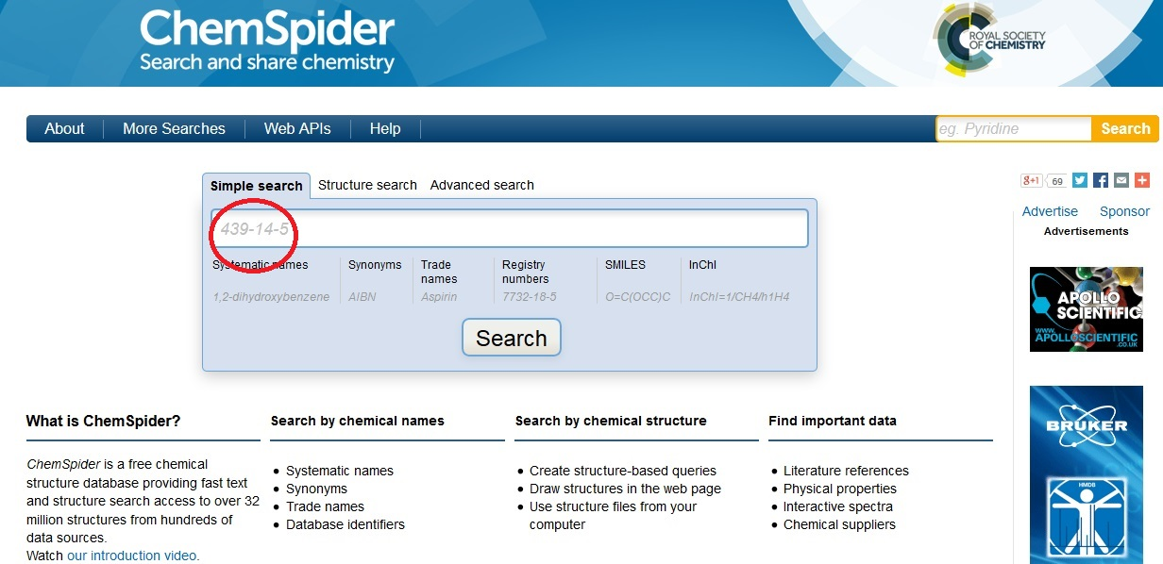
ChemSpider
Example: diazepam registry number seach
Notes:
In ChemSpider I searched by diazepam’s registry number, which is more convenient for chemicals with long, complex names.

Slide 17
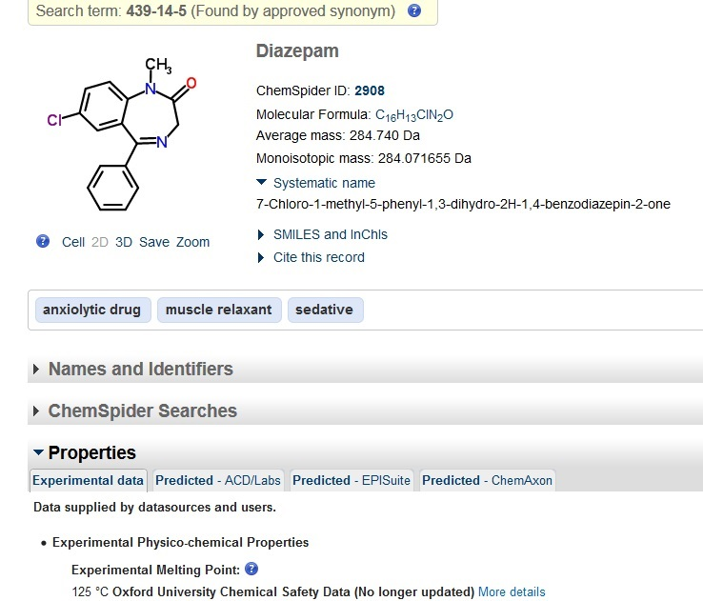
ChemSpider Results

Slide 18
Structural Searching
PubChem Searcher
Platform-independent chemical structure drawing tool. Provides translation into InChI/SMILES/etc., as well as exporting to image and chemical information files (i.e. MDL, ChemDraw, ISIS, etc.).
Cn3D Searcher
Cn3D ("see in 3D") is a helper application for web browsers that allows viewing of 3-dimensional structures from NCBI's Entrez Structure database. Cn3D is provided for Windows and Macintosh, and can be compiled on Unix. Cn3D simultaneously displays structure, sequence, and alignment, and now has powerful annotation and alignment editing features
Xminstry
A web-based, Java-free, HTML5-free structure drawing tool. Can import from programs on Windows with a small add-on. Can export to a variety of image and structure formats.
Accelrys Draw
Accelrys Draw is a simple program for drawing chemical structures. Requires registration. Other tools also available.
Jmol
Jmol is an open-source, Java-based viewer for viewing 3D chemical structures, and contains features for viewing chemicals, crystals, materials and biomolecules.

Slide 19
Chemical properties
CalTech Library chemistry website
Special thanks to CalTech Chemistry librarian, Donna T. Wrublewski, Ph.D., MRSC
The properties of many organic chemicals have been established for long enough that the information is available in open source and free resources.

Slide 20
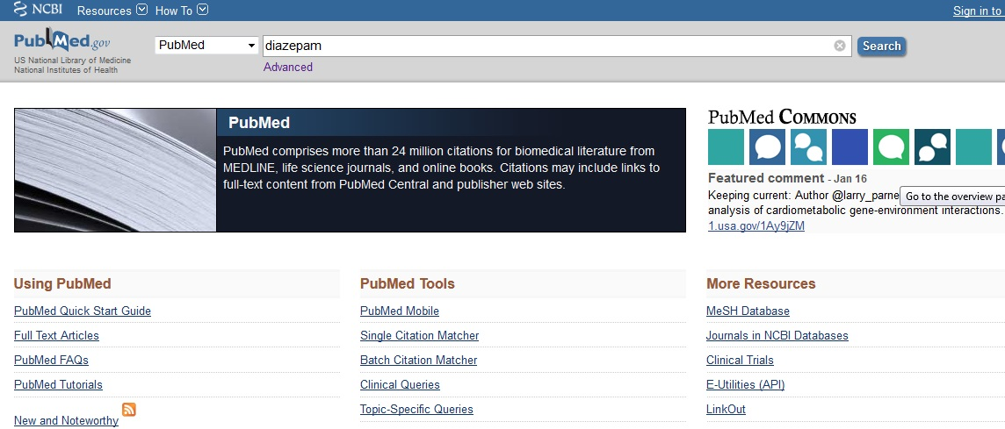
PubMed
PubMed will automatically suggest search terms as you type in your topic. You can select from these terms or search by the topic you typed.

Slide 21
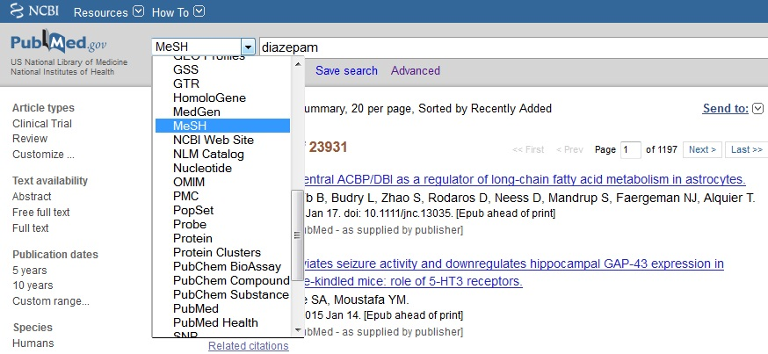
PubMed Subjects
Narrow results by using the drop down and choosing MeSH (Medical Subject Heading)

Slide 22
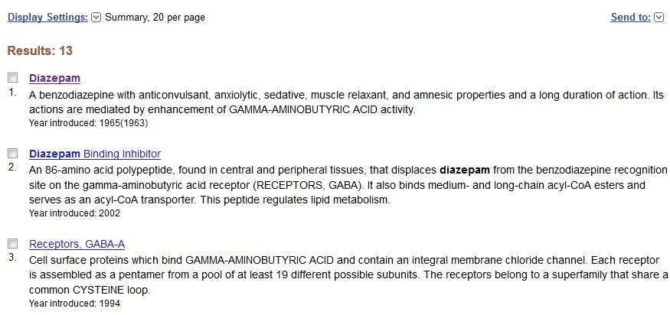
MeSH
Click on the best subject

Slide 23
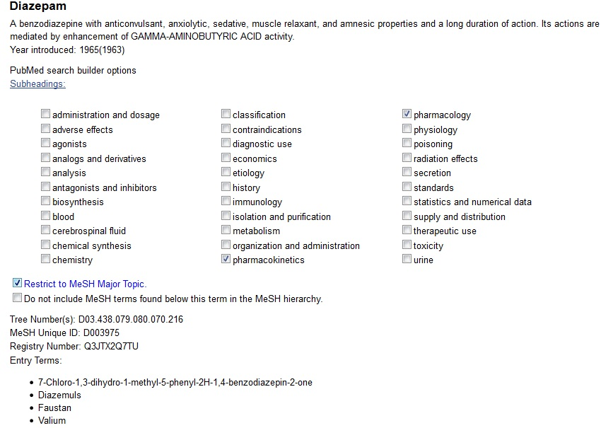
MeSH Subheadings
Click desired boxes
Notes:
Click on the appropriate subheadings to narrow the topic. You can click on more than one subheading. If you want your topic to be the major point of the article, click also on the box by Restrict to MeSH Major Topic.

Slide 24
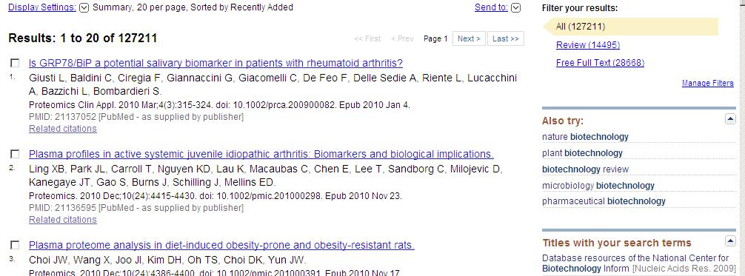
PubMed
The results will appear as follows:
To view the abstract (summary) of an article, click on the title.
To narrow down the list of results, use the Filter Your Results option or use the Also Try options to begin a new search.

Slide 25
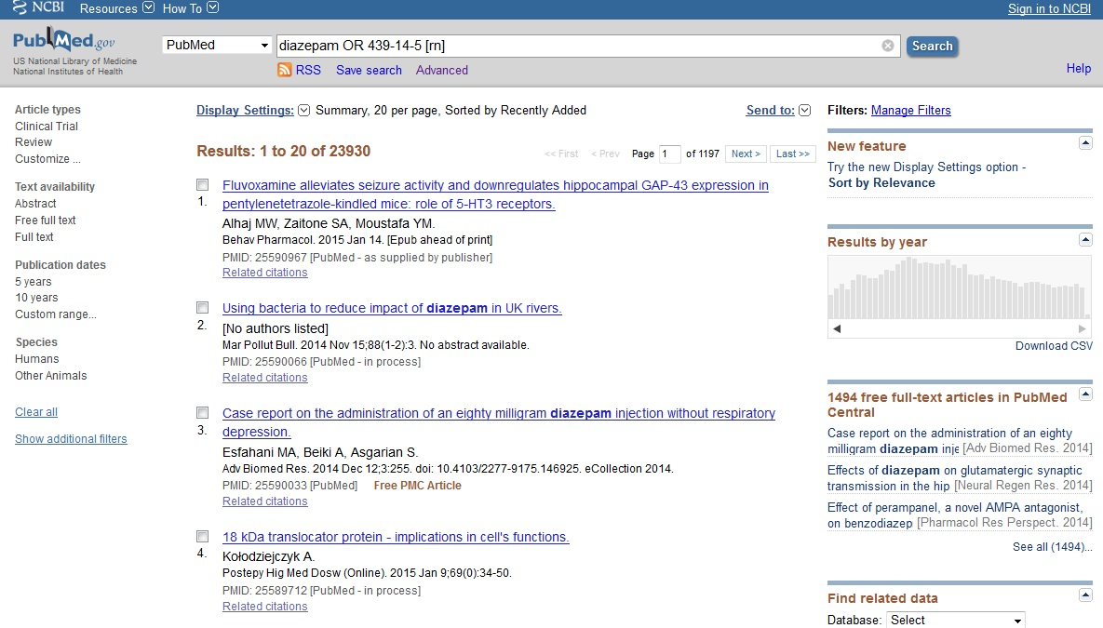
Pubmed results
Notes:
PubMed is a huge index of all medical articles going back for decades, including articles not in English.

Slide 26
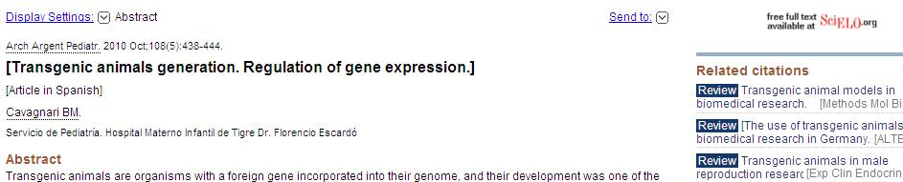
PubMed
Some articles available in PubMed have the full text of the article available.
  To access the full text, click the link on the abstract page to access the full text.

Slide 27
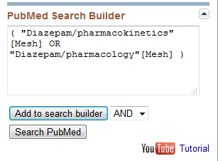
MeSH: add to search
Click on the far right: Add to Search Builder
Click on Search PubMed

Slide 28
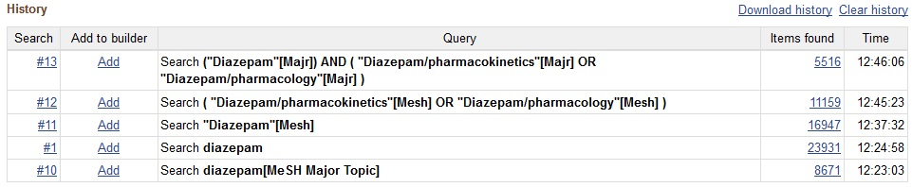
PubMed Search History
Compare the results from using Diazepam as free text, subject headings, Major topic, subheadings:
Notes:
Diazepam as a keyword search found 23931 articles. As a MeSH subject heading, it found 16947. With the two subheadings of pharmacokinetics and pharmacology, there were 11159 articles. When those articles also had to be a major topic of the article, it was narrowed down to5516 articles.

Slide 29
Large universities and corporations own more chemical sources:
Chemical Abstracts/SciFinder: chemical structures, properties, reactions and articles
Reaxys: chemical structures, properties and reactions)
Web of Science (Science Citation Index): Trace the research by who used a source or cited an author

Slide 30
Chemistry citations
American Chemical Society (ACS) Style Guide (3rd Edition, 2006) is available online
Bunnett, J. F.; Kearley, F. J., Jr.; J. Org. Chem., 1971, 36, 184-186.
The authors are listed last name, first initial(s).
The journal is italicized and listed in abbreviated form (more about that below).
The year is listed in bold font.
The journal volume is listed in italicized font.
The starting and ending pages are listed separated by a hyphen.
Sometimes you will see the title given between the author names and the journal abbreviation, but usually not. This is because titles can be very long and include non-standard symbols or fonts.

Slide 31
Journal Abbreviations
CASSI - Chemical Abstracts Services Source Index is a listing of both journal abbreviations and full titles. You can use this to translate an abbreviation, or, knowing the full journal title, find its accepted abbreviation to use in your citation. However, it is limited to publications indexed by CAS.
NLM's Abridged Index Medicus (AIM) - biological and clinical journals indexed in the AIM may have a different abbreviation, more info can be found on the linked page.

Slide 32
Recommended Databases
Academic Search Premiere (EBSCO) includes 430 chemistry journals some in fulltext. Many articles will need to be requested through interlibrary loan.
Science Direct includes 2052 books and journal titles in chemistry published by Elsevier including a few open source or fulltext owned by Marian. Most will need to be retrieved through interlibrary loan.
SAGE --fulltext journals from Sage Publishing including some in chemistry such as Analytical Chemistry Insights
MEDLINE/PubMed provides authoritative medical information including articles related to chemistry. Some articles will be in fulltext but most will require interlibrary loan.

Slide 33
Google Scholar
On campus, more fulltext articles should be available since Marian subscriptions should be recognized.
May be best for very old materials since they are not covered by copyright and are in public domain.
Citation searching
Not vetted or peer reviewed!

Slide 34
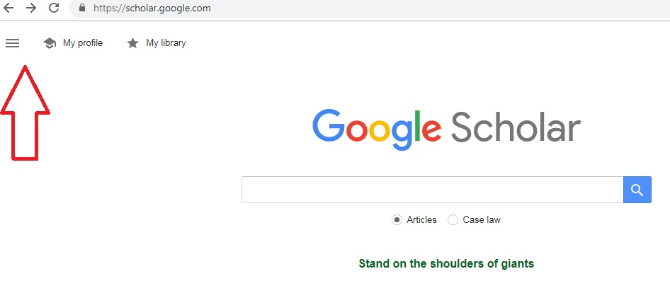
Google Scholar
Click here to use Advanced Search
Click on the very bottom Help to perform citation searches

Slide 35
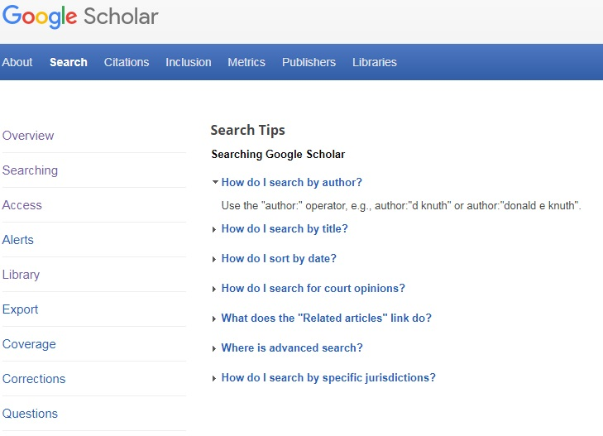
Google Scholar
Use the advanced methods to find citations, articles, sort by date, etc.

Slide 36
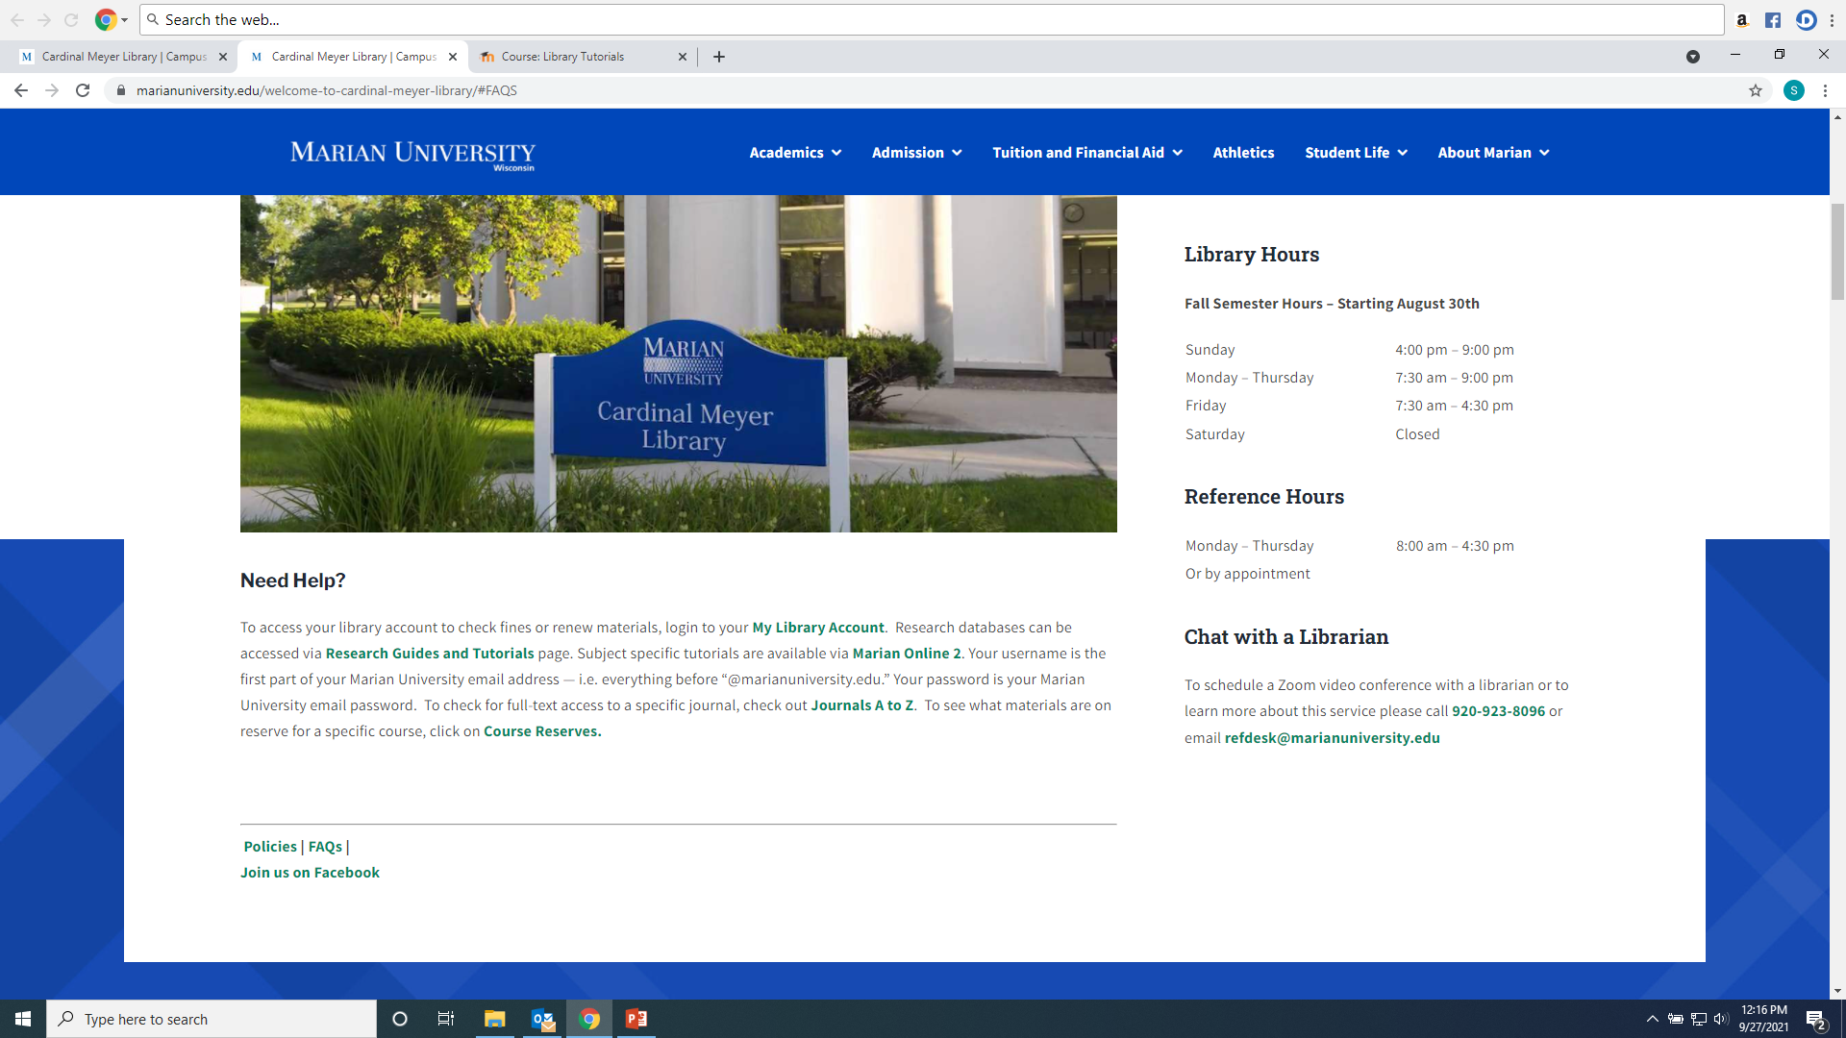
Questions?

