Slide 1
How to research in
Social Work
Cardinal Meyer Library
Marian University

Slide 2
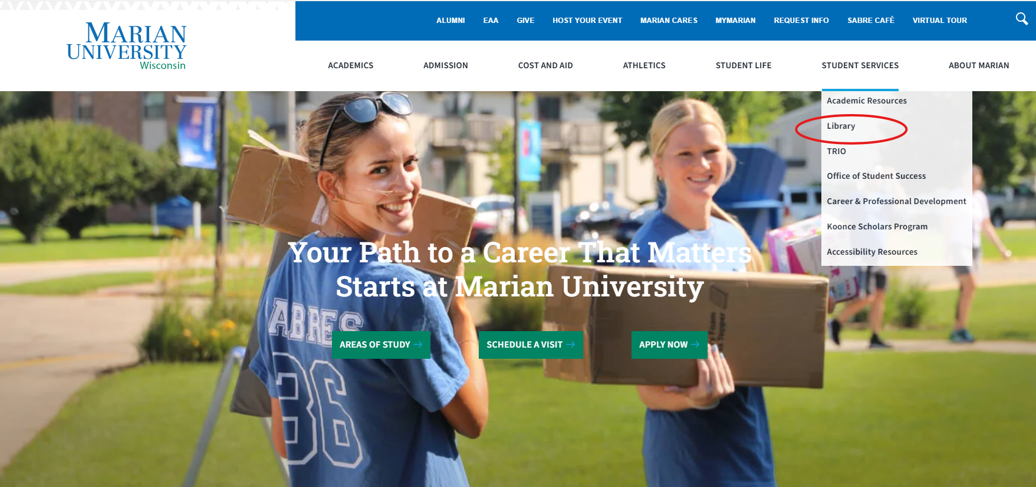
Click on Library from Marian website:

Slide 3
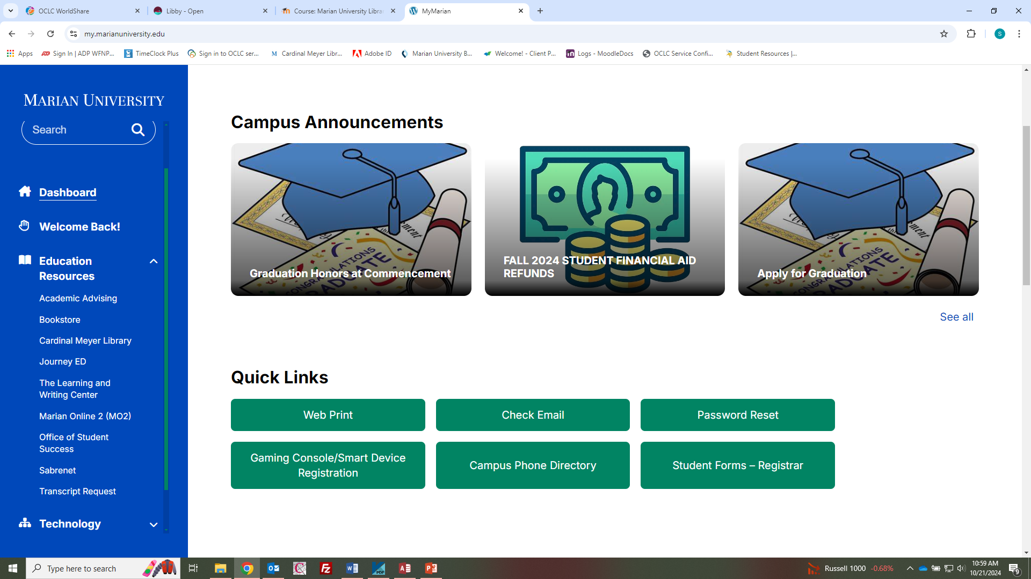
From MyMarian, click on Library:

Slide 4
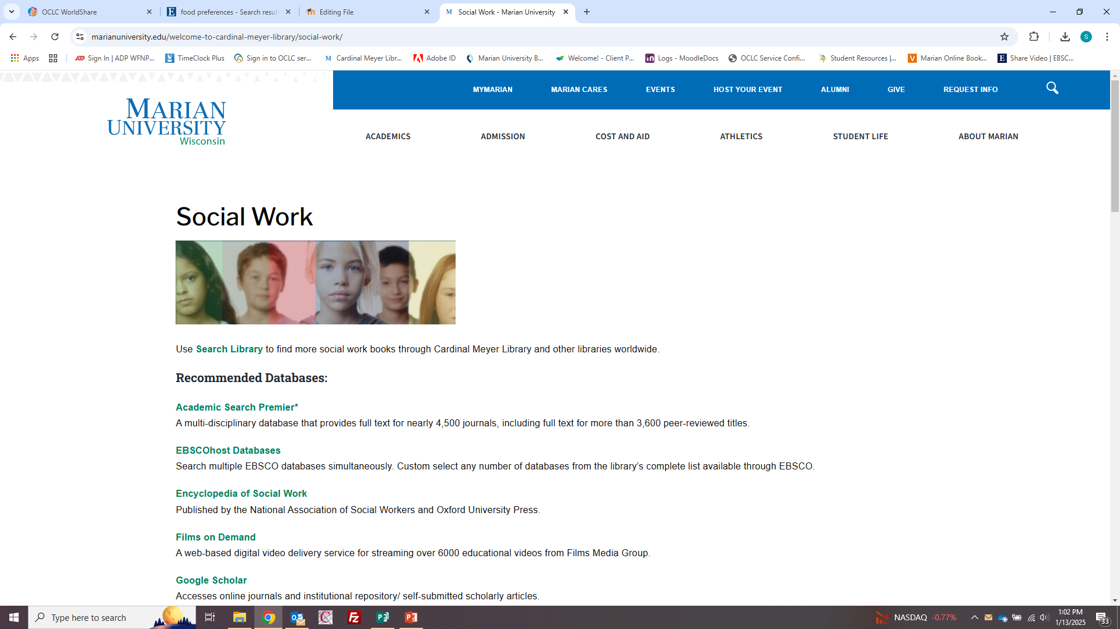
Social Work subject guide

Slide 5
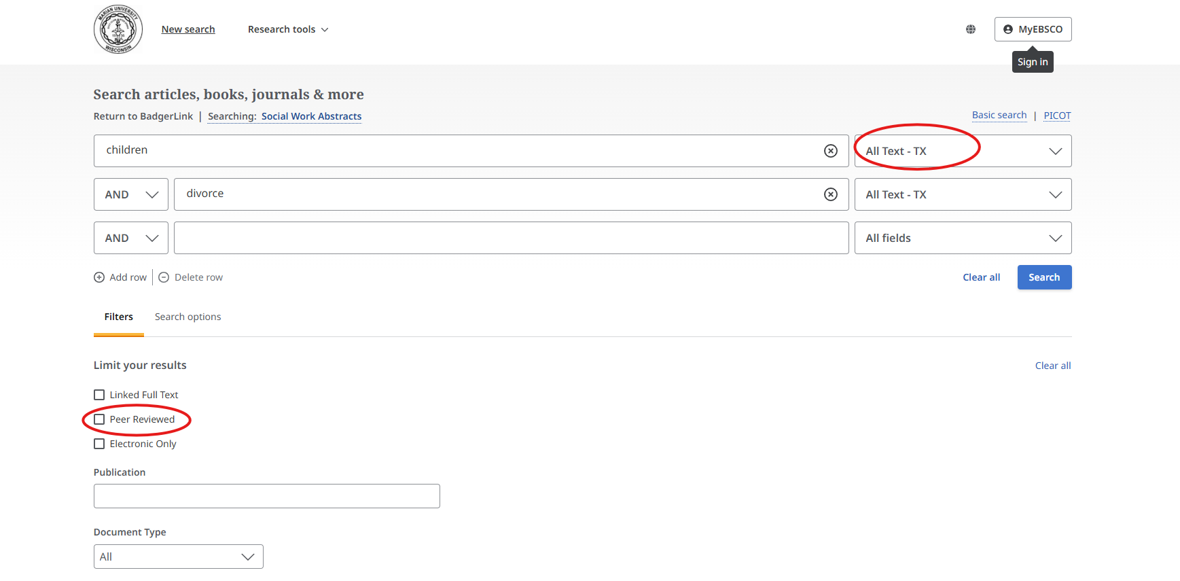
Social Work Abstracts
Example Search: Enter keywords in the boxes at the top of the search screen.
  In the drop down menu next to the search box, select an option of where the database will look for the keywords. The ‘All Text’ option will search everywhere for the keywords.
  Click on “Peer Reviewed” under limiters to obtain scholarly articles

Slide 6
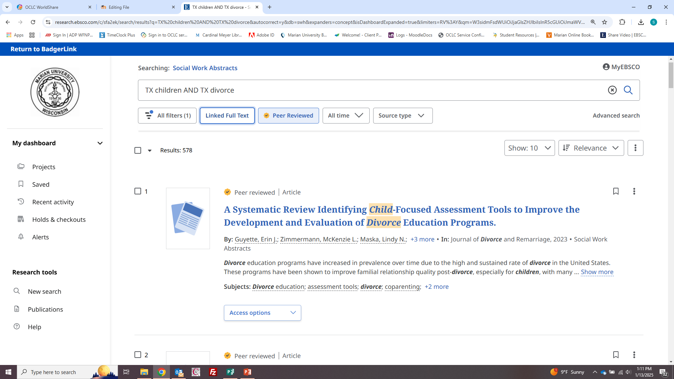
Social Work Abstracts has some full text options like pdf and online but most will be available for free via interlibrary loan

Slide 7
Social Work Abstracts
To read the article, click on the PDF or Online Full Text links:
If the article is not available in full text, click the Request Item through Interlibrary loan link to order the item from a different library.
  Note: Items requested via Interlibrary Loan may take 2 to 3 days to arrive.
A link may be provided to another database that does have the full text.

Slide 8
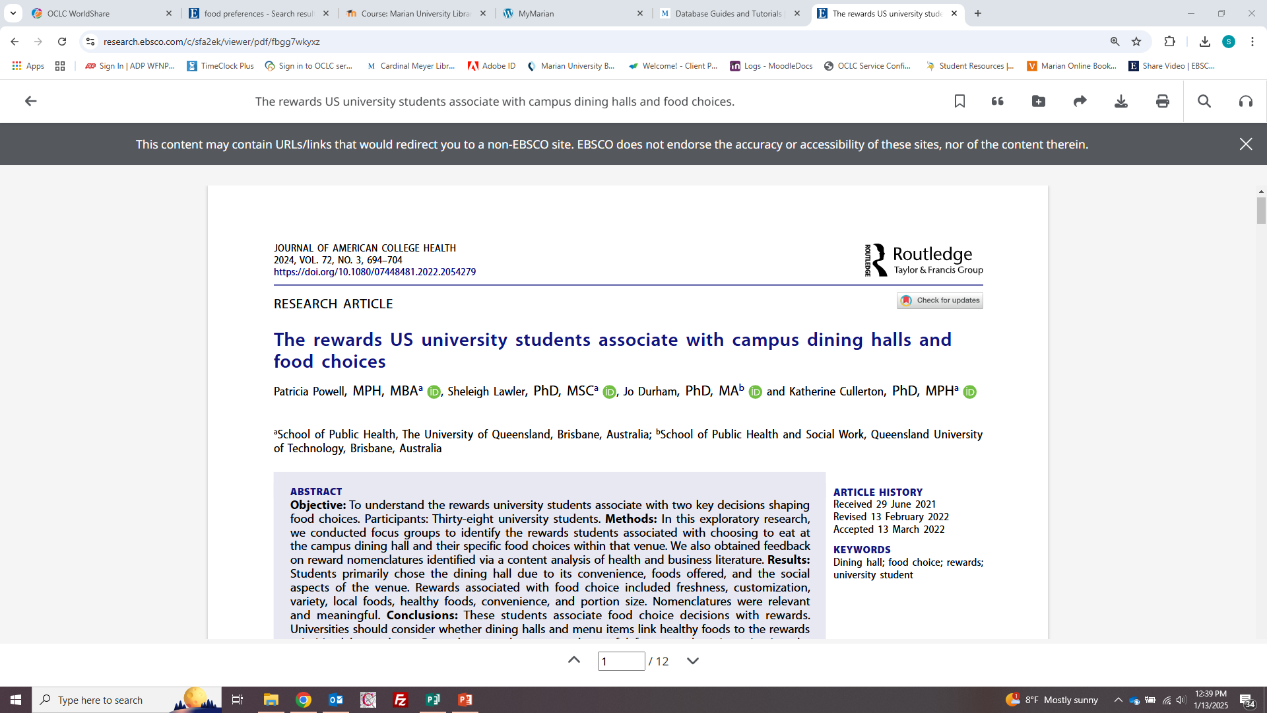
Articles can be shared, downloaded, and printed using the icons on the top right. You can also search within the article for keywords or have the article read to you.

Slide 9
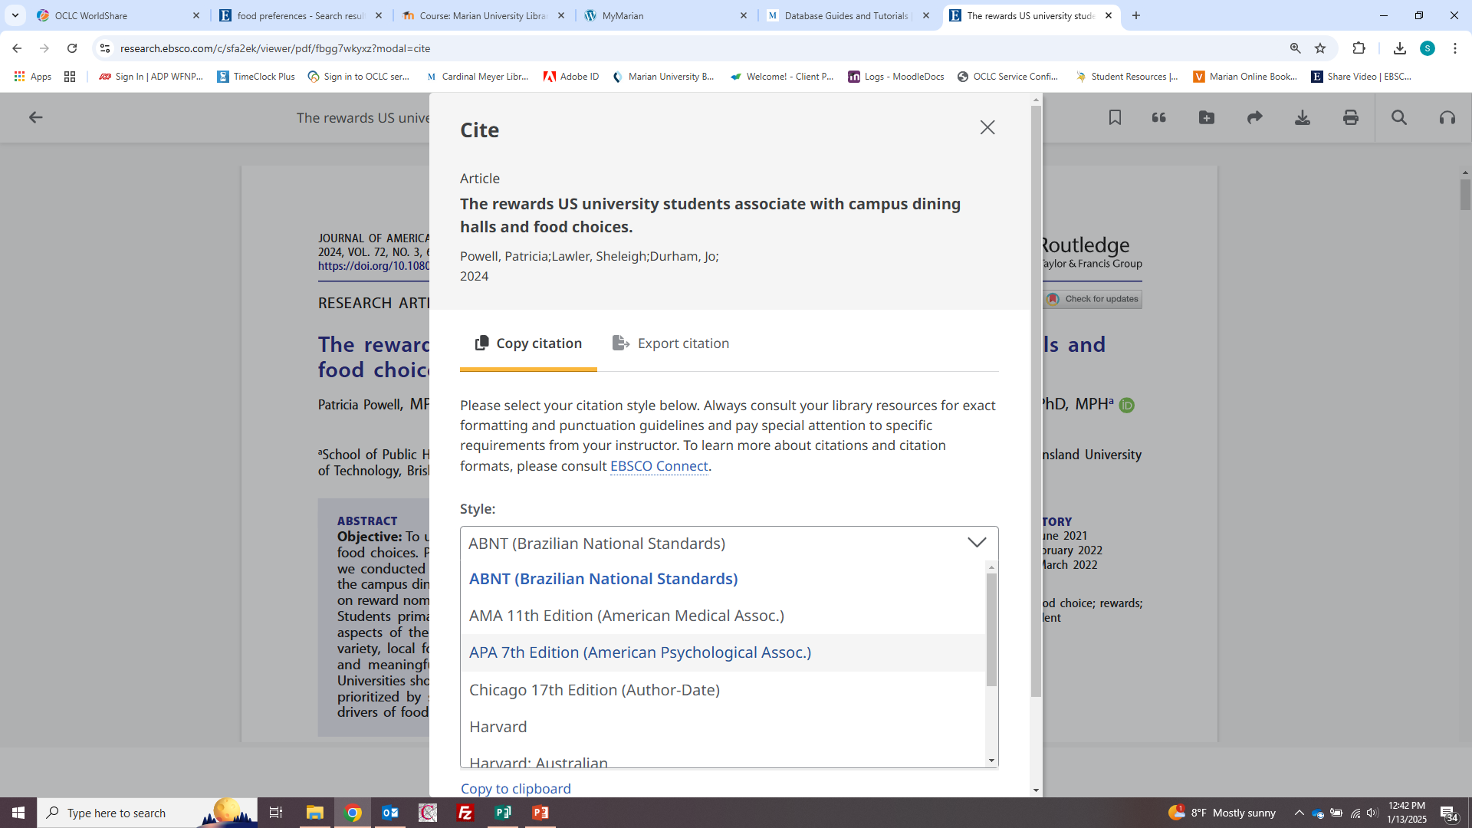
Use “Cite” icon to change to APA format, the icon is the quote mark on top right:

Slide 10
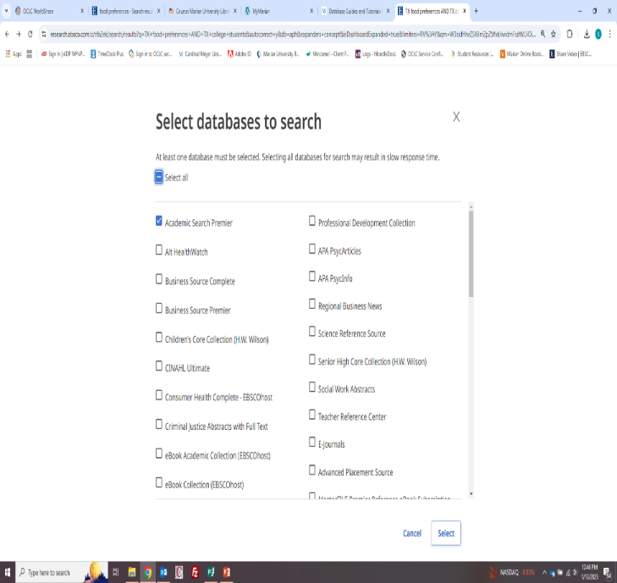
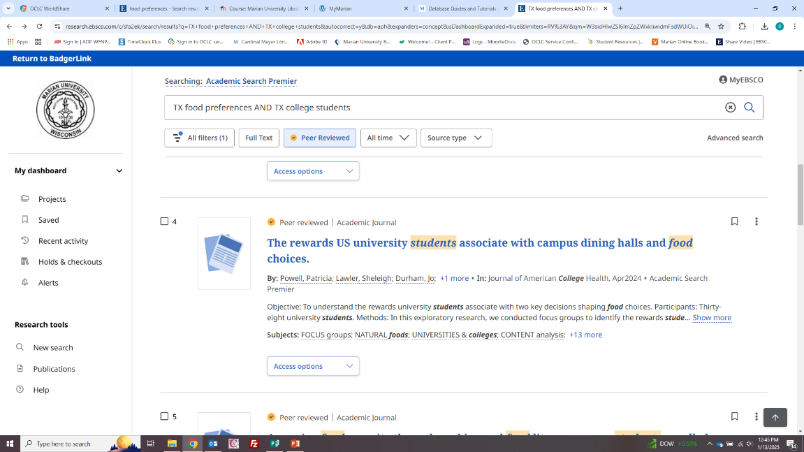
If more articles are needed, re-do the search by combining Ebsco databases into one search (for example psycinfo and psycarticles

Slide 11
Sage Premier
SAGE Premier access the full text of all SAGE Journals back to 1999 including journals in Criminology, Education, Health Sciences, Management & Organization Studies, Political Science, Psychology, Social Work, Sociology and Urban Studies.

Slide 12
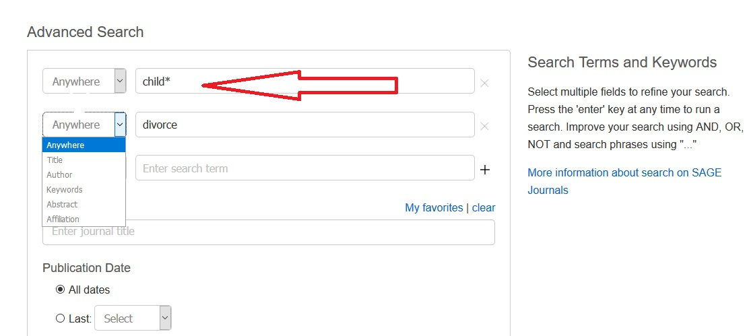
Sage Premier
Enter keywords into the search box
Use dropdown to specific title words, author, etc.

Slide 13
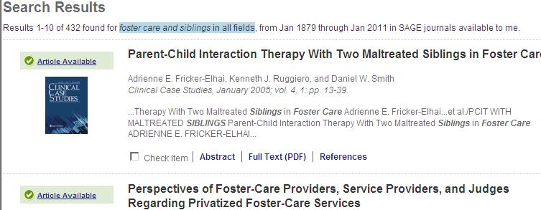
Sage Premier
A list of articles that pertain to the terms searched will be displayed. The number of articles will be displayed above the result list.
To display an article, click on the “Full Text PDF” link below the citation.

Slide 14
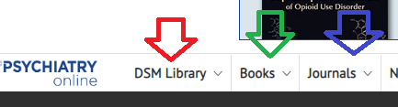
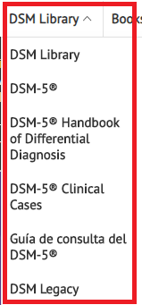
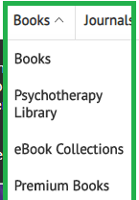
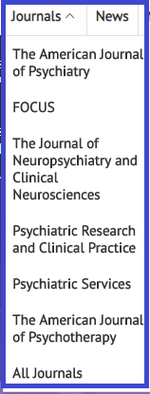
Searching Psychiartry Online
You have three options of browsing the collection: the DSM Library, Books, and Journals

Slide 15
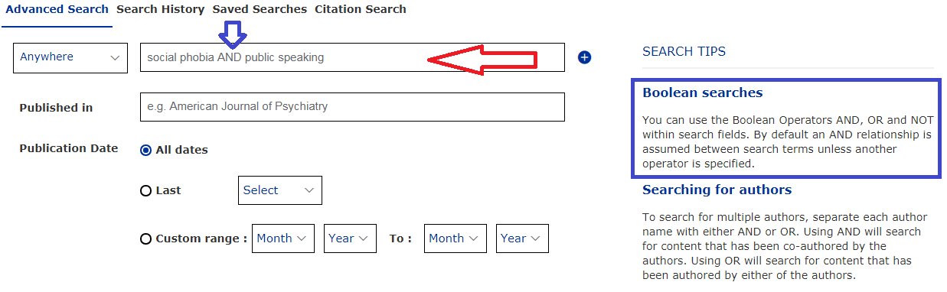
Advanced Keyword Search: enter terms into boxes; you can use Boolean Operators to narrow your search.

Slide 16
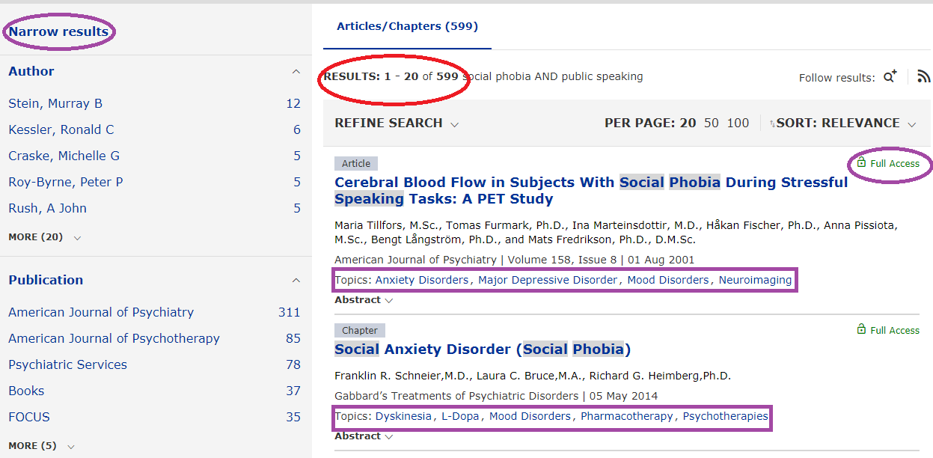
Number of Results will display at the top of the result page; if an article has an open lock it is full text, if it has a closed lock it is not full text and may need to be Interlibrary Loaned; you can narrow your results by using the Limiters: author, keyword, publication, and topics.

Slide 17
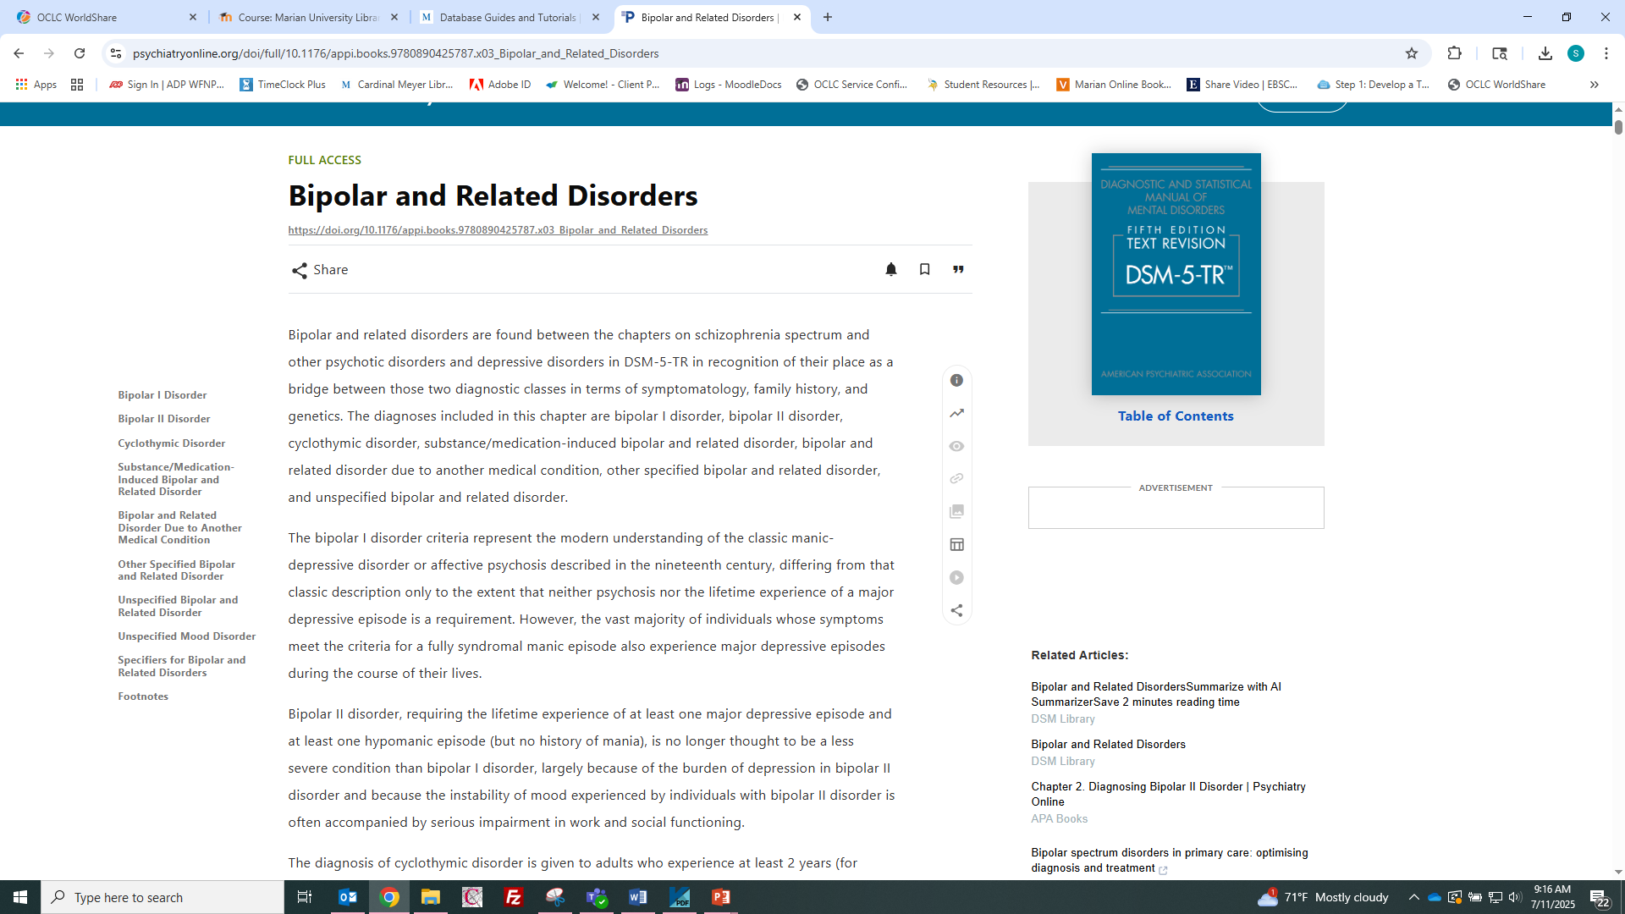
DSM V Entry

Slide 18
Each entry in the dsm will contain the following
Diagnostic Criteria Sets
For each disorder included in DSM, a set of diagnostic criteria indicates symptoms that must be present (and for how long) as well as a list of other symptoms, disorders, and conditions that must first be ruled out to qualify for a particular diagnosis. While these criteria help increase diagnostic reliability (i.e., the likelihood that two doctors would come up with the same diagnosis when using DSM to assess a patient), it is important to remember that these criteria are meant to be used by trained professionals using clinical judgment; they are not meant to be used by the general public.
Descriptive Text
Recording Procedures
Specifiers
Diagnostic Features
Associated Features
Prevalence
Development and Course
Risk and Prognostic Factors
Culture-Related Diagnostic Issues
Sex and Gender-Related Diagnostic Issues
Association with Suicidal Thoughts or Behavior
Functional Consequences
Differential Diagnosis
Cormorbidity

Slide 19
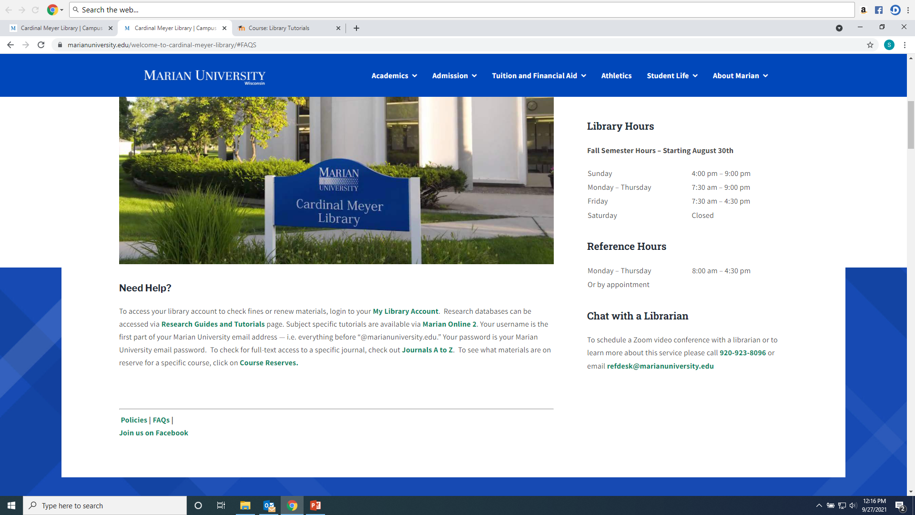
Any Questions?
Ask a library staff member!

