Slide 1
Sports and Recreational Management Databases
Sarah Thibodeau
srthibodeau64@marianuniversity.edu
920-923-8096

Slide 2
What is a scholarly or peer reviewed article?

Slide 3
Knowledge cycle:

Slide 4
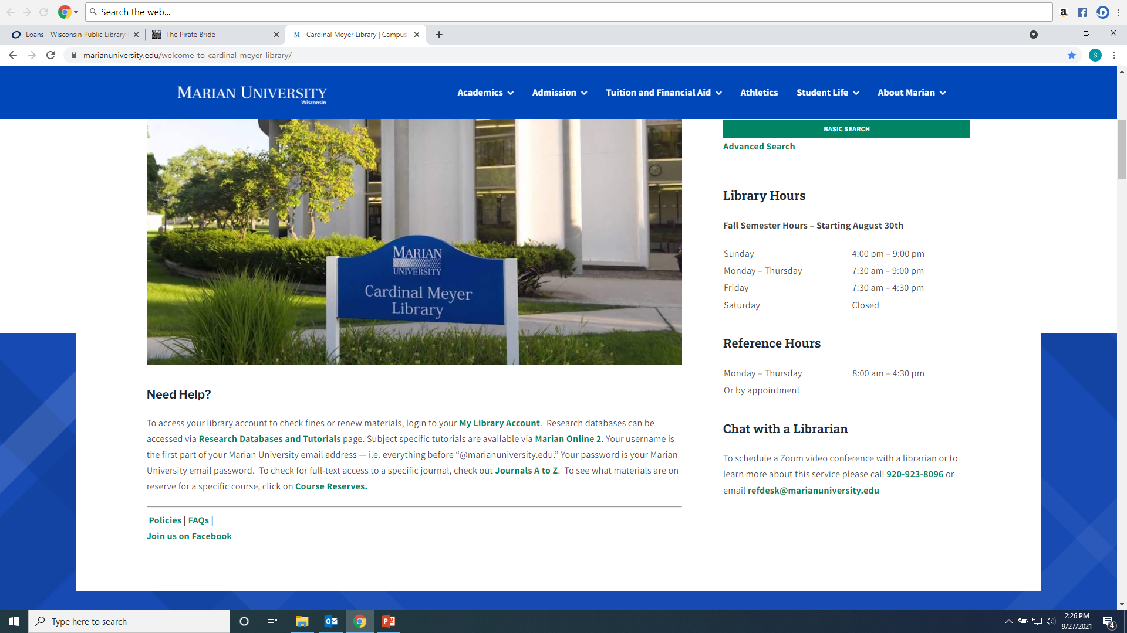
To search individual databases:

Slide 5
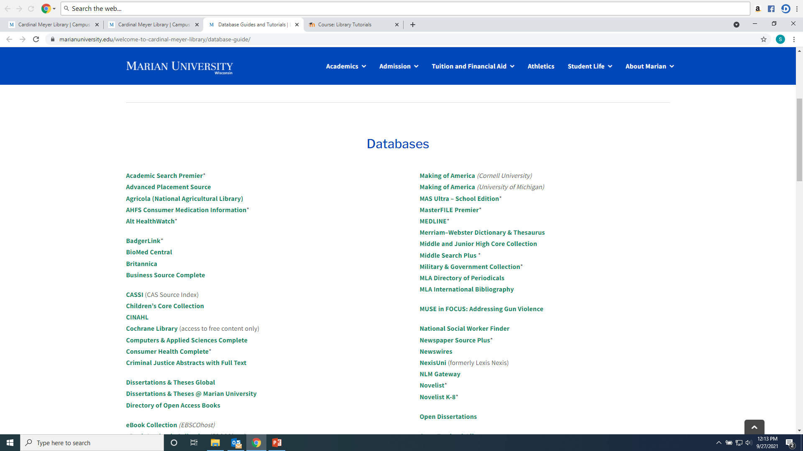
Choose a database according to the subject—ask a librarian for more help!

Slide 6
Academic Search Premier provides articles useful for most subjects:

Slide 7
School or university athletics:
ERIC [Education Resource Information Center]. (Scholarly articles, professional magazine articles, and government and nonprofit reports related to education)
Education Research Complete (Scholarly and professional magazine articles related to education)

Slide 8
Sports Business or Management:
Business Source Complete (business trade magazine articles, scholarly articles and news)
NexisUni (formerly Lexis Nexis). (corporate data, trade magazine articles, business newspaper articles, and scholarly business and legal articles.)
Regional Business News (regional business magazine and newspaper articles)
Global Newstream (newspaper articles including FDL Reporter, NY Times, Chicago Tribune, Wall Street Journal and other national publications which may include business and sports topics)

Slide 9
Motivation, sports psychology, and marketing:
PsycInfo (indexes mostly scholarly articles related to psychology, and also books and dissertations related to psychology. Includes some fulltext articles.)
PsycArticles (fulltext articles published in American Psychological Association journals)

Slide 10
Sports injuries, training and health related topics:
Medline (scholarly articles for physicians)
CINAHL (Cumulative Index of Nursing and Allied Health Literature)

Slide 11
Sports Law, Contracts, and Legal Issues:
NexisUni (formerly Lexis Nexis). Case law, government laws and regulations, legal journal articles, legal news
Criminal Justice Abstracts (Covers scholarly and professional magazines related to law enforcement)

Slide 12
Sports and Athletics History:
Academic Search Complete (Scholarly and magazine articles)
History Reference Center (Scholarly history articles and book chapters)
Humanities International Complete (Scholarly journal articles)
JSTOR (scholarly journal articles and some archival newspaper and other primary sources)
New York Times archive 1851- (News articles would provide eyewitness accounts of the sport, its games and players)

Slide 13
Databases on the EBSCO platform can be searched simultaneously:
Academic Search Complete
Business Source Complete
CINAHL
Criminal Justice Abstracts
Education Search Complete
Educational Administration Abstracts
ERIC
History Reference Center
Humanities International Complete
Medline
PsycArticles
PsycInfo
Regional Business News Plus

Slide 14
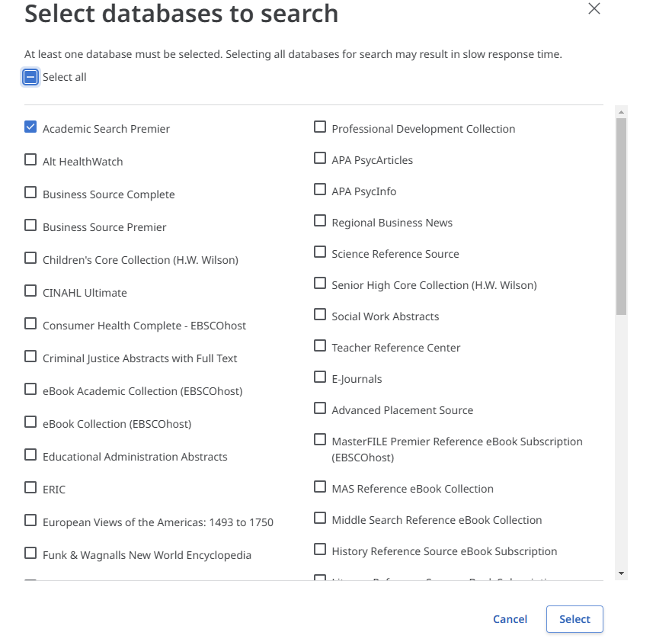
To search databases together on the Ebscohost platform, click on the name of the database you see upon initial search. A list of Ebschost databases will appear. Click the check box next to the ones you would like to search and click “Select”

Slide 15
Type words in box. The * means find every word that starts with those letters (sponsor, sponsors, sponsoring, sponsorship, sponsorships)

Slide 16
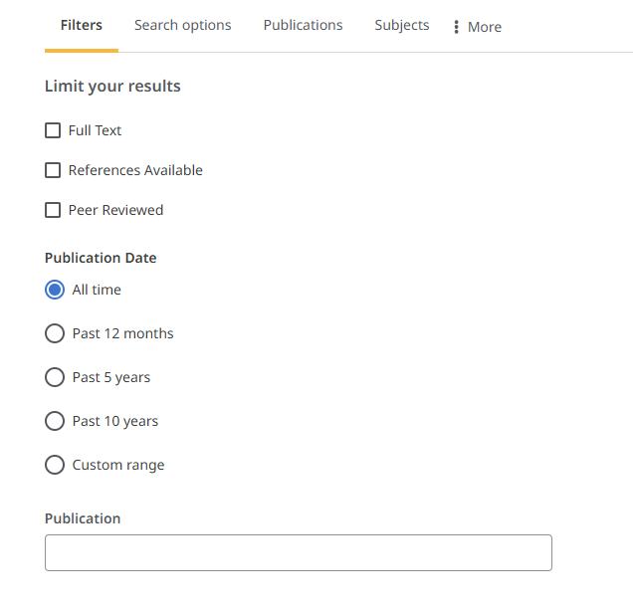
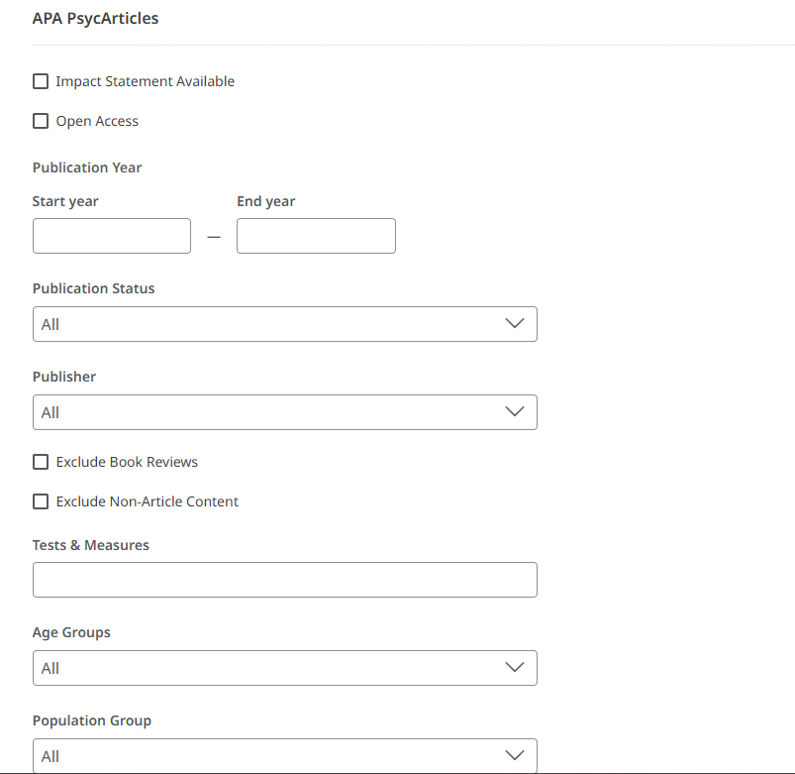
Add search filters to focus research: Each database selected to search will have its own list of filter options, choose as many or as few as needed. Peer Reviewed are scholary/academic research articles.

Slide 17
How to manage results: Read abstract of each item listed in result list, use subject headings or keyword listing to discover more words to search, use filters to focus research

Slide 18
How to manage results: Articles can be accessed under the “Access Options” menu in PDF, Online Full Text or link to an Interlibrary Loan form. If an article does not have a PDF or Online option, just fill out the Interlibrary Loan form and the library will request the article for free from a lending institution.

Slide 19
Printing, Downloading, Citations, and Linksharing: These functions are listed in the top right corner once you have selected your article Access Option.

Slide 20
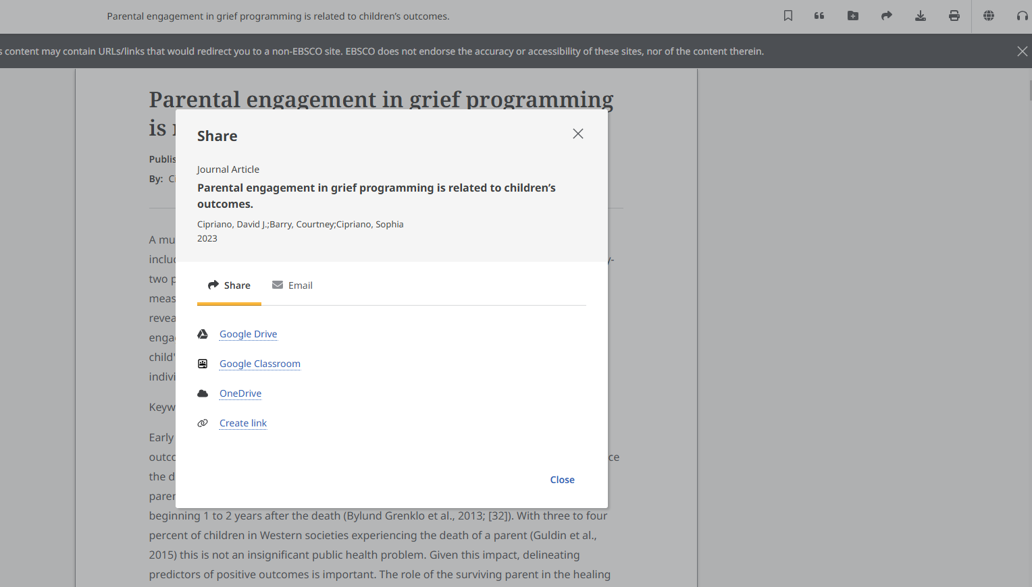
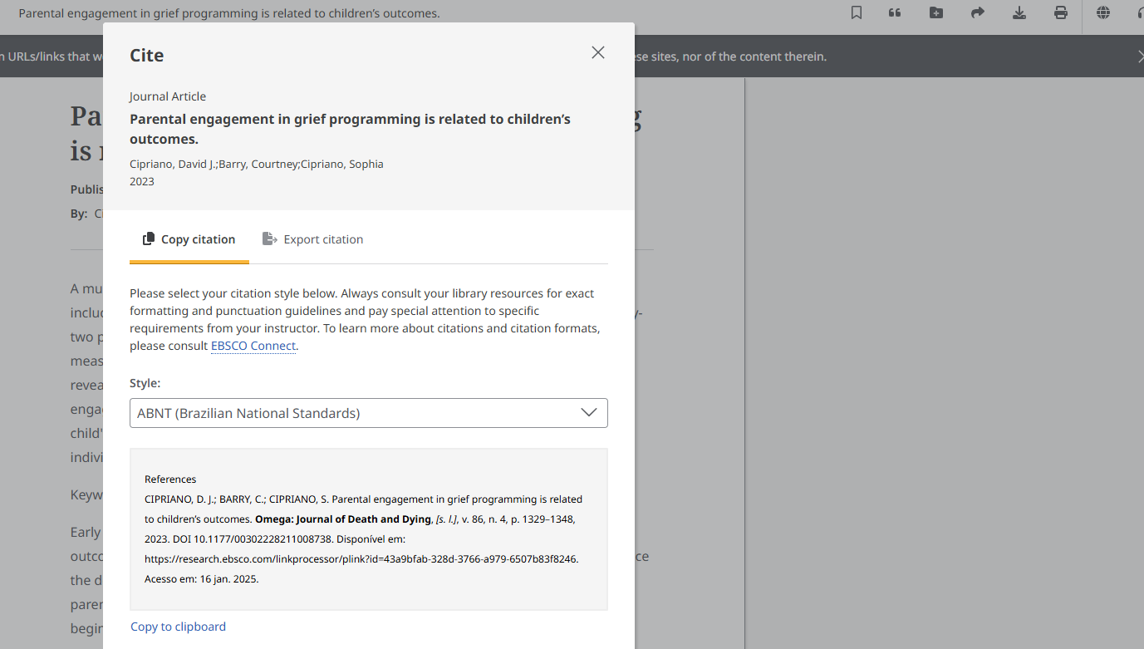
Citations and Linksharing: The “quote” mark symbol will bring up a list of citation formats. The “swoosh” symbol will bring up the option to send a permanent link of the article to a colleague or faculty member or post on MO2 discussion boards.

Slide 21
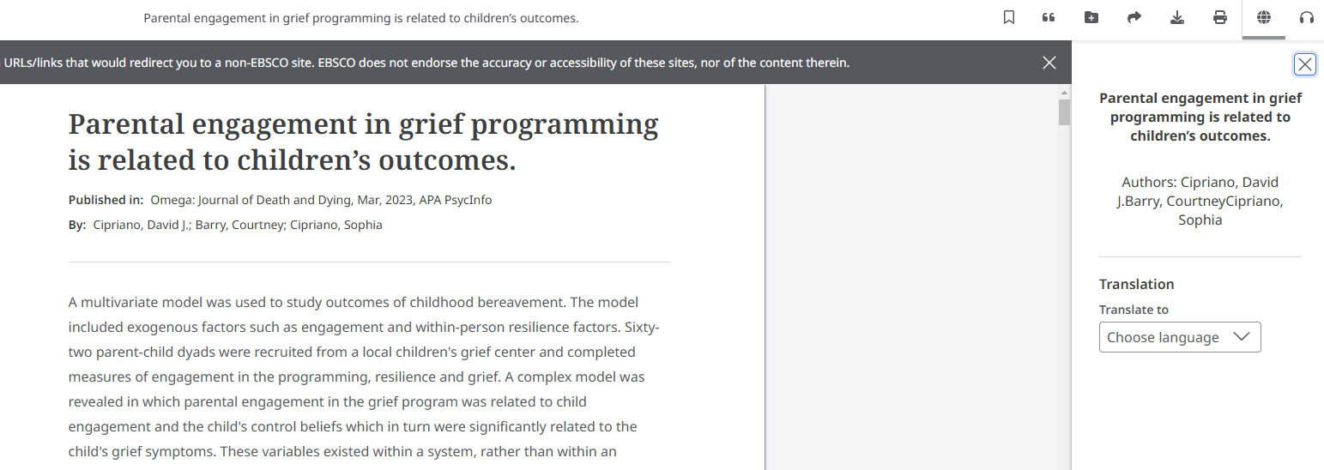
You can also have the article Translated or have it read aloud.

Slide 22
Nexis Uni includes:
Corporate information such as corporate officers and executives, financial data, SEC filings, and analyst reports
Legal cases
Scholarly and trade business articles, and business news
Legal reviews
Administrative regulations
Legislation

Slide 23
To find info on a specific company:

Slide 24
You can search by location, company name, industry, ticker symbol:

Slide 25
“Mercury Marine” exists as both a publically traded and privately held company:

Slide 26
Mercury Marine Private report. Private companies are not required to release as much information:

Slide 27
Mercury Marine Public report. Note the parent company has a link:

Slide 28
Find data, industry reviews, competitors, analysis…

Slide 29
Nexis Uni Help and Tips. Advanced search also may be easier:

Slide 30
Advanced Search. Click Add to create search. Use ! or * to find words beginning with those letters. Scroll down to click “Search” button.

Slide 31
The original search can be narrowed by adding additional terms, by document type, subject, topic, time period…

Slide 32
Save individual results, print, email, download…

Slide 33
Law review article example. Journal title:

Slide 34
Nexis Uni law cases:

Slide 35
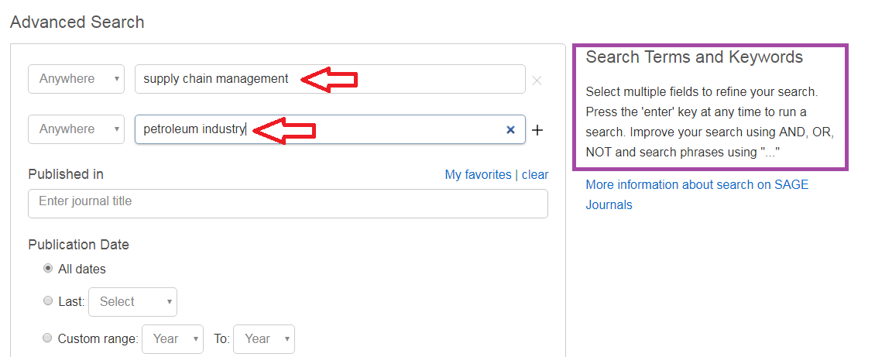
Searching SAGE Premier: Enter Keywords into search boxes; use Boolean Operators And, Or, Not to refine your search

Slide 36
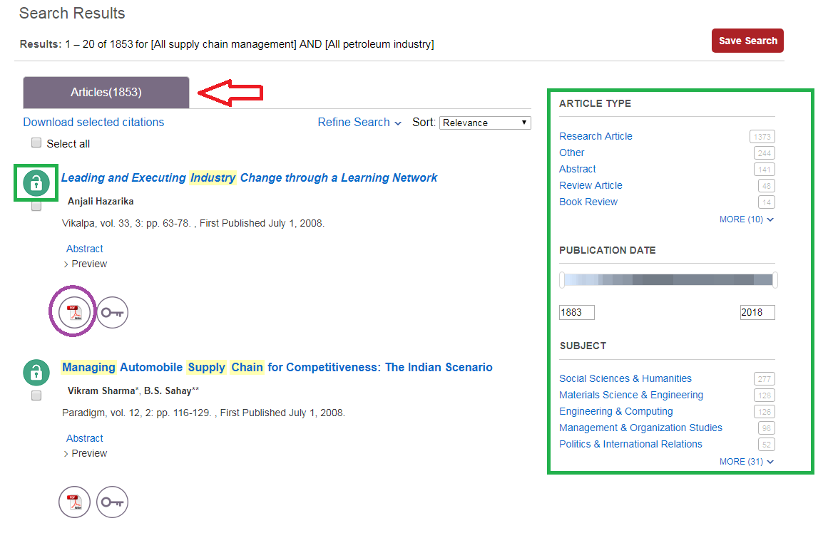
Results with be in at the top (1853). Use the Limiters on the left to narrow your search. The open lock means Marian has the article full text; the closed lock means the article is not full text and may need to be Interlibrary Loaned. Click on either the HTML or PDF full text option to open the article.

Slide 37
To find citation information for an article in the appropriate format click the “Cite” icon

Slide 38
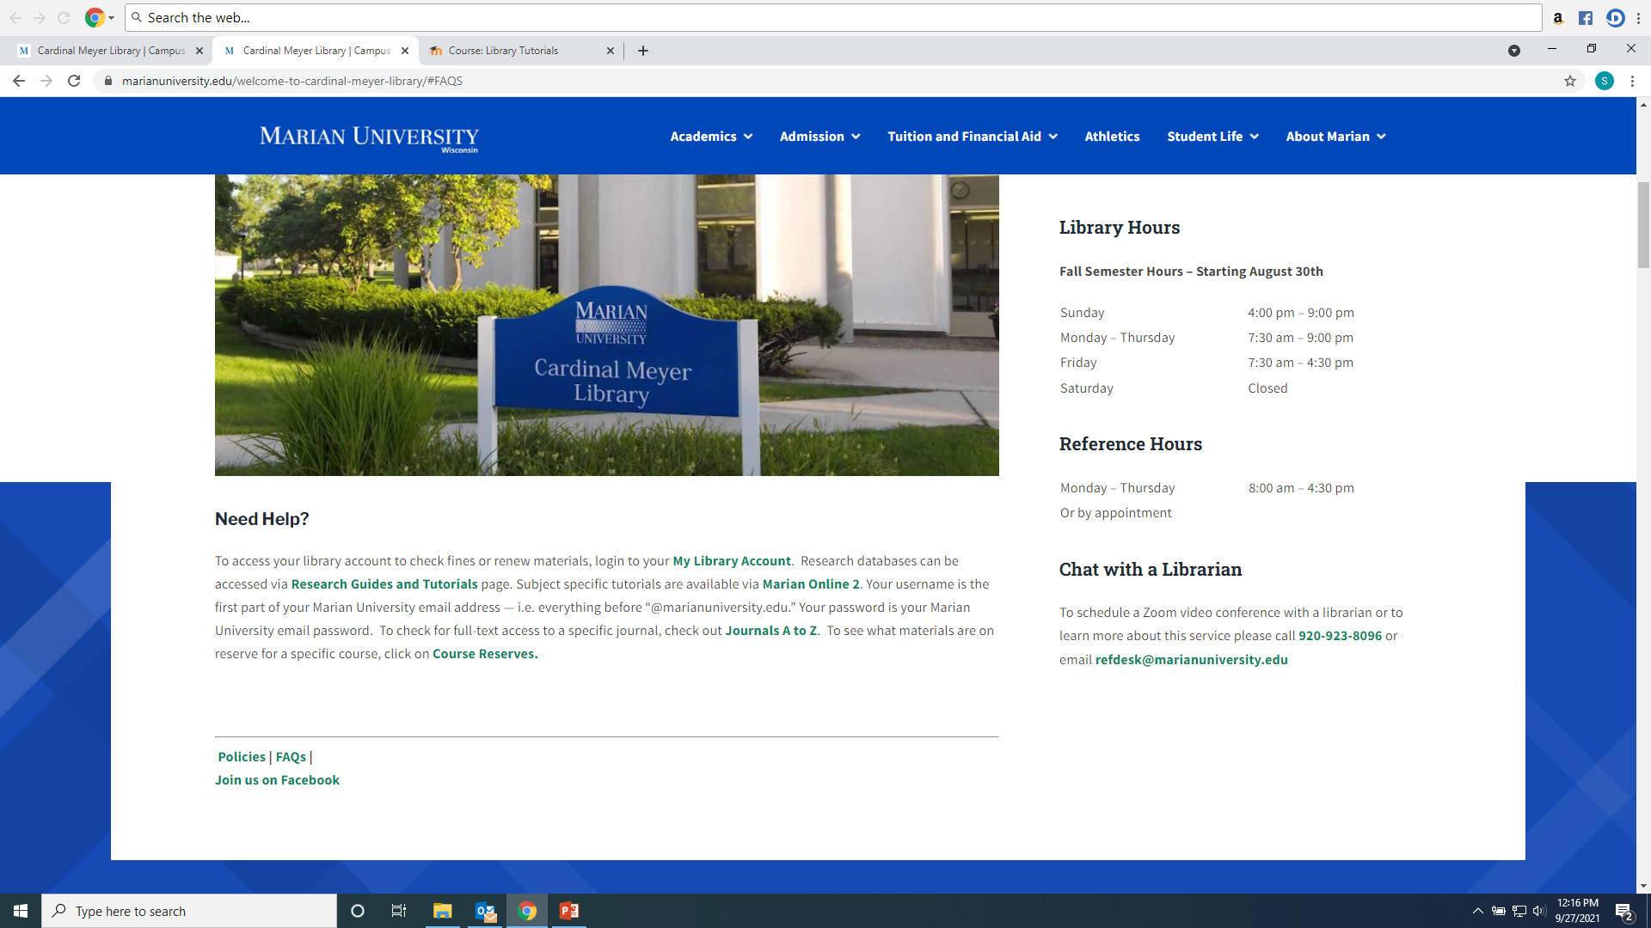
Any Questions? Ask a library staff member!

