Slide 1

Thanatology Databases: Research Articles
Sarah Thibodeau
srthibodeau64@marianuniversity.edu
920-923-8096

Slide 2
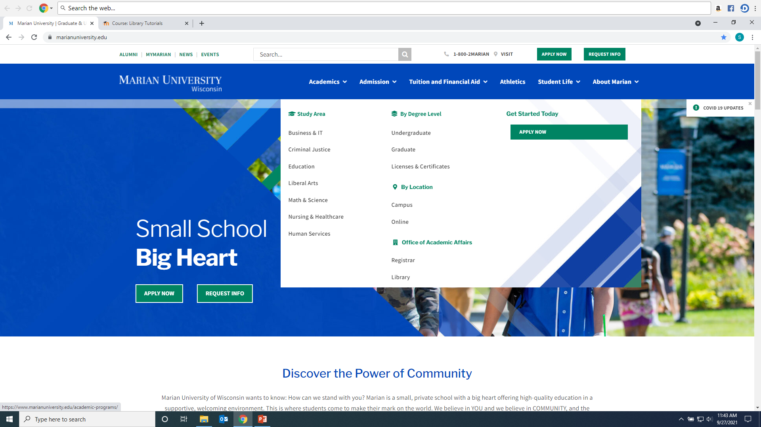
Click on Library from Marian website: https://www.marianuniversity.edu/

Slide 3
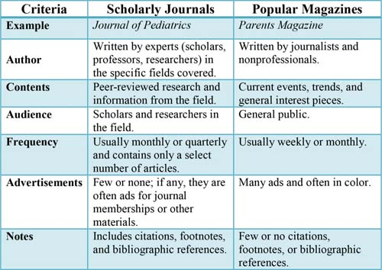
Scholarly/Peer-Reviewed Article vs. Popular Sources

Slide 4
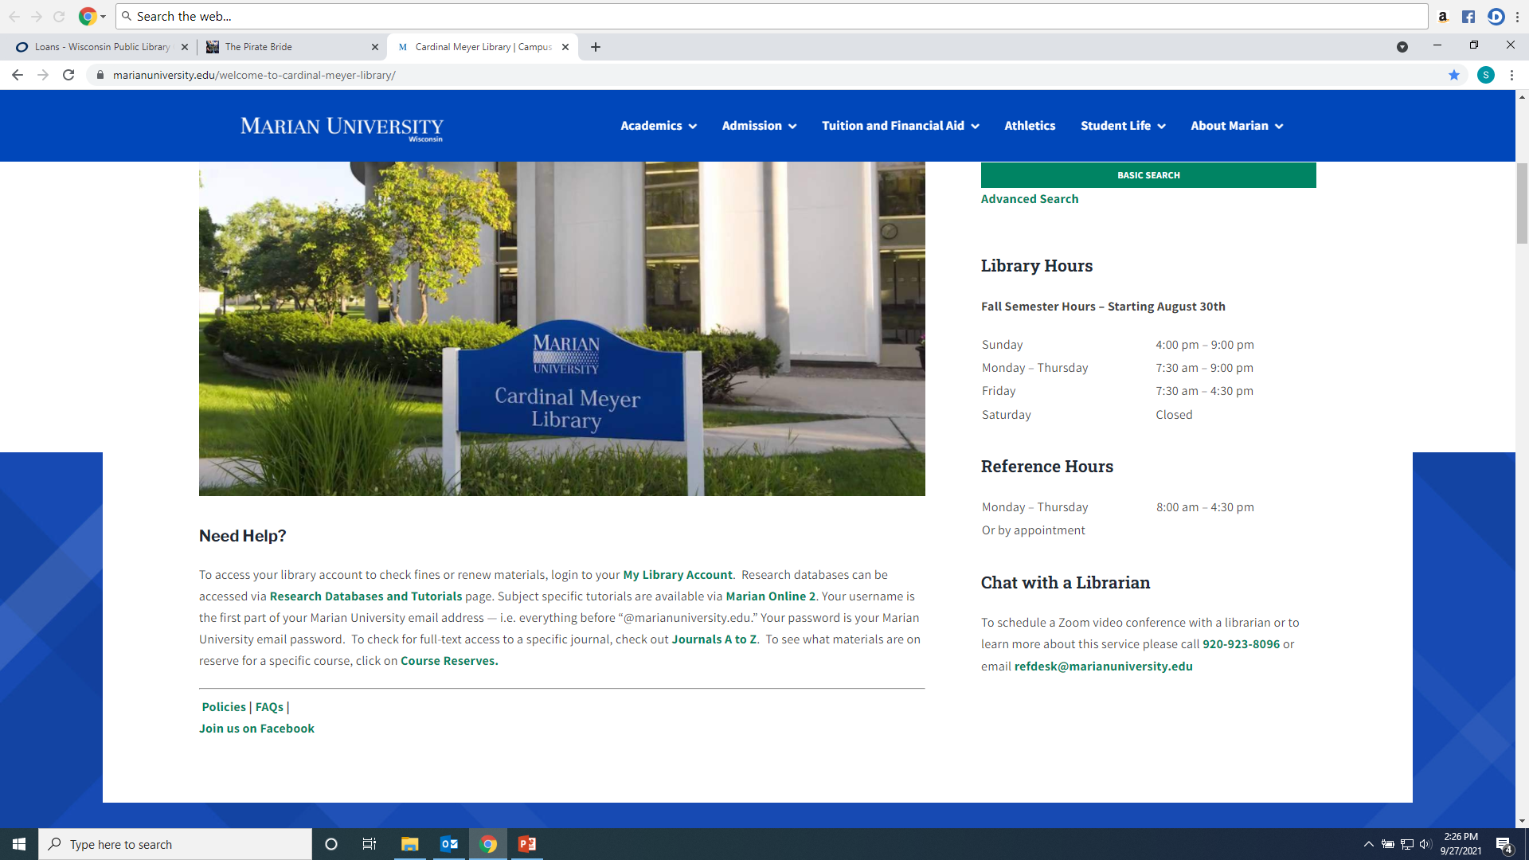
From the Library Home Page click on the “Databases” link on the left hand menu

Slide 5
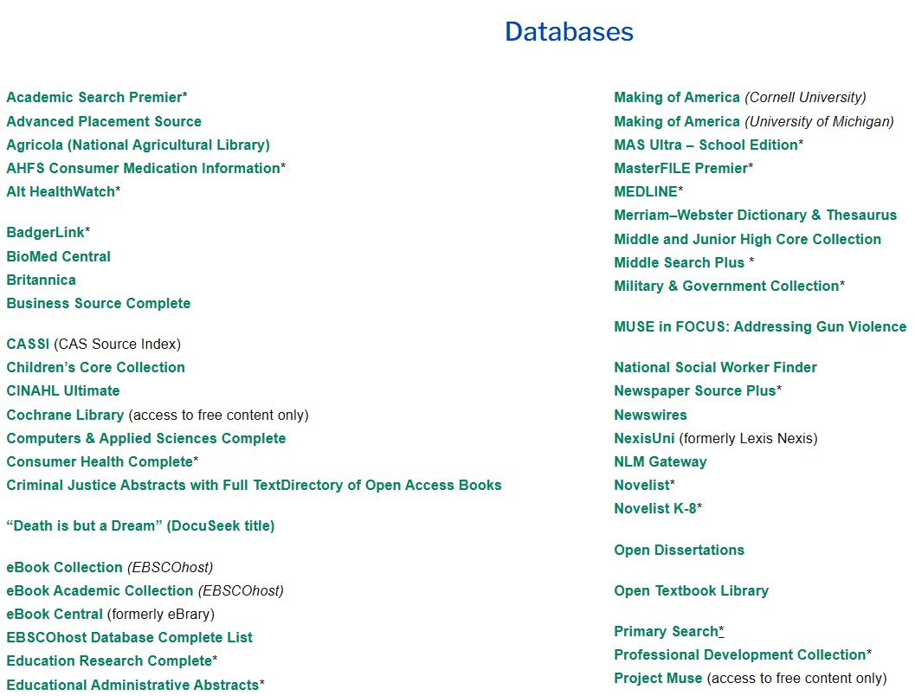
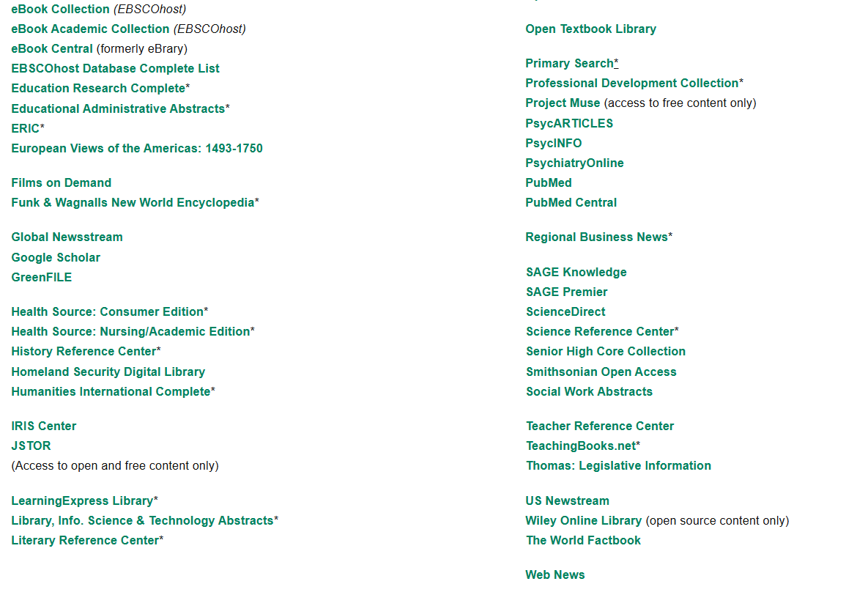
Recommended databases to search for Thanatology research articles are: Academic Search Premier, CINAHL, PsycARTICLES, PsycINFO, Sage Premier, Criminal Justice Abstracts, Project Muse, and NexiUni (Law)

Slide 6
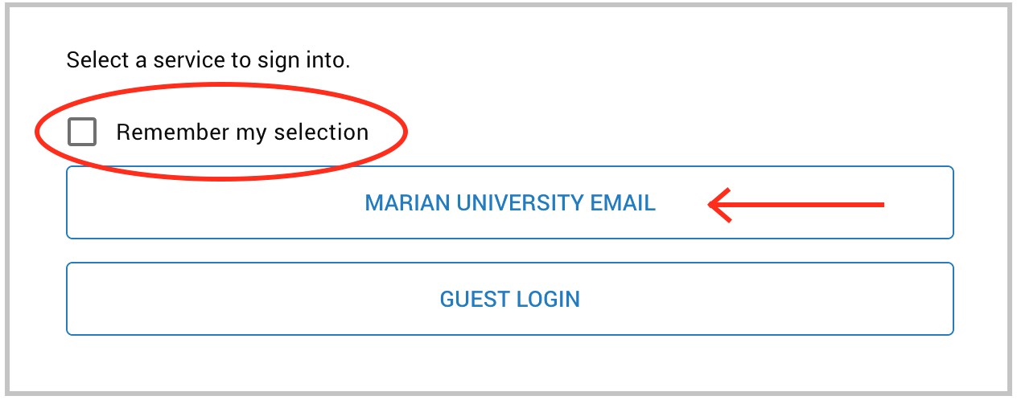
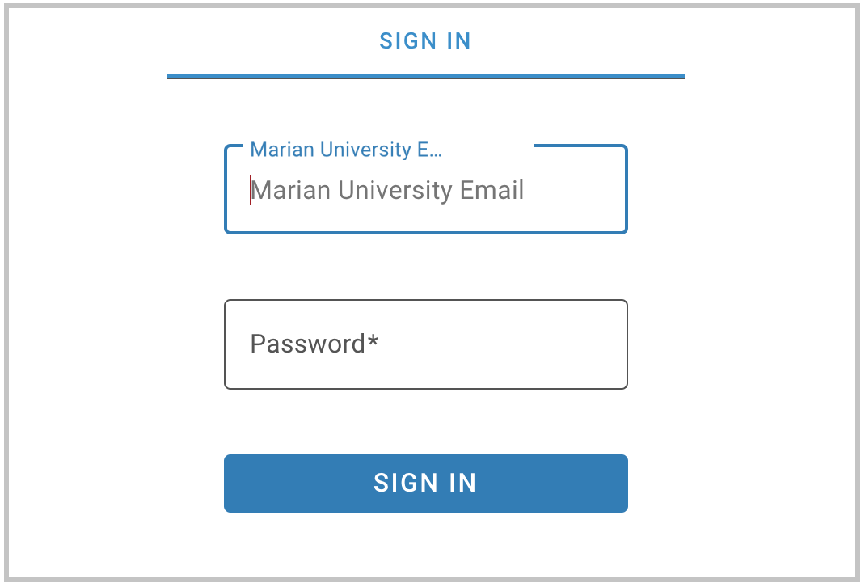
If you are accessing the databases from off-campus, you will be asked to login by clicking on the “Marian University Email” button. You must enter your full Marian Email and password”

Slide 7
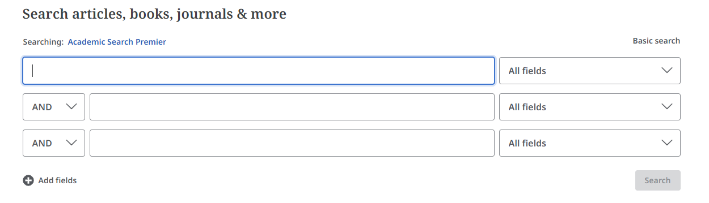
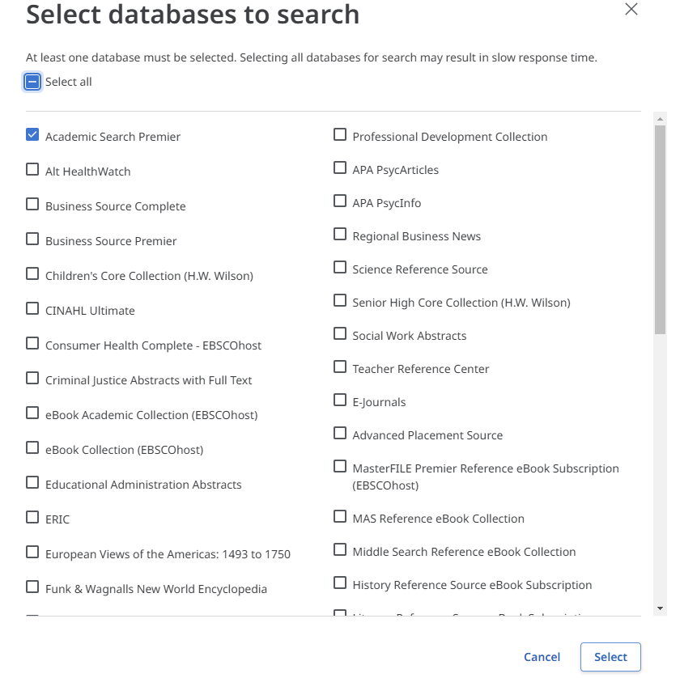
EbscoHost: PsycINFO, PsycARTICLES, Academic Search Premier and CINAHL. These resources can be searched in combination with each other. Just click on one from the “Research Databases” tab. When Ebsco opens click the name of the resource to bring up list of Ebscohost databases to select.

Slide 8
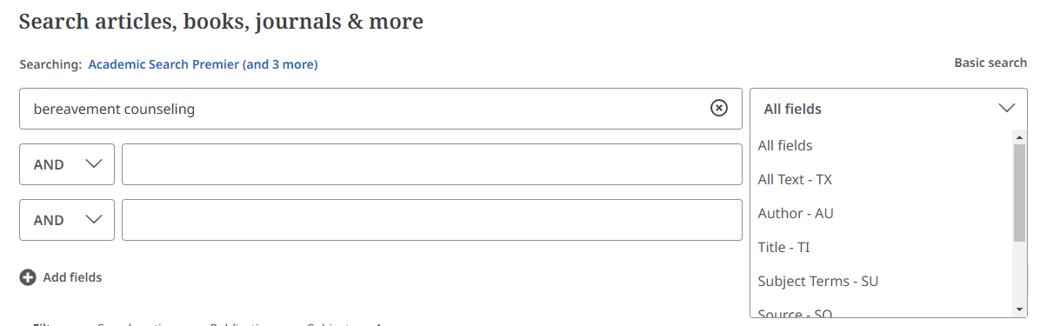
Conducting a keyword search: Enter keywords into the search boxes and choose “All Text” from the drop down menu on the right of each box.

Slide 9
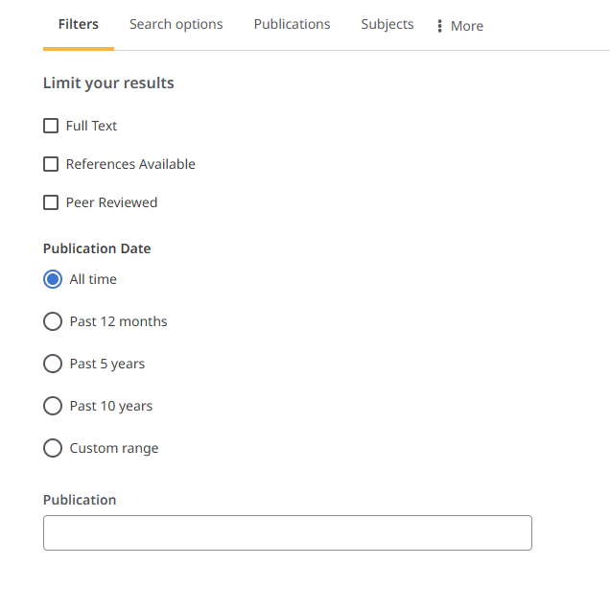
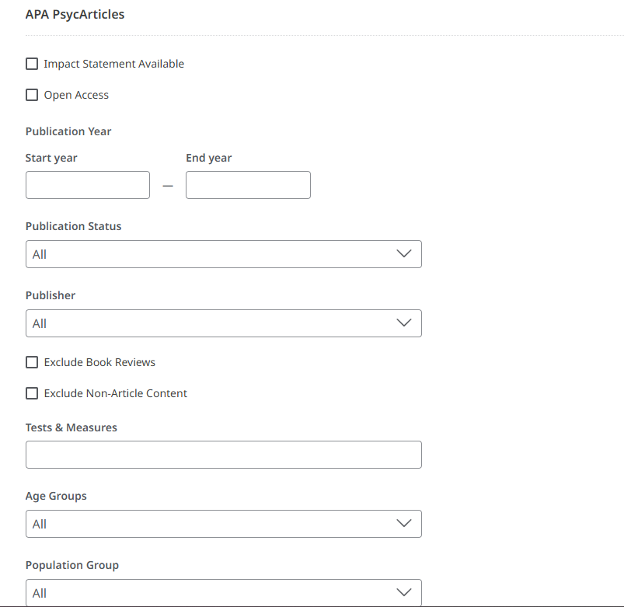
Add search filters to focus research: Each database selected to search will have its own list of filter options, choose as many or as few as needed. Peer Reviewed are scholary/academic research articles.

Slide 10
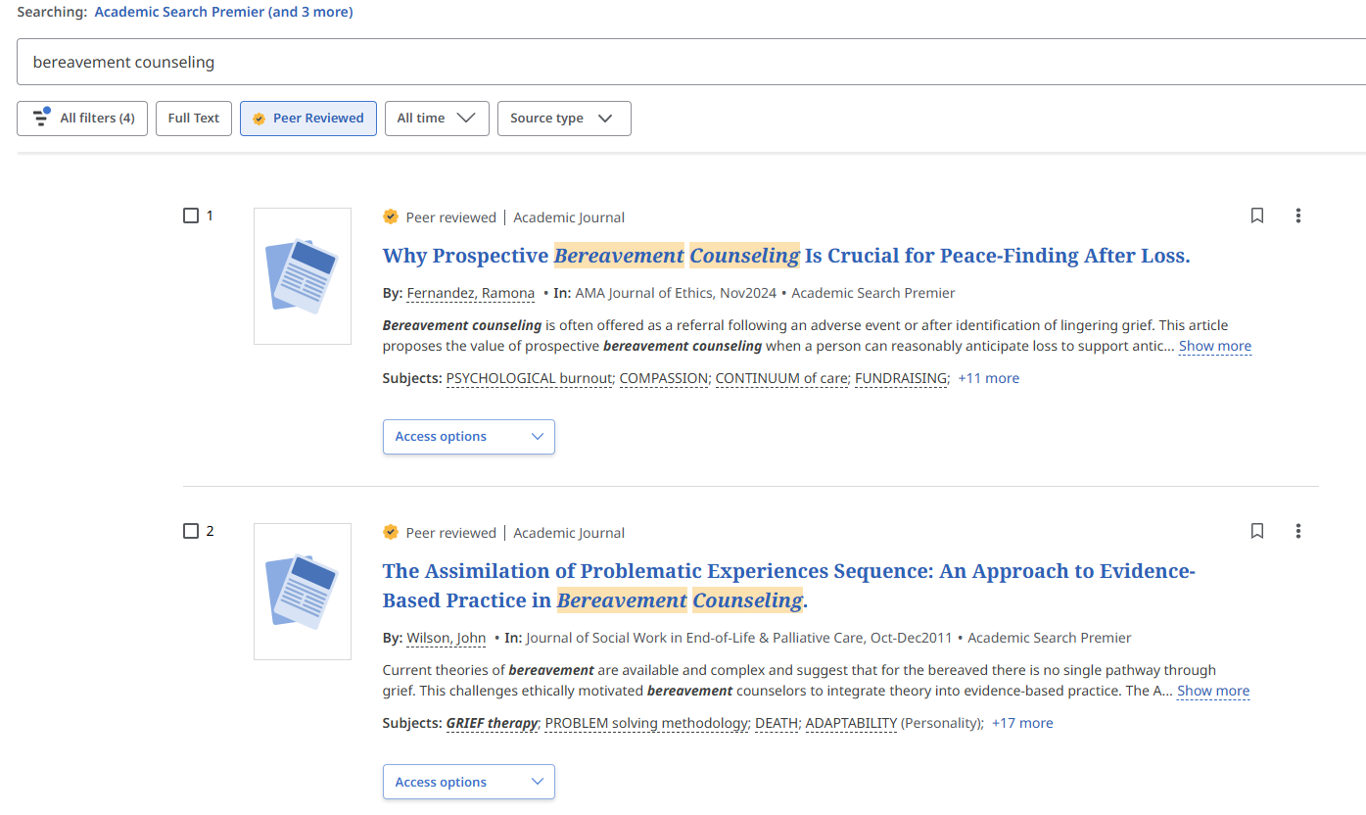
How to manage results: Read abstract of each item listed in result list, use subject headings or keyword listing to discover more words to search, use filters to focus research

Slide 11
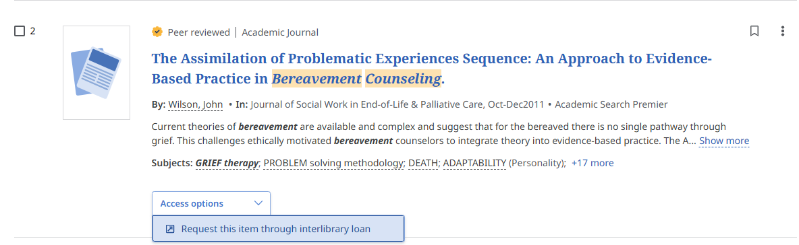
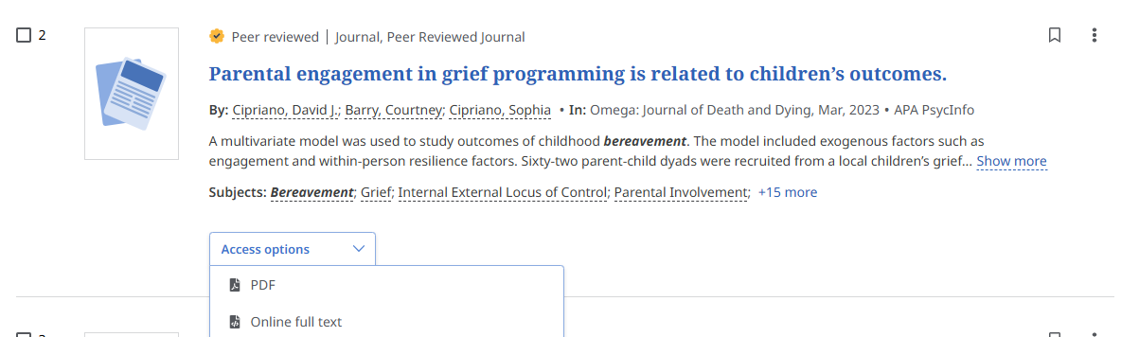
How to manage results: Articles can be accessed under the “Access Options” menu in PDF, Online Full Text or link to an Interlibrary Loan form. If an article does not have a PDF or Online option, just fill out the Interlibrary Loan form and the library will request the article for free from a lending institution.

Slide 12
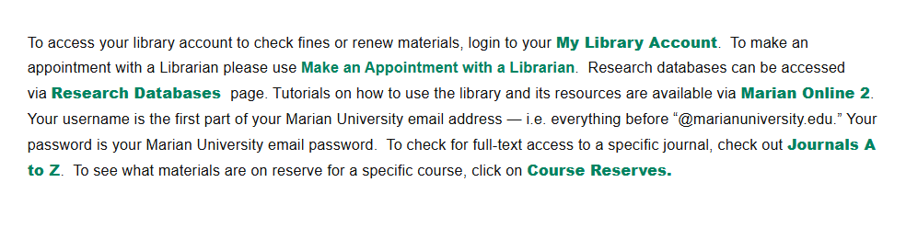
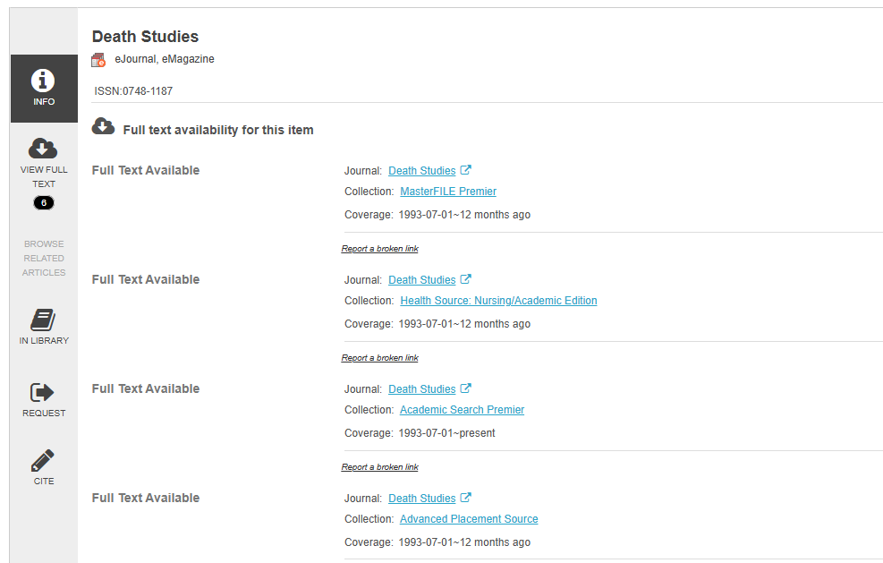
Before Interlibrary Loan Tip: If an article only has an interlibrary loan access option you can use the “Journals A to Z” link on the library homepage to discover if the journal is accessible in one of the library’s 40+ databases. Just type in the ISSN or journal name. Not all databases index the same journals. This option lets you discover if the library has access to a journal in a resource you may not be searching. If no results, fill out the Interlibrary Loan option.

Slide 13
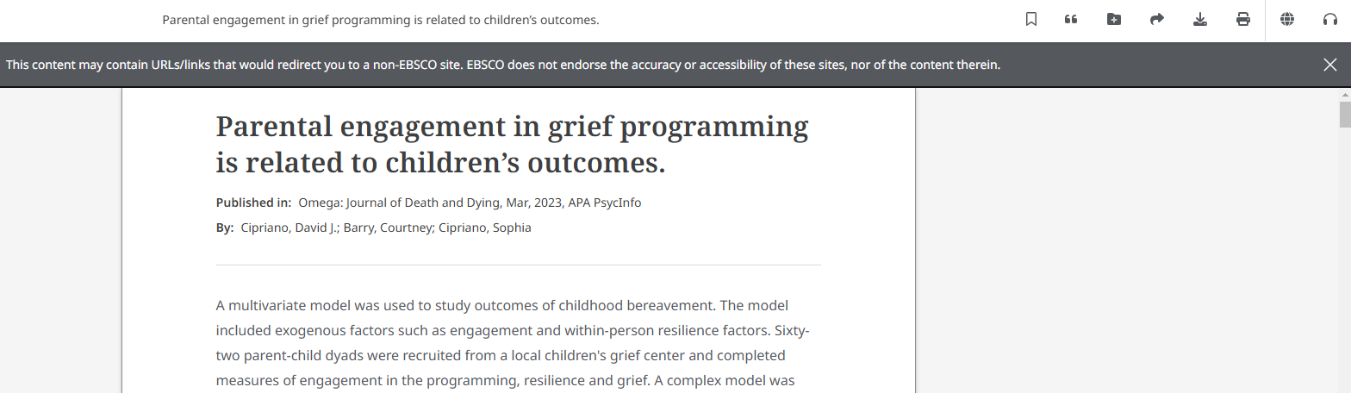
Printing, Downloading, Citations, and Linksharing: These functions are listed in the top right corner once you have selected your article Access Option.

Slide 14
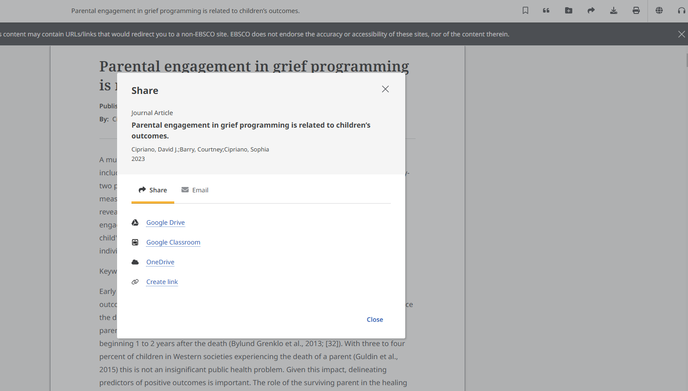
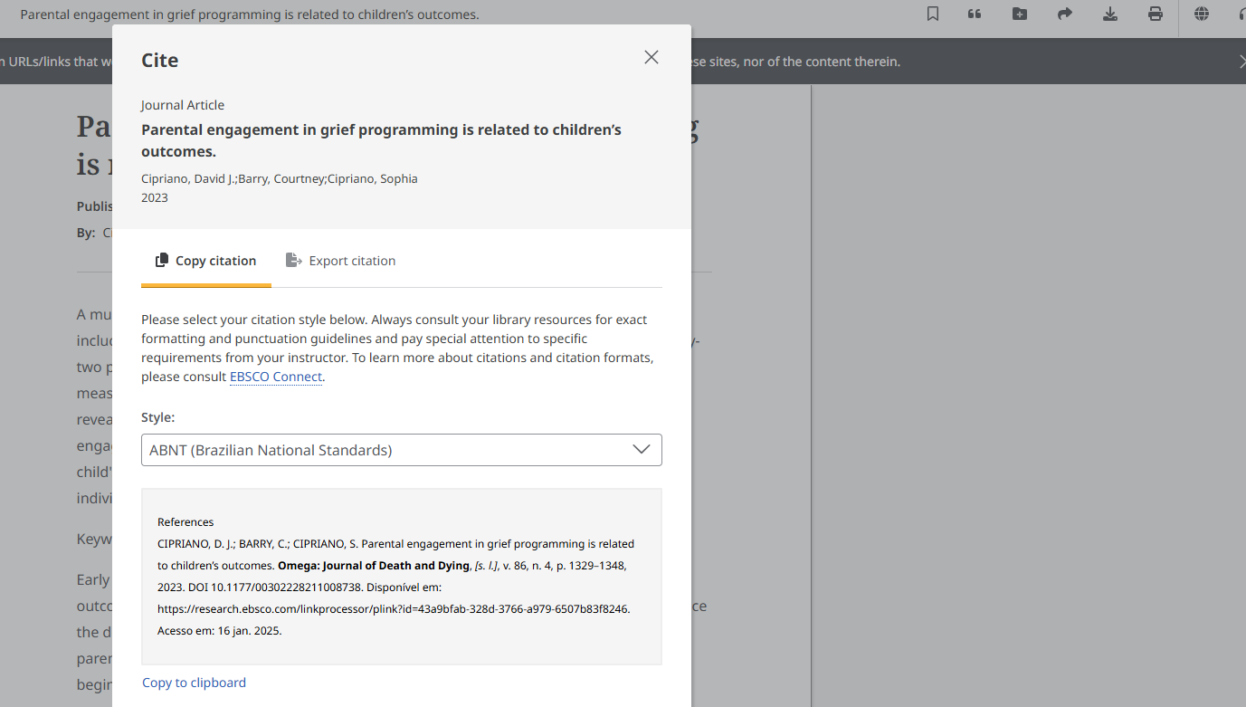
Citations and Linksharing: The “quote” mark symbol will bring up a list of citation formats. The “swoosh” symbol will bring up the option to send a permanent link of the article to a colleague or faculty member or post on MO2 discussion boards.

Slide 15
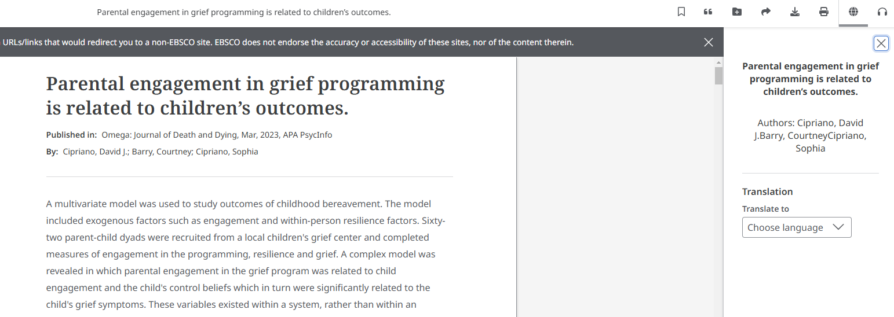
You can also have the article Translated or have it read aloud.

Slide 16
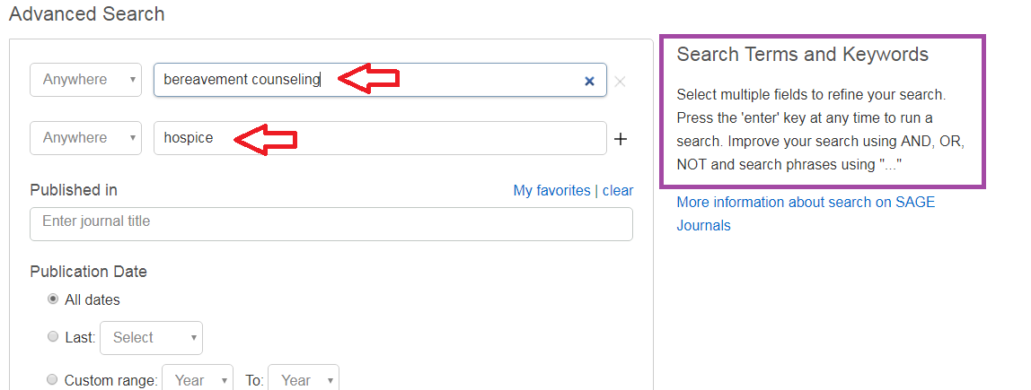
Searching SAGE Premier: Enter Keywords into search boxes; use Boolean Operators And, Or, Not to refine your search

Slide 17
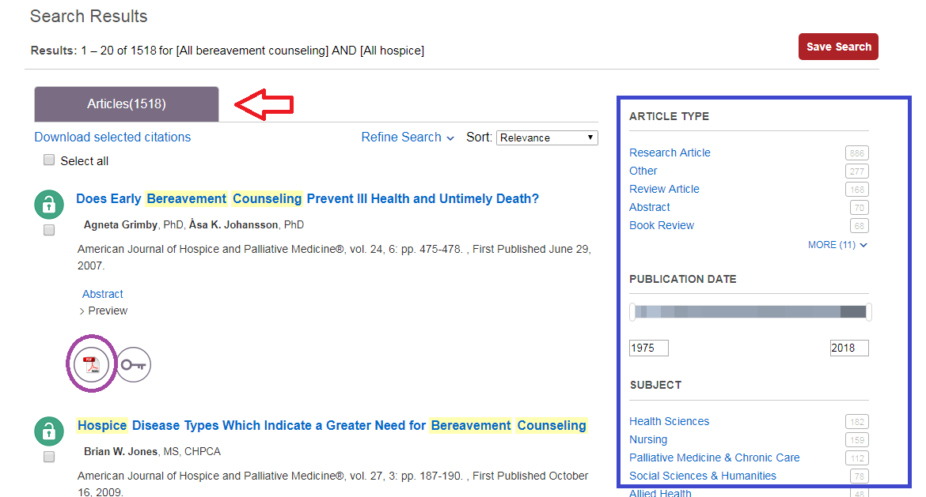
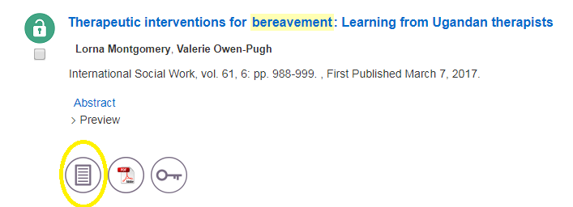
Results with be in at the top (1518). Use the Limiters on the left to narrow your search. The open lock means Marian has the article full text; the closed lock means the article is not full text and may need to be Interlibrary Loaned. Click on either the HTML or PDF full text option to open the article.

Slide 18
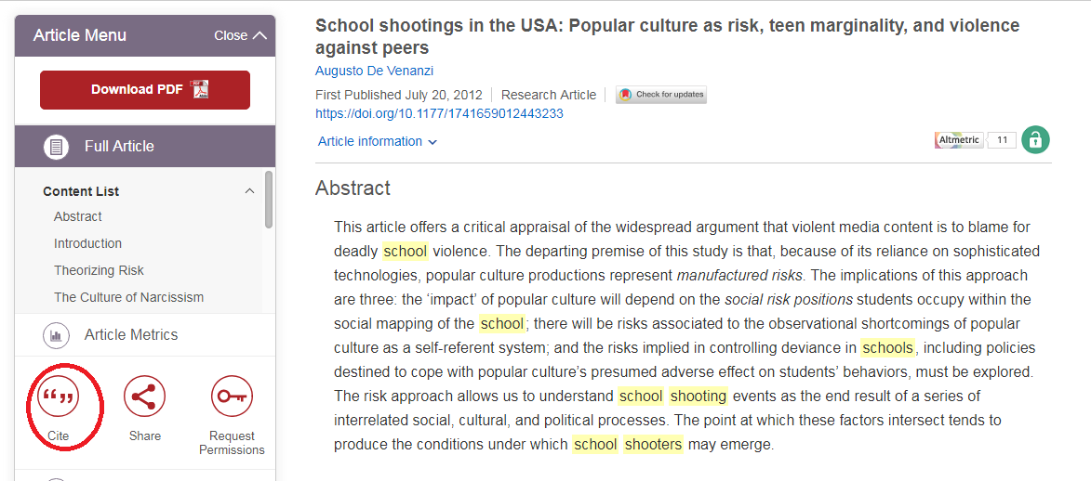
To find citation information for an article in the appropriate format click the “Cite” icon

Slide 19
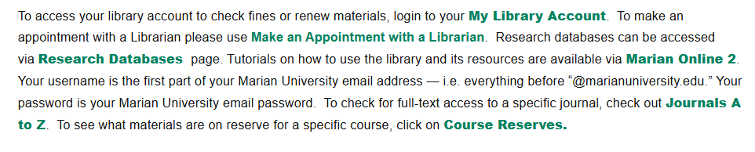
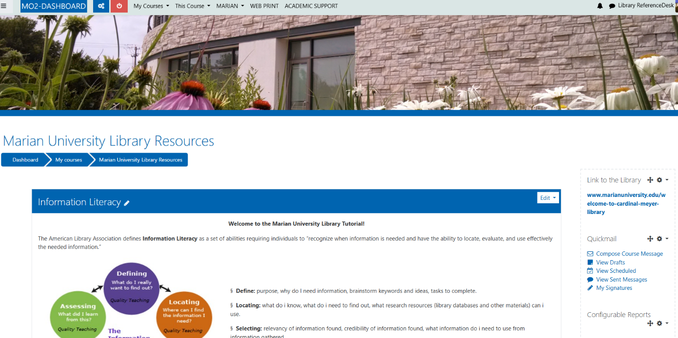
Library Tutorials on MO2: The library provides access to video and powerpoint tutorials on how to use specific resources, finding articles/books, citations, program specific resources and so much more. These can be accessed from the Library Homepage

Slide 20
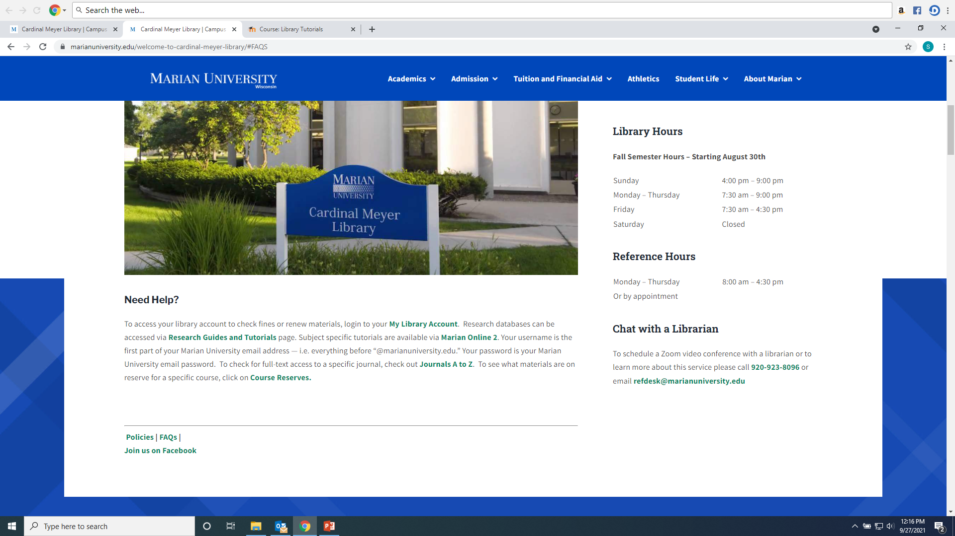
Any Questions? Ask a library staff member! Virtual Teams Meetings are encouraged!

